Slide 1
NUMPY COMPLETE TUTORIAL MACHINE LEARNING PREREQUISITE
Numpy Advanced Exercise On Array Slicing
Tutorial 11

Slide 2
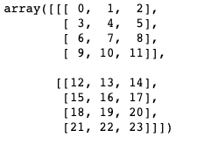
Example :1
What will be the output of the below :
a[1:,1:1:]
Out put:
array([], shape=(1, 0, 3), dtype=int64)

