Slide 1
BLOCKCHAIN DEVELOPMENT WITH PYTHON
BLOCKCHAIN DATA STRUCTURE
Tutorial:4

Slide 2
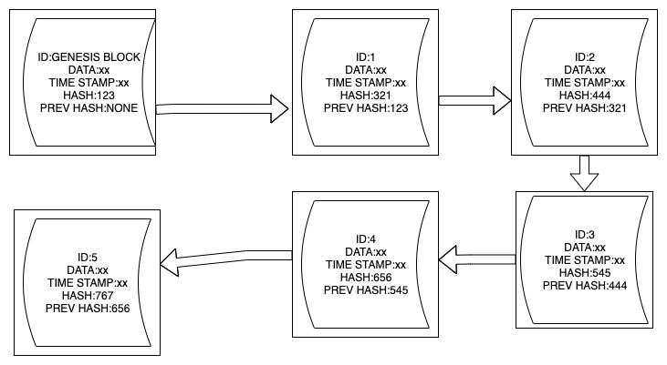
HIGHLEVEL REPRESENTATION OF A BLOCKCHAIN

Slide 3
DEVELOP THE CONNEDTED BLOCKS USING PYTHON
Github link for code
https://github.com/youtubetotaltechnology/source/blob/master/BLOCKCHAINCOMPLETE_CODE.py

