Slide 1
ACTIVE DIRECTORY AUTOMATION COMPLETE TUTORIAL
How to set user account expiration date:Part 12
TOTAL TECHNOLOGY

Slide 2
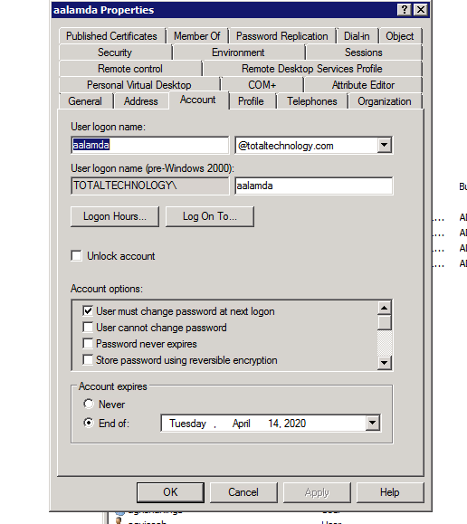

TOTAL TECHNOLOGY

Slide 3
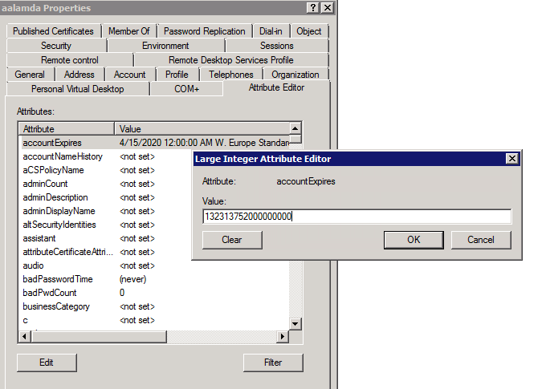
TOTAL TECHNOLOGY

Slide 4
CODE
#tutorial 12
#how to set account expiration date in ad user account
from pyad import *
import datetime
from filetimes import dt_to_filetime,utc
user=pyad.adobject.ADObject.from_cn("aalamda")
ed=dt_to_filetime(datetime.datetime(2025,5,11,0,0))
pyad.adobject.ADObject.update_attribute(user,"accountExpires",str(ed))
TOTAL TECHNOLOGY

