Slide 1
Whatsapp Automation Complete Tutorial
Whatsapp Bot To Get Live Status Update of Corona Virus with Graph
Tutorial :6

Slide 2
Pre-requisites
Twilio acoount
Ngrok
Mongodb atlas or any db
Api to get live data
https://rapidapi.com/api-sports/api/covid-193

Slide 3
Database Setup
Sign up for mongodb cloud instance from https://cloud.mongodb.com/
Create database and collection with name (anything you want)

Slide 4
Flow
DB
3rd party api
Code or application
User phone
Twilio sandbox

Slide 5
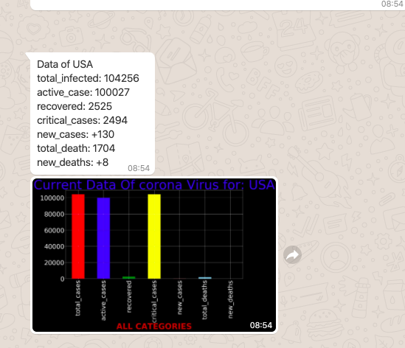
Output Sample

