Slide 1

Project:Tabletop Menu Tablet

Slide 2
Summary
The Sauce and Spoon Table top Menu tablet project was initiated and conducted the tablet test run last December 25-26, 2021.
We aimed to implement menu tablets at tables and digitizing the ordering process to speed up service and other processes, allowing turn tables time to be more quickly and serve more guests to Sauce & Spoon North and Downtown outlets at the bar area.
We were able to reached milestones in this project with the collaboration, efforts and dedication of the team. The sourcing of the vendors are well selected, reviewed and approved following the protocols and with the help of our expert consultant. We were able to achieve 100% of the training plan which consist of training the management, front staffs and back office staffs to ensure that everyone is well equipped to run with the new tablets and be able to assists customers if needed. We had few days of delay with the delivery of the tablets but we were able to still keep the launch date. The installation of software and wirings went smoothly and made them ready for the training dates stipulated.

Slide 3
Overview
The project team wanted to measure the customer satisfaction, the tablet performance like the ease of use, navigation, functionality and design as this will determine if we were able to achieve our goals.
We wanted also to measure the performance of the staff during service like any impact on their efficiency and usage of the tablets in receiving the orders online.
Under customer satisfaction, we wanted to know the overall experience of the customers and does the new tablet enhanced their experience at the restaurant.
In addition, it is important to know the accuracy of the orders they received through the use of the tablets and how the online portal worked for them
For the tablet performance, we need to evaluated what worked and what did not work as expected. We need to uncover any possible errors during the service that might have impacted the orders and table turn time.

Slide 4
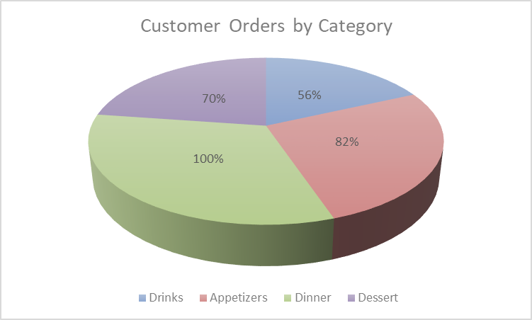
Findings
We conducted a survey for the 50 customers that participated in our test launch. For the test launch, we asked the customers to engage with the newly implemented tablets, as if they were participating in a typical restaurant experience. The customers were sent a digital survey after their experience ended
Here’s a chart that illustrates the orders made by the customers which simply says that all of them ordered dinner but only half of them ordered drinks.
This shows that customers least order would be from the last page of the menu listed on the tablet.

Slide 5
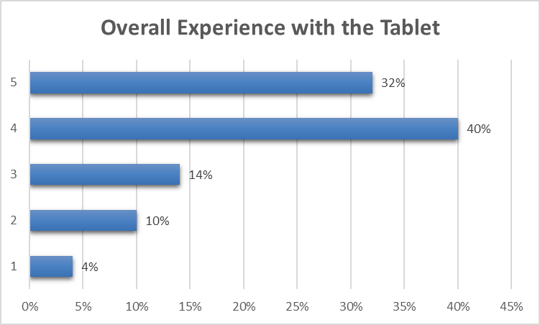
Findings
In this graph, it shows that more than half of the customers are satisfied with their experience with the tablets.
To highlight 32% had a great experience using the tablets during their visit.
However, there’s 4% of the customer who scored “lacking” with the use of the tablets and we need to check where this is coming from which will be a next step for improvement of the procedures or processes in place.

Slide 6
Next Steps
Based on the results of the survey conducted on the test run, we were able to come up with recommendations to improve the performance.
Since only 56% ordered drinks and 70% ordered desserts, we look into the ordering navigation and on the survey 64% of the customers was not able to do multiple orders which may be the cause that not all of them was able to order drinks or desserts.
First recommendation is provide recommendations of drinks or dessert when a customer orders the main dish or dinner. This can be embedded on the tablet by showing or displaying a pop up before check out.

Slide 7
Next Steps
The second recommendation is based on the overall satisfaction of the customer in using the tablets which is at 4% and upon further investigation, we recorded about 12% of technical issues during the service which impacted the overall experience of the customers.
The issues were:
The screen froze
It was glitchy
It kept freezing but after the waiter did a reboot it was fine
- It froze up a couple times
We need to check on traffic during the peak hours and a lot of customers are creating orders on the tablets.
We also need to check on the internet strength that may have impacted the technical issues reported to avoid this in the future.

