Slide 1
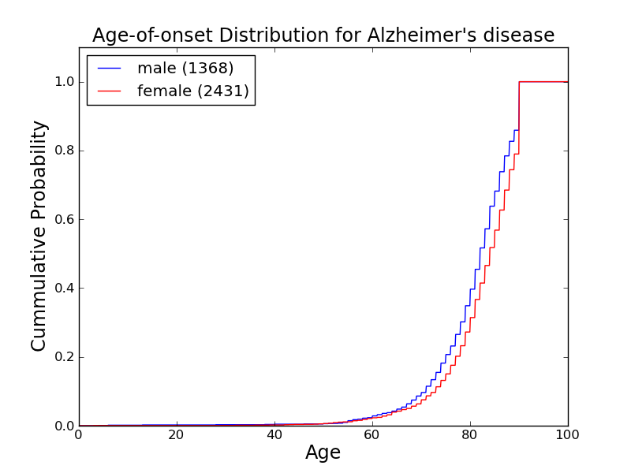
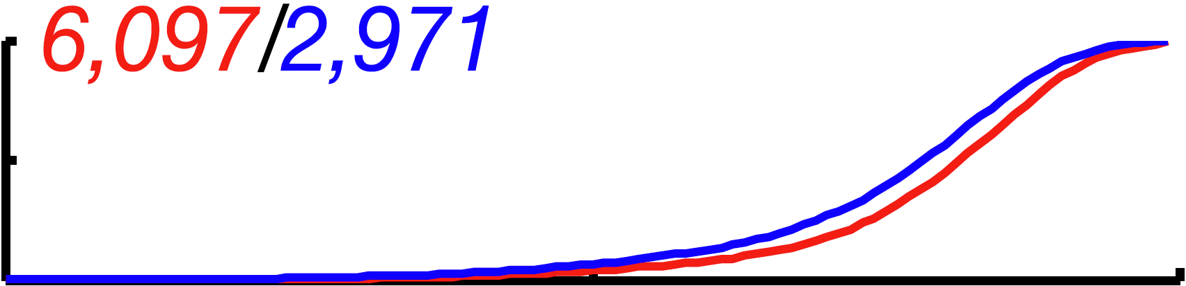

Slide 2
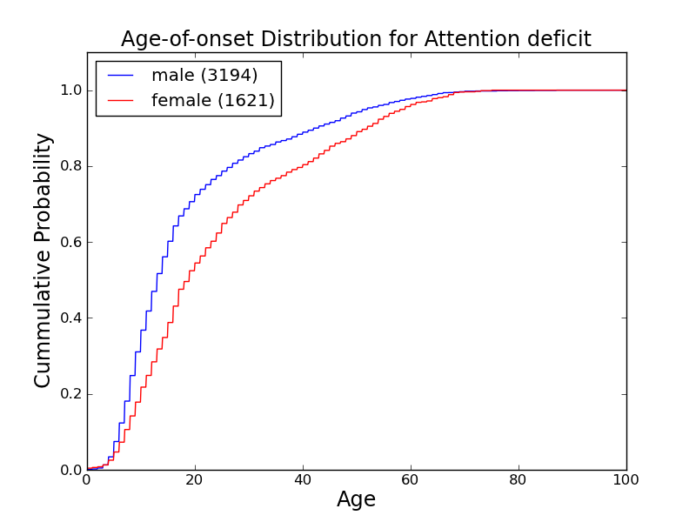

Bold lines from Rzhetsky at. el. 2007 (Columbia dataset). Thin lines from STRIDE dataset.

Slide 3
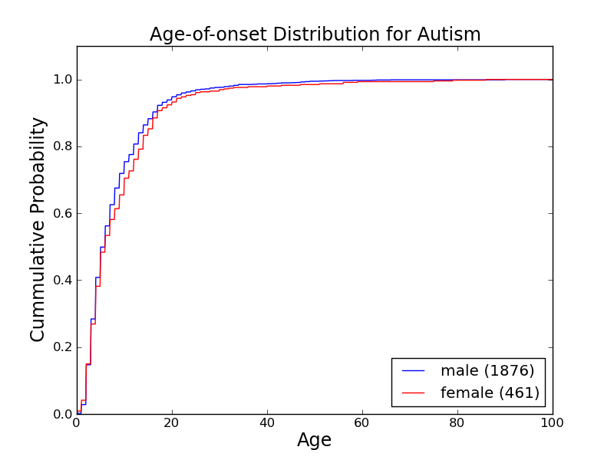


Slide 4
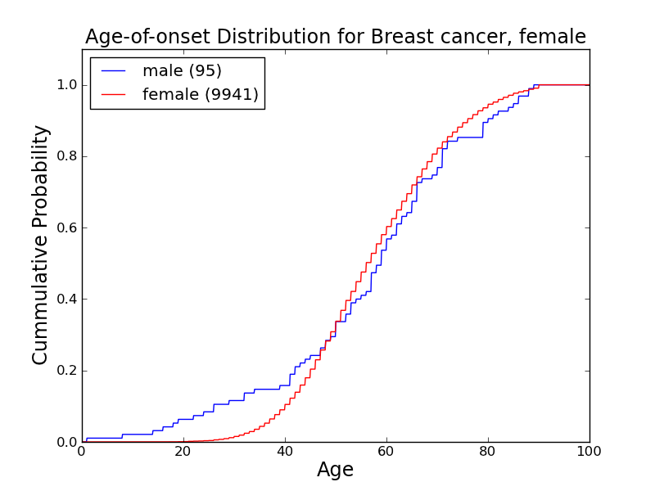
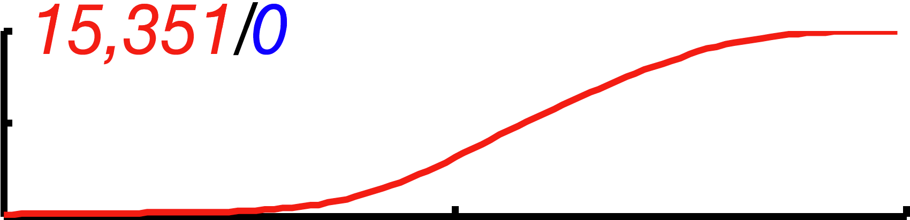
*Note, for STRIDE dataset, both male and female patients have ICD-9 codes of female breast cancer. Also right now we don’t have STRIDE data for ICD-9 of male breast cancer.

Slide 5

*Note, for STRIDE dataset, both male and female patients have ICD-9 codes of female breast cancer. Also right now we don’t have STRIDE data for ICD-9 of male breast cancer.

Slide 6
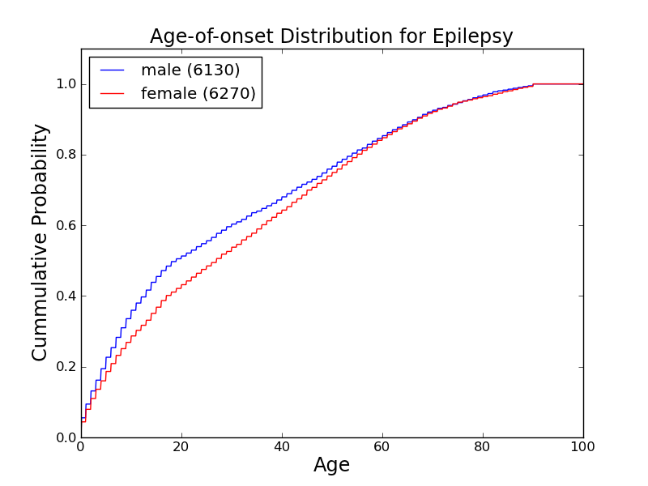
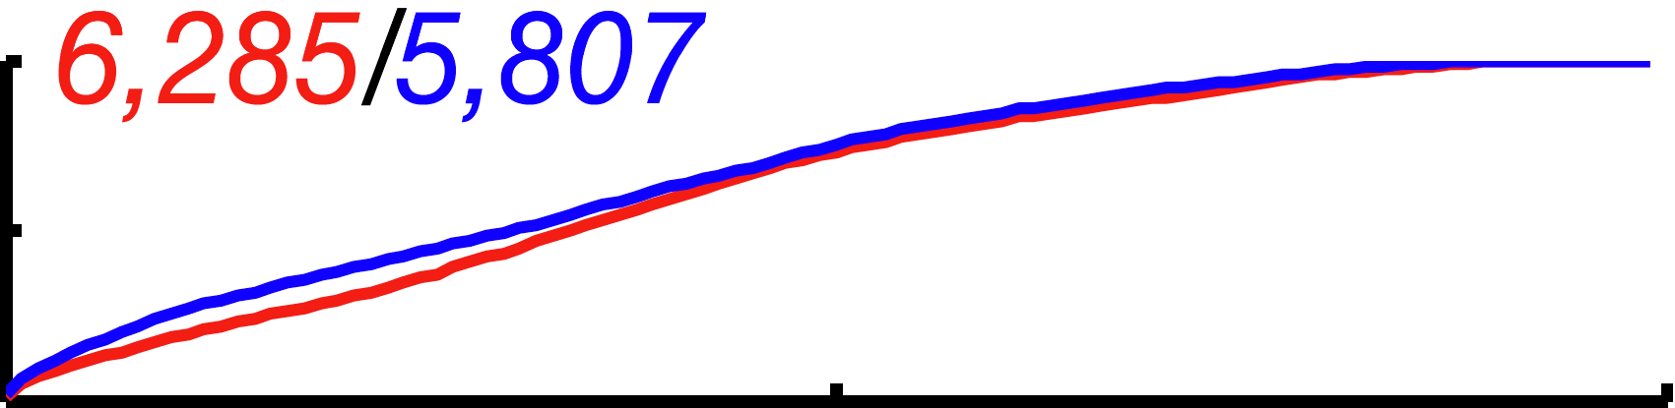

Slide 7
