Slide 1
Logical Calculus of Ideas Immanent in Nervous Activity McCulloch and Pitts
11-785 Deep Learning
Fatima Al-Raisi

Slide 2
Motivation
Provide a (mathematical) explanation of knowledge and rational human thinking.
Solve the “mind-body” problem

Slide 3
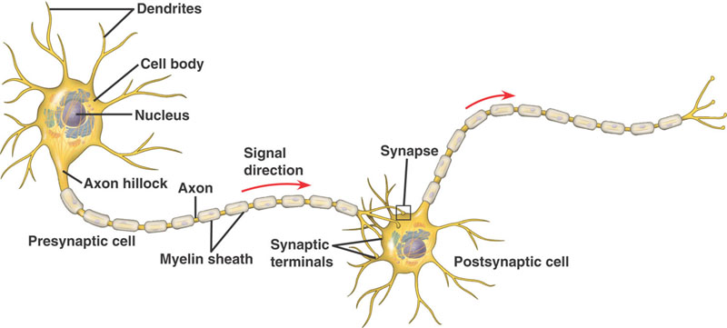
Background
Established neurophysiological facts:
The nervous system consists of neurons connected through synapses
Neurons communicate excitatory/inhibitory pulses Each neurons has a threshold determining the inputs corresponding to its excitation

Slide 4
Assumptions
The activity of neurons is “all-or-none” process.
A fixed number of synapses must be excited to excite a neuron at any time (independent of previous activity and position of the neuron?).
The only significant delay within the nervous system is synaptic delay. (?)
The activity of inhibitory synapse absolutely prevents excitation of the neuron at that time.
The structure of the net is fixed.

Slide 5
Mc-Pitts Binary Threshold Neuron
N_{i}(t) ← Sum(N_{j}(t-1))
N_{i}(t) :
1 (pulse/action) if Sum > threshold and no inhibition,
0 otherwise

Slide 6
Model
Main premise: neural signals are equivalent to propositions.
Neurons are denoted c₁, c₂, …, c_{n}.
A primitive expression. N_{i}(t) ↔ neuron c_{i} fires at time t.
Primitive expressions can be combined by logical connectives: ˄,˅, ̃, and temporal shift S
S[N_{i}(t)] = N_{i}(t-1)
Expression[N_{i}(t),…, N_{n}(t)] is a complex expression

Slide 7
Two main Questions
1. Calculate the behavior of any net:
Given a net, find a class of expressions C, s.t.,
for non-afferent c_{i} in C, _{ᴲ} a true expression
N_{i}(t) ↔ [N_{i-g}(t-1),…, N_{i-1}(t-1), N_{i}(t-1)]
where c_{i-g}, c_{i-2}, …, c_{i-1} have axons inputting c_{i-g}

Slide 8
Two main Questions
2. Find a net which will behave in a specific way (if one exists):
Given an expression of the form:
N_{i}(t) ↔ [N_{i-g}(t-1),…, N_{i-1}(t-1), N_{i}(t-1)]
Find a net for which it is true

Slide 9
Two main Questions
Nets without circles:
easily solved
Q1 answered by showing how to write an expression describing the relation between a neuron pulsing and the input it receives
Q2 answered by constructing networks corresponding to the four basic operations, and then using induction on network size to show the expression is satisfiable.

Slide 10
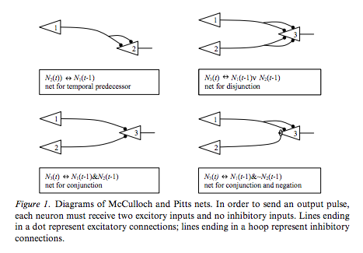
Two main questions

Slide 11
Two main questions
Nets with circles
Difficulties
Involved quantification over (possibly indefinite) time

Slide 12
Unanswered questions
What can these nets exactly compute?
What is the axiomatic/inference system of the proposed “logical calculus of ideas.”

Slide 13
Theory “Consequnces”
Impossibility of inferring causality
“Our knowledge of the world is incomplete”
“This ignorance is implicit
It is a counterpart of the abstraction that renders our knowledge useful
More difficulty with “changing nets”
Knowing the history of the patient is unnecessary for treating mental illness.
Phycology is reduced to neurophysiology → relations among psychological events are “binary”

Slide 14
Limitations
No proofs for the computational power of the model
Lack of empirical evidence/experimental work
From an attempt to model “rational thinking” in terms of neurophysiology to conclusions about knowledge acquisition and powers/limitations of human reasoning

Slide 15
Contributions
Inspired the work on digital circuits (logic gates),
Inspired the work on automata theory (Kleene proved the class of languages recognized by Mc-Pitts nets)
First work to ascribe computation to brain
Inspired research on artificial neural networks

Slide 16
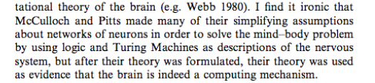
Questions?

