Slide 1
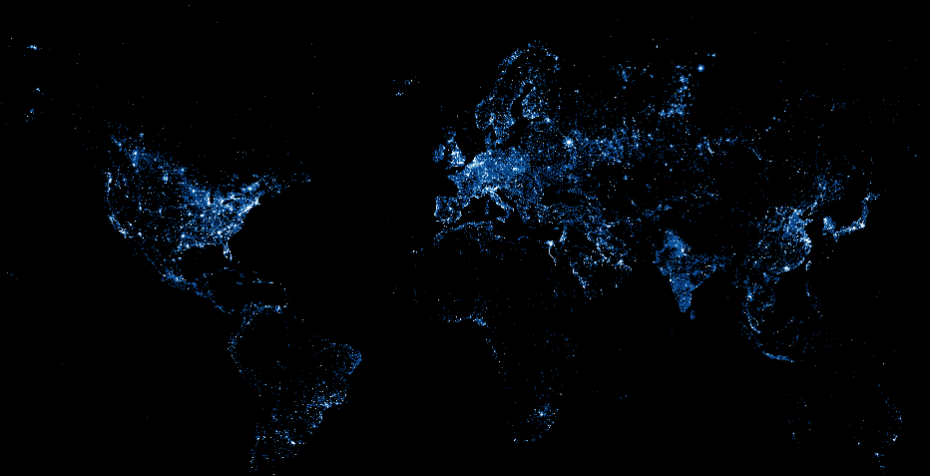
Using Night Lights to Measure Economic Growth
Peter Rasmussen

Slide 2
Issue: Data gaps in emerging markets
GDP
Syria
Afghanistan
Somalia
Notes:
Traditional means of getting socioeconomic data can be imprecise or unavailable
It can be difficult to get estimates for cities and conflict and post-conflict areas

Slide 3
Issue: Data gaps in emerging markets
How do we measure economic growth in places where statistics are imprecise or unavailable?

Slide 4
Hypothesis
We can use satellite night light imagery to measure economic growth (GDP)
Notes:
Values of pi

Slide 5
Hypothesis
GIF showing growth / change of night lights in Syria, Afghanistan, and Somalia
Notes:
Values of pi

Slide 6
Results
Pretty maps
Notes:
Values of pi

