Slide 1
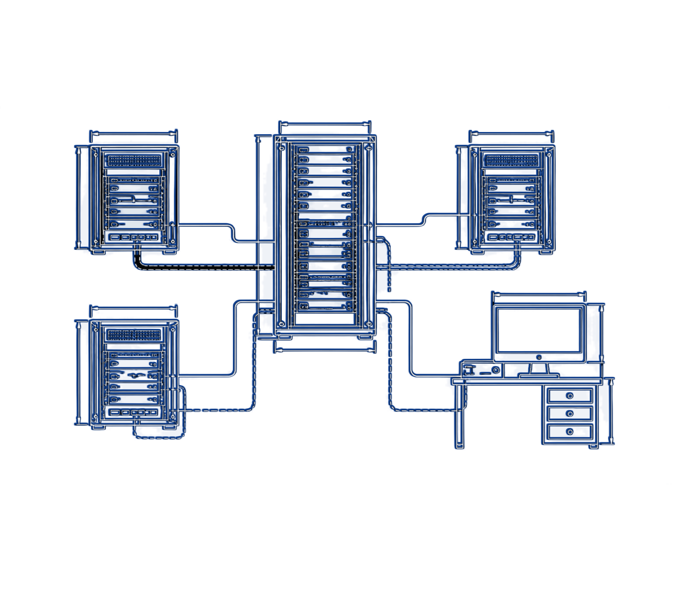
DEPLOYMENT TOOLS
CHEF AND SALTSTACK
DEVOPS ENGINEERING · DEPARTMENT OF COMPUTER SCIENCE & ENGINEERING
Presented By: Lokesh (Roll No. 24011P0565)
and Sooraj (Roll No. 24011P0566)
SUBJECT
TOPIC
TOOL 01
TOOL 02
DevOps Engineering
Deployment Tools
Chef
SaltStack
Good morning respected Sir / Ma'am and friends. I am Lokesh, and my teammate is Sooraj. Our seminar topic is Deployment Tools – Chef and Salt Stack. Today, we will explain how these two powerful tools automate server deployment and configuration.
Notes:
Good morning, respected Sir/Ma'am and friends. I am Lokesh, and my teammate is Sooraj. Our seminar topic is Deployment Tools – Chef and SaltStack. Today, we will explain how these two powerful tools automate server deployment and configuration.

Slide 2


NEED FOR DEPLOYMENT TOOLS
THE MANUAL DEPLOYMENT PROBLEM
THE DEVOPS SOLUTION
01
Infrastructure as Code (IaC)
Manual SSH commands
Server configurations are written as repeatable code files.
Manual SSH commands are slow and lead to human errors.
02
Idempotency
Applying a configuration multiple times gives the exact same result without errors.
Configuration drift
Servers end up with different versions and packages, causing production crashes.
03
Centralized control
Configure 1,000 servers automatically from one central machine.
Earlier, engineers manually configured each server using shell scripts. This created 'configuration drift' where servers had different settings, causing crashes. DevOps deployment tools solve this using Infrastructure as Code. They make deployment automated, repeatable, and error-free across hundreds of servers. Now, Sooraj will explain our first tool: Chef.
Notes:
Earlier, engineers manually configured each server using shell scripts. This created “configuration drift,” where servers had different settings, causing crashes. DevOps deployment tools solve this using Infrastructure as Code. They make deployment automated, repeatable, and error-free across hundreds of servers. Now, Sooraj will explain our first tool: Chef.

Slide 3
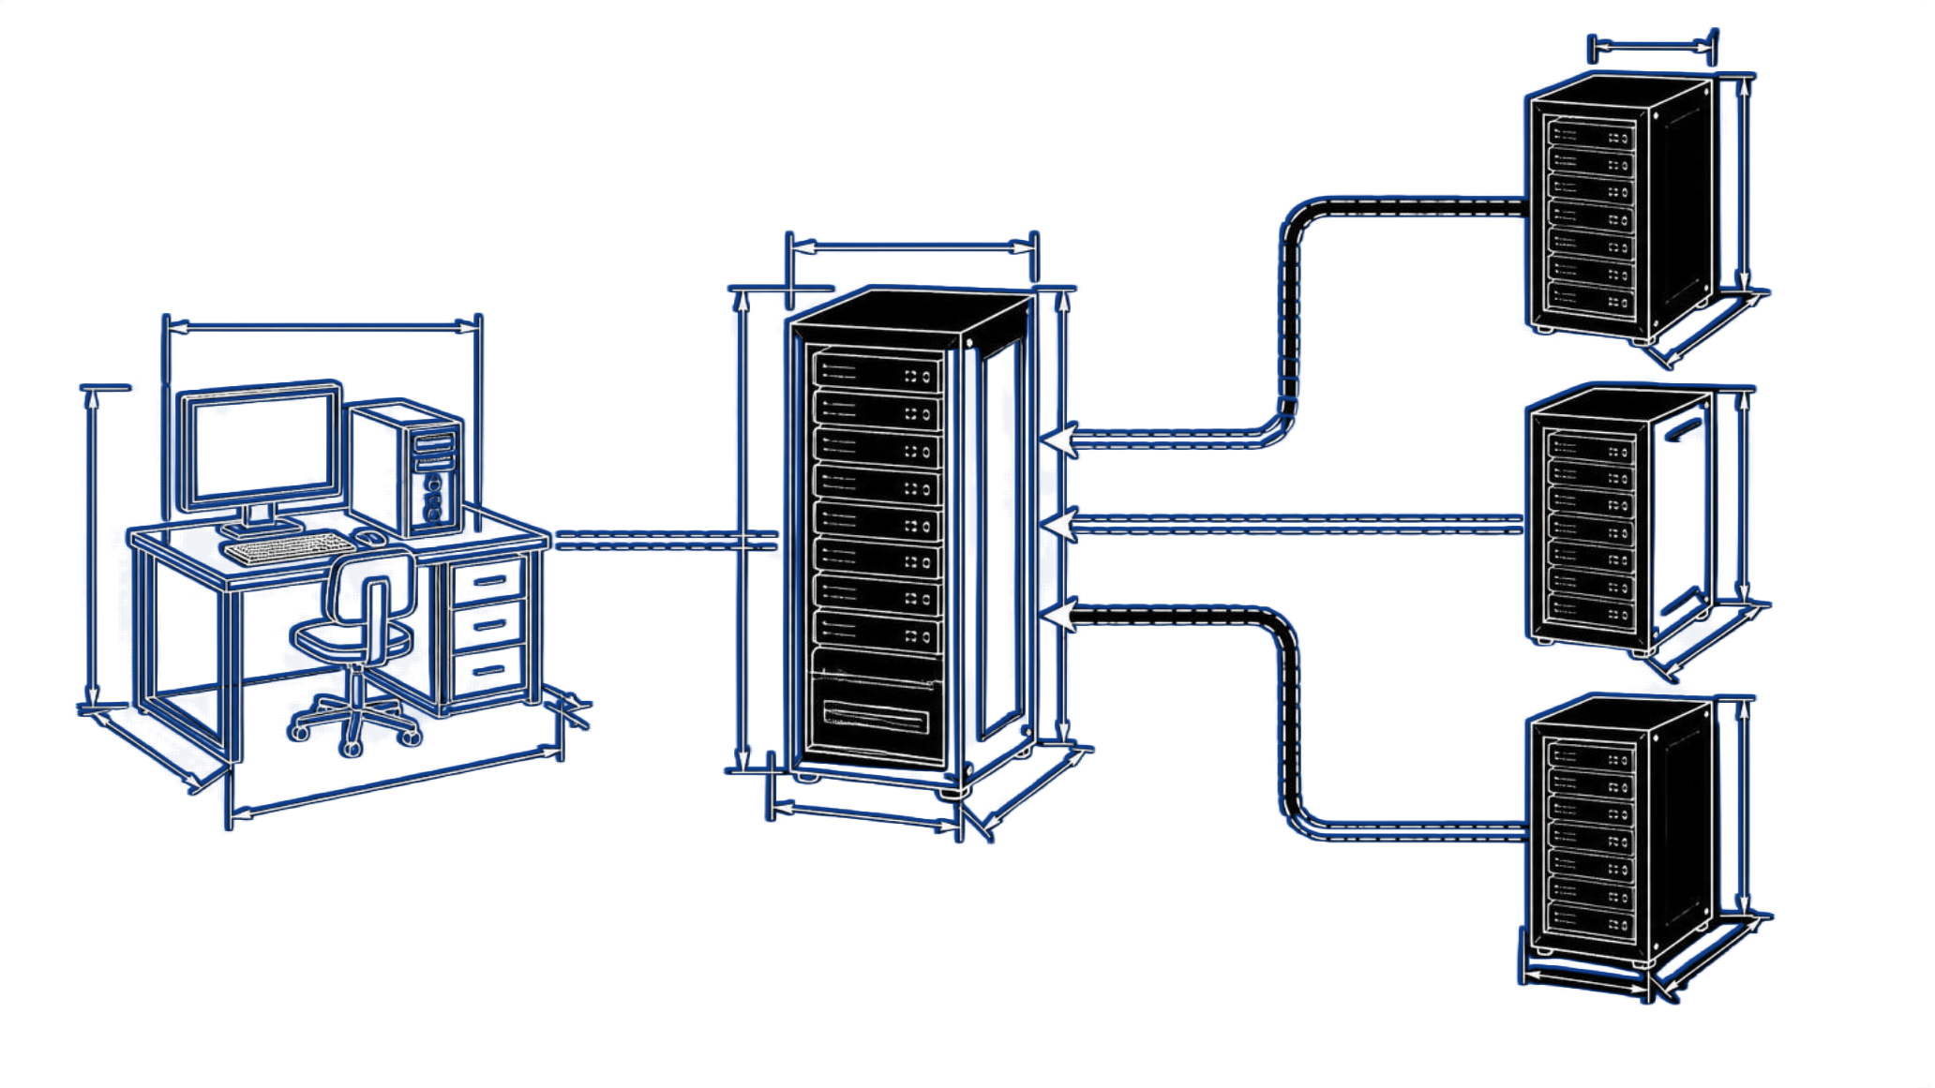
CHEF – ARCHITECTURE & PULL MODEL
CODE LANGUAGE
Ruby (Ruby DSL)
01
Chef Workstation
Developers write and test configurations.
02
Chef Server
Stores policies, cookbooks, and node data.
03
Chef Nodes (Clients)
Target servers running the chef-client background agent.
Each chef-client wakes up periodically (e.g., every 30 minutes), pulls the latest instructions from the Chef Server, and applies them locally.
Client-server pull model: nodes retrieve their instructions from the central server.
Thank you, Lokesh. The first tool is Chef. Chef uses the Ruby language and follows an agent-based Pull model with three main parts: First, the Workstation where we write our configuration code. Second, the Chef Server which stores all configurations centrally. Third, the Chef Nodes where the chef-client agent runs. The agent pulls configurations from the server and updates the machine automatically.
Notes:
Thank you, Lokesh. The first tool is Chef. Chef uses the Ruby language and follows an agent-based Pull model with three main parts: first, the Workstation where we write our configuration code; second, the Chef Server, which stores all configurations centrally; and third, the Chef Nodes, where the chef-client agent runs. The agent pulls configurations from the server and updates the machine automatically.

Slide 4
CHEF – COOKBOOKS, RECIPES & CODE
CHEF RECIPE CODE (DEFAULT.RB)
# 1. Install Web Server
package 'nginx' do
action :install
end
# 2. Deploy Web Page
file '/var/www/html/index.html' do
content '<h1>Deployed via Chef!</h1>'
action :create
end
# 3. Start Service
service 'nginx' do
action [:enable, :start]
end
CODE LANGUAGE
Ruby (.rb)
Recipe
A basic configuration block written in Ruby that tells Chef what to install or configure.
Cookbook
A package containing recipes, templates, and files.
In Chef, configurations are organized into Cookbooks and Recipes written in Ruby. As shown in our code example, a recipe uses simple Ruby instructions. It tells the server: install Nginx, create the web page, and start the service. Chef ensures the system always stays in this desired state.
Notes:
In Chef, configurations are organized into Cookbooks and Recipes written in Ruby. As shown in our code example, a recipe uses simple Ruby instructions. It tells the server to install Nginx, create the web page, and start the service. Chef ensures the system always stays in this desired state.

Slide 5
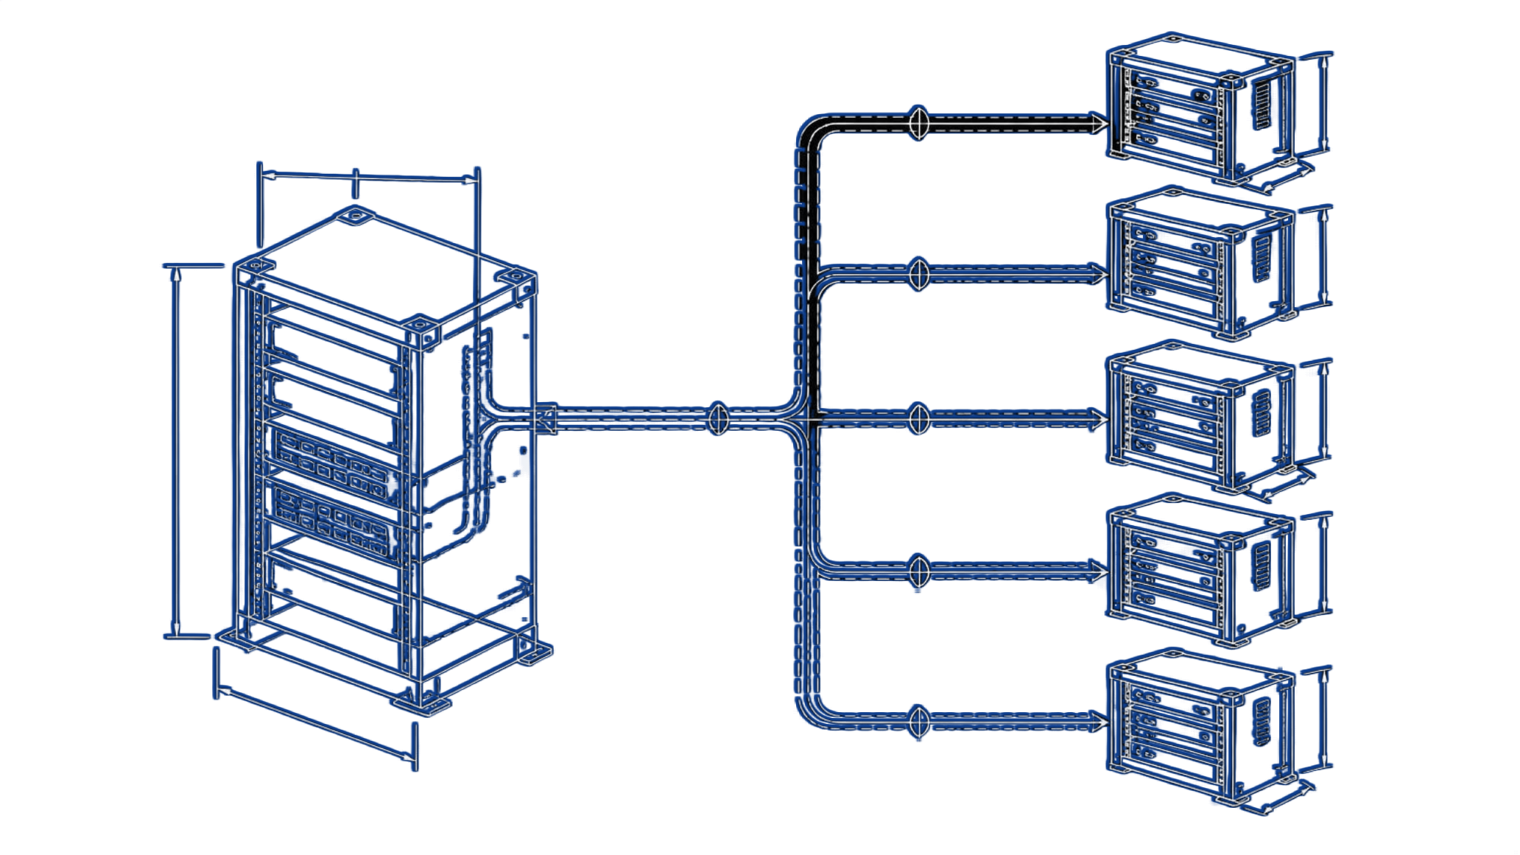
SALTSTACK – ARCHITECTURE & HIGH SPEED
CODE LANGUAGE
Python & YAML
CORE PHILOSOPHY
Extreme speed, scalability, and event-driven automation.
01
Salt Master
Central controlling server that issues commands.
02
Salt Minions
Lightweight agent processes running on managed servers.
Why SaltStack is super fast: powered by the ZeroMQ communication bus, using a Push / Publish-Subscribe model to send commands to 10,000 servers in milliseconds.
Master-minion push model: the Salt Master sends commands outward to managed servers.
Now let us look at the second tool: SaltStack. SaltStack is built with Python and uses YAML for configuration. Unlike Chef's pull model, SaltStack uses a Push model. The Salt Master uses a high-speed bus called ZeroMQ to push commands instantly to all Salt Minions. It can configure thousands of servers in just seconds. Now, Lokesh will show the SaltStack code and comparison.
Notes:
Now let us look at the second tool: SaltStack. SaltStack is built with Python and uses YAML for configuration. Unlike Chef's pull model, SaltStack uses a Push model. The Salt Master uses a high-speed bus called ZeroMQ to push commands instantly to all Salt Minions. It can configure thousands of servers in just seconds. Now, Lokesh will show the SaltStack code and comparison.

Slide 6
SALTSTACK – SLS STATES & COMPARISON
SALT STATE EXAMPLE (WEBSERVER.SLS, YAML)
install_nginx:
pkg.installed:
- name: nginx
deploy_page:
file.managed:
- name: /var/www/html/index.html
- contents: "<h1>Deployed via SaltStack!</h1>"
start_service:
service.running:
- name: nginx
- enable: True
CHEF VS SALTSTACK COMPARISON
ASPECT | CHEF | SALTSTACK
Code Language | Ruby DSL | YAML & Python
Architecture | Pull-based | Push-based
Communication | HTTPS | ZeroMQ (ultra fast)
Config Files | Recipes (.rb) | SLS States (.sls)
Best For | Deep server policies | High-speed fleet execution
In SaltStack, configurations are written as YAML SLS states. Comparing both: Chef uses Ruby with a Pull model, ideal for enterprise policy management. SaltStack uses YAML with a Push model and ZeroMQ, ideal for high-speed fleet execution.
Notes:
Thank you, Sooraj. In SaltStack, configurations are written in simple YAML files called SLS states, as shown in the code. Comparing both tools: Chef uses Ruby and a Pull model, making it ideal for enterprise policy management. SaltStack uses YAML and a Push model with ZeroMQ, making it best for high-speed fleet execution.

Slide 7
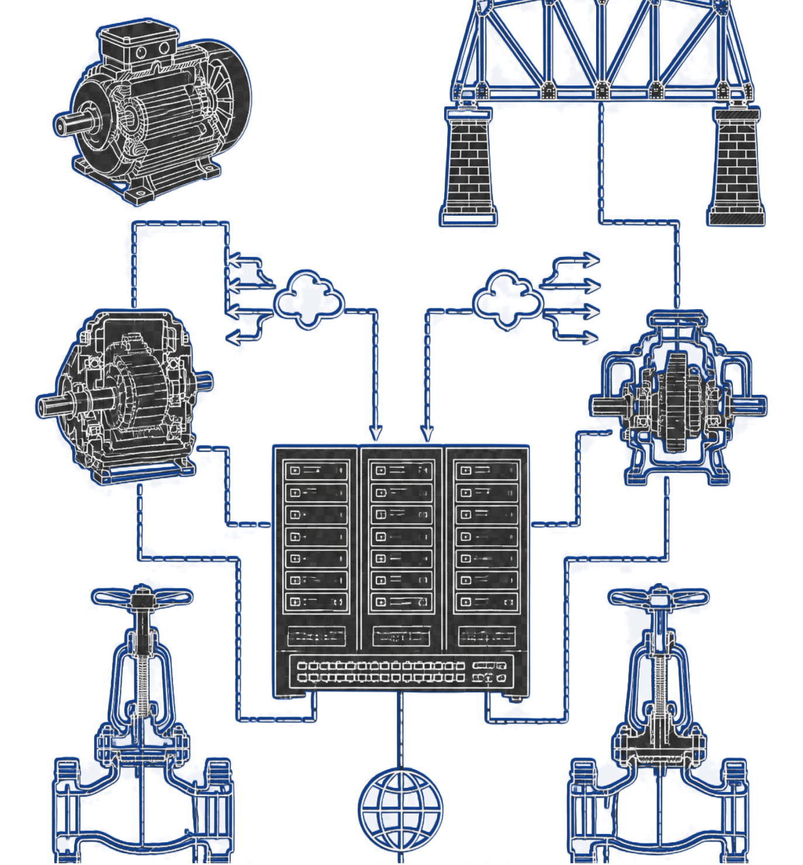
KEY TAKEAWAY
Both Chef and SaltStack eliminate manual deployment errors using Infrastructure as Code (IaC).
01
Chef (Ruby)
Ideal for enterprise compliance and policy-driven environments.
02
SaltStack (YAML/Python)
Ideal for high-speed, large-scale cloud infrastructure.
PRESENTED BY
DEPARTMENT
Lokesh (24011P0565), Sooraj (24011P0566)
Computer Science & Engineering
To conclude, Chef and SaltStack are two leading configuration and deployment tools that make modern cloud operations reliable and scalable. Thank you Sir, thank you everyone! Thank you. We are now open for any questions.
THANK YOU!
Notes:
To conclude, Chef and SaltStack are two leading configuration and deployment tools that make modern cloud operations reliable and scalable. Thank you, Sir, thank you everyone! Thank you. We are now open for any questions.

Slide 8
DEPLOYING FRONTEND, BACKEND & CI/CD
01
02
03
FRONTEND
BACKEND
CI/CD
React / HTML build
Node / Python API
Git push triggers deploy
Copy build to Nginx, reload service
Install runtime, deploy code, run systemd service
Pipeline calls chef-client or salt '*' state.apply
Chef: Ruby Salt: YAML
Chef: Ruby Salt: YAML + Python
Pipeline: YAML
Flow: Git push > CI pipeline > Chef / Salt > Servers > Live website
Notes:
Chef and SaltStack are not only for installing Nginx. The same tools deploy the frontend build, the backend API, and plug into the CI/CD pipeline. Chef uses Ruby, SaltStack uses YAML with Python for custom logic.

Slide 9
CODE: RUBY, YAML & PYTHON
RUBY - CHEF (backend.rb)
YAML - SALT (frontend.sls)
PYTHON - SALT MODULE
package 'nodejs'
git '/srv/api' do
repository 'github.com/app'
end
service 'api' do
action [:enable,:start]
end
deploy_frontend:
file.recurse:
- name: /var/www/html
- source: salt://dist
reload_nginx:
service.running:
- name: nginx
def deploy(app):
__salt__['git.pull'](app)
__salt__['service.restart'](
'api')
return 'deployed'
YAML - CI/CD PIPELINE (.github/workflows/deploy.yml)
on: { push: { branches: [main] } }
jobs:
deploy:
steps:
- run: npm run build
- run: salt '*' state.apply frontend # or: chef-client
Notes:
Here is the same deployment in three languages. Ruby for Chef recipes, YAML for Salt states and the CI pipeline, and Python for a custom Salt module.

Slide 10
LIVE RESULT: WEBSITE DEPLOYED
https://deploy-demo.vercel.app
DEPLOYMENT
Ready
Deployed via Chef!
Status
Production
Branch
main
Deployed via SaltStack!
Build
28s
Nginx running | Automated | Zero manual steps
Tools
Chef + Salt
Servers
1,000
Visit Site
Notes:
Finally, this is the result. After the pipeline runs and Chef or SaltStack configures the servers, our website is live, shown here like a Vercel deployment dashboard.

