Slide 1

Foraging IN the Field
CS698R: Deep Reinforcement Learning Project
Mentors: Adithya, Ajita
Group-5:
Tabish Ahmad - 21111060
Prakhar Srivastava - 170486
Areeb Ahmad -180135
Mohd Niyas P -170394
Samarth Mehrotra -20128408

Slide 2
Problem description:
There is a field with certain number of patches, and each patch has certain number of berries of various sizes.
Reward is proportional to the size of the berry.
There is a pre-defined variable draining rate proportional to distance travelled which depletes the total reward accumulated.
Continuous movement or having the option to stay?
Field constant or changing ?
AIM:
Maximize the reward remaining at the end?
Maximize the total cumulative reward collected during 5 mins?
Both?

Slide 3
MOTIVATION:
Although most decision research concerns choice between simultaneously presented options, in many situations options are encountered sequentially.
The decision is whether to exploit an option or explore for a better one.
All animals must forage food for survival but doing so is energetically costly.
But we know little about process involved in decision making.

Slide 4
LITERATURE SURVEY:
Information foraging : - Application of optimal foraging theory to understand human behaviour while searching for information on internet.
Marginal Value Theorem : It describes the behaviour of an optimally foraging individual in an environment where resources (berries) are located in discrete patches separated by areas with no resources.
Observation of Animals : - Species like great tits and screaming hairy armadillos have been studied and their foraging patterns have been tested for optimality.
NEAT: Neural Evolution of Augmented Topologies. A genetic algorithm which evolves the neural networks over generations.

Slide 5
ENVIRONMENT DETAILS: (RECAP)
Overall ​ ● Field - 20,000 x 20,000 pixels ​ ● Screen - 1920 x 1080​ ● Time - 5 minutes​ | Patch​ ● Size - 2600 x 2600 ​ ● Number - 10 ​ ● Patches completely inside field ​ ● Interpatch distance - >=5000 ​ ● Berry sizes - 10, 20, 30, 40 ​ ● Berry number - 20 each/patch​
Reward ​ ● Initial = 0.5 (out of 1) ​ ● Drain rate = 0.5d/(120*400) (d distance in pixels) ​ ● Berry reward = diameter/10,000​ | Player ​ ● Size = 10​ ● Speed - 400 pixels/seconds​ ● Arrow key movement (8 directions)​

Slide 6
ASSUMPTIONS
Agent knows that there are four types of berries(by size).
Agent’s vision is restricted to visible screen.
The berries don’t replenish after they are consumed.
Patches has same densities.

Slide 7
Implementation:
Environment implemented with OpenAi gym integrated with PyGame for rendering.
Environment has the option human and computer(agent) play.
Agent is trained by the algorithm Double DQN.
Agent is provided two options: Continuous Action or Have an additional option to stay.
Continuous action helps is maximizing the cumulative reward.
Non-continuous action allows the agent to maximize the reward remaining at the end.

Slide 8
Agents
Continuous Movement
Non-Continuous Movement
Random Environment

Slide 9
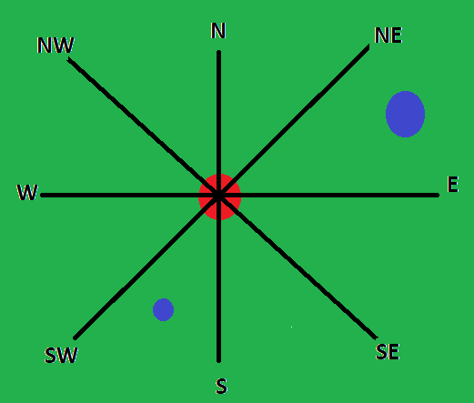
AGENT:
State-Size = 35, Action-Size = 8 or 9 (depending on continuous or non-continuous movement).
The input vector to our neural network is a 35 length vector. The output is a vector of size 8 or 9.
Since we can’t use CNN because of memory issues and FPS drops we took the information from the image as features and provided it to the network.
The features are:
Consider the vector: [N, S, E, W, NE, NW, SE, SW]
The agent scans in the 8 contained directions as far as it can see or until it sees a berry .
The vector is filled as: [0, 0, size1/distance, 0,size1/distance, 0, 0, 0]
Another example: [0, size2/distance,0, 0,0, 0, 0,size2/distance]
There is a different vector for each size of berry. Therefore we have 8*4 = 32 states.
Intuition: Is it worth travelling the distance for the corresponding size?

Slide 10
33rd state is the density. Meaning how much berries are occupying the screen at the current moment.
34th state is the current health remaining.
35th state is the current time remaining.
Intuition:
Density helps in determining if it is a good time to leave the patch.
Current health and time helps in determining whether to stay in the already depleted patch instead of exploring.
Precisely at any point of time the agent should have the health to explore a new patch and if it doesn’t the current patch should be able to provide that much resources.
Features are scaled so that any feature don’t get too big or too small.

Slide 11
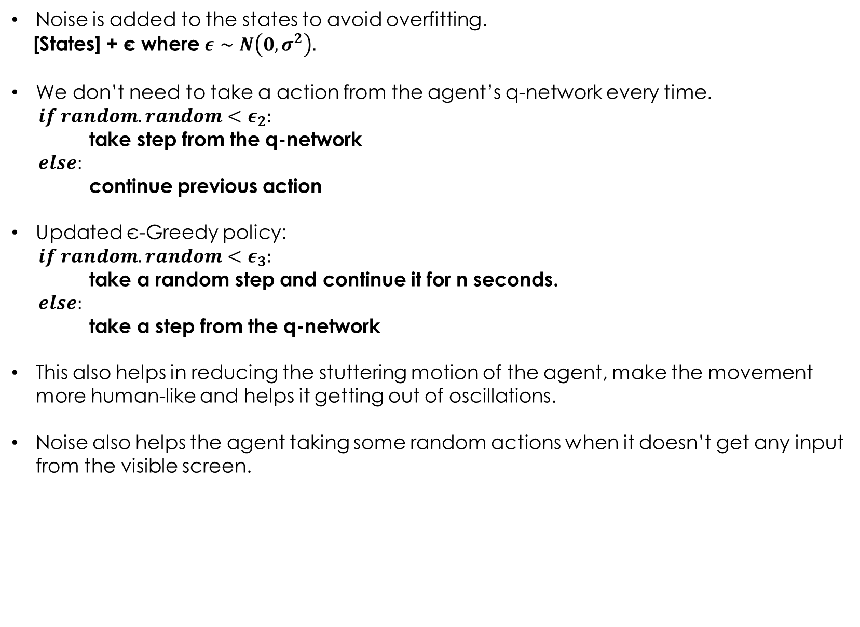
Noise is added to the states to avoid overfitting.
[States] + є where $ε∼N\left(0, σ^{2}\right).$
We don’t need to take a action from the agent’s q-network every time.
$if random.random<ε_{2}:$
take step from the q-network
$else:$
continue previous action
Updated є-Greedy policy:
$if random.random<ε_{3}:$
take a random step and continue it for n seconds.
$else:$
take a step from the q-network
This also helps in reducing the stuttering motion of the agent, make the movement more human-like and helps it getting out of oscillations.
Noise also helps the agent taking some random actions when it doesn’t get any input from the visible screen.

Slide 12
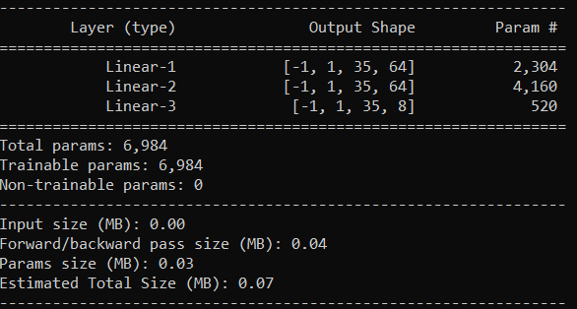
MODEL SUMMARY:
Size of the model is about 70KB which is very less.
The model inference time is very fast and doesn’t effect or slows down the game.
This also contributes to agent playing like a human would play.

Slide 13
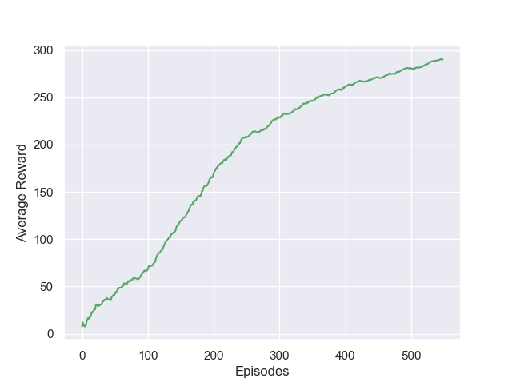
Results:
Running Average Reward vs Episodes
Time taken for 500 episodes: 26hrs
The problem’s objective starts getting completed after it is able to achieve more than 250 cumulative score.
The human players average is 344.
The trained agent average is 416.

Slide 14
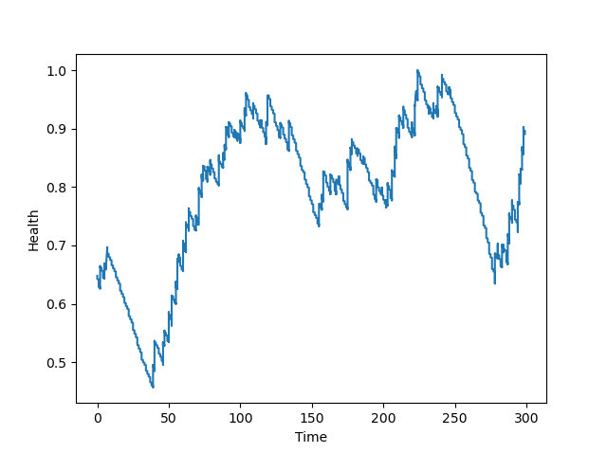
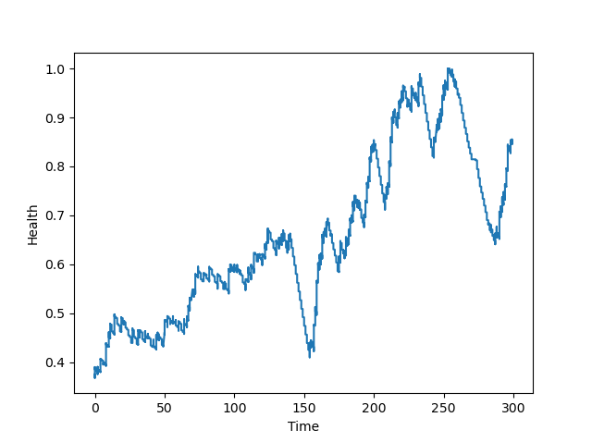
Health vs Time:
Same Environment

Slide 15
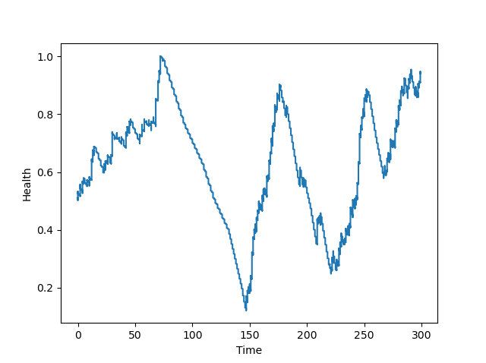
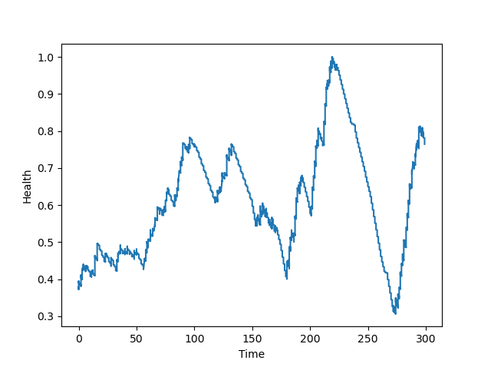
Random Environment

Slide 16
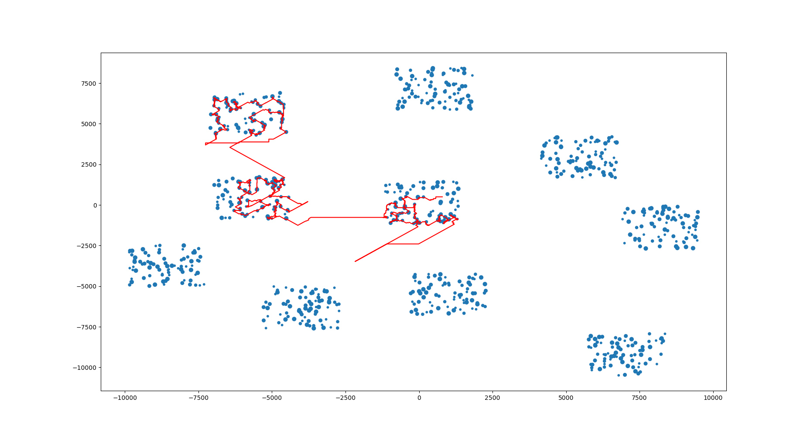
Agent’s Path:

Slide 17
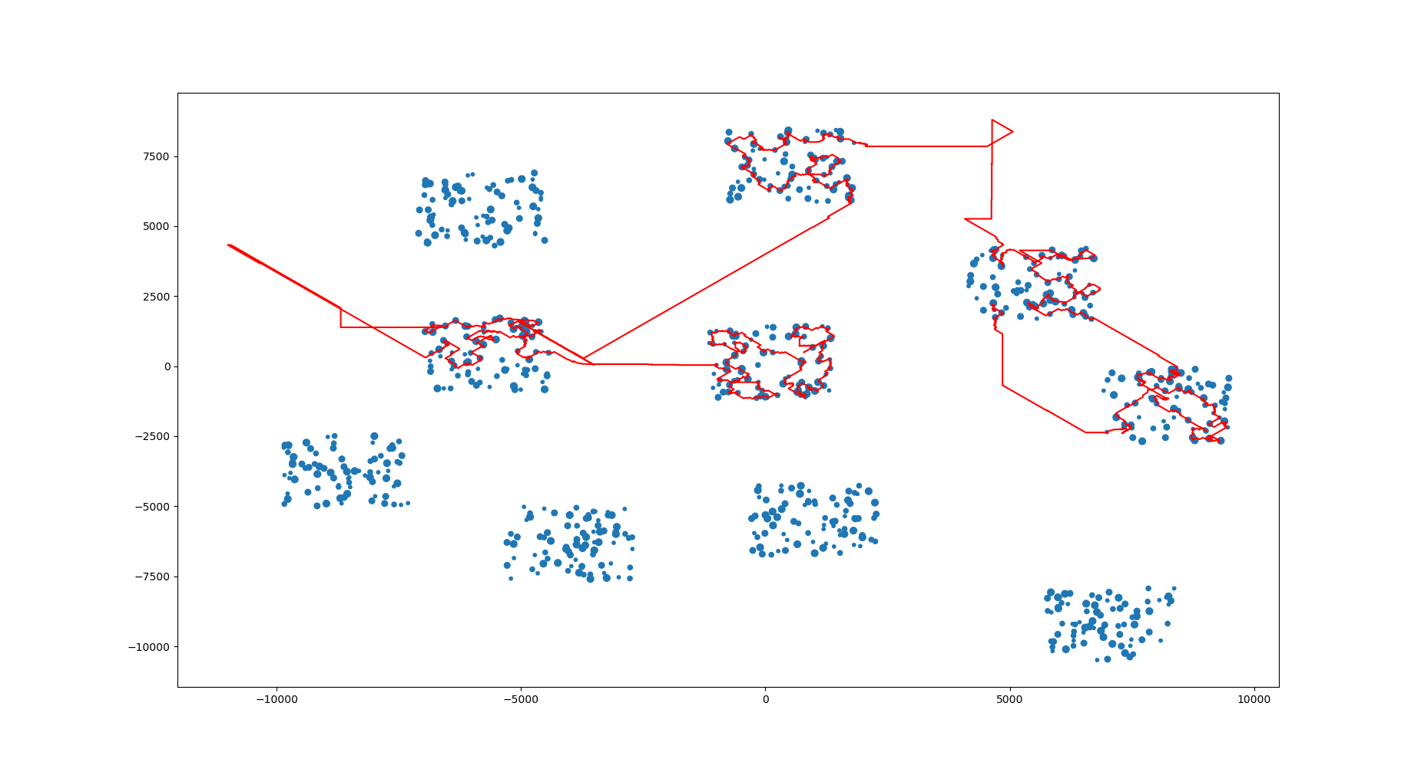

Slide 18
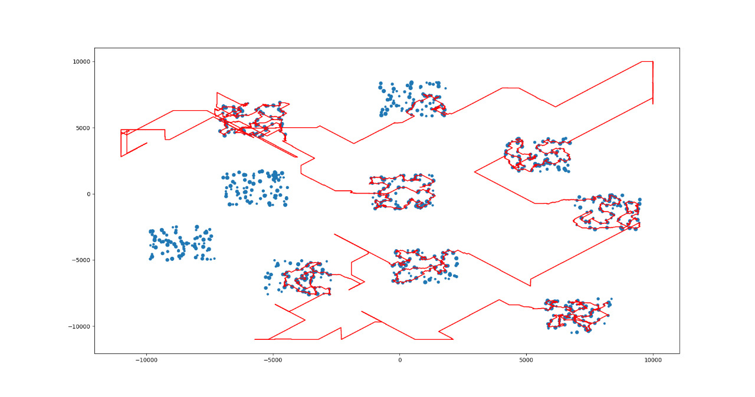
AN OUTLIER !!!!

Slide 19
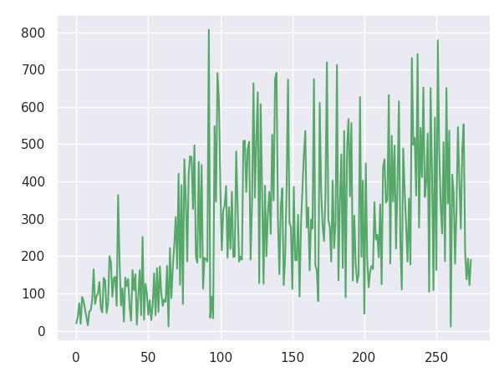
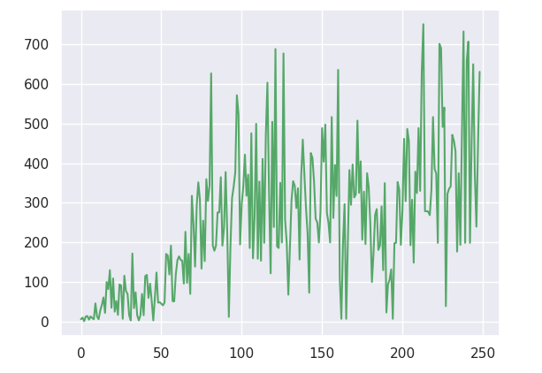
AGENT’S PERFORMANCE
Total rewards vs episodes (Stay option) Total rewards vs episodes (No-Stay option)

Slide 20
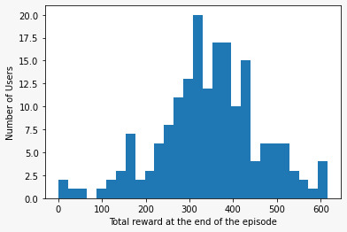
HUMAN PERFORMANCE
The following is the human players performance distribution(data of 183 users.)

Slide 21
Challenges:
Time to train the agent take about 8-9 hours to reach decent performance.
As it can be seen, there is lot oscillations ,we believe that it will mitigate as episodes will progress, but it takes lot of time in execution.
Optimizing the game for smooth performance.
Resource constraints for using CNN.
Agents would get stuck into oscillations and the health goes to zero very rapidly.
Tuning the hyperparameterss of the DDQN.

Slide 22
Future:
CNN with optimizations of getting the current screen without FPS drop.
CNN will help in learning more complicated features.
More human-like performance.
NEAT (Neural Evolution of Augmented Topologies).
NEAT is a genetic algorithm: (Simulates the process of natural selection)
Individuals with good fitness scores are given preference to pass their genes to successive generations.
Cross over of Genes.
Mutation in the next generation.
Fitness for new population.

Slide 23
FINAL Contribution:
NAME | CONTRIBUTION
Tabish Ahmad - 21111060 | Environment, Feature selection, Literature survey.
Prakhar Srivastava - 170486 | Environment, Pygame and model implementation, Literature Survey, Solution approach, Feature selection, Training agent, getting results, final slides and final report.
Areeb Ahmad -180135 | Environment, Solution Approach, Training agent, plotting results, final slides and final report, Data Analysis.
Mohd Niyas P -170394 | -
Samarth Mehrotra -20128408 | -

Slide 24
DEMO

Slide 25
References
Charnov, E. L. 1976. Optimal foraging: the marginal value theorem. Theoretical Population Biology 9:129–136
Cowie, R. J. (1977) “Optimal foraging in great tits (Parus Major)” Nature 268:137–139
Cassini, Marcelo H., Alejandro Kacelnik, and Enrique T. Segura (1990) “The tale of the screaming hairy armadillo, the guinea pig, and the marginal value theorem” Animal Behavior 39(6):1030–1050
A. Mesquita, Y. Nogueira, C. Vidal, J. Cavalcante-Neto and P. Serafim, "Autonomous Foraging with SARSA-based Deep Reinforcement Learning," 2020 22nd Symposium on Virtual and Augmented Reality (SVR), 2020, pp. 425-433, doi: 10.1109/SVR51698.2020.00070.
https://neat-python.readthedocs.io/en/latest/neat_overview.html

