Slide 1
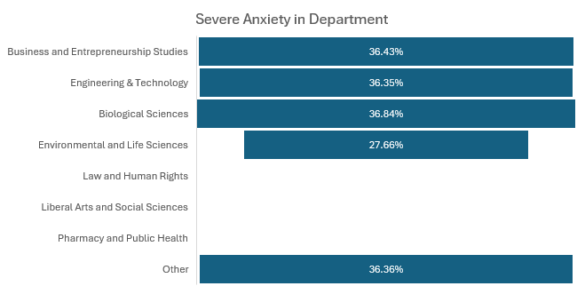
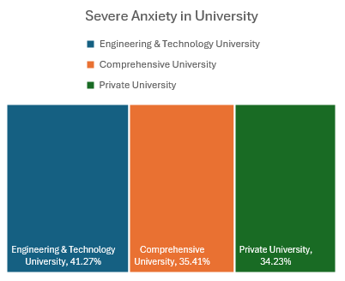
Data-Driven Analysis of Key Factors Influencing University Students’ Mental Health
Demographic Attributes
Academic Information
Financial Status
Insights:

