Slide 1
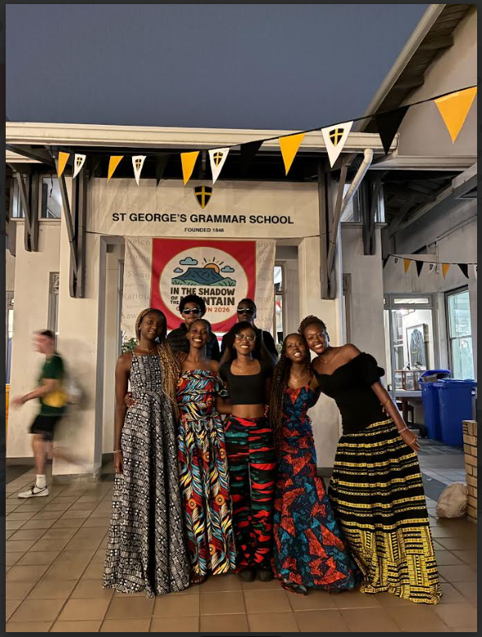
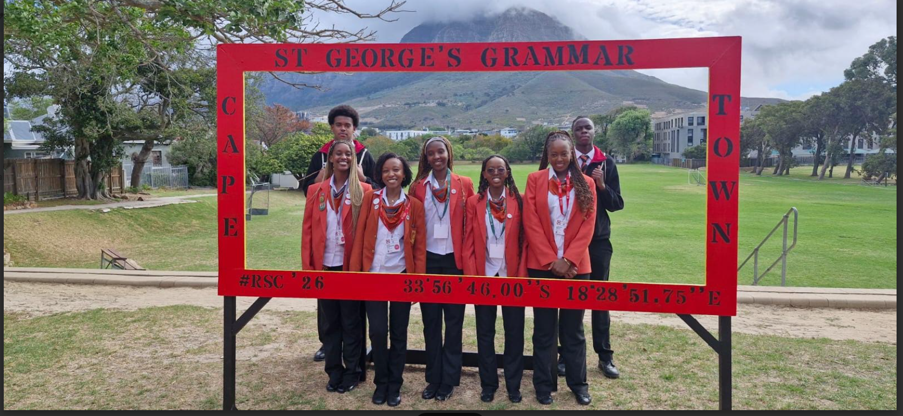
Round Square Conference hosted by St. George's Grammar School in Cape Town. The conference theme, “Adventure: Under the Shadow of the Mountain,”

