Slide 1
Learning by Loss Minimization

Slide 2




Machine learning: Learn a Function from Examples
Function:
Examples:
Supervised:
Unsupervised:
Semisuprvised:
Notes:
f(x)=y \;\;\; x \in \mathcal{X} \;\;\; y \in \mathcal{Y}
\{x_i,y_i\}_{i=1}^n
\{x_i\}_{i=1}^{n}
\{x_i\}_{i=1}^{n_1}
\{x_i,y_i\}_{i=1}^{n2}

Slide 3
Machine learning: Learn a Function from Examples
Function:
Examples:
Supervised:
Unsupervised:
Semisuprvised:
Notes:
f(x)=y \;\;\; x \in \mathcal{X} \;\;\; y \in \mathcal{Y}
\{x_i,y_i\}_{i=1}^n
\{x_i\}_{i=1}^{n}
\{x_i\}_{i=1}^{n_1}
\{x_i,y_i\}_{i=1}^{n2}

Slide 4


Example: Regression
Examples:
Notes:
\mathcal{X}=\mathbb{R} \;\;\; \mathcal{Y}=\mathbb{R}

Slide 5

Example: Regression
Examples:
Function:

Slide 6

Example: Regression
Examples:
Function:
How to find ?

Slide 7
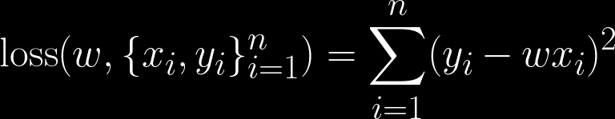
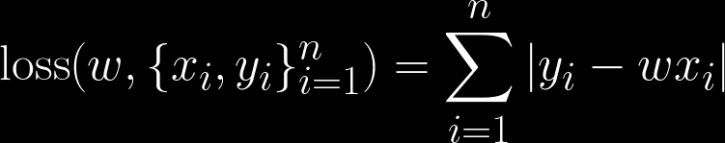
Loss Functions
Least Squares:
Least absolute deviations
Notes:
\text{loss}(w,\{x_i,y_i\}_{i=1}^n)=\sum_{i=1}^n(y_i-wx_i)^2

Slide 8
Open Questions
How to choose the model function?
How to choose the loss function?
How to minimize the loss function?
Notes:
\text{loss}(w,\{x_i,y_i\}_{i=1}^n)=\sum_{i=1}^n(y_i-wx_i)^2

Slide 9

Example: Binary Classification
Notes:
\mathcal{X}=\mathbb{R}^d \;\;\; \mathcal{Y}=\{-1,1\}

Slide 10






Support Vector Machines (SVMs)
Binary classification can be viewed as the task of separating classes in feature space:
Notes:
x= [x_1,x_2]
w= a[-1,1] \;\;\; a>0

Slide 11

Support Vector Machines (SVMs)

Slide 12
Support Vector Machines (SVMs)

Slide 13

Support Vector Machines (SVMs)
right label
Its sign is the
predicted label

Slide 14
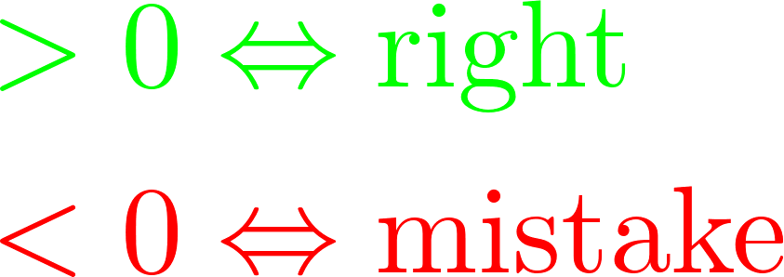
Support Vector Machines (SVMs)

Slide 15


Support Vector Machines (SVMs)

Slide 16

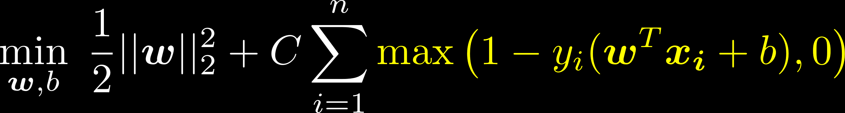
Support Vector Machines (SVMs)

Slide 17
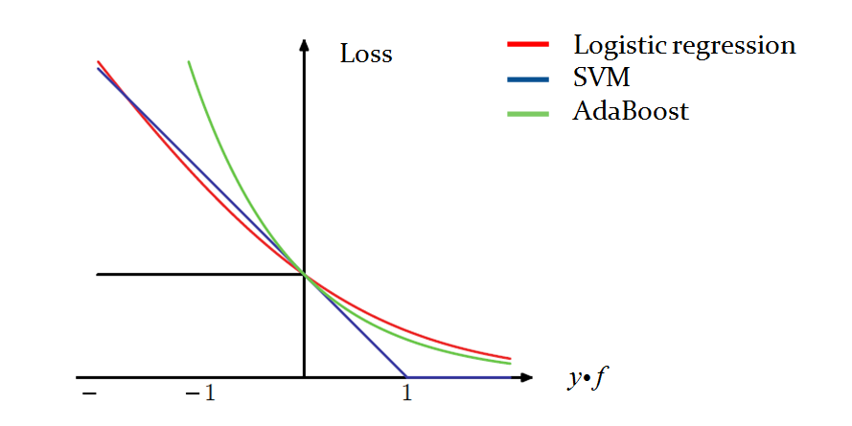
Other losses ?

Slide 18


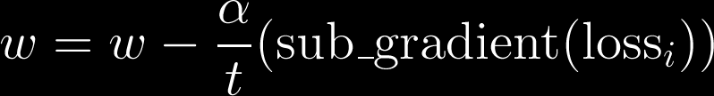

Can minimize using Stochastic subGradient Decent (SGD)
Notes:
\text{loss}(w,\{x_i,y_i\}_{i=1}^n)= \\
\frac{1}{2}
||w||^2_2 + C \sum_{i=1}^n \max(1-y_i(w^Tx_i),0)
-------------------------------------------------------------------------------------------------------------
w= w - \frac{\alpha}{t} (\text{sub\_gradient}(\text{loss}_i))

Slide 19
Can minimize using Stochastic subGradient Decent (SGD)
Constant
Notes:
\text{loss}(w,\{x_i,y_i\}_{i=1}^n)= \\
\frac{1}{2}
||w||^2_2 + C \sum_{i=1}^n \max(1-y_i(w^Tx_i),0)
-------------------------------------------------------------------------------------------------------------

Slide 20
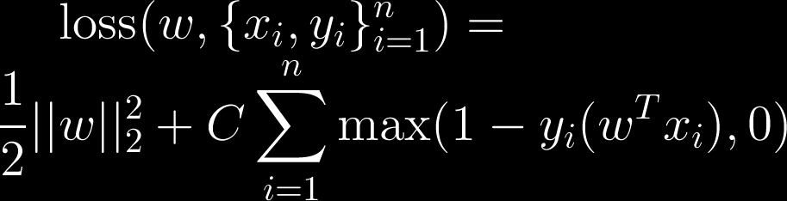
Can minimize using Stochastic subGradient Decent (SGD)

Slide 21
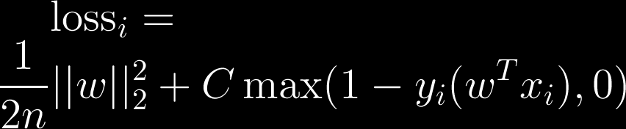
Can minimize using Stochastic subGradient Decent (SGD)
Notes:
\text{loss}_i= \\
\frac{1}{2n}||w||^2_2 + C \max(1-y_i(w^Tx_i),0)

Slide 22
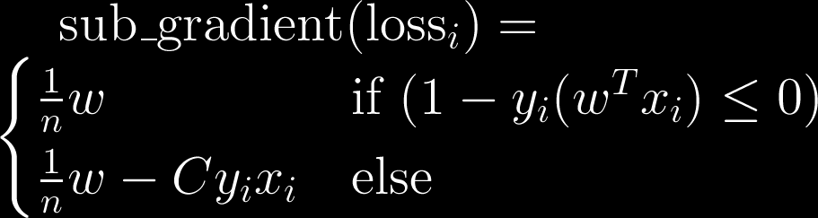
Can minimize using Stochastic subGradient Decent (SGD)
Notes:
\text{loss}_i= \\
\frac{1}{2n}||w||^2_2 + C \max(1-y_i(w^Tx_i),0)
\text{sub\_gradient}(\text{loss}_i)= \\
\begin{cases}
\frac{1}{n}w & \text{if } (1-y_i(w^Tx_i) \leq 0) \\
\frac{1}{n}w-C y_i x_i & \text{else}
\end{cases}

Slide 23
Papers
Pegasos: Primal Estimated sub-GrAdient SOlver for SVM, Shai Shalev-Shwartz, Yoram Singer, Nathan Srebro, Andrew Cotter 2011
The Tradeoffs of Large Scale Learning, Léon Bottou and Olivier Bousquet 2011
Stochastic Gradient Descent Tricks, Léon Bottou 2012

Slide 24
Non-Linear SVMs
Datasets that are linearly separable:
x
0

Slide 25
Non-Linear SVMs
Datasets that are linearly separable:
Datasets that are NOT linearly separable?
x
0
0
x

Slide 26
Non-Linear SVMs
Datasets that are linearly separable:
Datasets that are NOT linearly separable?
Mapping to other (here higher) dimensions:
x
0
0
x
x²
0
x

Slide 27
What should be the mapping?
3
1
Notes:
x= [x_1,x_2]
w= a[-1,1] \;\;\; a>0

Slide 28

What should be the mapping?
3
1
Notes:
x= [x_1,x_2]
\Phi(x_1,x_2)=\sqrt{x_1^2+x_2^2}-2

Slide 29

What should be the mapping?
-1
0
1
Notes:
x= [x_1,x_2]
\Phi(x_1,x_2)=\sqrt{x_1^2+x_2^2}-2

Slide 30
What should be the mapping in general?

Slide 31



Support Vector Machines (SVMs)
The Lagrangian dual:
Where the classifier is:

Slide 32
Support Vector Machines (SVMs)
The Lagrangian dual:
Where the classifier is:

Slide 33
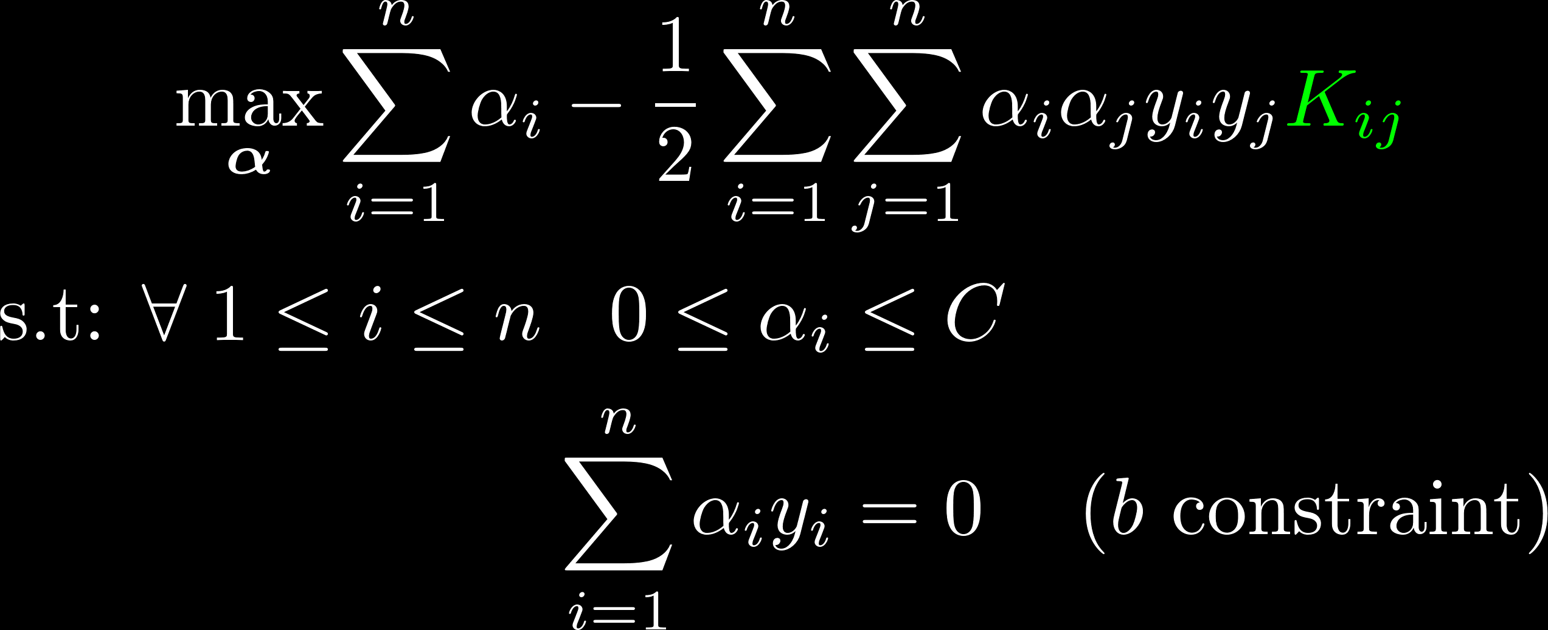
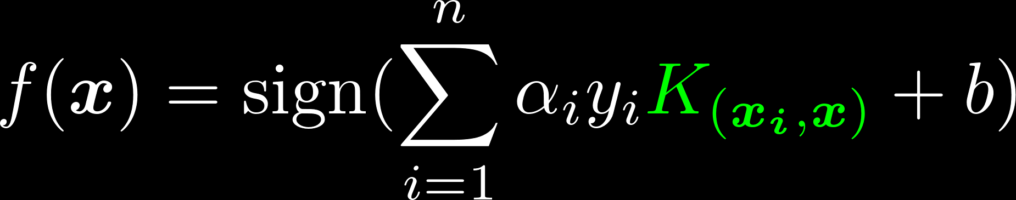
Support Vector Machines (SVMs)
The Lagrangian dual:
Where the classifier is:

Slide 34
Support Vector Machines (SVMs)
The Lagrangian dual:

Slide 35

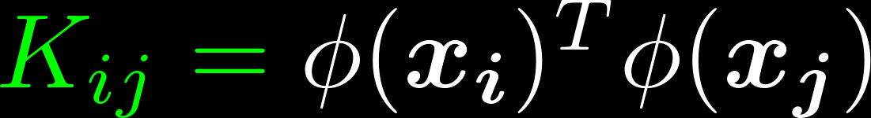
Support Vector Machines (SVMs)

Slide 36
Support Vector Machines (SVMs)

Slide 37
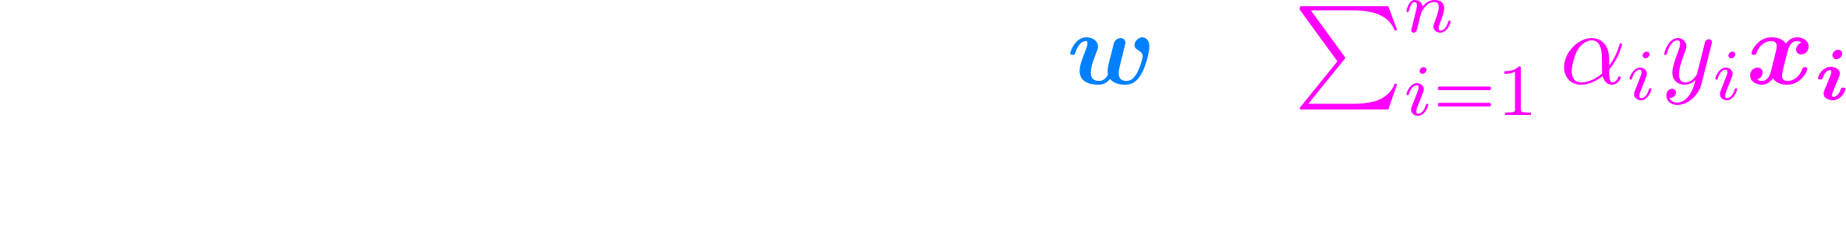
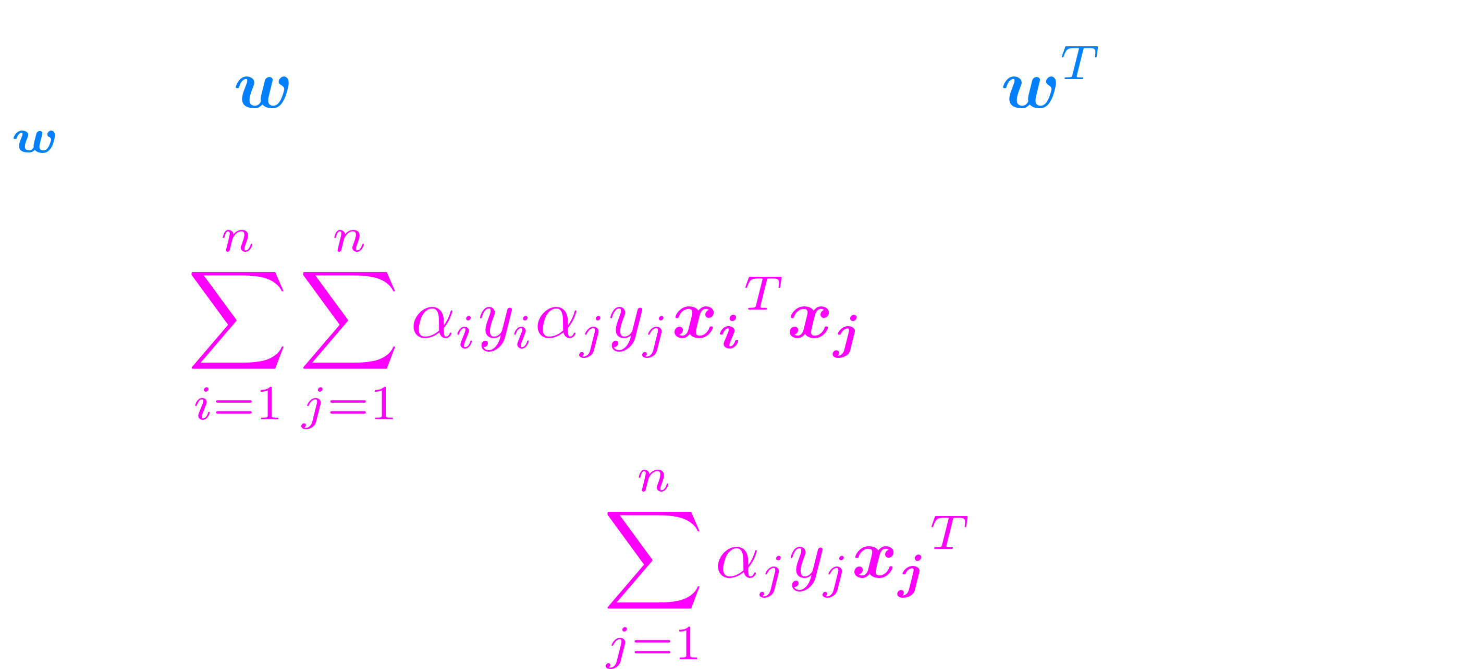
Support Vector Machines (SVMs) Primal with Kernels (Chapelle 06)

Slide 38
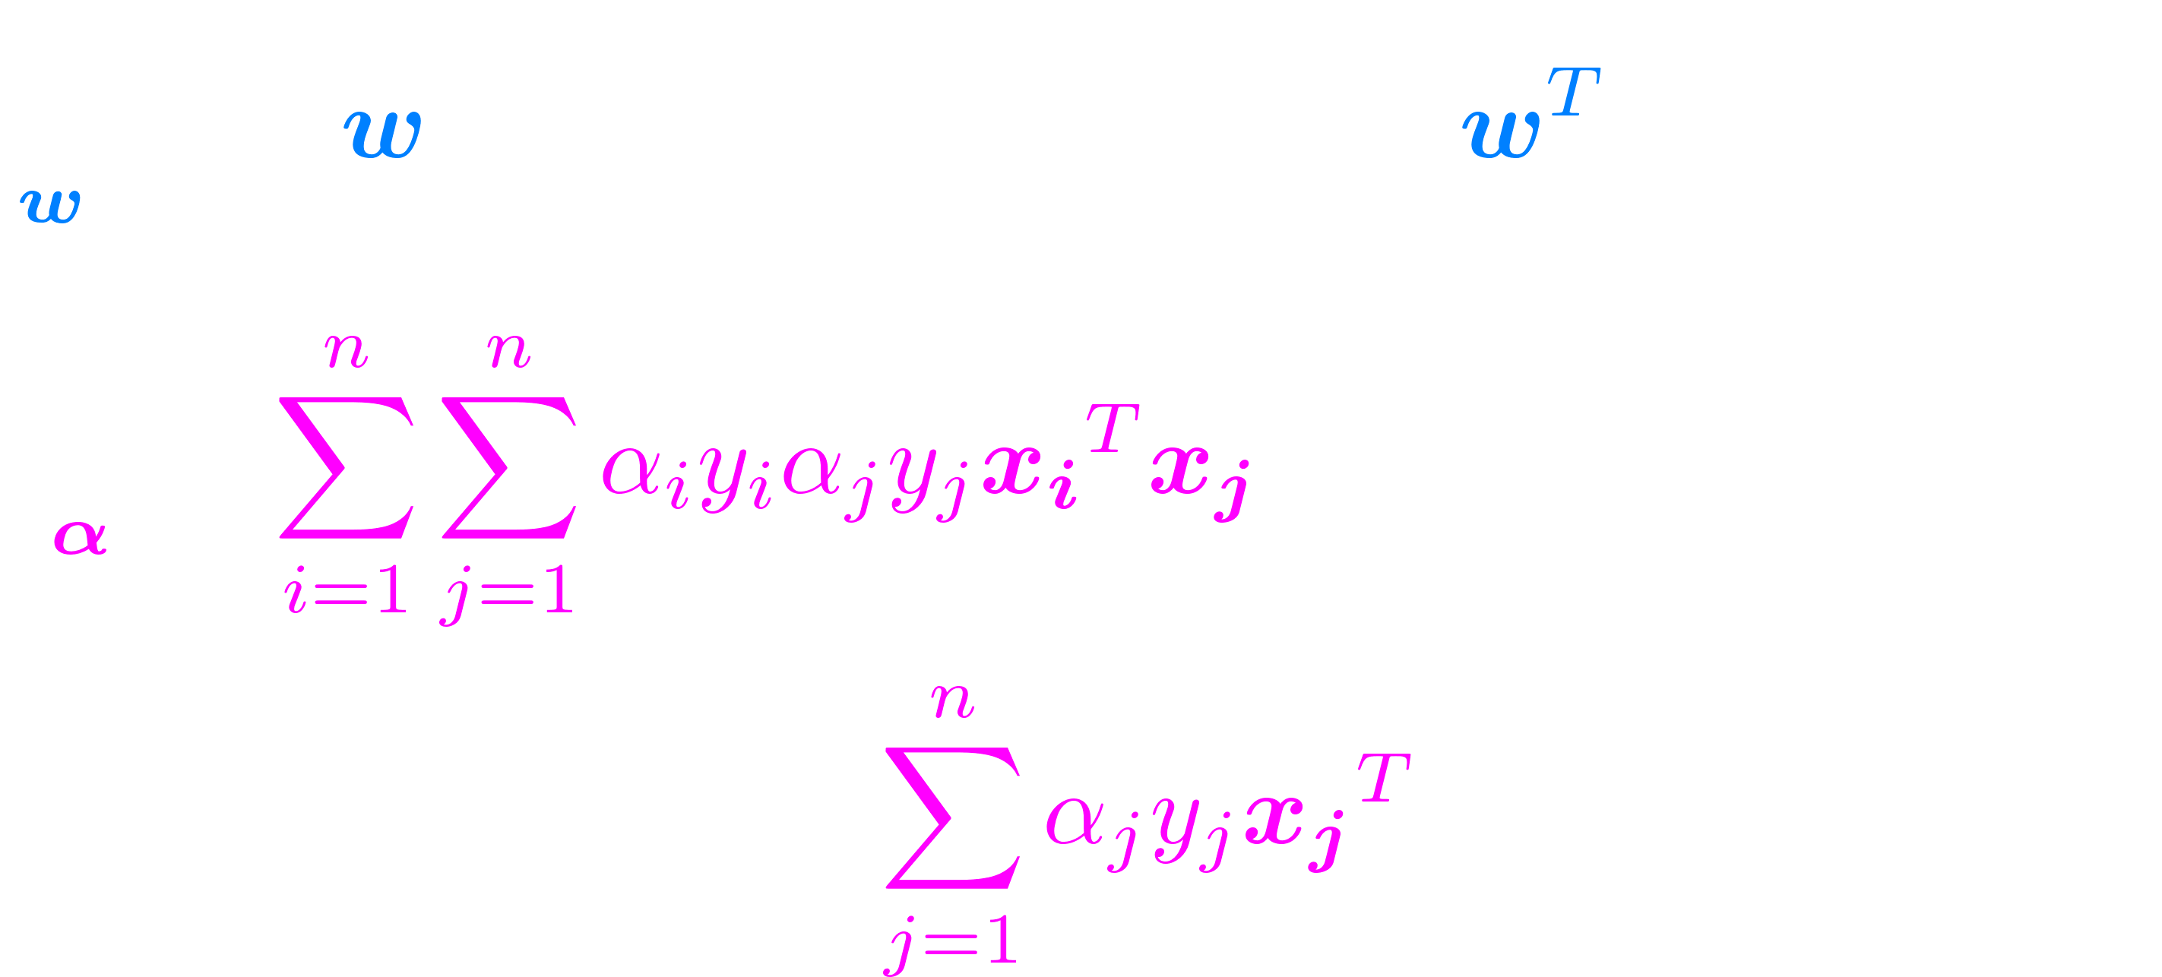
Support Vector Machines (SVMs) Primal with Kernels (Chapelle 06)

Slide 39


Support Vector Machines (SVMs) Primal with Kernels (Chapelle 06)

Slide 40

Support Vector Machines (SVMs) Primal with Kernels (Chapelle 06)

Slide 41



Popular Choices for Kernels
Polynomial (homogenous) kernel:
Polynomial (inhomogenous) kernel:
Gaussian Radial Basis Function (RBF) kernel:
Notes:
K_{ij}= ({\boldsymbol{x}_i}^T\boldsymbol{x}_j+c)^p

Slide 42
Multiclass ?
One-vs-One: trains classifiers, each one to classify between two classes and classify by majority.

Slide 43

Multiclass ?
One-vs-One: trains classifiers, each one to classify between two classes and classify by majority.
One-vs-All: train classifiers, each one to classify between one class and all other classes and classify by majority.

Slide 44
Multiclass ?
One-vs-One: trains classifiers, each one to classify between two classes and classify by majority.
One-vs-All: train classifiers, each one to classify between one class and all other classes and classify by majority.
Multiclass (Crammer and Singer): train one-vs-all classifiers jointly.

Slide 45
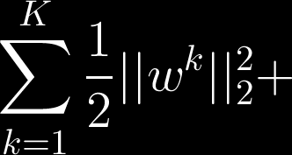
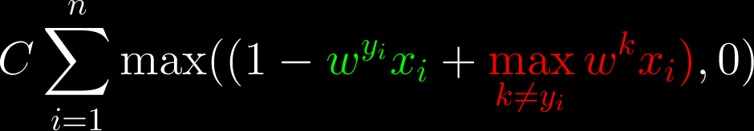
Multiclass (Crammer and Singer): train one-vs-all classifiers jointly.
Notes:
\sum_{k=1}^{K}\frac{1}{2}||w^k||^2_2 +
C \sum_{i=1}^n \max((1-
\color[rgb]{0,1,0}w^{y_i}x_i\color[rgb]{1,1,1}+
\color[rgb]{1,0,0}\max_{k \neq y_i}w^{k}x_i)\color[rgb]{1,1,1}
,0)

Slide 46
Multiclass (Crammer and Singer): train one-vs-all classifiers jointly.
Right class response
Notes:
\sum_{k=1}^{K}\frac{1}{2}||w^k||^2_2 +
C \sum_{i=1}^n \max((1-
\color[rgb]{0,1,0}w^{y_i}x_i\color[rgb]{1,1,1}+
\color[rgb]{1,0,0}\max_{k \neq y_i}w^{k}x_i)\color[rgb]{1,1,1}
,0)

Slide 47
Multiclass (Crammer and Singer): train one-vs-all classifiers jointly.
Wrong class that got the largest response
Notes:
\sum_{k=1}^{K}\frac{1}{2}||w^k||^2_2 +
C \sum_{i=1}^n \max((1-
\color[rgb]{0,1,0}w^{y_i}x_i\color[rgb]{1,1,1}+
\color[rgb]{1,0,0}\max_{k \neq y_i}w^{k}x_i)\color[rgb]{1,1,1}
,0)

Slide 48
Complex labels – Structured Prediction

Slide 49
How to choose C or sigma for Gaussian kernel or … ?

Slide 50
How to evaluate performance ?

Slide 51
Neural Nets = Deep Learning

