Slide 1
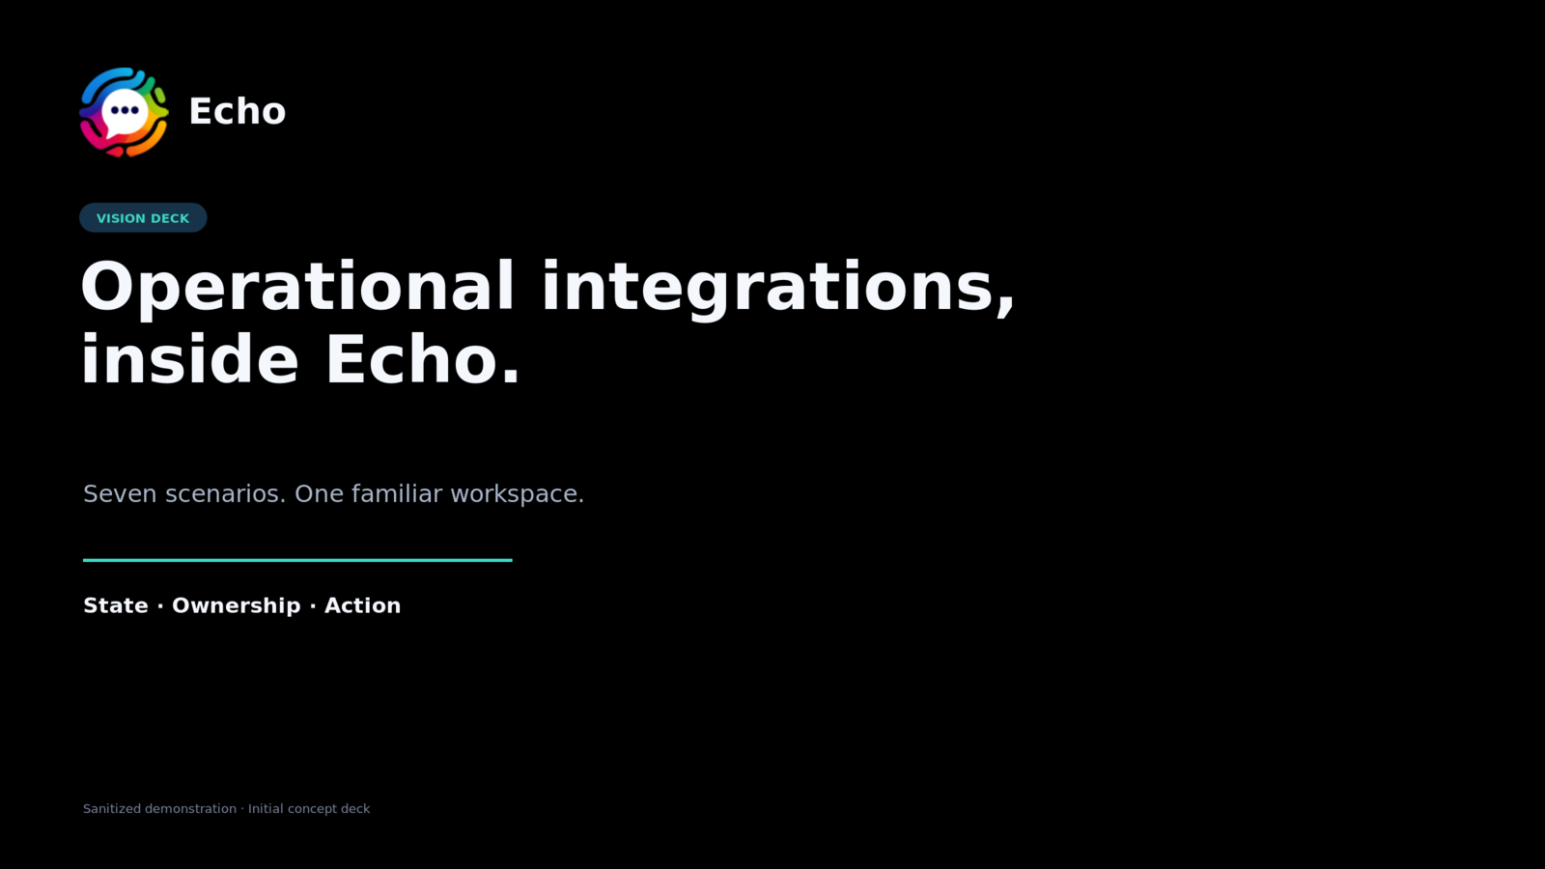
Notes:
Open with Echo as an operational collaboration layer, not merely another chat application.

Slide 2
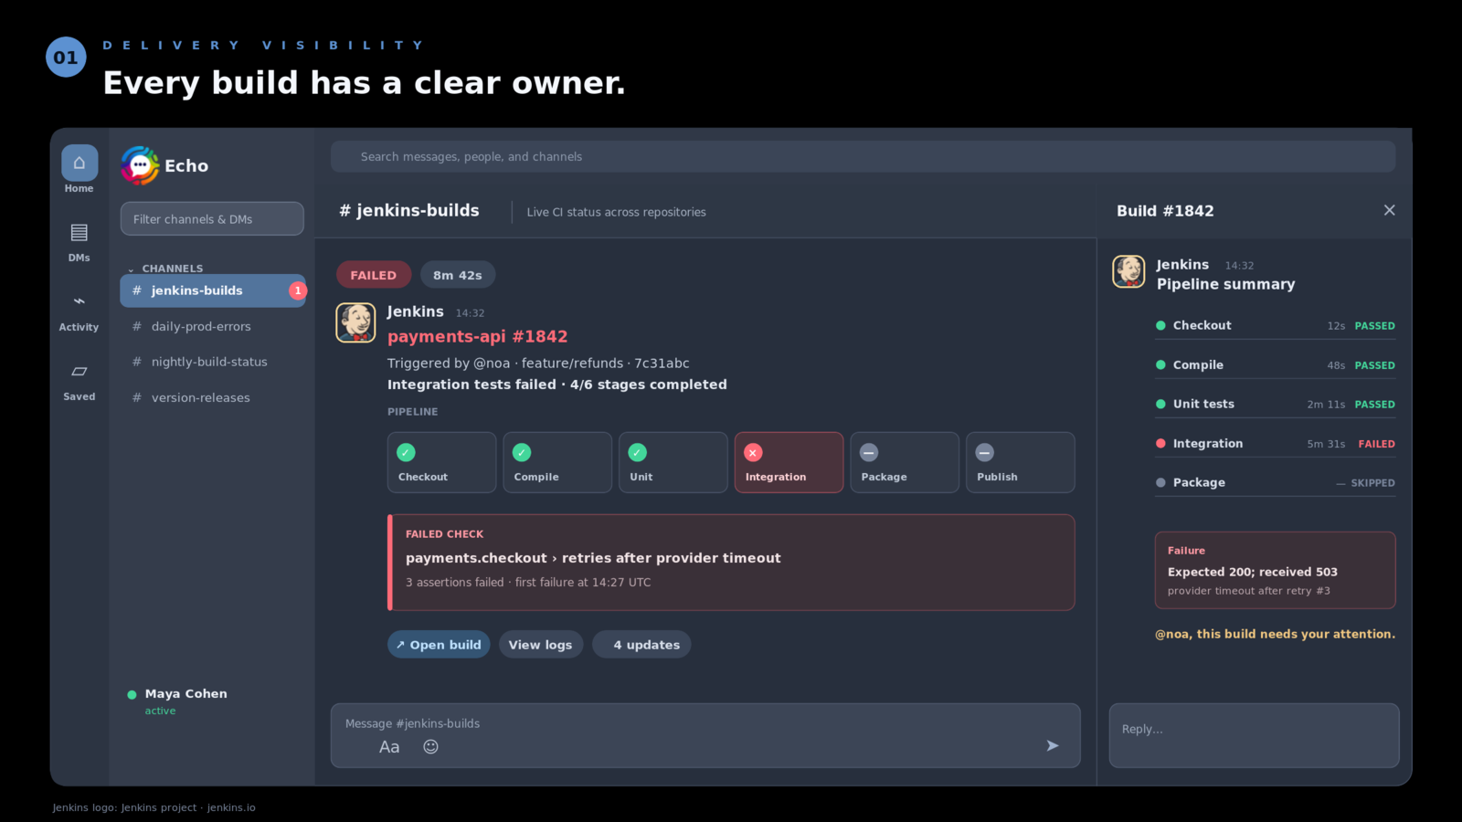
Notes:
One evolving message per build. Mention the trigger owner only when action is required.

Slide 3
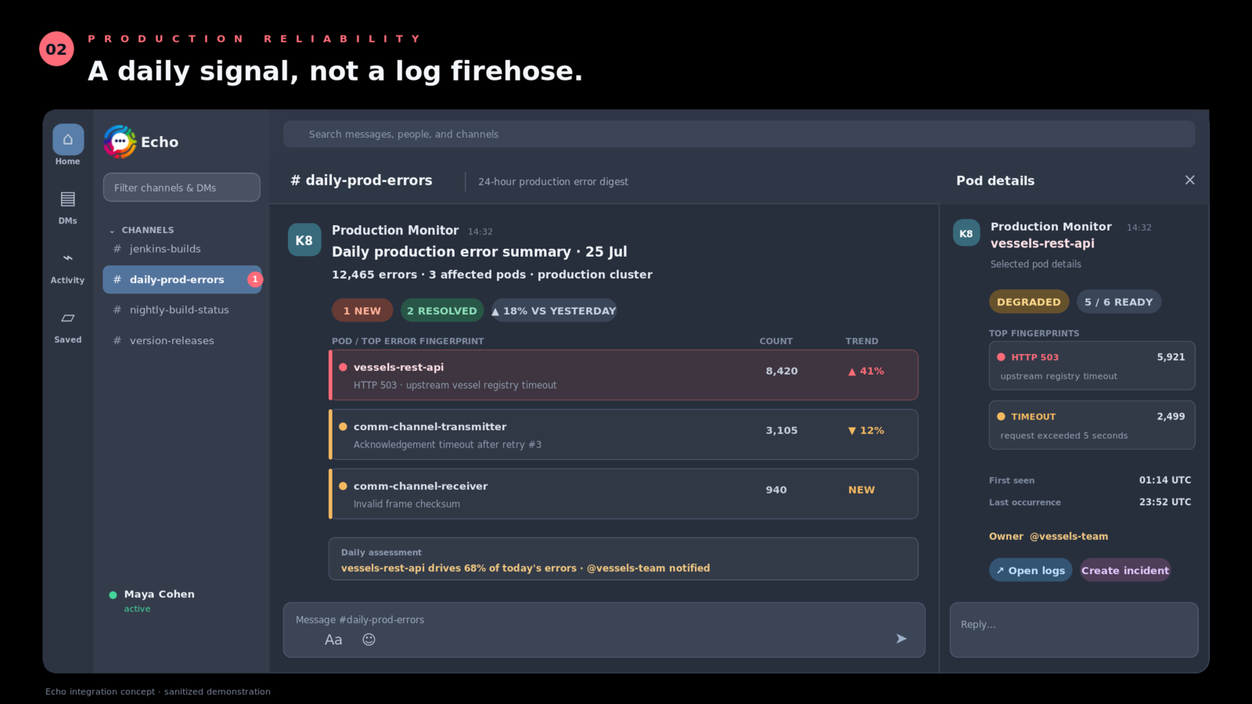
Notes:
Aggregate by stable workload and error fingerprint—not ephemeral pod name.

Slide 4
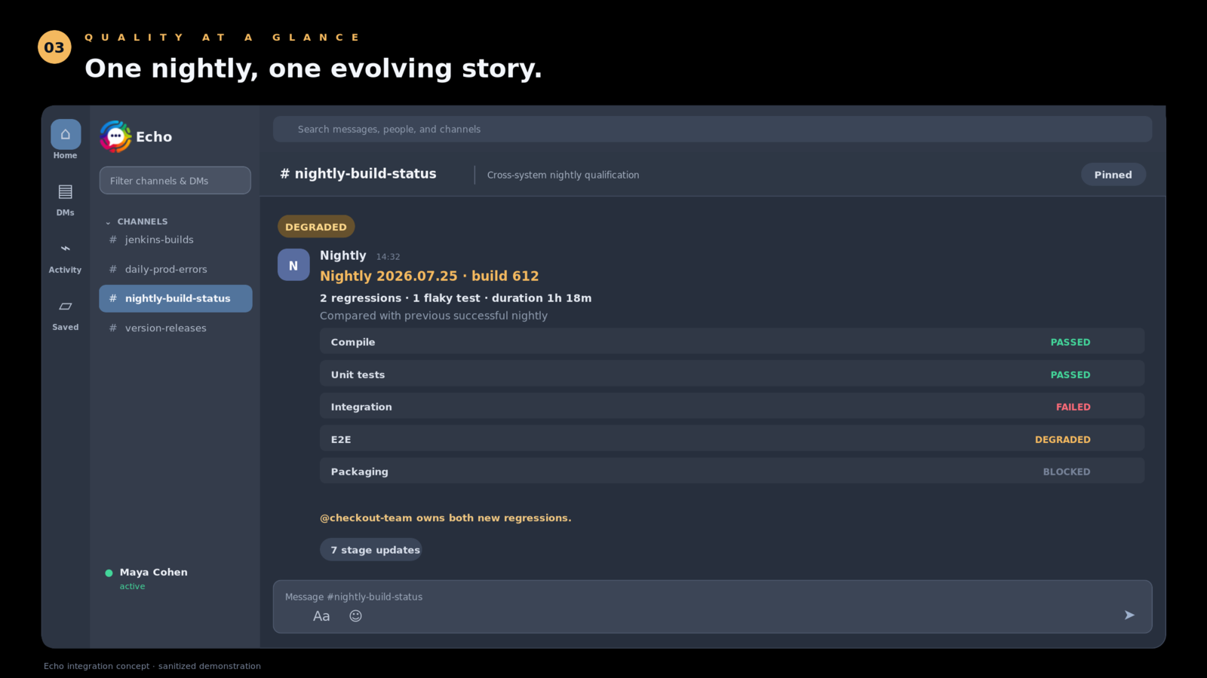
Notes:
The nightly is a cross-system qualification story, with regressions compared to the previous baseline.

Slide 5
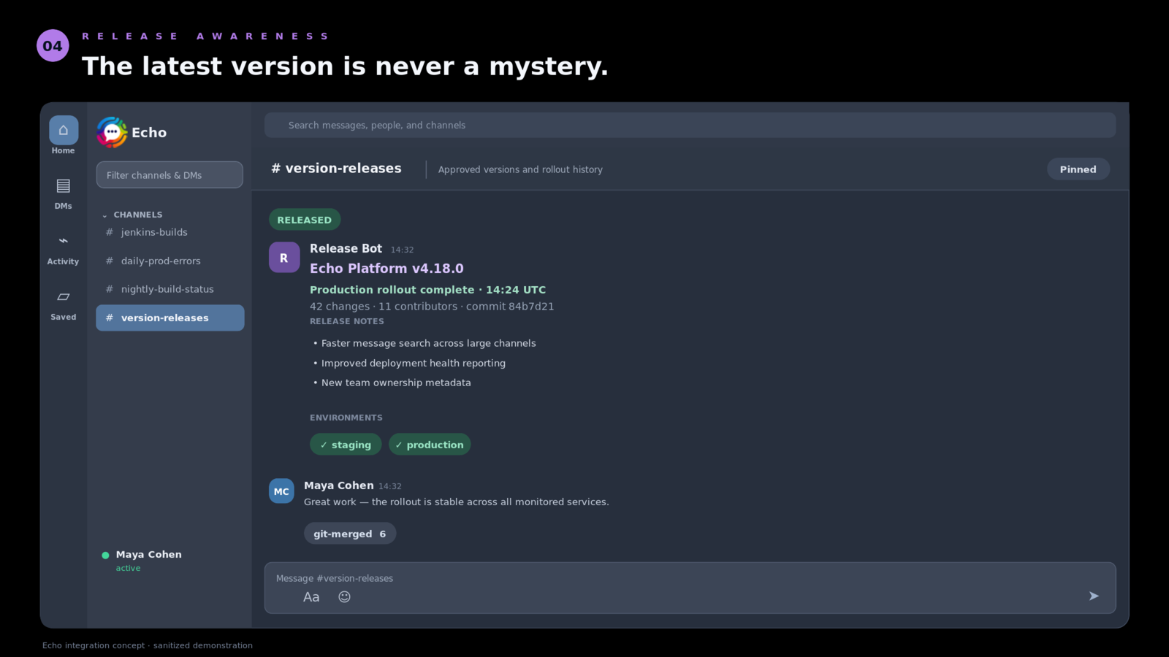
Notes:
Connect release notes to artifacts and environment rollout state.

Slide 6
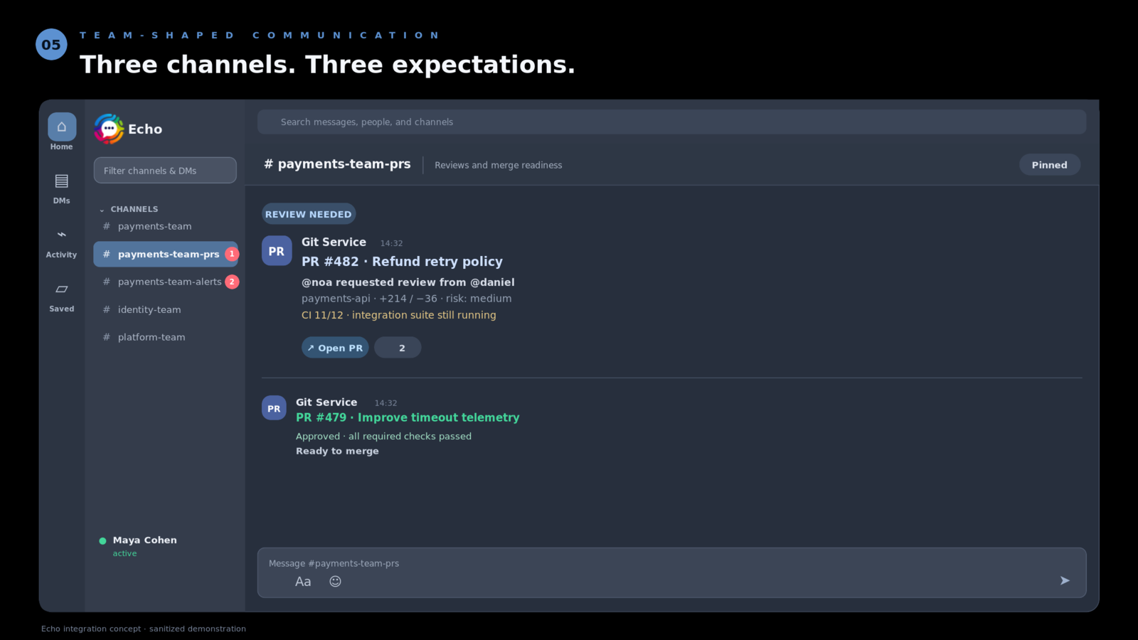
Notes:
Different channels carry different expectations: conversation, review, and action.

Slide 7
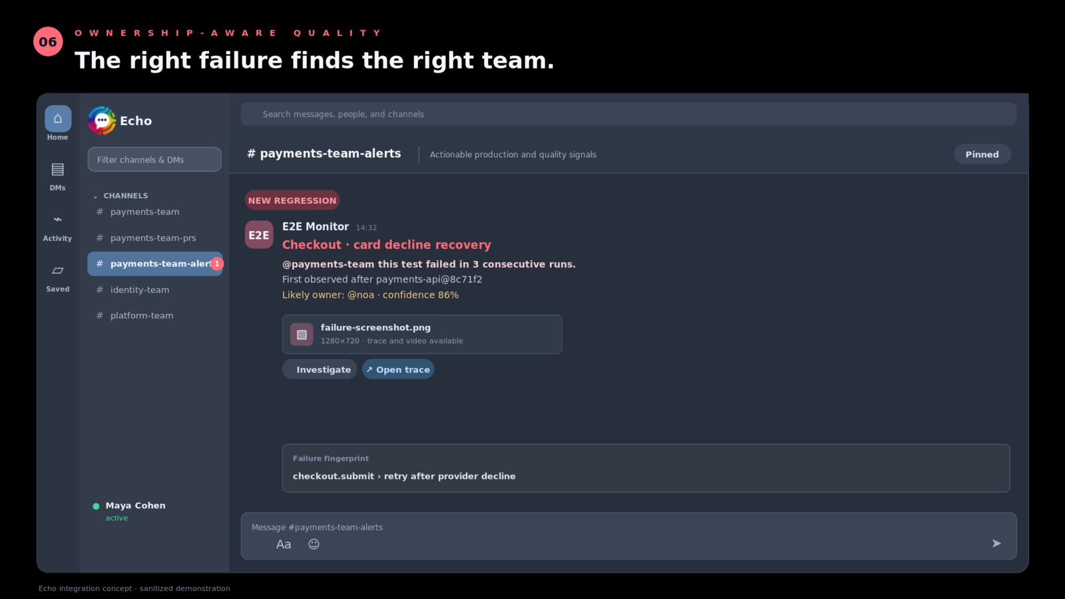
Notes:
Ownership metadata makes the routing layer reusable across every integration.

Slide 8
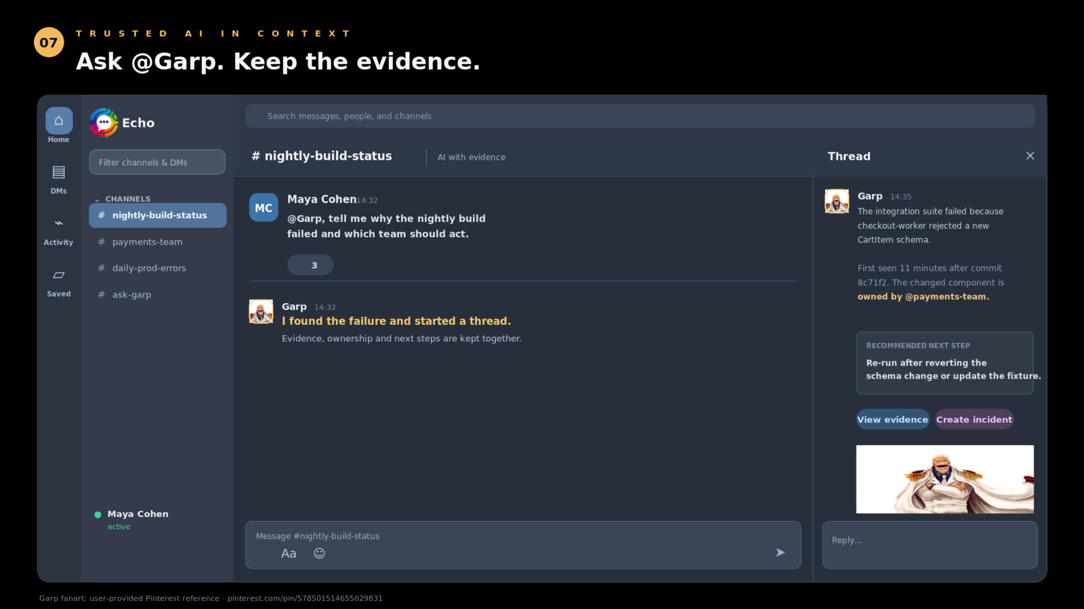
Notes:
Garp answers in a thread, cites evidence, and recommends next steps while preserving human judgment.

