Slide 1
Affect Synchrony
You are about to watch a short video clip, depicting a social interaction.
Affect synchrony is an important component of social interactions, measuring how much the participants are coordinated, or harmonious, in the type and intensity of the emotion they express.
Please rate with the slider the level of affect synchrony on a scale from “no affect synchrony at all” to “maximal affect synchrony”.
Next, we will present you few examples:
(press keyboard to continue)

Slide 2
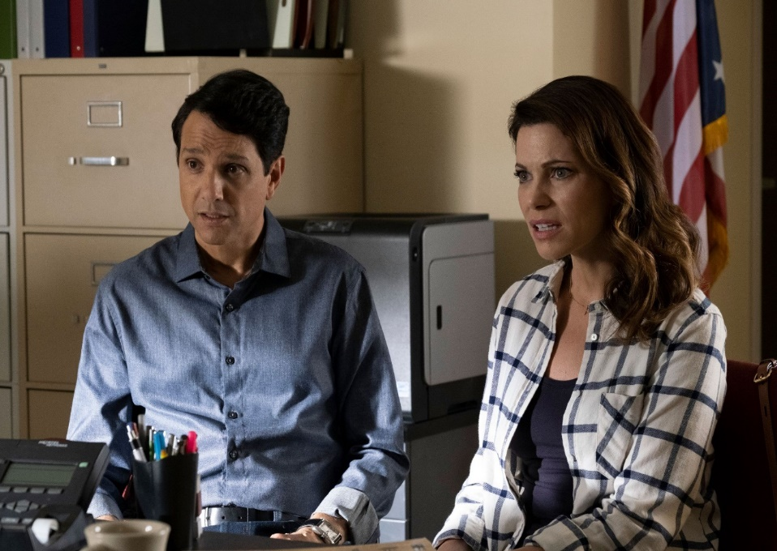
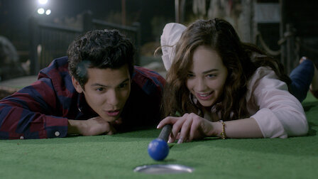
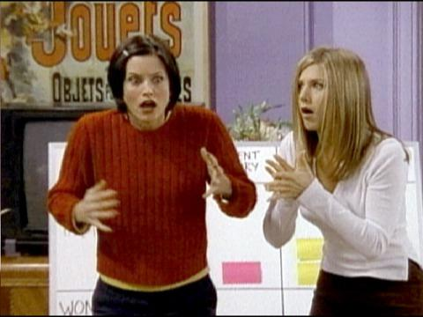
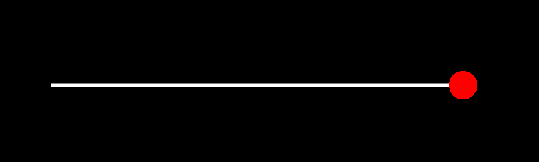
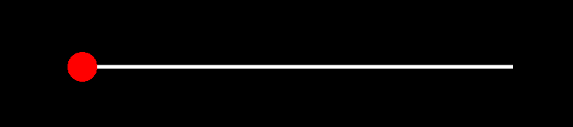
High level of affect synchrony may occur when both figures are coordinated and feel a similar emotion. Important! The emotion may be negative or positive.

Slide 3
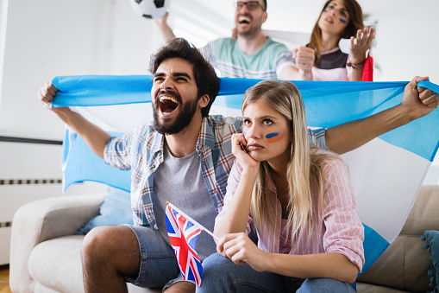
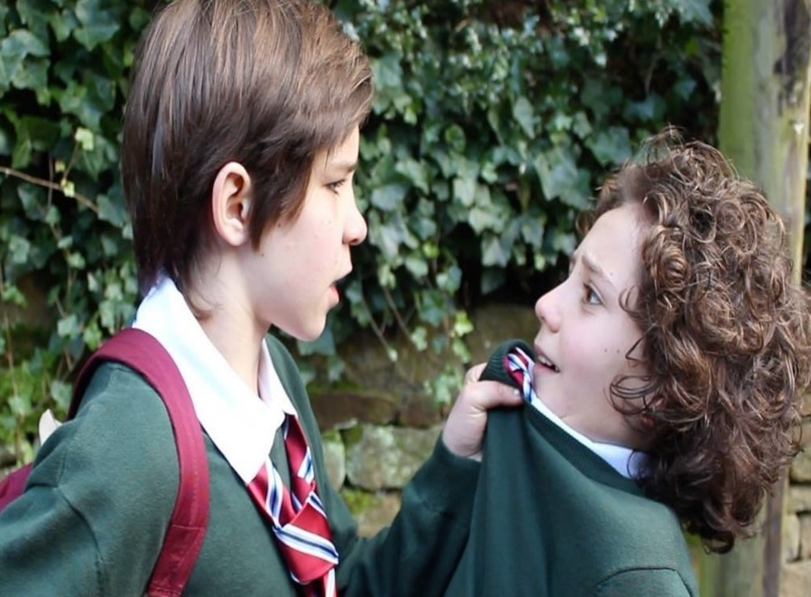
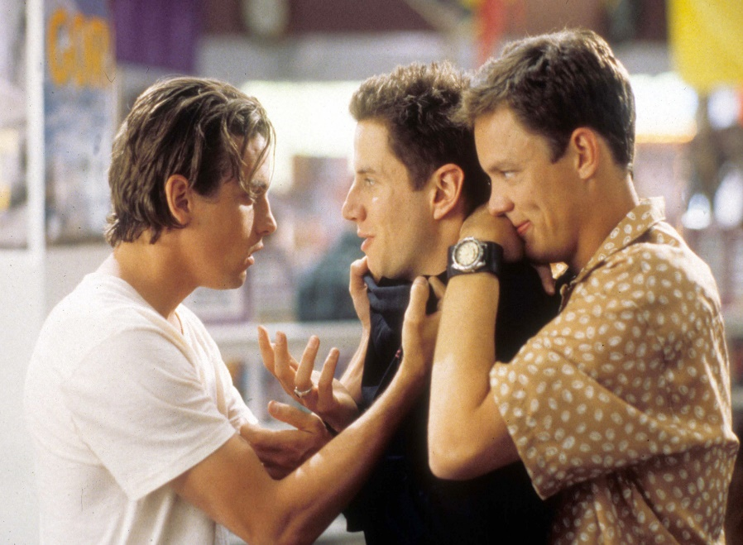
However, when there is a single figure on screen or when both figures are not coordinated and display different or opposite emotions, there is no affect synchrony at all.

Slide 4
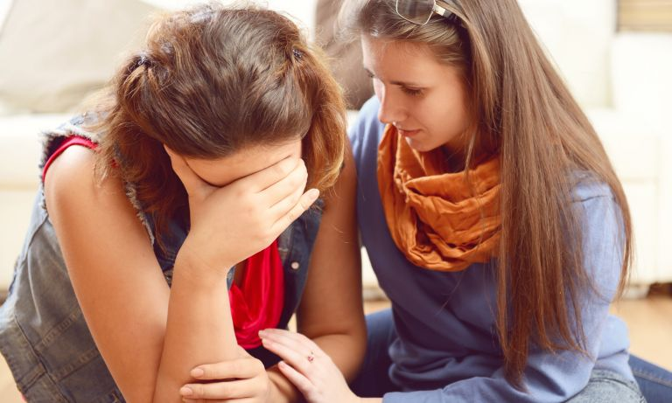
There are situations in which both figures feel similar (but not identical) emotions, or when one figure identifies with the other figure’s feelings

Slide 5
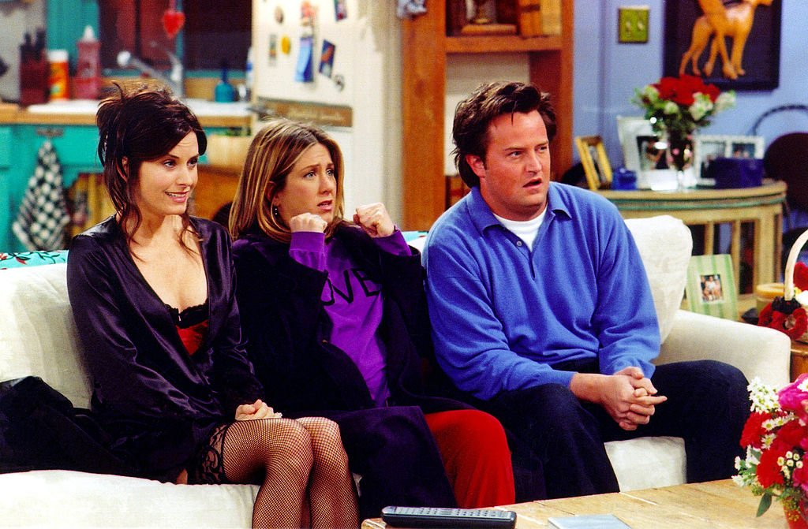

Or situations when each figure displays a different emotion

Slide 6
Please use the slider to freely rate the level of affect synchrony between the figures on the movies as you experience and understand for every single moment.
In case there are more than two figures on screen, rate the overall level of affect synchrony in the situation, as you understand it.
If there are no figures on screen, please move the slider to the left end (no synchrony at all)

