Slide 1
Gaze synchrony
You are about to watch a short video clip, depicting a social interaction.
Eye contact is an important component of social interactions.
Please rate with the slider the level of gaze synchrony on a scale from “no gaze synchrony at all” to “maximal gaze synchrony”.
Next, we will present you few examples:
(press keyboard to continue)

Slide 2
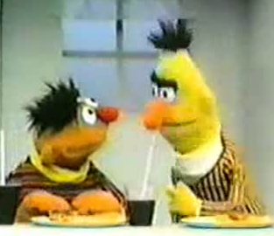
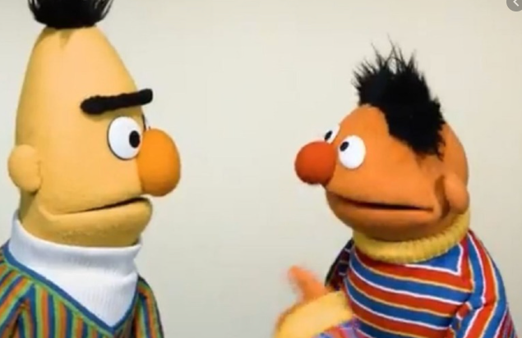
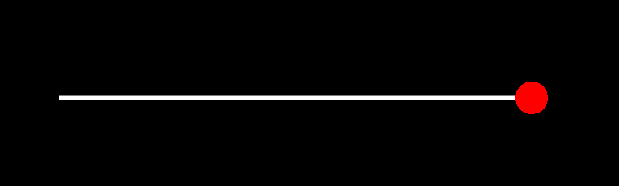
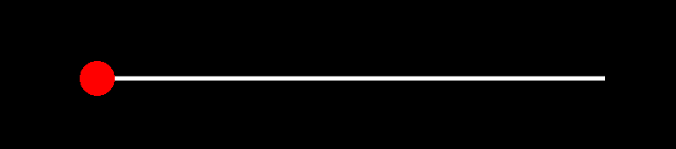
High level of gaze synchrony may be a direct eye contact between the figures (for example, figure A gaze directly at figure B, which simultaneously, gazes directly at figure A)

Slide 3
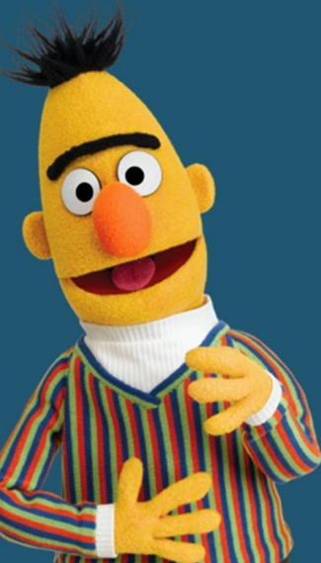
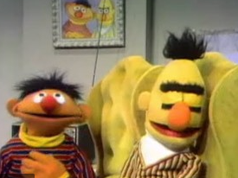
However, when there is a single figure on screen, or when both figures are gazing at opposite directions and there is no eye contact, there is no gaze synchrony at all.

Slide 4
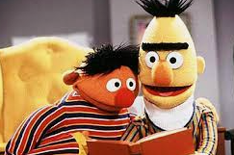
In some situations, both figures gaze at the same object simultaneously

Slide 5
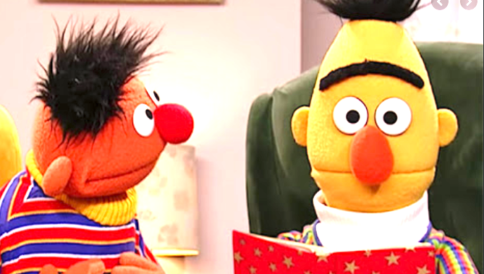
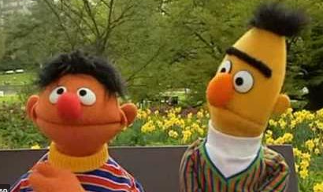
Or figure A gazes directly at figure B, but figure B averts and avoids eye contact

Slide 6
Please rate freely using the slider the level of gaze synchrony between the figures in the video clip, as you experience and understand it for every single moment.
If there are more than two figures, please rate the overall gaze synchrony level as you understand it.
If there are no figures shown, move the slider to the left (no synchrony).

