Slide 1
Physical proximity synchrony
You are about to watch a short video clip, depicting a social interaction.
Physical proximity is composed of touch, body position and physical distance, which are important components of social interactions.
Please rate with the slider the level of physical proximity on a scale from “no physical proximity synchrony at all” to “maximal physical proximity synchrony”.
Next, we will present you few examples:
(press keyboard to continue)

Slide 2
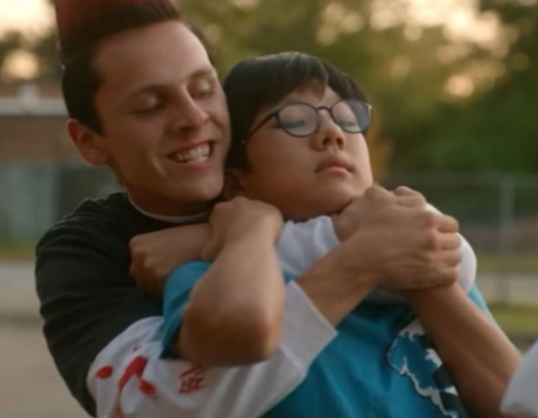
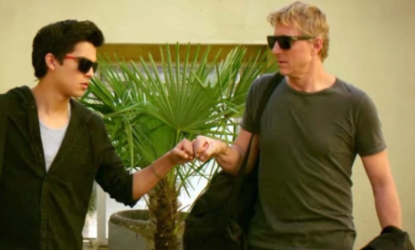
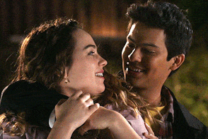
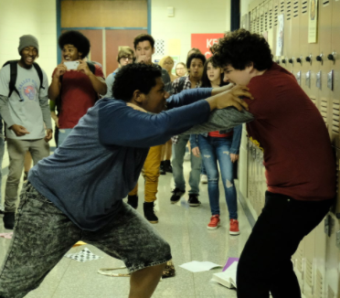

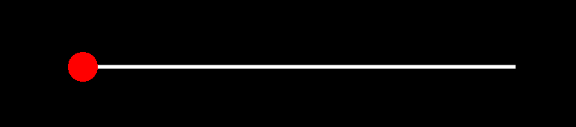
High physical proximity synchrony may occur when both figure A and figure B actively preform an action of getting closer, or actively touching each other simultaneously.
Physical proximity may occur in a positive context (i.e. a hug) or in a negative context (i.e. wrestling).

Slide 3
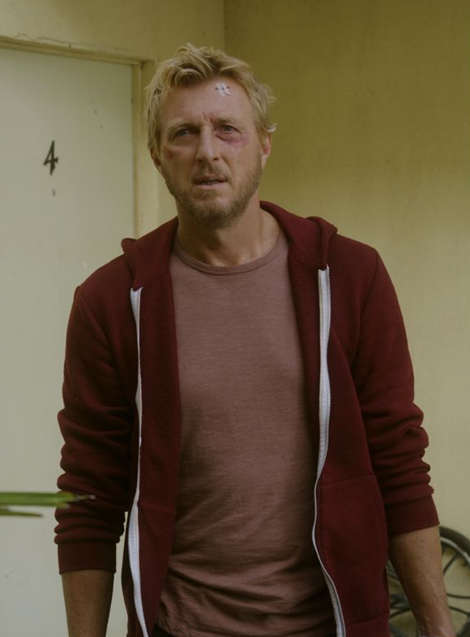
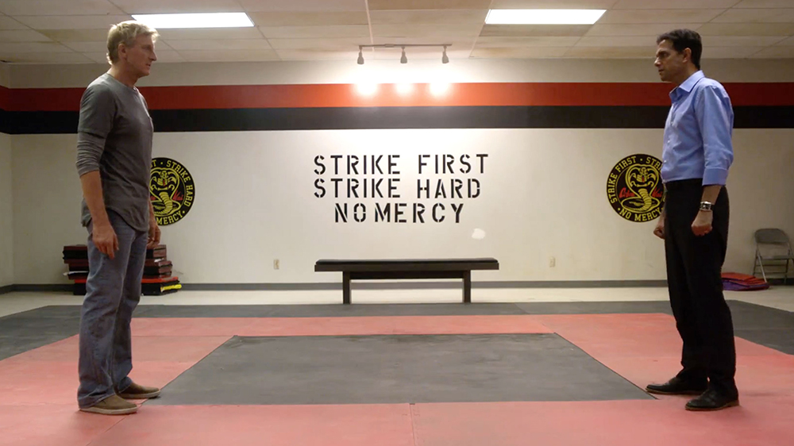
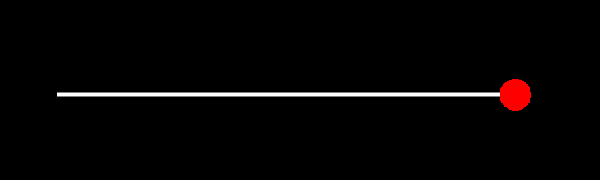
However, when there is a single figure on screen or when the figures do not touch each other or when they are far away from each other – there is no physical proximity synchrony at all

Slide 4
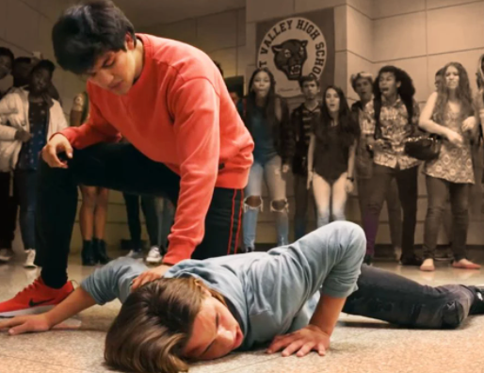
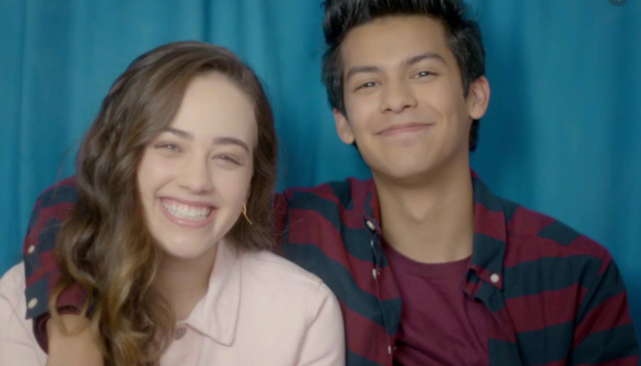

There are situations, in which one figure actively initiates touch, while the other figure is passive. For example, figure A is touching figure B, but figure B does not reach out for figure A.

Slide 5


In some cases, there is no direct contact between the figures, sometimes they lean towards each other, or change the physical distance between them

Slide 6
Please rate freely using the slider the level of physical proximity synchrony between the figures in the video clip, as you experience and understand it for every single moment.
If there are more than two figures, please rate the overall physical proximity synchrony level as you understand it.
If there are no figures displayed on the screen, please move the slider to the left (no synchrony at all).

