Slide 1
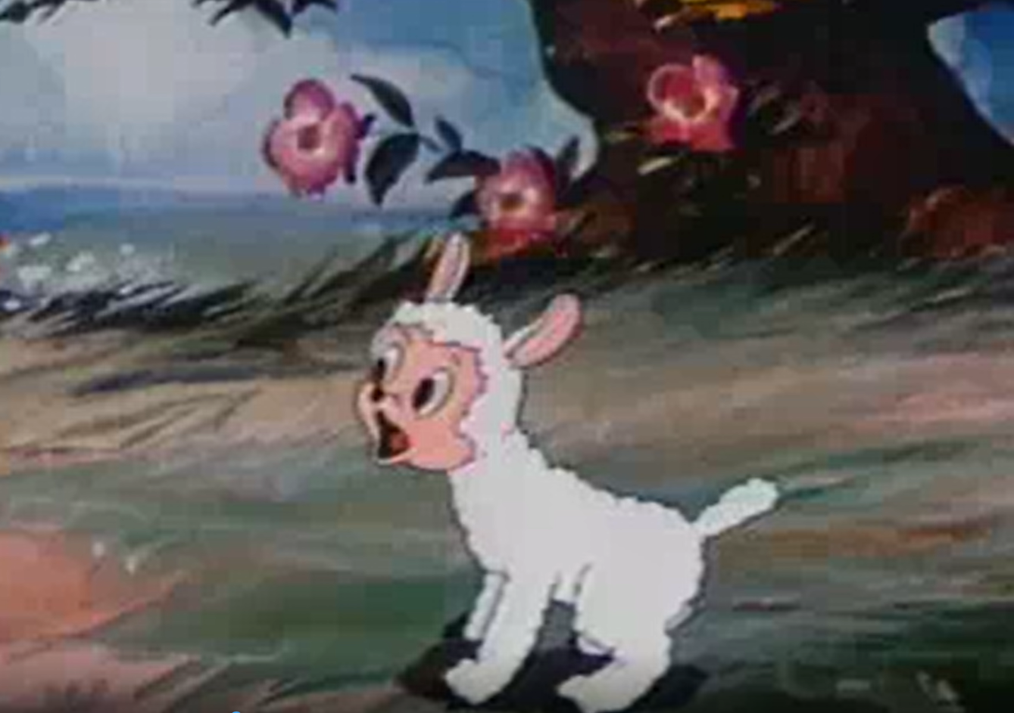
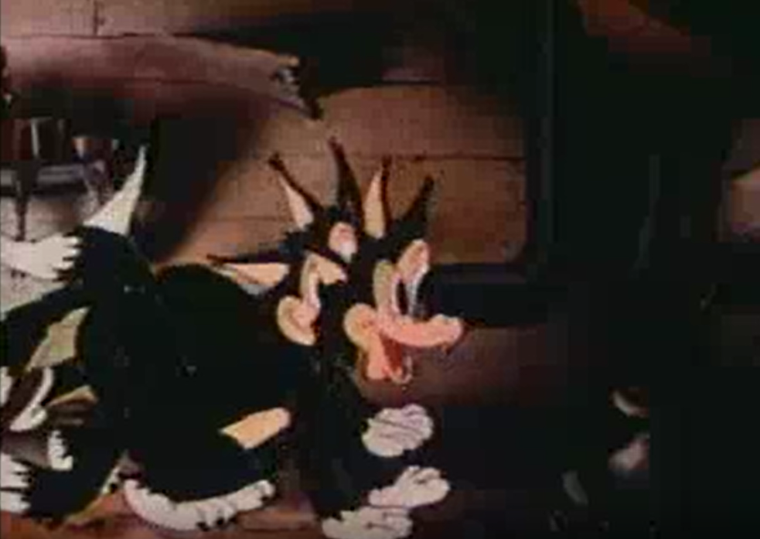


Now you will practice using the slider, while watching a video clip.
You will be presented with a short cartoon. Please move the slider (using the computer mouse) to the right when you see a wolf or to the left when you see a sheep.
If there are no wolves or sheep on screen, move the slider to the middle.
(press keyboard to continue)
Sheep
Wolf
Sheep
Wolf

Slide 2
Next, you will see another short video clip. Move the slider to the right end, whenever you hear speech.
Speech

Slide 3
Next, after you’ve practiced using the slider, we will instruct you regarding the movie rating task

Slide 4
Please check your speakers and try again!

