Slide 1

Book Recommendation System
Submitted by-
Supervised by- Assan

Slide 2

Summary
First idea
Data for the project
Data handling
Recommendation algorithms
Project structure

Slide 3



First Idea
Lots of books recommendations applications available…
But what if we want :
French site,
Lots of international referenced books (paper and electronic)
To give my opinion
To export my personal created library
To have personal recommendations…
…there is only one application -Babelio

Slide 4

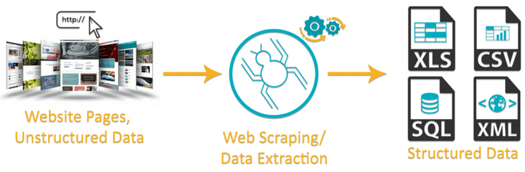
First Idea ...Is there some database ???
If we want :
…it remains only one solution- Web Scrapping, ETL
Of course… not free !
Amazon, Good Reads…do not share their API anymore.
Partial on some data science web site
Notes:
The difficulty is to found data base with users ratings provided.

Slide 5
Data for the Project
Books Dataset:
Book Crossing- approx. 300k books data
Good Books- approx. 10k books data
Books attribute in dataset:
ISBN
Book-Title
Book-Author
Year-Of-Publication
Publisher
Image-URL

Slide 6
Data for the Project
Books Dataset:
Book Crossing- approx. 300k books data
Good Books- approx. 10k books data
Books attribute in dataset:
ISBN
Book-Title
Book-Author
Year-Of-Publication
Publisher
Image-URL

Slide 7
Additional Features on Book Data
Scrapped the below book details using Google books API and Good Reads for the book dataset we have:
ISBN_13
Category
Book_Description
Book_Language
Number_Of_Pages
Author_Genres
Books_In_Series
Average_Rating
Awards
Notes:
The following columns were already existing :
ISBN / Book-Title / Book-Author / Year-Of-Publication / Publisher / Image-URL-S / Image-URL-M / Image-URL-L
All those information have been saved in a csv file.

Slide 8
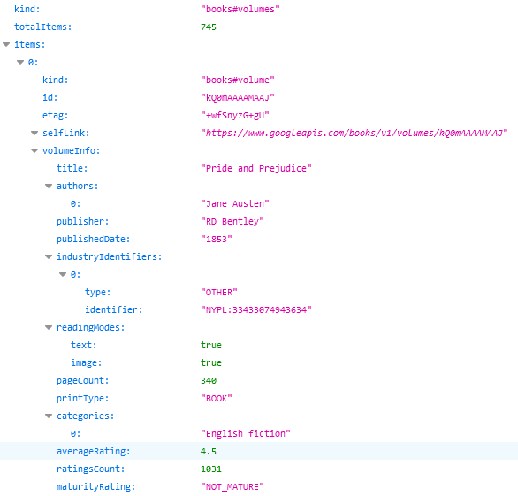
Google books
Easy way to access to book's information thanks to public API
But…
Not always reliable
Some information are not available
Search results with the title are always prolific
Notes:
2 methods have been used => a json file is returned
https://www.googleapis.com/books/v1/volumes?q=isbn:055321215X
https://www.googleapis.com/books/v1/volumes?q=title:Beloved%20(Plume%20Contemporary%20Fiction)
Some issues
Not reliable : for ex the language information
Not available : for ex the author gender
Search with title => lots of books description sheets results, but sometimes none of them are even related to the title !
=> solved by an additional comp of author in the 1st obtained books

Slide 9
Good Reads
Information directly parsed from multiple web pages
2 Python libraries used :
urlopen from urllib.request
BeautifulSoup from bs4
Example :
book's gender
⇔
key words "actionLinkLite bookPageGenreLink“
But…
No available API
Regular jumps on web pages
Links for series were specific
if (soup.find("a", class_="actionLinkLite bookPageGenreLink")):
catSearched = soup.find_all("a", class_="actionLinkLite bookPageGenreLink")[0].text
Notes:
Database on Kaggle came from Good Reads web site (author gender…)
=> So we have performed scraping on Good Reads web site
urlopen from urllib.request (mainly to save web page during our tests session)
Some information like the author gender are localized on another web page whose link was in the current books description sheets.
When current book was part of a serie, there were URL links towards other books of the same series. But those links were specific format for Good Reads, and not directly usable.

Slide 10
Final solution
Both web sites used :
1st search with ISBN on Google Books
=> ISBN found : complementary search on Good Reads
=> Else : search with ISBN on Good Reads
=> ISBN found : finished
=> Else : search with title and author on Good Reads
AWS :
The scraping was very long => Ubuntu EC2 instance opened
Anaconda installed (use of jupyter notebooks)
GitHub services (use of scripts and files from our project GitHub)
Byobu (continuous scraping)
sftp connection (scraped information from remote computer to our PC)
Notes:
Google books : limitation on performedrequests’ nb : not too many requests had to be made in a short time.
=> Then it would have disabled our PCs for too long time.

Slide 11
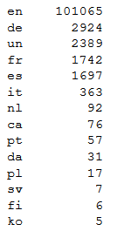
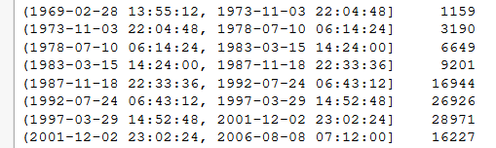
First Statistics
On the scraped version of Book Crossing data base, some data analysis have been performed and observed such as:
Language :
Mainly English books :
Years of publication :
Lots of books published between 1983 and 2006 :

Slide 12

Continued…
Publication between 1983 and 2006
English books
Max number of awards for a same book : 27 !!!
2033 kinds of awards
5 010 book's categories (lots of fiction…)
Notes:
Google books : limitation on performedrequests’ nb : not too many requests had to be made in a short time.
=> Then it would have disabled our PCs for too long time.

Slide 13
Data handling
Data Extracted
Data Profiling
Data Cleaning
Filled the missing value through scrapping
Merging the dataset of bookcrossing and good books.
Notes:
All following cleaning :
applied on Book Crossing + Good Books database
+ concatenation of both cleanings
saved in another csv file

Slide 14
Continued…
ISBN
Language
Removing of "\n"
Coding ISO 639
Unexpected words
(ex. "Catalan; Valencian“ => ca)
Awards
Split according to "," (list of awards)
Split according to "(“ (keep only name)
Keep only 1 award name per book (most famous awards)
Notes:
Error of handing (ISBN) :
During the various file manipulations : through excel, which transform all the isbn_13 in string ending with '+12' or '+11’.
isbn_13 value has then been lost.
For those books, the isbn_13 has been removed to 0.0.
It remains 613 kind of awards.

Slide 15
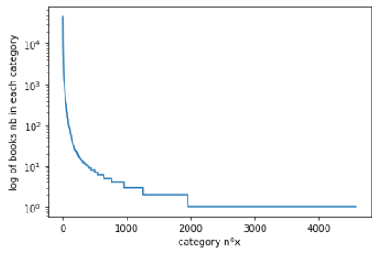
Continued…
Category / Author gender
First cleaning :
Several words, separated by "&", "(…)" or ",". (2nd column created)
Stemming operation (PorterStemmer)
Number of categories reduction :
Keep only the first 1953 categories… but only two books inside !
The first 403 categories have at least 10 books inside
Notes:
Considered together for the cleaning : quite the same information
Stemming algorithms work by cutting off the end or the beginning of the word, taking into account a list of common prefixes and suffixes that can be found in an inflected word.
=> For a search, we want to find also for the other possible forms of the words we used
To keep 95% of the most important categories, we should keep the 3989 first categories (on 5010).

Slide 16
Category / Author gender (2/2)
First cleaning :
Several words, separated by "&", "(…)" or ",". (2nd column created)
Stemming operation (PorterStemmer)
Number of categories reduction :
Keep only the first 1 953 categories… but only two books inside !
The first 403 categories have at least 10 books inside

Slide 17
Word Embedding

Slide 18
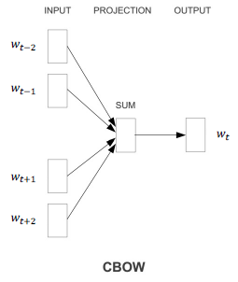
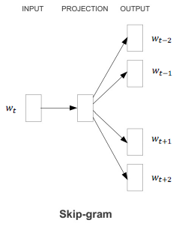
Word Embedding
CBOW (Word2Vec) :
Skip-gram
Created all the possible contexts with 2 words before and after the target word
Trained a simple network: embedding + 2 linear layers
It's the invers, from a word, it will output a possible context
Notes:
This algorithm uses a shallow neural network to learn word vectors so that each word of a given corpus is good at predicting its own contexts (Skip-Gram) or vice versa (CBOW) :
Remark : Gensim library propose a more generic implementation, without specifying any target words.

Slide 19
Continued…
For example, we can retrieve words that have :
-semantic relations such as Country-Capital :
vector(Paris) — vector(France) + vector(Morocco) ~ vector(Rabat)
-syntactic relationships such as the Singular-Plural:
vector(Kings) - vector(King) + vector(Person) ~ vector(People)
Notes:
Empirical results using these methods seem to show that this approach is successful at learning the meaning of words. In fact, the resulting embedding space seems to have directions of semantic and syntactic meaning that can be exposed through simple operations on word vectors.

Slide 20
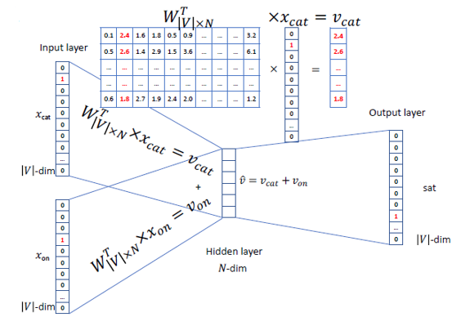
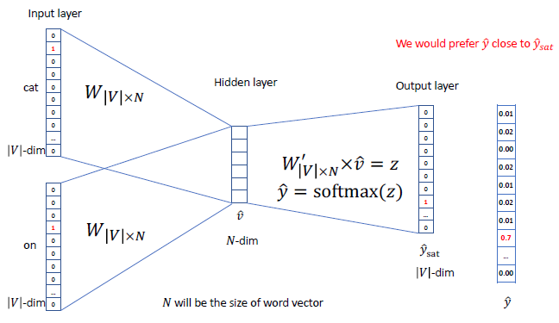
Model
Training of this model :
The matrix W is learned by the network: each columns represents a word embedding :
Prediction:
Then the predicted word is calculated :

Slide 21
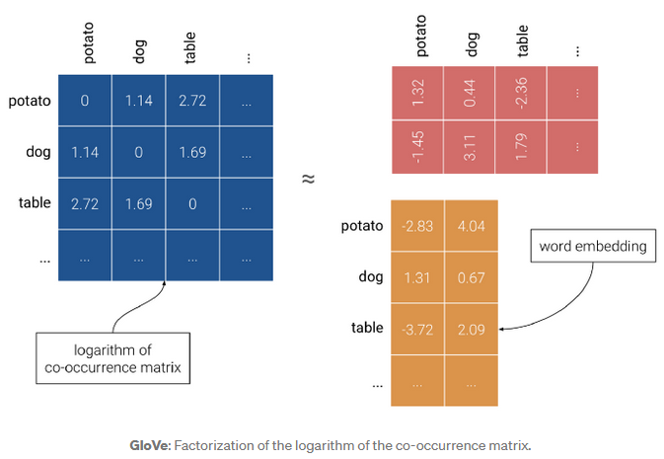

GloVe: Global Vectors
We can discover relationships between words by looking at ratios of these probabilities. For instance, by computing the following ration for lots of words j :
We can interpret this as GloVe implicitly factorizing the logarithm of the co-occurrence matrix X.

Slide 22
Sentence Embedding
Doc2Vec:
Sentence embedding techniques represent entire sentences and their semantic information as vectors.
This helps the machine in understanding the context, intention, and other nuances in the entire text.
It is an unsupervised algorithm and adds on to the Word2Vec model by introducing another ‘paragraph vector’.
Also, there are 2 ways to add the paragraph vector to the model.
PVDM (Distributed Memory version of Paragraph Vector)
PVDOBW (Distributed Bag of Words version of Paragraph Vector)
Notes:
PVDM (Distributed Memory version of Paragraph Vector) :
It is an extension of the Continuous Bag-of-Word type of Word2Vec : the model learns to predict a center word based on the context.
Similarly, in PV-DM, the central idea is : paragraph vectors are obtained by training a neural network on the task of predicting a probability distribution of words in a paragraph given a randomly-sampled word from the paragraph.
On the following matrix D has embeddings for paragraphs :

Slide 23
Sentence-BERT
At the heart of this BERT-based model, there are 4 key concepts:
Attention
Transformers
BERT
Siamese Network

