Slide 1
Books’ recommendation
Carine THEROND
Asif SIDDIQUE
Ariel NATAF (abandoned the project along the way)

Slide 2

Summary
First idea
Data for the project
Data handling
Recommendation algorithms
Project structure

Slide 3


First idea Lots of books recommendations applications, but…
If we want :
French site,
Lots of international referenced books (paper and electronic)
To give our opinion
To export our personal created library
To have personal recommendations…
…there only one site left…

Slide 4

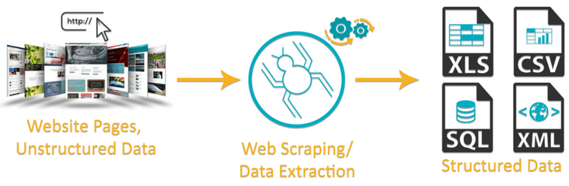
First idea Is there some database ???
There are some :
Of course… not free !
Amazon, Good Reads…do not share anymore their API !
Partial on some data science web site
…it remains only one solution…
Notes:
The difficulty is to found data base with :
users information
ratings provided

Slide 5
Data for the project
Context

Slide 6
300 000 books on Book Crossing ⇒ 1/3 completed
10 000 books on Good Books ⇒ completed
Raw data
isbn_13 / OtherID
Category
book_description
book_language
number_of_pages
author_genres
books_in_series
average_rating
awards
Additional fields
Notes:
Book Crossing
ISBN / Book-Title / Book-Author / Year-Of-Publication / Publisher / Image-URL
ratings / users (with age and location)
10 000 Good Books
Book_id / Goodreads_book_id / ISBN / Authors / Original_publication_year / Original_title / Title / Langage_code / Average_rating / Ratings_count / Image_URL
- ratings.csv / book_tags.csv / Wich list
All those information have been saved in a csv file.

Slide 7
Data for the project
Scraping

Slide 8
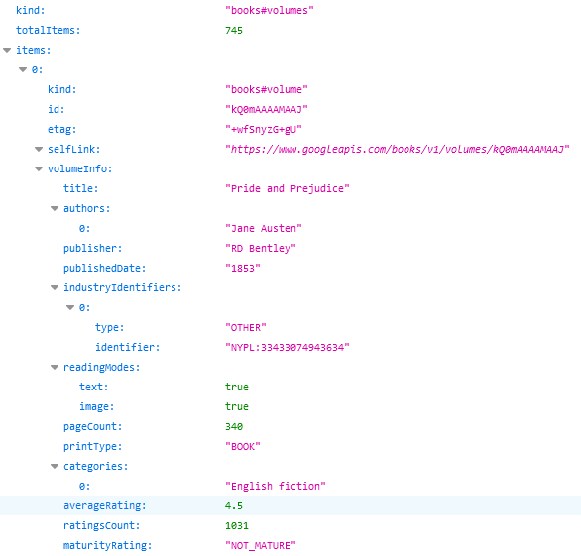
Easy way to access to book's information thanks to public API
Google books
But…
Not always reliable
Some information are not available
Search results with the title are always prolific
Notes:
2 methods have been used => a json file is returned
https://www.googleapis.com/books/v1/volumes?q=isbn:055321215X
https://www.googleapis.com/books/v1/volumes?q=title:Beloved%20(Plume%20Contemporary%20Fiction)
Some issues
Not reliable : for ex the language information
Not available : for ex the author gender
Search with title => lots of books description sheets results, but sometimes none of them are even related to the title !
=> solved by an additional comp of author in the 1st obtained books

Slide 9
Information directly parsed from multiple web pages
Good Reads
2 Python libraries used :
urlopen from urllib.request
BeautifulSoup from bs4
Example :
book's gender
⇔
key words "actionLinkLite bookPageGenreLink“
But…
No available API
Regular jumps on web pages
Links for series were specific
if (soup.find("a", class_="actionLinkLite bookPageGenreLink")):
catSearched = soup.find_all("a", class_="actionLinkLite bookPageGenreLink")[0].text
Notes:
Database on Kaggle came from Good Reads web site (author gender…)
=> So we have performed scraping on Good Reads web site
urlopen from urllib.request (mainly to save web page during our tests session)
Some information like the author gender are localized on another web page whose link was in the current books description sheets.
When current book was part of a serie, there were URL links towards other books of the same series. But those links were specific format for Good Reads, and not directly usable.

Slide 10
Final solution
Both web sites used :
1st search with ISBN on Google Books
=> ISBN found : complementary search on Good Reads
=> Else : search with ISBN on Good Reads
=> ISBN found : finished
=> Else : search with title and author on Good Reads
AWS :
The scraping was very long => Ubuntu EC2 instance opened
Anaconda installed (use of jupyter notebooks)
GitHub services (use of scripts and files from our project GitHub)
Byobu (continuous scraping)
sftp connection (scraped information from remote computer to our PC)
Notes:
Google books : limitation on performed requests’ nb : not too many requests had to be made in a short time.
=> Then it would have disabled our PCs for too long time.

Slide 11
Data for the project
First Statistics

Slide 12

Mainly…
Publication between 1983 and 2006
English books
Max number of awards for a same book : 27 !!!
2 033 kind’s of awards
5 010 book's categories (lots of fiction…)

Slide 13
Data handling
Cleaning
Notes:
All following cleaning :
applied on Book Crossing + Good Books database
+ concatenation of both cleanings
saved in another csv file

Slide 14
ISBN
Language
Removing of "\n"
Coding ISO 639
Unexpected words
(ex. "Catalan; Valencian“ => ca)
Awards
Split according to "," (list of awards)
Split according to "(“ (keep only name)
Keep only 1 award name per book (most famous awards)
Duplicates
On ISBN
Then title + author.
Notes:
Error of handling (ISBN) :
During the various file manipulations : through excel, which transform all the isbn_13 in string ending with '+12' or '+11’.
isbn_13 value has then been lost.
For those books, the isbn_13 has been removed to 0.0.
It remains 613 kind of awards.

Slide 15
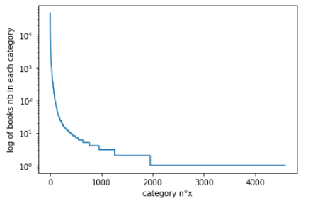
Category / Author gender (1/2)
First cleaning :
Several words, separated by "&", "(…)" or ",". (2nd column created)
Stemming operation (PorterStemmer)
Number of categories reduction :
Keep only the first 1 953 categories (steeper decline)… but only two books inside !
The first 403 categories have at least 10 books inside
Notes:
Considered together for the cleaning : quite the same information
Stemming algorithms work by cutting off the end or the beginning of the word, taking into account a list of common prefixes and suffixes that can be found in an inflected word.
=> For a search, we want to find also for the other possible forms of the words we used
To keep 95% of the most important categories, we should keep the 3 989 first categories (on 5 010).

Slide 16
Category / Author gender (2/2)
CAT_SEL CAT_OTHER
- cat_1 - oth_1
- cat_2 - oth_2
- … - …
- cat 403 - …
Word Embedding
neighbour
Word2Vec trained with :
- "book_description"
- "Category"
- "Category_other"
- "author_genres"
- "author_genres_other"
Notes:
PB with already available words embeddings data base, 'glove-wiki-gigaword-50' and 'word2vec-google-news-300' :
Our words categories are not inside.
Colab do not accept such huge data set loading.
Before training : cleaning of "book_description" col :
stopwords
words of length < 2
'...’
Word2Vec inside gensim.models, Skip Gram version => numerical vector of length 50 for embedding.
+ model.wv.most_similar_to_given.

Slide 17
Data handling
Embedding

Slide 18
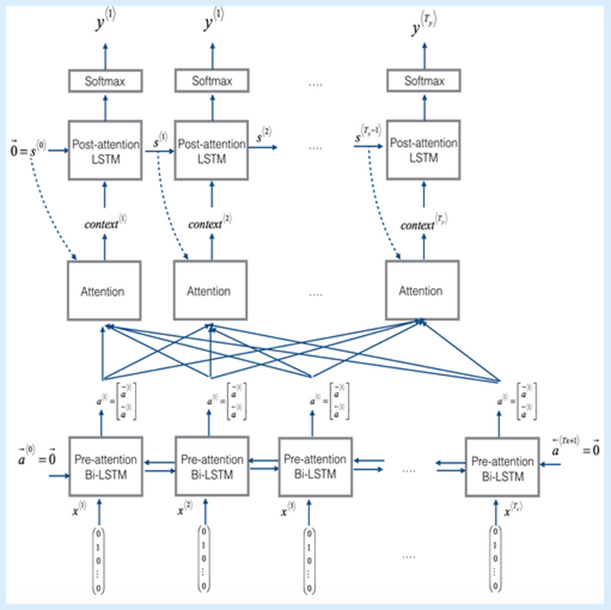
sentenceBERT embedding
- book's description -
Transform in tokens
Pretrained BertModel
Outputs are of 4 dimensions :
- 13 layers
- batch number (for us: nb of sentences per description)
- 64 (size of sentence)
- 768
Final dimension is of 768
(averaging and reduction)
Notes:
First the 'bert-base-uncased' pretrained tokenizer : transform our books description in tokens
For each book's description
for each sentence of the current book's description
encode_plus method has been used
each attention masks and tokens indexes are concatenated
'bert-base-uncased’
Dimension has been reduced in several steps :
one specific layer output has been used ([len(input_ids), 64 (size of sentence), 768]
average of tokens vectors of a same sentence ([len(input_ids), 768]
average of sentences vectors of a same book's description ([768])
=> This final vector has been saved in a books dataframe as a list of 768 strings

Slide 19
Fast Text embedding
- book's description -
Book’s description cleaning + tokenization
Training of FastText
All tokens embedding of dimension 60
Final dimension is of 60
(Tokens of same book's description averaged)
Fast Text embedding
- categories context -
Sentence created with :
"book_title"
"book_author"
"Category"
"Category_other"
"author_genres"
"author_genres_other"
Notes:
First data cleaning, mainly with the use of regular expressions :
Remove all the special characters
Remove all single characters
Substituting multiple spaces with single space
Converting to lowercase
Lemmatization with PorterStemmer
Removing of punctuation with word_punctuation_tokenizer
FastText from gensim library to train a model from our book's description
wv method used to find embedding

Slide 20

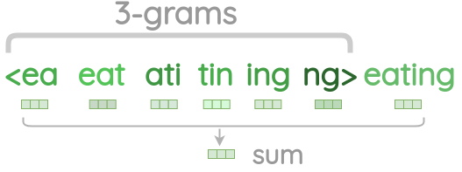
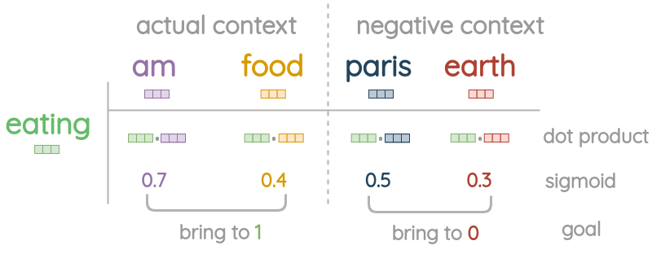
Fast Text embedding
Like Skip Gram : word => context
Center word treatment
Prediction
Notes:
Pb with GloVe and Word2vec : they only learn embeddings for words of the vocabulary
Huge number of unique n-grams
=> hashing: each character n-gram is hashed to an integer between 1 to B

Slide 21
Recommendation algorithms
Classifiers
Notes:
Find ratings of the book, when book’s features inputs are given

Slide 22
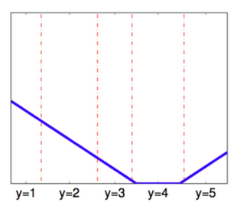
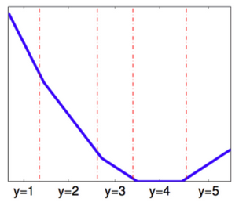
Ordinal regression
Extension of simple logistic regression model
2 losses used :
Immediate-threshold
All-threshold
Notes:
Pb with immediate-threshold loss : it ignores how many thresholds are crossed relative to the origin of the correct label.
=> Indeed, it is better to predict ‘4’ than ‘1’ if the true label is ‘5’.
Python library MORD (Multi-class classifier for ORDinal regression)

Slide 23
Recommendation algorithms
Results
Notes:
We systematically compare results of 4 algorithms
- LogisticAT
- OrdinalRidge
- LinearRegression
- RandomForestClassifier

Slide 24
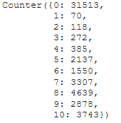
One embedding only
Each algorithms executed 3 times (3 embeddings)
10 unbalanced classes
5 unbalanced classes
Balanced binary classes
Balanced 10 classes (over / under sampling)
Balanced 5 classes (over / under sampling)
PCA
Book's description embedded with Bert Model
Balanced 10 classes (over / under sampling)
With 100 components : 82% of variance explained
With 150 components : 87% of variance explained
Notes:
Balanced binary classes
Class '1' of well-reviewed books : old 7, 8, 9 and 10 ratings
Class '0' of poorly rated books :
old 1, 2, 3 and 4 ratings
a part of old 0 ratings, the number needed to balance classes
Over / Under sampling :
- SMOTETomek(ratio='auto’) => large, balanced classes
Combination of :
oversampling with SMOTE on small classes
then undersampling with RandomUnderSampler on big classes
classes of about 2 000 /3 000 or 4 000 elements each

Slide 25
Several embeddings
Concatenation of 2 embeddings :
Unbalanced classes and Balanced binary classes
book's description with Bert || Categories context with fastText
book's description with fastText || Categories context with fastText
Addition of 2 embeddings :
Unbalanced classes and Balanced binary classes
book's description with fastText + Categories context with fastText
Incremental embeddings :
Balanced classes (over / under sampling) and fastText
Concatenation and addition
Embed features one by one
Notes:
Incremental embeddings
Title^{E} || Author^{E} || Categories^{E}
versus (Title || Author || Categories)^{E} = Categories context embedding previously performed

Slide 26
Conclusion
Results :
LogisticAT in unbalanced case predicts the mostly represented class
Random Forest slightly better
(begins to predict the 2 other classes the mostly represented)
OrdinalRidge and LinearReg better predict the least represented classes
(poorly)
Improvements :
Number of classes reduced to 5
Balanced classes with over / under sampling
(more classes are predicts, even if very poorly)
PCA in for Random Forest
Notes:
No improvements :
- More than one embedded features as input is not so clear. But maybe it is due to the fact that results are highly biased because of the unbalanced classes.
- In some cases normalisation of all the embedding values slightly improve such previous results.
- In case of balanced binary classes, the predictions are better distributed, and about of 45% of misclassified. It is very close to coin toss.

Slide 27
Project structure
Our ideas

Slide 28
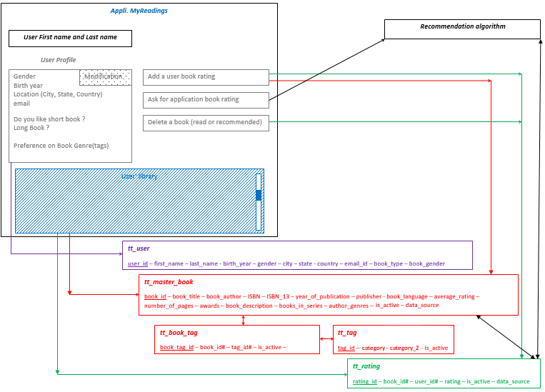
Notes:
So the application could keep in mind all the deleted books: Rating is set to 11.
Maybe it's a previous recommendation : Rating was 12
Recommendation algorithm
Training triggered each time a book is added or deleted.
Updating of the 5 recommended books
Verify that it was not a previously deleted one
Not recommend an already read book !
Take into account trilogy
Our recommendations must also bring an element of surprise, and not only deal with entries data.

Slide 29
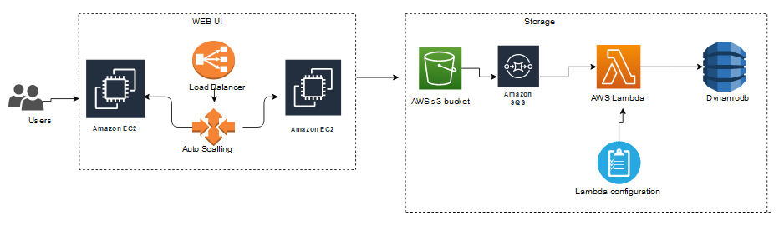
Notes:
Simpler solutions exist with flask, in term of web traffic handling (more simpler than AWS load balancer and auto scaler).
Cleaned files will be imported into AWS s3 and the file will be processed with Lambda function and load(full load) data into Dynamodb (master_book)
The same function can be used to do the incremental load as the new files(new books released) arrive.

Slide 30


