Slide 1
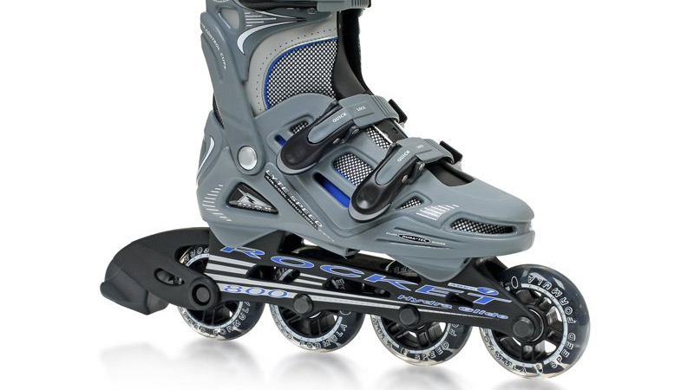
Dynamic Binary Translation and Optimization
Students – Shahar Dror, Ariel Pomeranchik

Slide 2
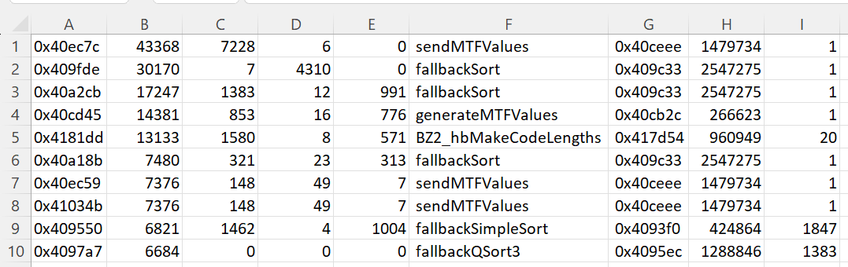
Profiling - Data Collection (prof mode)
Step 1 Gather information about all loops and functions
Step 2 Save information of the top 10 most called loops, sorted by the number of times the loop was seen (countSeen)
Step 3 Analyze which function should we inline

Slide 3
Optimization (opt mode)
Step 1 Gather information about all loops and functions
Step 2 Save information of the top 10 most called loops, sorted by the number of times the loop was seen (countSeen)
Step 3 Analyze which function should we inline

Slide 4
Translation Cache
Step 1 Gather information about all loops and functions

Slide 5
Function Inlining
Step 1 Gather information about all loops and functions

Slide 6
Performance Results
Step 1 Gather information about all loops and functions

Slide 7
Performance Results – bzip2

Slide 8
Performance Results – cc1

Slide 9
Performance Results – mcf

Slide 10
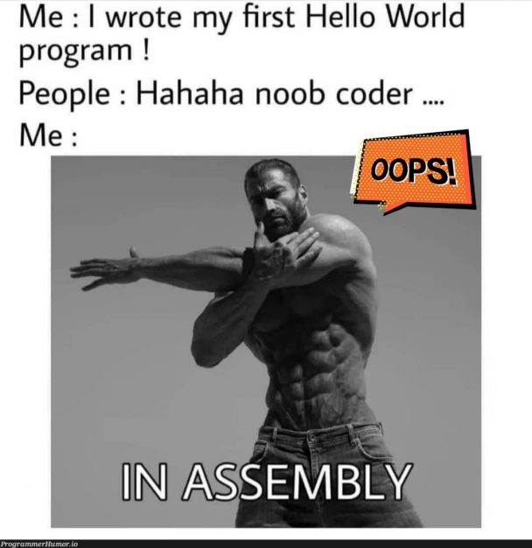
The End

