Slide 1

Project 1: Coffee Shop Analysis Using Hive
Ariel Rubio Perez

Slide 2


Technologies Used
Hive
Data warehouse to write SQL-like queries
Version 2.3.8
Hadoop
Framework for storing and processing massive amounts of data.
Version 3.3.0
HDFS
A distributed file system used to store the Hive Database.

Slide 3
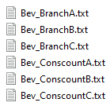
Input Files
Bev_BranchA.txt
(100 lines)
Bev Branch
Bev_BranchB.txt (200 lines)
Ex. ICY_LATTE,Branch5 MED_LATTE,Branch2
Bev_BranchC.txt (300 lines)
Input Files
Bev_ConscountA.txt (1000 lines)
Bev ConsCount
Bev_ConscountB.txt (2000 lines)
Ex.
Cold_Lite,262 SMALL_Coffee,466
Bev_ConscountC.txt (3000 lines)

Slide 4
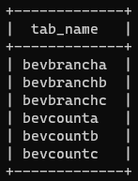
Project Setup
1) Create a database in Hive
CREATE DATABASE IF NOT EXISTS proj1db;
2) Create tables for Bev_Branch and Bev_Conscount files
create table if not exists BevBranchA (beverage STRING, branch STRING) row format delimited fields terminated by ',' stored as textfile; create table if not exists BevBranchB (beverage STRING, branch STRING) row format delimited fields terminated by ',' stored as textfile; create table if not exists BevBranchC (beverage STRING, branch STRING) row format delimited fields terminated by ',' stored as textfile;
create table if not exists BevCountA (beverage STRING, count INT) row format delimited fields terminated by ',' stored as textfile; create table if not exists BevCountB (beverage STRING, count INT) row format delimited fields terminated by ',' stored as textfile; create table if not exists BevCountC (beverage STRING, count INT) row format delimited fields terminated by ',' stored as textfile;

Slide 5
Project Setup
3) Import the data from HDFS into Hive
LOAD DATA INPATH '/user/arielrubio/projectdata/Bev_BranchA.txt' OVERWRITE INTO TABLE bevbranchA; LOAD DATA INPATH '/user/arielrubio/projectdata/Bev_BranchB.txt' OVERWRITE INTO TABLE bevbranchB; LOAD DATA INPATH '/user/arielrubio/projectdata/Bev_BranchC.txt' OVERWRITE INTO TABLE bevbranchC; LOAD DATA INPATH '/user/arielrubio/projectdata/Bev_ConscountA.txt' OVERWRITE INTO TABLE bevcountA; LOAD DATA INPATH '/user/arielrubio/projectdata/Bev_ConscountB.txt' OVERWRITE INTO TABLE bevcountB; LOAD DATA INPATH '/user/arielrubio/projectdata/Bev_ConscountC.txt' OVERWRITE INTO TABLE bevcountC;

Slide 6

Problem Scenario
1
Total number of consumers for Branch 1 and Branch 2

Slide 7
Problem Scenario One Total Number of Consumers for Branch 1
1) Make two tables for Branch 1 create table branch1 as select * from bevbrancha where branch = 'Branch1'; insert into table branch1 select * from bevbranchb where branch = 'Branch1'; insert into table branch1 select * from bevbranchc where branch = 'Branch1';
create table countbranch1(beverage string, count bigint); insert into table countbranch1 (select BevcountA.beverage,sum(BevcountA.count) from branch1 join BevcountA on(branch1.beverage = BevcountA.beverage ) group by BevcountA.beverage union all select BevcountB.beverage,sum(BevcountB.count) from branch1 join BevcountB on(branch1.beverage = BevcountB.beverage ) group by BevcountB.beverage union all select BevcountC.beverage,sum(BevcountC.count) from branch1 join BevcountC on(branch1.beverage = BevcountC.beverage ) group by BevcountC.beverage);

Slide 8

1,115,974
The total amount of consumers for branch 1

Slide 9
Problem Scenario One Total Number of Consumers for Branch 2
1) Make two tables for branch 2 create table branch2 as (select * from bevbrancha where branch = 'Branch2' union all select * from bevbranchb where branch = 'Branch2' union all select * from bevbranchc where branch = 'Branch2’);
create table countbranch2(beverage string, count bigint); insert into table countbranch2 (select BevcountA.beverage,sum(BevcountA.count) from branch2 join BevcountA on(branch2.beverage = BevcountA.beverage ) group by BevcountA.beverage union all select BevcountB.beverage,sum(BevcountB.count) from branch2 join BevcountB on(branch2.beverage = BevcountB.beverage ) group by BevcountB.beverage union all select BevcountC.beverage,sum(BevcountC.count) from branch2 join BevcountC on(branch2.beverage = BevcountC.beverage ) group by BevcountC.beverage);

Slide 10

5,099,141
The total amount of consumers for branch 2

Slide 11
Problem Scenario
2
Most consumed beverage of Branch 1
Least consumed beverage of Branch 2

Slide 12


Problem Scenario Two Most/Least Consumed Beverage
Most consumed beverage in Branch 1
select beverage, sum(count) totalsum from countbranch1 group by beverage order by totalsum desc limit 1;
Least consumed beverage in Branch 2
select beverage, sum(count) totalsum from countbranch2 group by beverage order by totalsum limit 1;
Special Cappuccino
108,163
Cold Mocha 47,524

Slide 13
Problem Scenario
3
Beverages available on Branch 1, 8, or 10
Common beverages of Branch 4 and 7

Slide 14
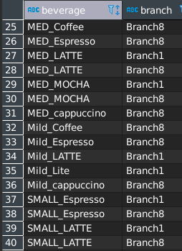
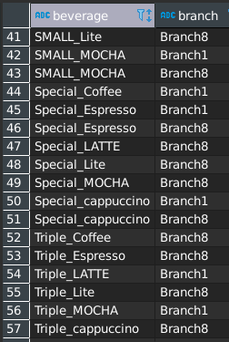
Problem Scenario Three Beverages available on Branch 1, 8, or 10
1) Make a table for all branches create table branch_all as select * from bevbrancha; insert into table branch_all (select * from bevbranchb); insert into table branch_all (select * from bevbranchc);
2) Run a query to select all beverages in branch 1, 8 or 10.
select distinct * from branch_all where branch = 'Branch10' or branch = 'Branch8' or branch = 'Branch1';

Slide 15
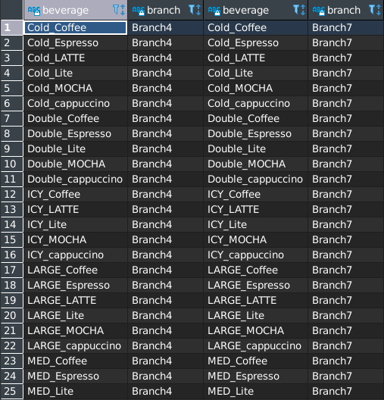
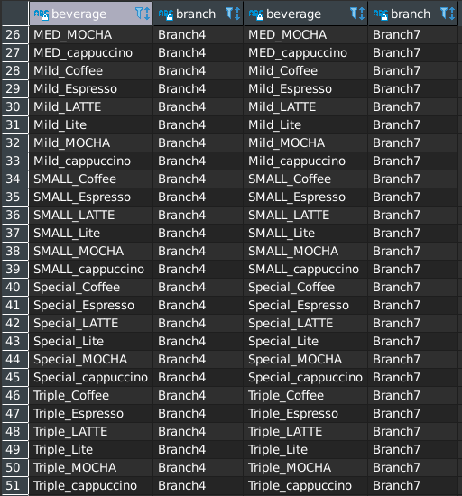
Problem Scenario Three Common beverages of Branch 4 and 7
1) Run a query to select common beverages select distinct * from branch_all b1 inner join branch_all b2 on b1.beverage = b2.beverage and (b1.branch = 'Branch4' and b2.branch = 'Branch7') order by b1.beverage;

Slide 16
Problem Scenario
4
Create a -Partition -Index -View for Scenario 3

Slide 17
Problem Scenario Four Partition, Index, View of Scenario 3
Partition
set hive.exec.dynamic.partition.mode=nonstrict;
CREATE TABLE branch_all_partition( beverage STRING) PARTITIONED BY (branch STRING) row format delimited fields terminated by ',' stored as textfile; insert into table branch_all_partition PARTITION(branch) select beverage, branch from branch all;
View
CREATE view branch10_8_1 as select distinct *
from branch_all where branch = 'Branch10' or branch = 'Branch8' or branch = 'Branch1';
Index
Create INDEX beverage_index on table branch_all(beverage) AS 'org.apache.hadoop.hive.ql.index.compact.CompactIndexHandler' WITH DEFERRED REBUILD;

Slide 18
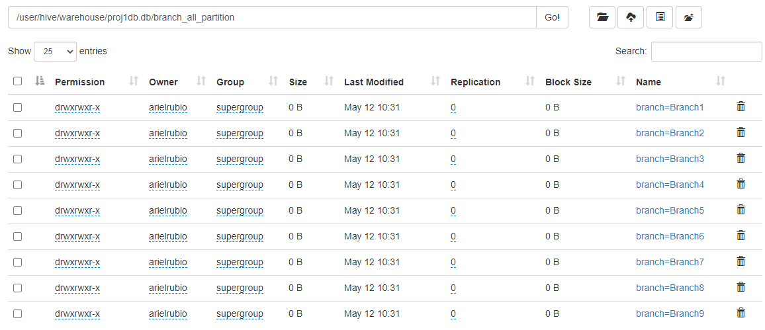
Partition

Slide 19
Problem Scenario
5
Alter the table properties to add: -“note”, -“comment” to a table

Slide 20
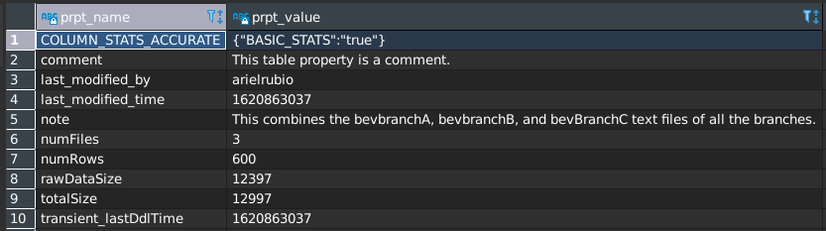
Problem Scenario Five Alter the table properties
Set Note
ALTER TABLE branch_all SET TBLPROPERTIES ('note' = 'This combines the bevbranchA, bevbranchB, and bevBranchC text files of all the branches.’);
Set Comment
ALTER TABLE branch_all SET TBLPROPERTIES ('comment' = 'This table property is a comment.');
Show Table Properties
show tblproperties branch_all;

Slide 21
Problem Scenario
6
Remove the 5th row from the output of Scenario 1

Slide 22
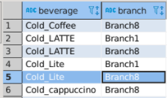
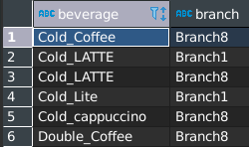
Problem Scenario Six Remove Row 5 from Scenario One
Before
Remove Row
After
create table delete5row as (select distinct * from branch_all where branch = 'Branch10' or branch = 'Branch8' or branch = 'Branch1' order by beverage);
INSERT OVERWRITE TABLE delete5row Select tmp.beverage, tmp.branch from (select beverage, branch, ROW_NUMBER() OVER (ORDER BY beverage) as rank from delete5row) as tmp
WHERE tmp.rank != 5;
select beverage, branch, ROW_NUMBER() OVER (ORDER BY beverage) as rank from delete5row;

Slide 23

Thanks!
Any questions?
You can find me at:
ariel.rubioperez@revature.net

