Slide 1

Similarity Level

Slide 2
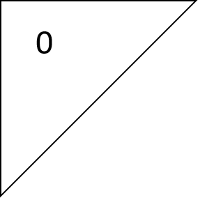
0

