Slide 1
WiFi: unoconf / unoplatform
#unoconf on Twitter
bienvenue à montréal
https://github.com/unoplatform/workshops
Please download the course materials and complete the developer environment setup module to ensure that all prerequisites are installed.

Slide 2

Geoffrey Huntley
@geoffreyhuntley
geoffrey.huntley@nventive.com

Slide 3

Carl de Billy
@carldebilly
carl.debilly@nventive.com

Slide 4

Michael Hawker
@xamllama
michael.hawker@microsoft.com

Slide 5
WiFi: unoconf / unoplatform
#unoconf on Twitter
github > unoplatform > workshops

Slide 6
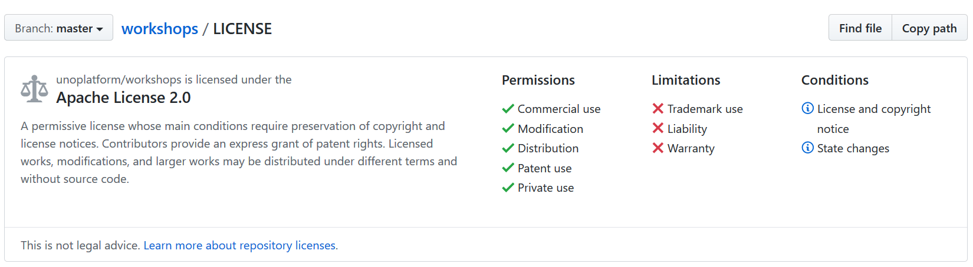
this workshop is open-source you are permitted [and encouraged] to use this workshop internally within your company or at your local meetup as long as you…

Slide 7
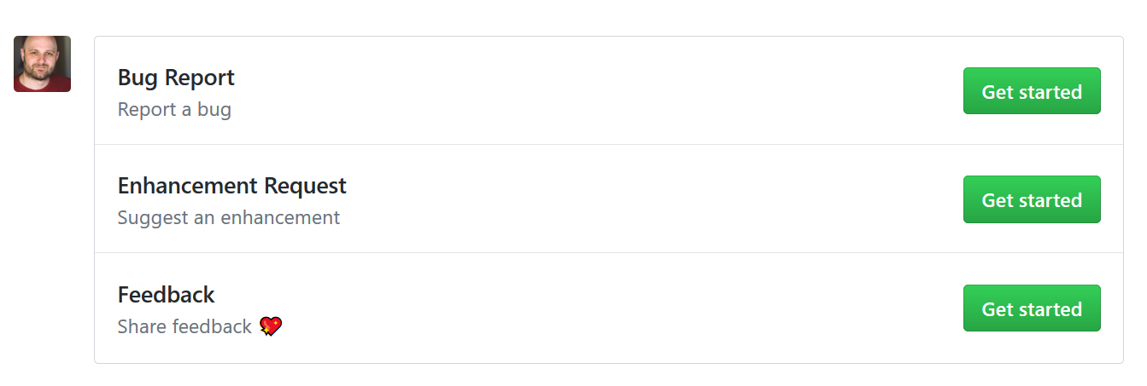
pinkie swear to help make this workshop better by providing feedback via GitHub and by sending in pull-requests with improvements 💖 💖 💖

Slide 8
Agenda
08:30 AM. Developer Environment Setup
09:00 AM. Introduction to the Uno Platform
10:00 AM. Productivity with Uno: Tooling and Ecosystem
10:30 AM. Let Views Do Views
11:30 AM. Creating Rich, Responsive UI on mobile & web
12:00 PM. Lunch
02:30 PM. Native intercompatibility
03:30 PM. Working with Uno’s internals

Slide 9
Topics Covered
Initial developer setup and getting started
The most productive way to develop an application
Building a iOS, Android and WebAssembly apps with Uno
Building rich, responsive UI on mobile and web
Usage of platform native views and intermixing them
How Uno works under the hood
How to extend Uno and monkey patch Uno’s internals

Slide 10
WiFi: unoconf / unoplatform
#unoconf on Twitter
github > unoplatform > workshops >
uno bootcamp > introduction to uno

Slide 11
🎯 calculator.platform.uno

Slide 12
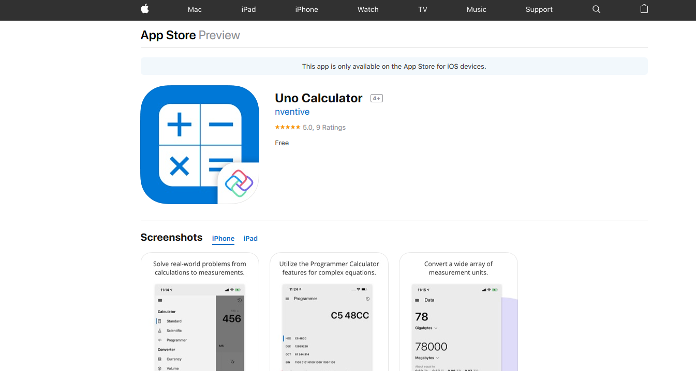

Slide 13
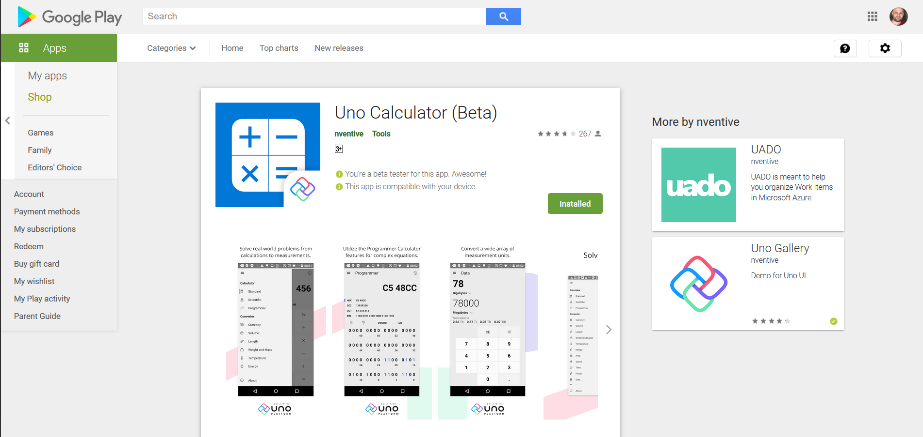

Slide 14
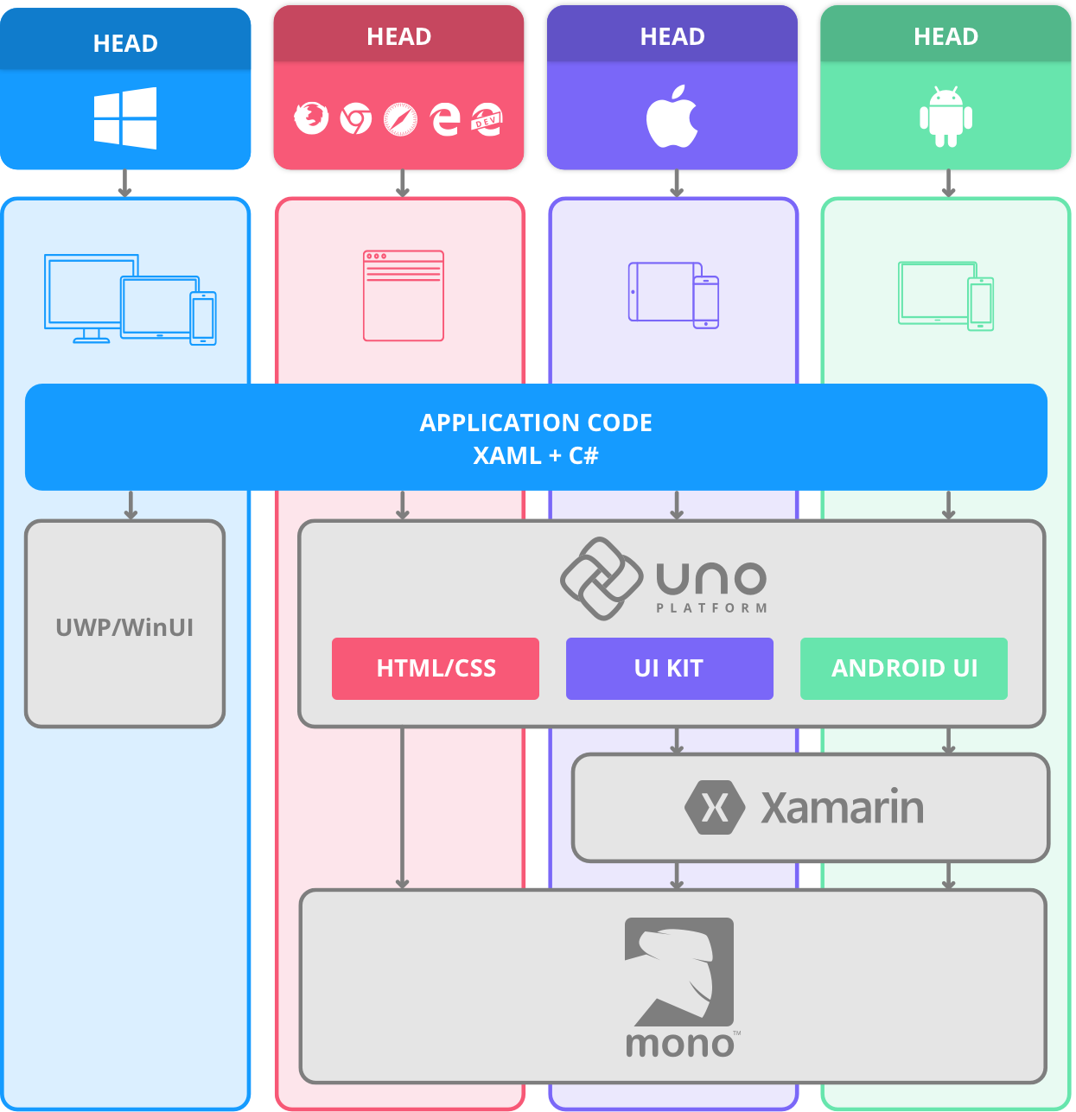
On iOS and Android, the Uno Platform relies extensively on the Xamarin Native stack. On WebAssembly, the Uno Platform relies directly on the Mono-WASM runtime.

Slide 15
All views inherit from the native base view type
On Android this means View. On iOS this means UIView. Since Uno couldn't change the design of the iOS or Android frameworks, Uno made DependencyObject a interface with a implementation that is automatically supplied by code generation which makes it incredibly easy to mix UWP view types with purely native views. For instance, a StackPanel can contain a RelativeLayout on Android, or a MKMapView on iOS.

Slide 16
A shared project is just a list of files
Referencing a shared project in an ordinary .csproj project causes those files to be included in the project. They're treated in exactly the same way as the files inside the project.

Slide 17
A shared project is compiled separately for each platform
It's important to be aware that the code in a shared-project file is compiled separately for each platform head. If you add a netstandard NuGet package such as Json.NET to a platform head and forget to add it to the other platform heads then those platform heads won't compile until you add the package.

Slide 18
⏭️ recap of introduction to uno

Slide 19
WiFi: unoconf / unoplatform
#unoconf on Twitter
github > unoplatform > workshops >
uno bootcamp > leverage existing tools

Slide 20
🎯 C# edit and continue

Slide 21
🎯 live visual tree

Slide 22
🎯 windows hot reload

Slide 23
🎯 uno hot reload

Slide 24
⏭️ recap of leverage existing tools

Slide 25
WiFi: unoconf / unoplatform
#unoconf on Twitter
github > unoplatform > workshops >
uno bootcamp > let views do views

Slide 26
🎯 todomvc.com

Slide 27
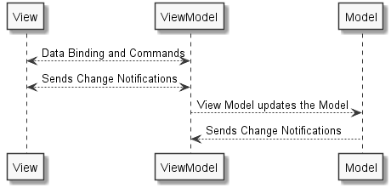
Put interesting code into a class that represents the View

Slide 28
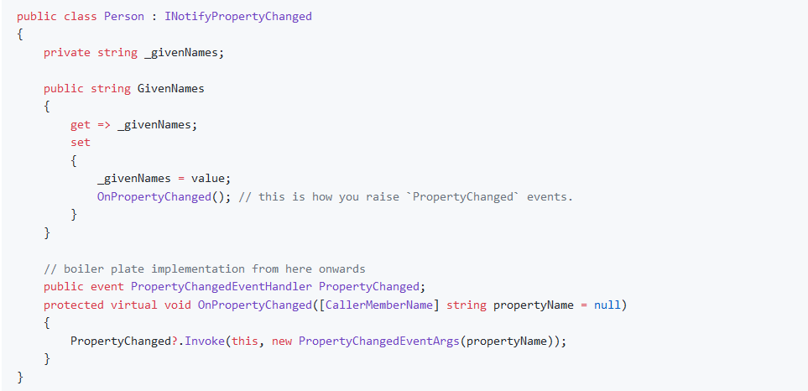
UI needs to be informed that it should redraw

Slide 29
🎯 complete the implementation

Slide 30
⏭️ recap of let views do views

Slide 31
WiFi: unoconf / unoplatform
#unoconf on Twitter
github > unoplatform > workshops >
uno bootcamp > create rich responsive UIs

Slide 32
💡 platform specific code for C# and XAML

Slide 33
ValueConverters
XAML allows us to easily bind our data model to our view. However, the type of data value the view is expecting sometimes doesn't match the type of the data in our model.
Rather than having to re-work our model, we can create a helper value converter in order to transform the data coming from the model into a type the view can understand by creating a class that implements IValueConverter

Slide 34
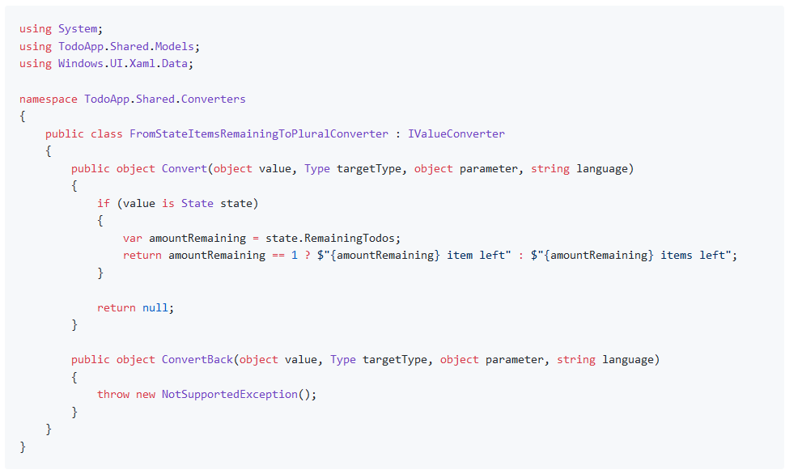
ValueConverters

Slide 35
Debugging XAML
Enabling FeatureConfiguration…AssignDOMXamlName in your WASM head enables you to see XAML names directly in the DOM by using the browser F12 tools.

Slide 36
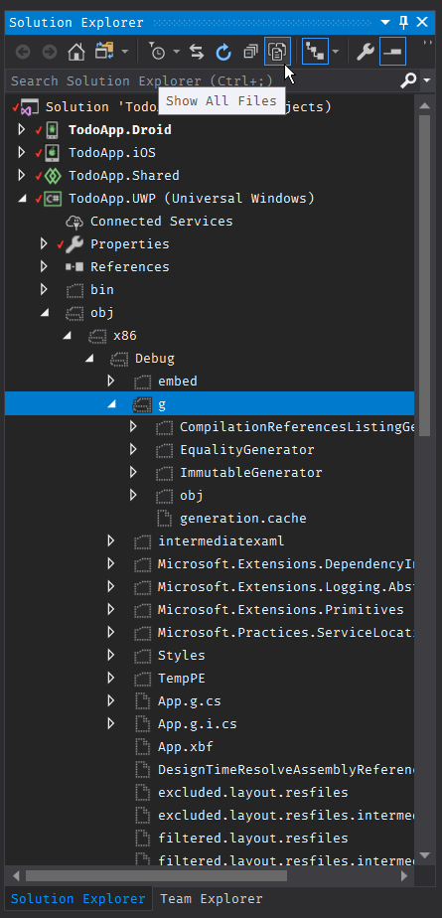
Debugging XAML

Slide 37
🎯 complete the implementation

Slide 38
⏭️ recap of create rich responsive UIs

Slide 39
WiFi: unoconf / unoplatform
#unoconf on Twitter
github > unoplatform > workshops >
uno bootcamp > native intercompatibility

Slide 40
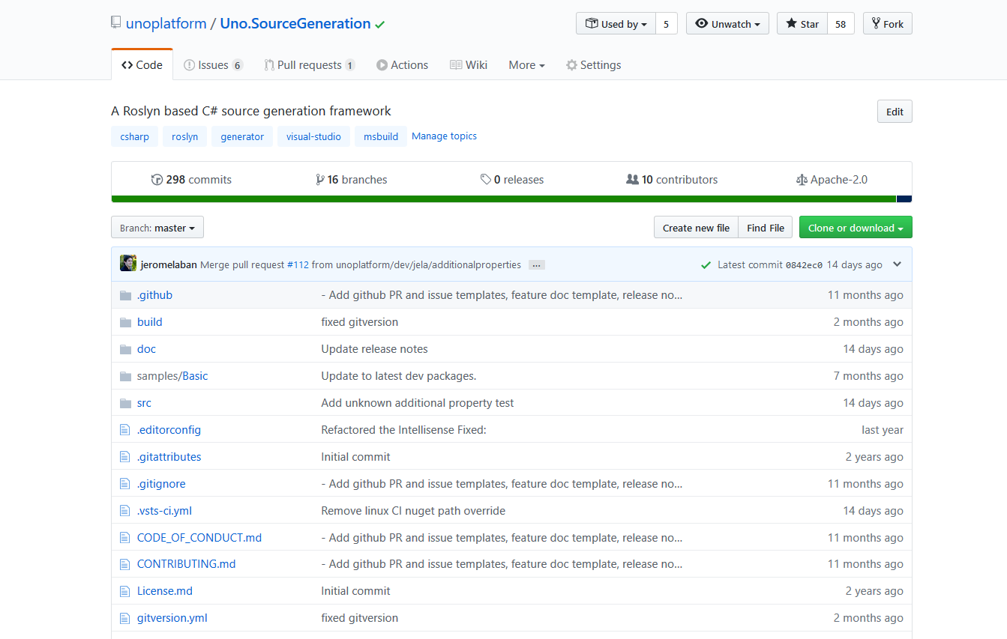
What happens when you compile

Slide 41
Uno chose to make DependencyObject an interface with an implementation that is supplied by code generation
Part of the power of Uno on Android and iOS is the ability to easily mix UWP view types with purely native views. This is possible because, in Uno, all views inherit from the native base view type.
On Android this means View.
On iOS this means UIView.

Slide 42
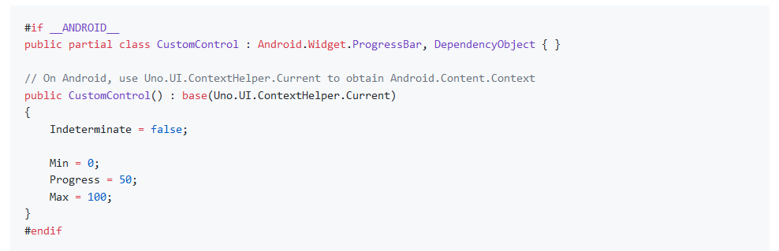
Platform specific controls with Uno
Tag the platform-specific control with the : DependencyObject interface and the implementation of the interface will be automatically supplied by the source generator.

Slide 43
Native Constructors are automatically provided
As views in Uno inherit directly from native views on Android/iOS, they need to have special constructors that are called under-the-hood by Xamarin.
Writing these by hand would be tedius and particularly painful when porting existing UWP code, so Uno generates them for you automatically if they don't already exist.

Slide 44
🎯 complete the implementation

Slide 45
⏭️ recap of native intercompatibility

Slide 46
WiFi: unoconf / unoplatform
#unoconf on Twitter
github > unoplatform > workshops >
uno bootcamp > working with uno

Slide 47


Slide 48
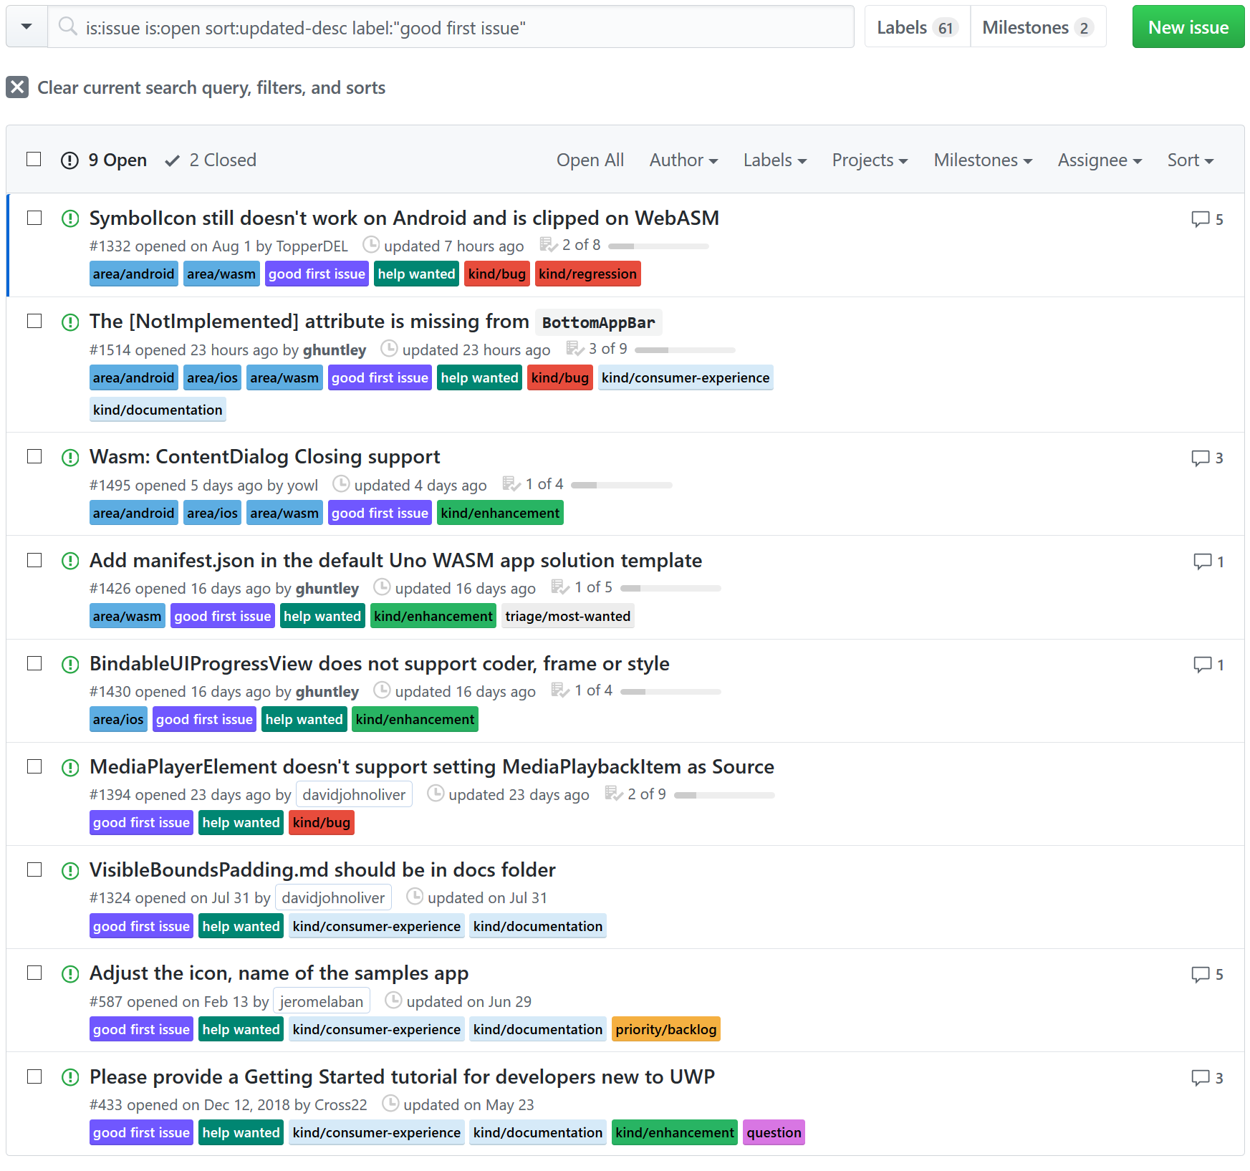

our approach to building uno & contributor community
pair programming with contributors
issues of various complexity available

Slide 49
Open source and professionally supported
If your organization requires a deeper level of support beyond our community support, please contact us. Our professional support is more than a contract – it is a shared responsibility for your project success.
Our engineering team will collaborate with you to ensure the success of your projects, and our custom application development team at nventive is also available to lend its expertise.

Slide 50
🎯 /uno/src /Uno.UI/Generated/

Slide 51
🎯 /uno/src /Uno.UI/UI/XAML/

Slide 52
🎯 /uno/src /SourceGenerators/

Slide 53
🎯 /uno/src /SamplesApp/

Slide 54
🎯 solution filters

Slide 55
🎯 cross targeting override

Slide 56
Controlling which platforms are built by Visual Studio
Inside of the cross targeting override file, you'll find a property called UnoTargetFrameworkOverride which provides you with a way to selectively choose which target framework monikers are compiled by Visual Studio for Windows.

Slide 57
Overriding your local NuGet cache
By enabling <UnoNugetOverrideVersion> and building from source you'll never be in a situation where you are blocked waiting for pull-requests to be merged and a release to be cut.

Slide 58
🎯 vendoring uno

Slide 59
🎯 source level step debugging

Slide 60
🎯 debugging the source generator

Slide 61
⏭️ recap of working with uno

Slide 62



Slide 63
If you use this material to conduct your own workshop, please share where it was used and provide feedback by creating a new issue on GitHub.

Slide 64
If you see a opportunity to improve the courseware please send in a pull-request.

Slide 65
🙌
merci beaucoup

