Slide 1

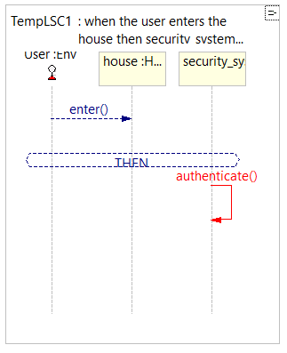
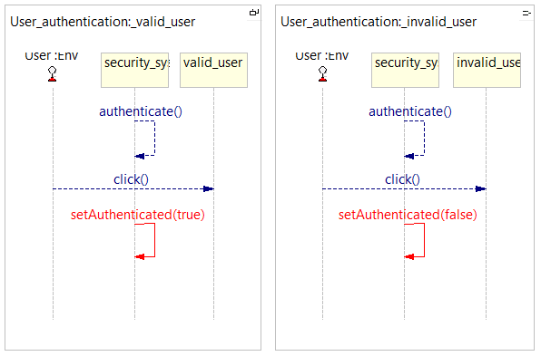
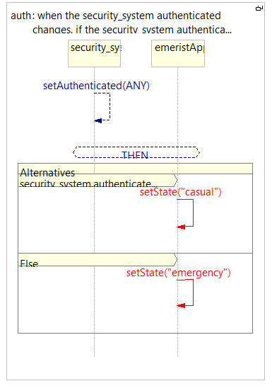
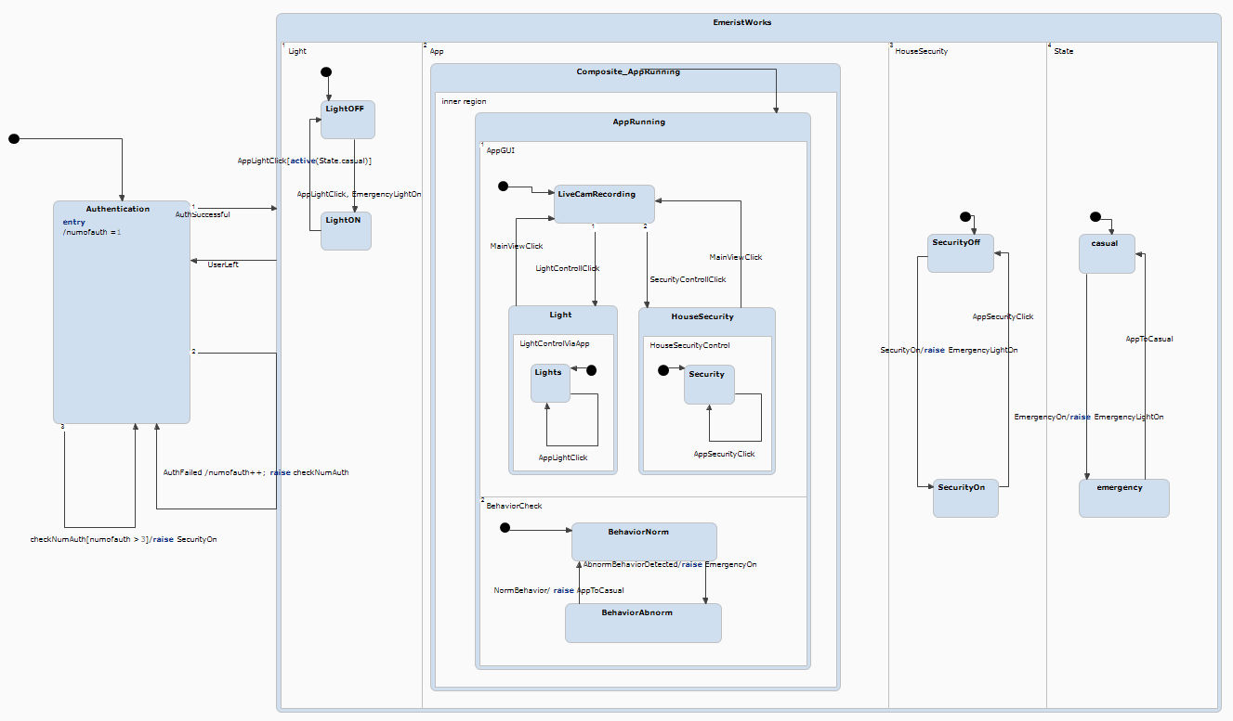
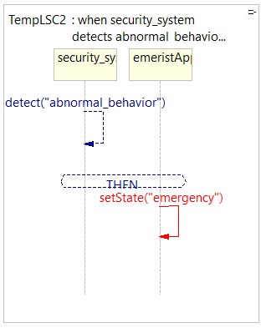
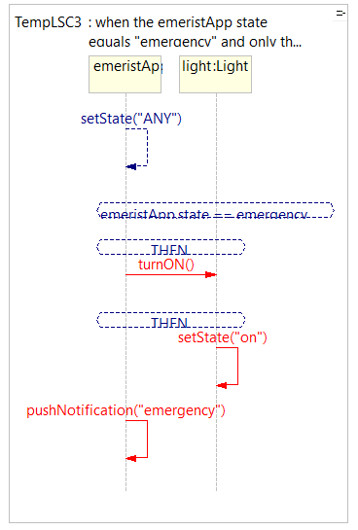
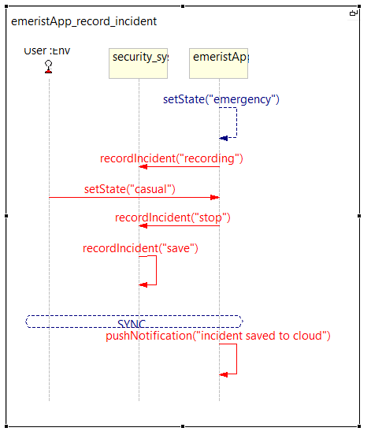
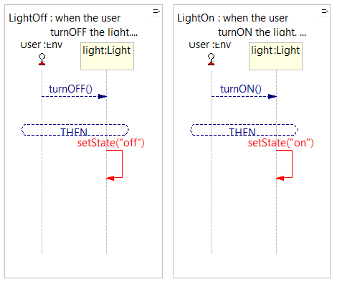
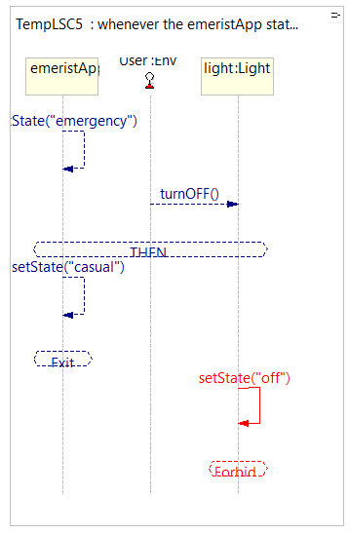
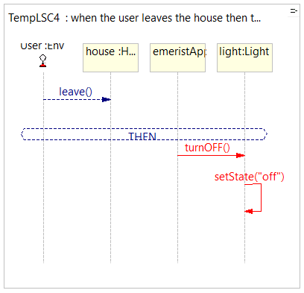


Visual programming
EMERIST
Elena Golubeva and Arielle Mizrahi
336377064 209381292
Michal Gordon
הפקולטה למדעים
מערך פרויקטים ושיתוף פעולה עם התעשייה
Reactivity of EMERIST:
What is EMERIST?
Emerist uses recordings from the cameras and tracks user’s behavior. When abnormal behavior is detected, the application changes its state to emergency and starts starts recording of the incident.
At the same time relevant users (relatives or guardian) receives information about the incident.
The system also reacts to user’s button click in the app itself. For example, if user clicks turn off the light - EMERIST will turn off the lights in the house.
In case of emergency EMERIST will not let user turn off the lights.
Emerist - emergency assistant application that uses cameras around the house to track people’s behavior at all time. Only in emergency situations the application will save the recording, and upload to the cloud.
Emerist app lets user control the smart lights in the house and house security.
Application’s flow is described in two environments: Statecharts (by Yakindu) and Natural language programming (by PlayGo).
We were able to cover most of application’s functionality with LSC using natural language.
Reflections
We had some struggle creating complex LSC’s with natural language. We found our work around by creating smaller charts and using simple sentences. It was easier to control and debug complex flows with Statecharts as it has more simple UX, but here we faced some difficulties with conditional formatting.
While working with both softwares it was clear that no matter how simple is your project, it won’t work until you know exactly what it will do. You have to think strategically.
We definitely learned some organizational and project management skills while working on EMERIST.
LSC’S
Statecharts
Online course, Development languages and work environments
Link to YouTube explanatory videos
Statecharts: https://youtu.be/iwVGALJUgvs
LSC: https://youtu.be/UKPiIeLD-pc

