Slide 1


The Genome Analysis Centre
Building Excellence in Genomics and Computational Bioscience

Slide 2

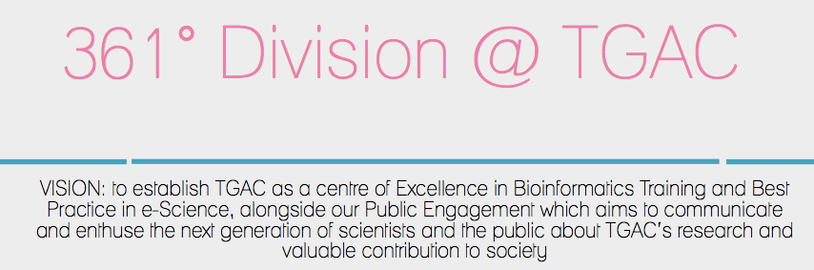
The Genome Analysis Centre
Notes:
1) Seminars don't train
Second,
while seminars are entertaining, they're
generally not the
best way to change behavior. Most of
the content in a traditional seminar flows in one e ar
and out the other.
2) not a t raining problem. If you
do have a training problem, you must explicitly
describe the behaviors you expect after training.
3) Positive behaviors must be reinforced if they are to be
retained. Di

Slide 3
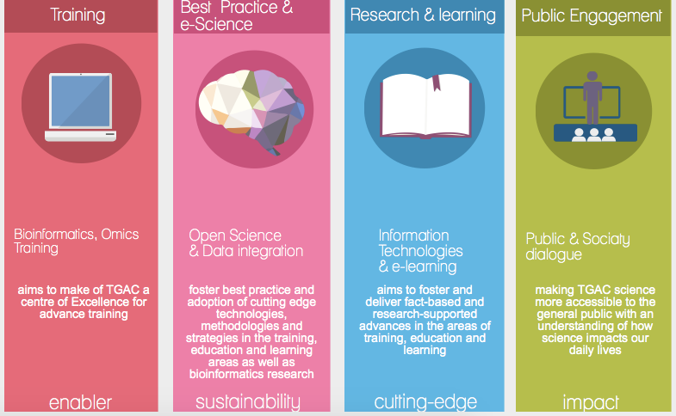
The Genome Analysis Centre
Notes:
1) Seminars don't train
Second,
while seminars are entertaining, they're
generally not the
best way to change behavior. Most of
the content in a traditional seminar flows in one e ar
and out the other.
2) not a t raining problem. If you
do have a training problem, you must explicitly
describe the behaviors you expect after training.
3) Positive behaviors must be reinforced if they are to be
retained. Di

Slide 4
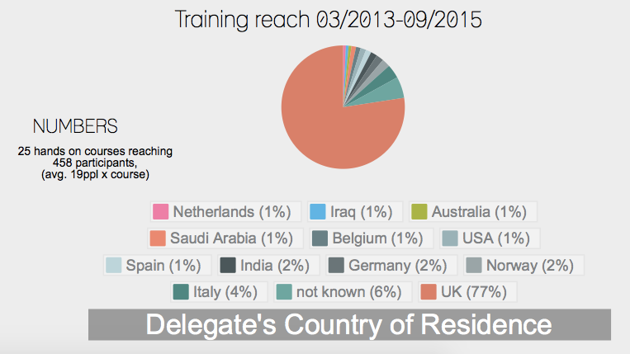
The Genome Analysis Centre
Notes:
1) Seminars don't train
Second,
while seminars are entertaining, they're
generally not the
best way to change behavior. Most of
the content in a traditional seminar flows in one e ar
and out the other.
2) not a t raining problem. If you
do have a training problem, you must explicitly
describe the behaviors you expect after training.
3) Positive behaviors must be reinforced if they are to be
retained. Di

Slide 5
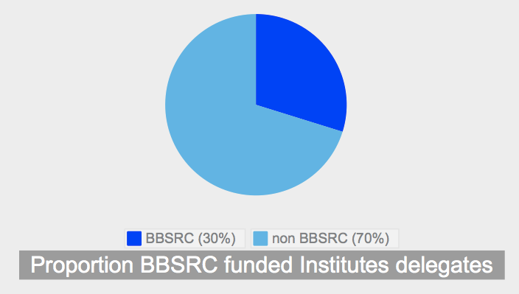
The Genome Analysis Centre
Notes:
1) Seminars don't train
Second,
while seminars are entertaining, they're
generally not the
best way to change behavior. Most of
the content in a traditional seminar flows in one e ar
and out the other.
2) not a t raining problem. If you
do have a training problem, you must explicitly
describe the behaviors you expect after training.
3) Positive behaviors must be reinforced if they are to be
retained. Di

Slide 6
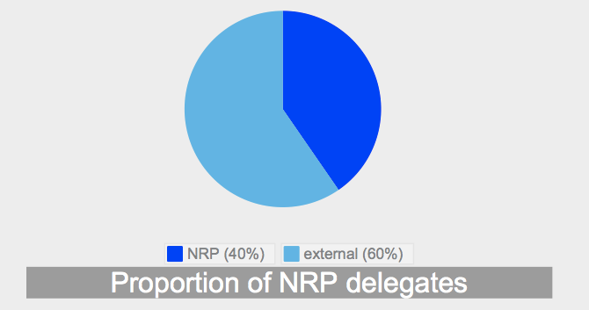
The Genome Analysis Centre
Notes:
1) Seminars don't train
Second,
while seminars are entertaining, they're
generally not the
best way to change behavior. Most of
the content in a traditional seminar flows in one e ar
and out the other.
2) not a t raining problem. If you
do have a training problem, you must explicitly
describe the behaviors you expect after training.
3) Positive behaviors must be reinforced if they are to be
retained. Di

Slide 7
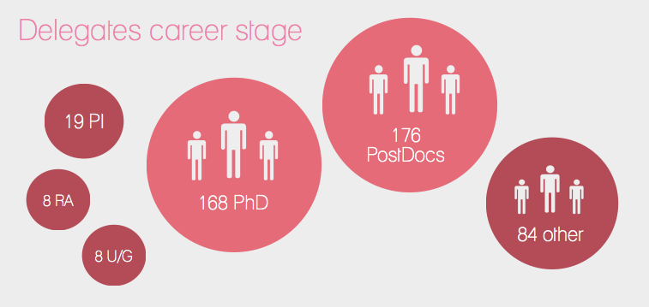
The Genome Analysis Centre
Notes:
1) Seminars don't train
Second,
while seminars are entertaining, they're
generally not the
best way to change behavior. Most of
the content in a traditional seminar flows in one e ar
and out the other.
2) not a t raining problem. If you
do have a training problem, you must explicitly
describe the behaviors you expect after training.
3) Positive behaviors must be reinforced if they are to be
retained. Di

Slide 8
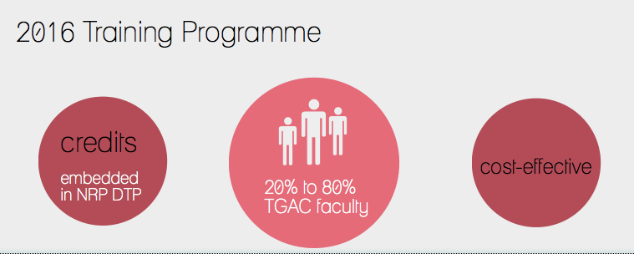
The Genome Analysis Centre
Notes:
1) Seminars don't train
Second,
while seminars are entertaining, they're
generally not the
best way to change behavior. Most of
the content in a traditional seminar flows in one e ar
and out the other.
2) not a t raining problem. If you
do have a training problem, you must explicitly
describe the behaviors you expect after training.
3) Positive behaviors must be reinforced if they are to be
retained. Di

Slide 9
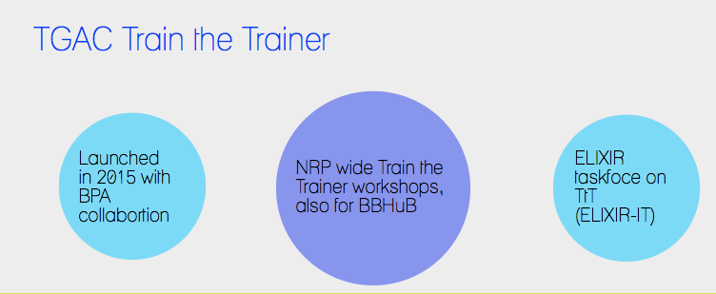
The Genome Analysis Centre
Notes:
1) Seminars don't train
Second,
while seminars are entertaining, they're
generally not the
best way to change behavior. Most of
the content in a traditional seminar flows in one e ar
and out the other.
2) not a t raining problem. If you
do have a training problem, you must explicitly
describe the behaviors you expect after training.
3) Positive behaviors must be reinforced if they are to be
retained. Di

Slide 10
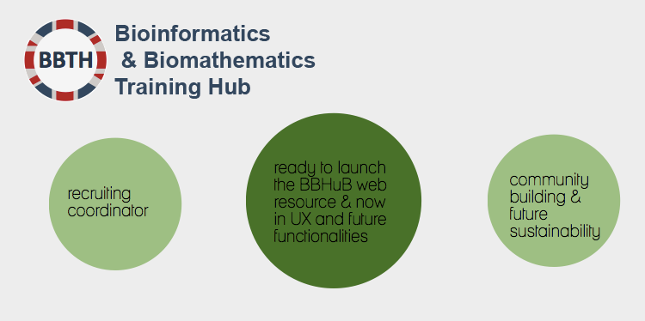
The Genome Analysis Centre
Notes:
1) Seminars don't train
Second,
while seminars are entertaining, they're
generally not the
best way to change behavior. Most of
the content in a traditional seminar flows in one e ar
and out the other.
2) not a t raining problem. If you
do have a training problem, you must explicitly
describe the behaviors you expect after training.
3) Positive behaviors must be reinforced if they are to be
retained. Di

Slide 11
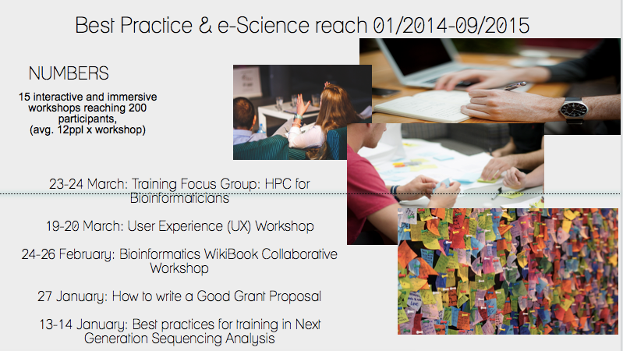
The Genome Analysis Centre
Notes:
1) Seminars don't train
Second,
while seminars are entertaining, they're
generally not the
best way to change behavior. Most of
the content in a traditional seminar flows in one e ar
and out the other.
2) not a t raining problem. If you
do have a training problem, you must explicitly
describe the behaviors you expect after training.
3) Positive behaviors must be reinforced if they are to be
retained. Di

Slide 12
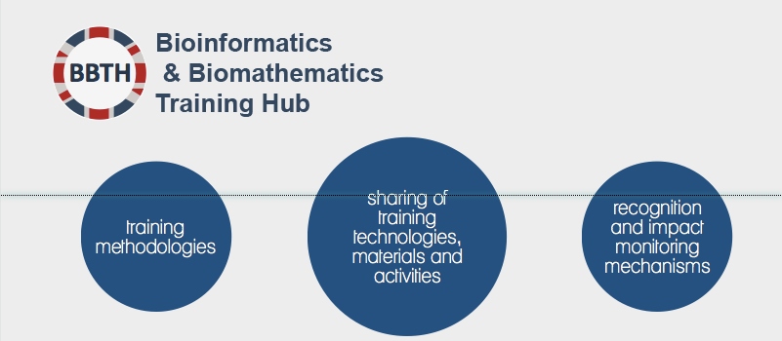
The Genome Analysis Centre
Notes:
1) Seminars don't train
Second,
while seminars are entertaining, they're
generally not the
best way to change behavior. Most of
the content in a traditional seminar flows in one e ar
and out the other.
2) not a t raining problem. If you
do have a training problem, you must explicitly
describe the behaviors you expect after training.
3) Positive behaviors must be reinforced if they are to be
retained. Di

