Slide 1






Building Excellence in Genomics and Computational Bioscience
miRNA Workshop: miRNA biogenesis & discovery
Simon Moxon
simon.moxon@tgac.ac.uk

Slide 2

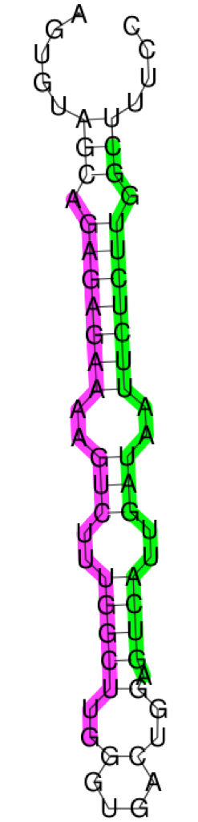
BRIEF INTRODUCTION TO MIRNAS
pre-miRNA
Short non-coding RNAs (21-23nt in length)
Found in both plants and animals
Transcribed into a long primary transcript (pri-miRNA)
This is processed into a hairpin-like precursor sequence (pre-miRNA) by Drosha in animals and Dicer in plants
Further processed by Dicer into a short duplex containing the miRNA and it’s complement (miRNA*)
The Genome Analysis Centre

Slide 3
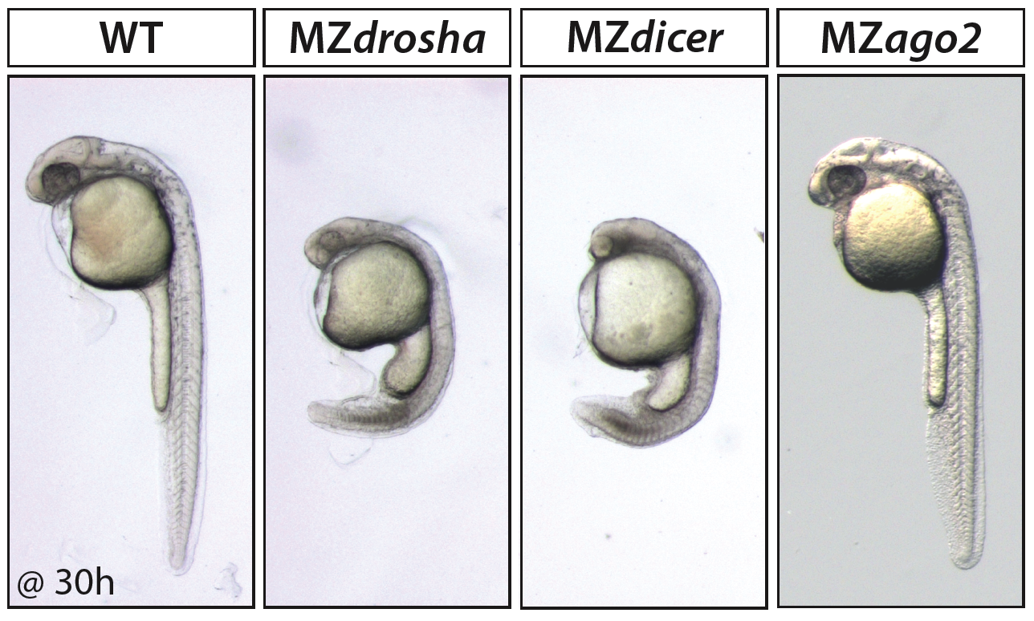
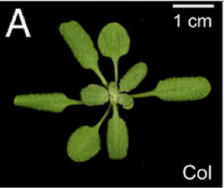
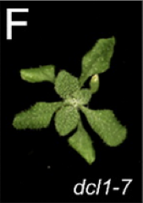
MIRNA FUNCTION
MiRNAs regulate gene expression post-transcriptionally
They bind to mRNAs based on Watson-Crick base-pairing
In animals they generally lead to translational repression followed by RNA degradation. In plants mRNA cleavage
Critical functions in development & disease
Zebrafish embryos 30 hpf.
Drosha and Dicer mutants fail to develop to adulthood
Arabidopsis embryos A) Wildtype F) Dicer mutant. Dicer mutants fail to develop past seedling stage
The Genome Analysis Centre

Slide 4
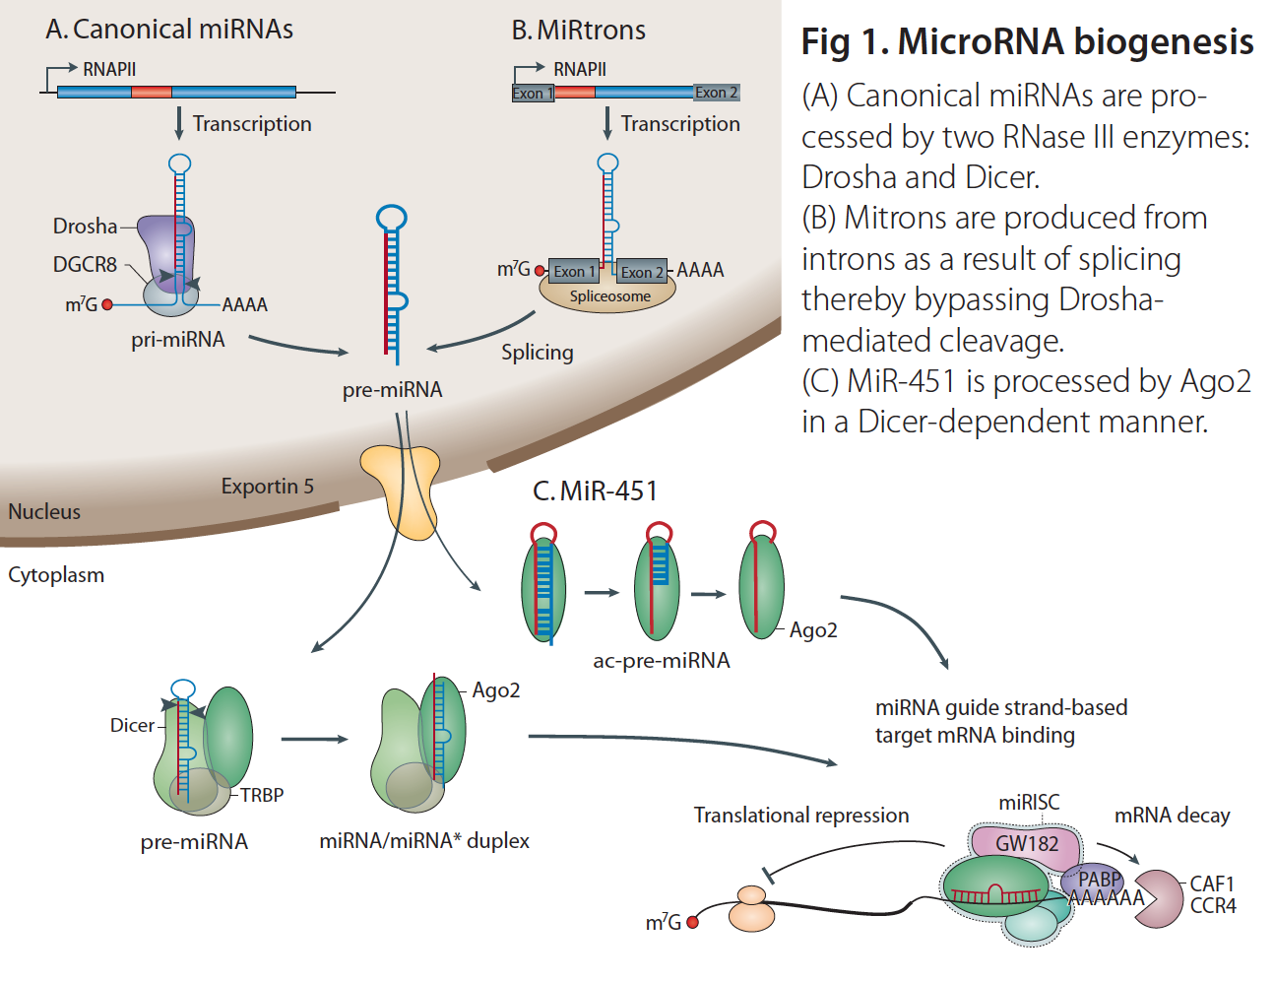
MIRNA BIOGENESIS - ANIMALS
Adapted from Krol et al.Nat Rev Genet. 2010 Sep;11(9):597-610.
The Genome Analysis Centre

Slide 5
HOW MANY MIRNAS?
 | Human |  | Fly
Pre-miRNAs | 1600 |  | 238
In introns | 841 | (53%) | 105 | (44%)
Clustered (<10 kb) | 422 | (26%) | 85 | (36%)
Mature miRNAs | 2042 |  | 426
w/ validated targets | 317 | (16%) | 38 | (9%)
miRBase v19
miRTarBase v3.5
The Genome Analysis Centre

Slide 6
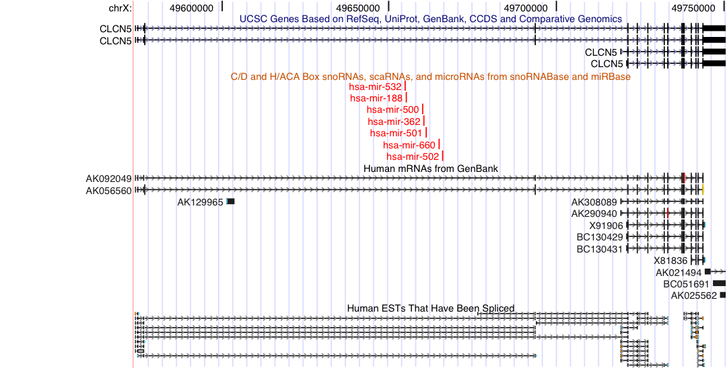
HOW ARE THEY MADE?
Intronic miRNAs
The Genome Analysis Centre
Notes:
40-50% of all animal miRNAs

Slide 7
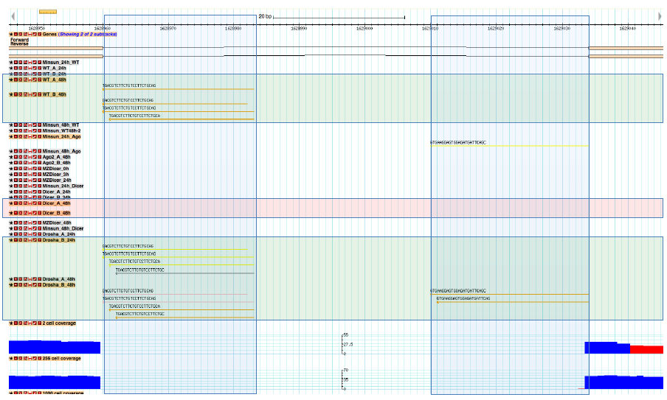
HOW ARE THEY MADE?
“miRtrons” – Drosha independent miRNAs
The Genome Analysis Centre

Slide 8
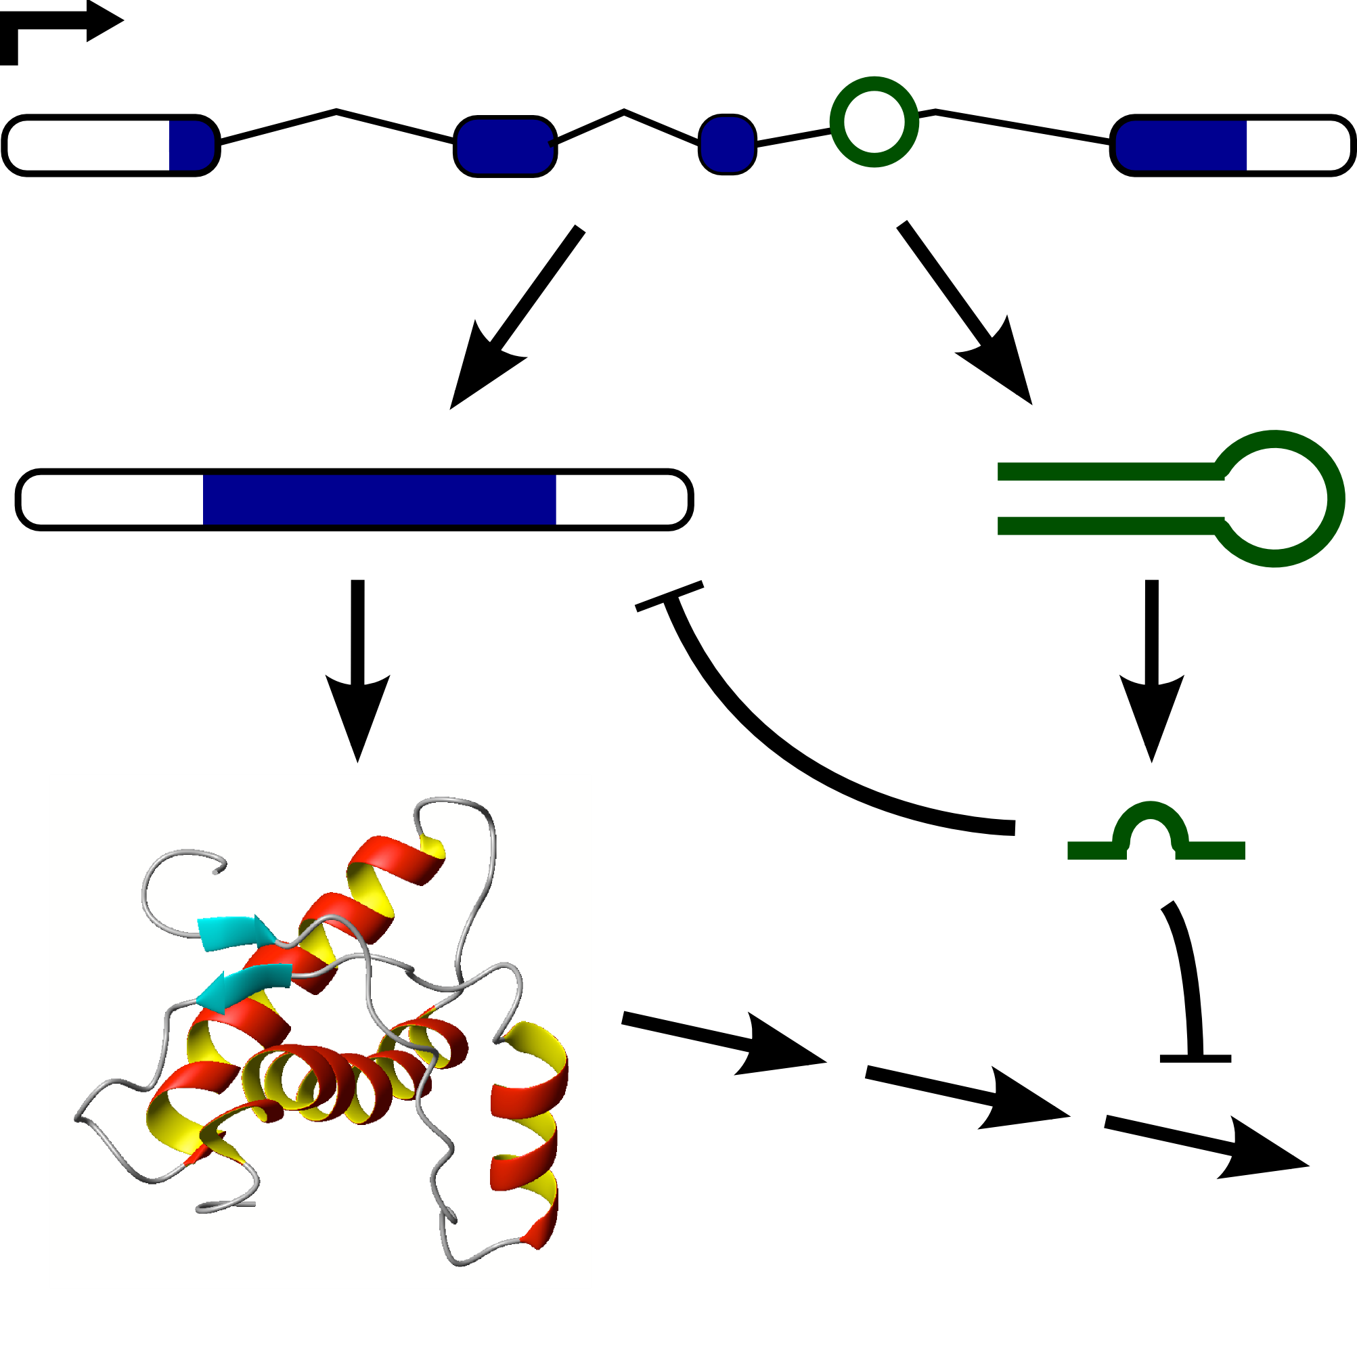
FUNCTIONS OF MULTIPLE PRODUCTS
miRNA is linked to expression of the host gene
Can potentially target the host gene to control its expression
Alternatively it could target other related genes to control their expression level
The Genome Analysis Centre

Slide 9
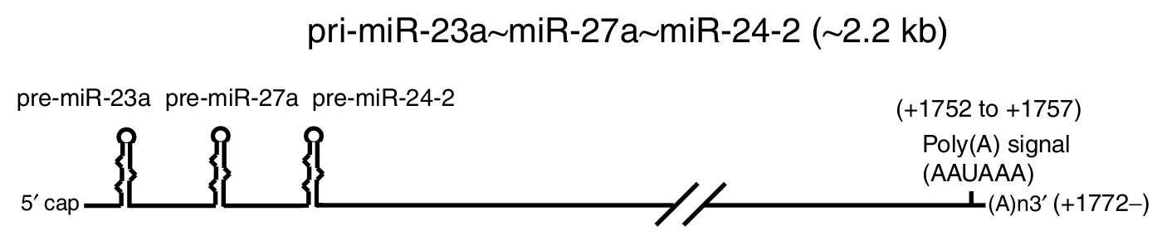
INTERGENIC MIRNAS
Transcribed by RNA polymerase II and look like mRNAs
Can give rise to single primary miRNA transcripts or a polycistronic cluster containing multiple miRNAs
The Genome Analysis Centre
Notes:
30-40% of all animal miRNAs

Slide 10
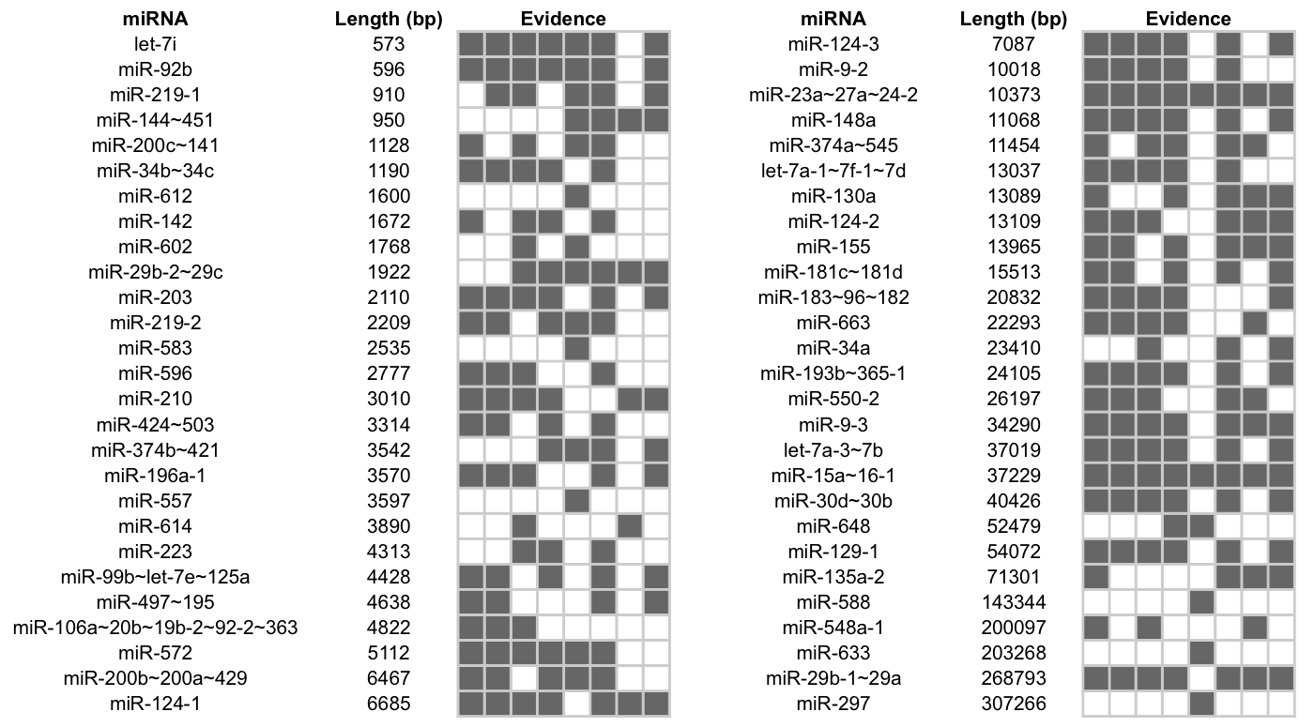
INTERGENIC MIRNAS
TSS | CpG | polyA | 5'CAGE | Ditag | EST | cDNA | cons
The Genome Analysis Centre
Notes:
30-40% of all animal miRNAs
Huge variation in length

Slide 11
MIRNA DISCOVERY
Problem – accurately classify hundreds of miRNAs from a sample containing millions of small RNAs (actually much easier in animals than plants)
Several tools for the discovery of miRNAs from next generation sequencing data. I recommend two:
miRCat (Moxon et al. 2008 & Stocks et al. 2012)
miRDeep (Freidlander et al. 2008 & 2012)
The Genome Analysis Centre

Slide 12
SEQUENCING SMALL RNAS
Small RNAs are small: we don’t care about read length!
Sequencing depth is not a problem for ubiquitously expressed miRNAs
Some miRNAs are cell type specific – higher depth needed to discover these miRNAs when sequencing a while organism, organ or tissue
For miRNA annotation often good to take multiple tissues to capture more miRNAs
The Genome Analysis Centre

Slide 13
GENERAL OVERVIEW
Small RNA reads (FASTQ/FASTA)
Adaptor trimming & filtering
Define small RNA producing loci
Map to a reference genome
Classify (structure and alignment)
Fold windows
Extract genomic windows around loci
Predicted pre- and mature-miRNAs
The Genome Analysis Centre

Slide 14
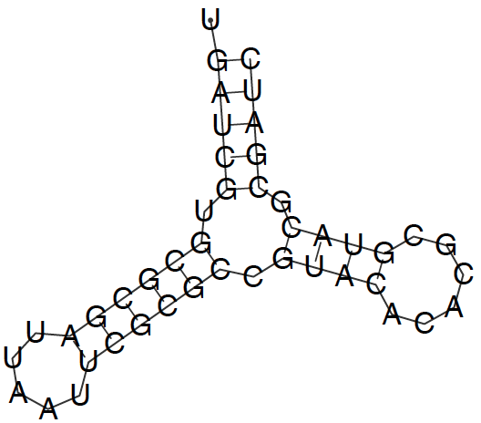
KEY POINTS
miRNA must come from a hairpin
Alignments of small RNAs to hairpin should be consistent with Dicer/Drosha processing and be in the same orientation
☺
☹
Drosha cut
Random degradation
Dicer cut
☺
☹
The Genome Analysis Centre
Notes:
Also check against genome annotation – is it in intron/intergenic (likely candidate) or in CDS or annotated ncRNA (likely false postitive)?

Slide 15
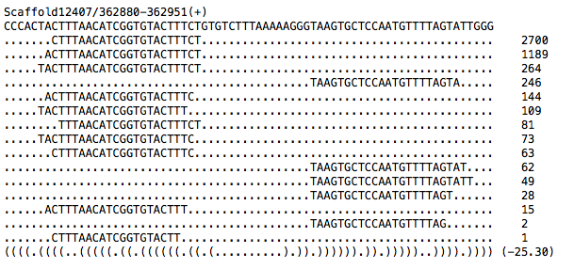
KEY POINTS
Looking at small RNA alignments to hairpin is key to finding false positives
The Genome Analysis Centre

Slide 16
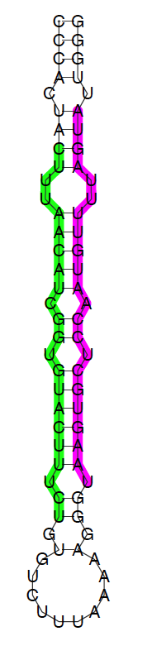
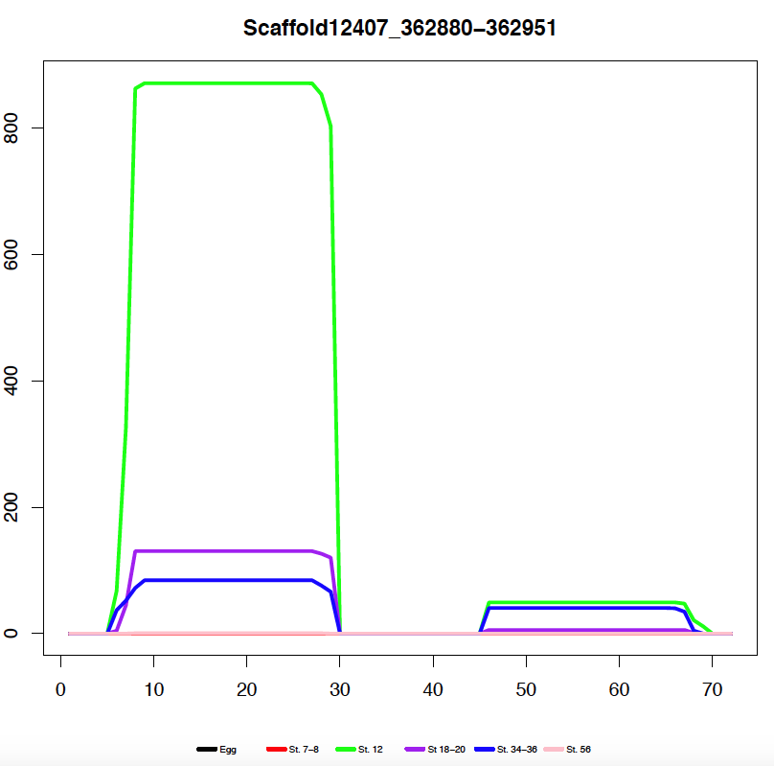
KEY POINTS
Can plot read coverage across the hairpin – look for two peak alignment
Things to look for
Two peak pattern
Things to look for
No large bulges
Bulges symmetrical
2nt 3’ overhang
The Genome Analysis Centre

