Slide 1






Building Excellence in Genomics and Computational Bioscience
miRNA Workshop: Plant miRNA targeting & PARE analysis
Simon Moxon
simon.moxon@tgac.ac.uk

Slide 2



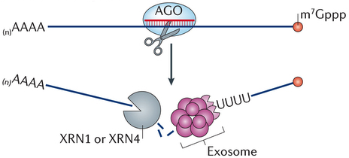
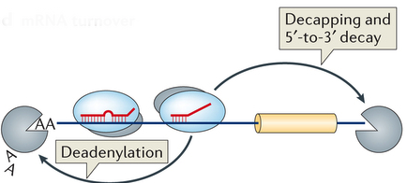
MIRNA TARGETING
Typical in plants
Typical in animals
Nature Reviews Molecular Cell Biology 14, 475–488 (2013)
The Genome Analysis Centre

Slide 3
MIRNA TARGET PREDICTION
Target prediction is a useful step toward determining miRNA function
Target predictions are exactly that – predictions
Further (experimental) evidence is required before we can confidently say that a gene is regulated by a miRNA sequence
The Genome Analysis Centre

Slide 4
MIRNA TARGET PREDICTION
Plants – easier (more complementarity required between miRNA and target sequence)
Animals – very hard (only requires perfect matching in 7nt “seed” sequence)
Several computational tools available for both plant and animal miRNA target prediction
The Genome Analysis Centre

Slide 5
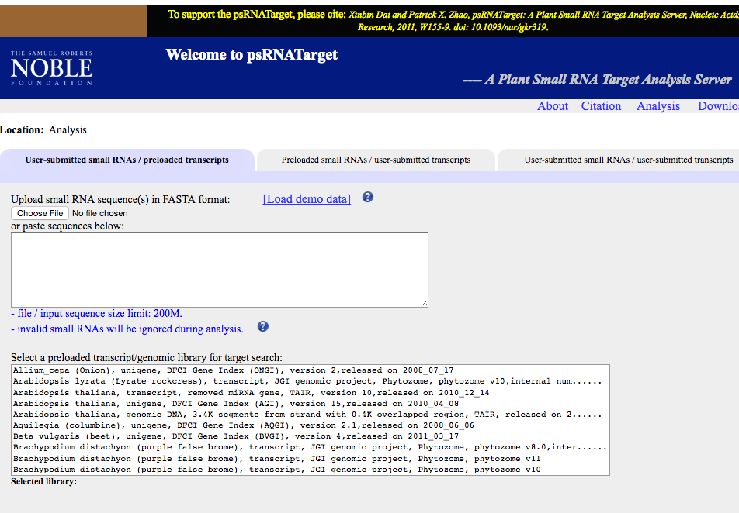
PLANT TARGET PREDICTION TOOLS
psRNATarget - http://plantgrn.noble.org/psRNATarget/
Web based tool for plant miRNA target prediction
The Genome Analysis Centre

Slide 6
EXERCISE 1
Go to miRBase (http://mirbase.org/) and find the mature miRNA sequence for ath-miR156a-5p
Go to psRNATarget: http://plantgrn.noble.org/psRNATarget/ and look for targets of this miRNA in Arabidopsis thaliana (TAIR10)
How many targets are there?
Which gene family are they predicted to target?
The Genome Analysis Centre
Notes:
Choose a miRNA and find targets
LIMITATIONS: Only for miRNAs in miRBase
LIMITATIONS: Only for a subset of species
PERL SCRIPTS AVAILABLE FOR CUSTOM DATASETS

Slide 7
EXERCISE 2 – GO term enrichment
Download results (click “Batch Download”) and open in spreadsheet software
Go to g:profiler website: http://biit.cs.ut.ee/gprofiler/index.cgi
Select organism Arabidopsis thaliana
Copy gene accessions from spreadsheet and paste into “Query” box and hit search
What is the most significantly enriched term for this set of predicted targets?
The Genome Analysis Centre
Notes:
Choose a miRNA and find targets
LIMITATIONS: Only for miRNAs in miRBase
LIMITATIONS: Only for a subset of species
PERL SCRIPTS AVAILABLE FOR CUSTOM DATASETS

Slide 8
TARGET VALIDATION
Predictions generated by such tools tend to produce varying levels of false positive results, therefore further experimental validation is required.
Animal predictions are notoriously prone to false positives
Usually experimentally validated by luciferase assay
In plants, a common feature of the miRNAs we have described is that they can silence mRNAs in a sequence specific manner through endonucleolytic cleavage.
The examination of mRNA cleavage products is one of the steps necessary for sRNA/target interaction validation in plants.
The Genome Analysis Centre

Slide 9
TARGET VALIDATION - PLANTS
Low throughput method – 5’RACE
A method known as RLM-5’ RACE (RNA linker mediated 5’ rapid amplification of cDNA ends) can be used to experimentally validate sRNA mediated cleavage by identifying mRNA cleavage fragments for a particular mRNA.
The cleavage fragments can be aligned to the reference mRNA and the first nucleotide at the 5’ end of the fragments are expected to align to same position as the cleavage site of the complementary miRNA.
High throughput method – PARE or degradome sequencing
The Genome Analysis Centre

Slide 10
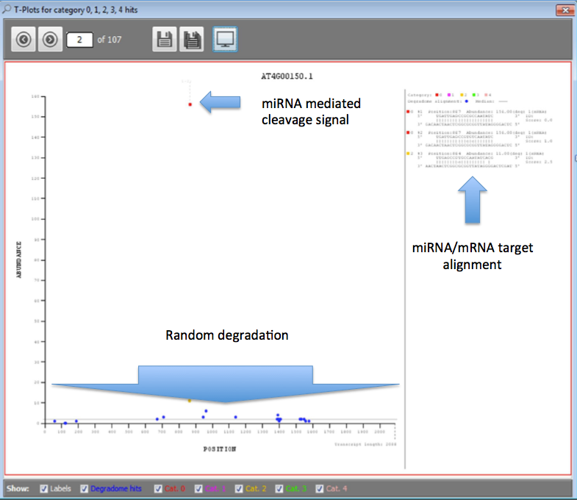
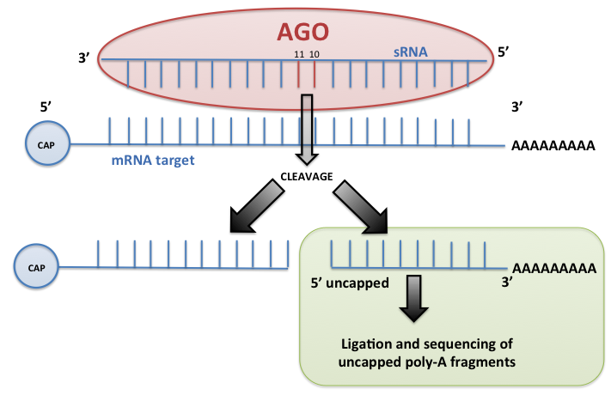
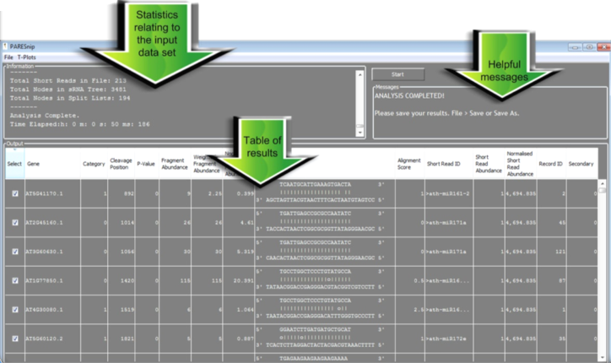
TARGET VALIDATION - PARE
In plants AGO usually cleaves target. We can sequence 3’ fragments
2.
1.
PAREsnip tool finds all potential cleaved targets by looking for degradome peaks cleaving sRNA
3.
Returns a list of binary sRNA/mRNA interactions and cleavage positions

Slide 11
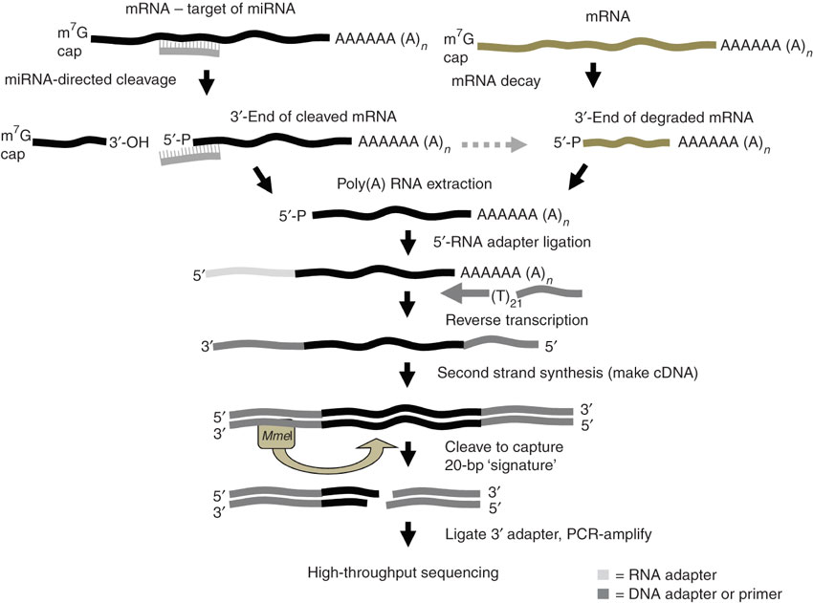
MIRNA TARGET DISCOVERY - PARE
miRNA-mediated cleaved transcripts
Random mRNA degradation
PARE sequencing can be used to find cleaved miRNA targets. Mostly used in plants but is applicable to animal data
The Genome Analysis Centre

Slide 12
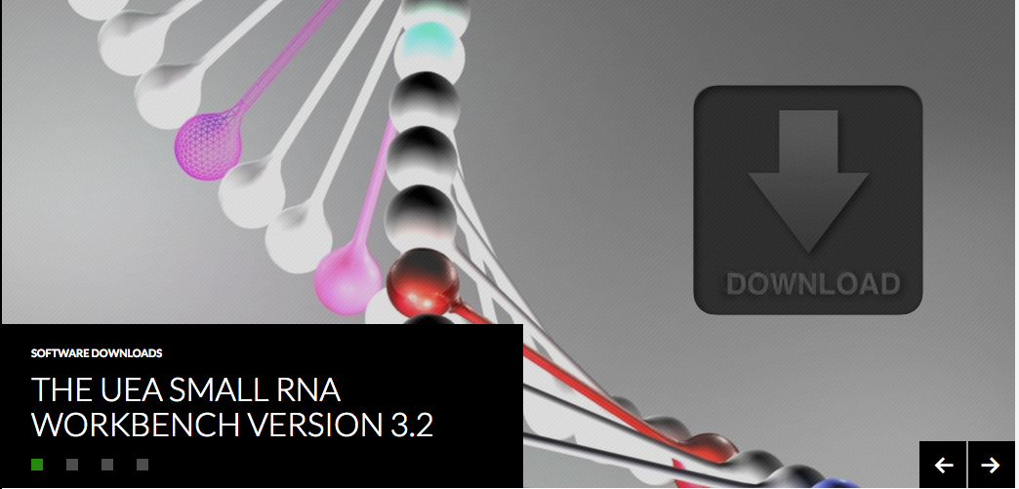
DEGRADOME ANALYSIS TOOL
PAREsnip (http://srna-workbench.cmp.uea.ac.uk/ )
A user friendly, cross platform degradome analysis tool which can be used for high throughput target analysis.
Input:
mRNA dataset (transcriptome)
Transcript degradation fragments (degradome)
miRNAs
Genome (optional)
Output:
Degradome assisted miRNA target predictions
Target plots
The Genome Analysis Centre

Slide 13
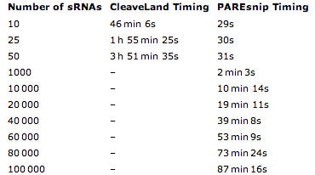
PARESNIP – WHY USE IT?
PAREsnip is extremely fast – we can analyse all potential cleavage events on a genome-wide scale (millions of small RNAs vs millions of degradome reads)
This is not computationally feasible with other tools
PAREsnip has a user-friendly GUI but can also be run on the command line and added into analysis pipelines
The Genome Analysis Centre

Slide 14
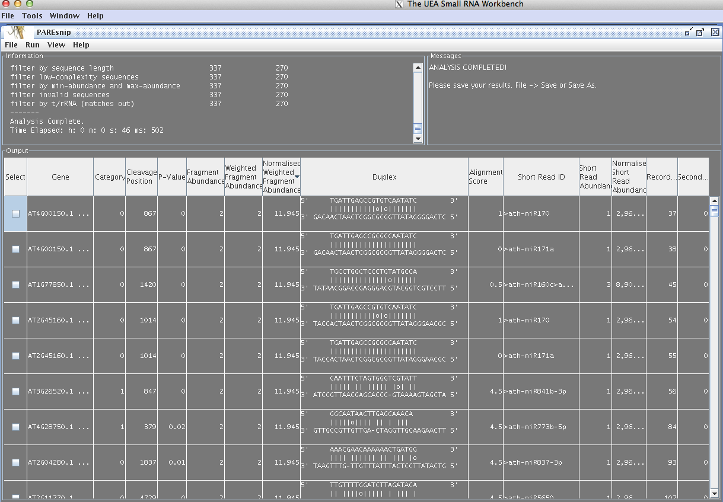
PARESNIP INTERFACE
P-value
Target gene
miRNA/target interaction
The Genome Analysis Centre

Slide 15
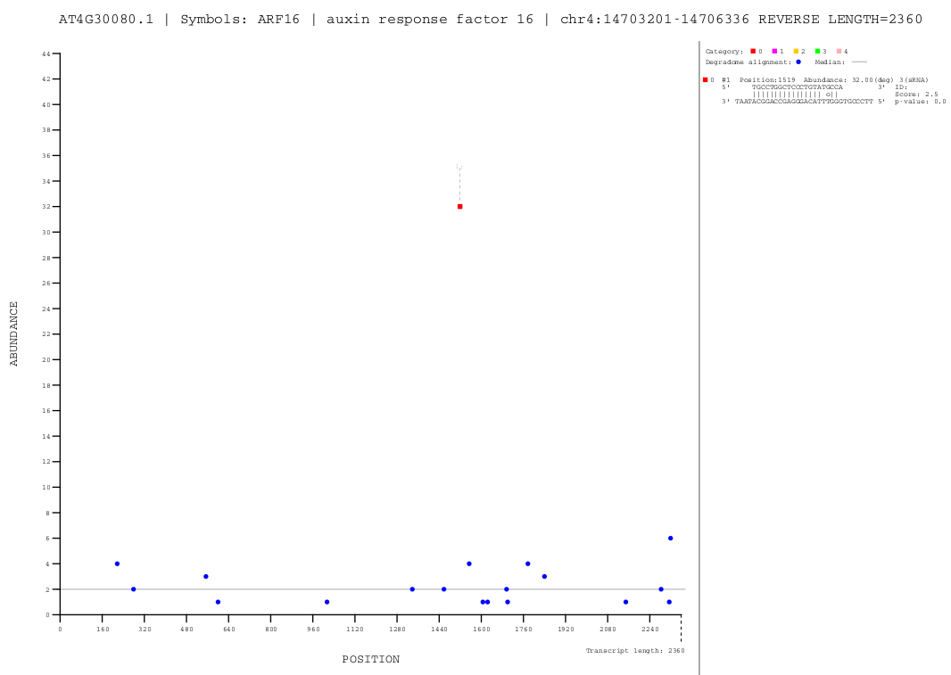
PARESNIP T-PLOT
Alignment of small RNA to cleaved target site
Cleavage signal
Background non-specific degradation
The Genome Analysis Centre

Slide 16
PARESNIP
PAREsnip allows users to find all potential interactions between small RNAs and their targets
PARE data is noisy – we can get around this by using replicates and only accepting conserved peaks (which are unlikely to be random degradation products)
PAREsnip can be used to construct small RNA/mRNA interaction networks on a genome-wide scale
The Genome Analysis Centre

Slide 17
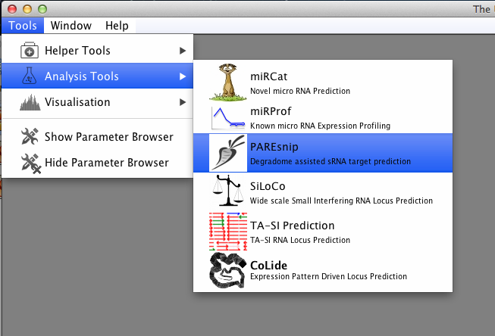
TUTORIAL
Select PAREsnip from the Tools menu. This will launch the tool:
The Genome Analysis Centre

Slide 18
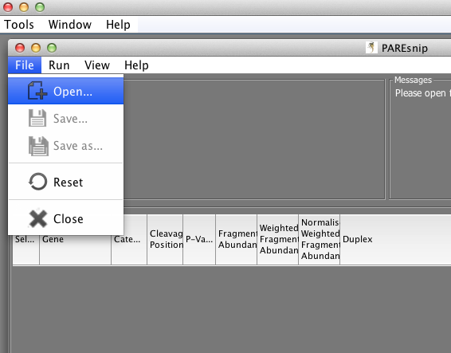
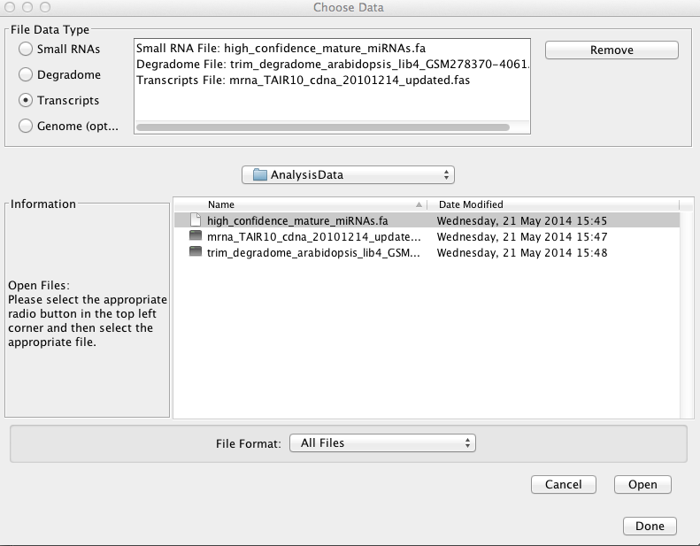
TUTORIAL
Download http://tinyurl.com/pare-data and load into the tool
The Genome Analysis Centre

Slide 19
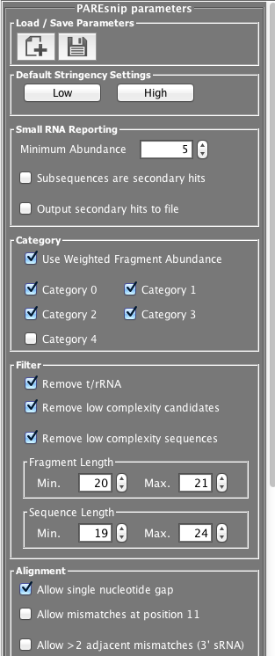
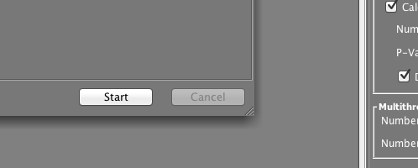
TUTORIAL
For this analysis, we will set the parameters to the default high stringency settings.
Change the sRNA minimum abundance to 1.
Set the analysis going by pressing the Start button.
Documentation containing an explanation of the parameters settings is available from: http://srna-workbench.cmp.uea.ac.uk/doc/PAREsnip_UserGuide.pdf
The Genome Analysis Centre

Slide 20
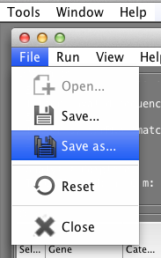
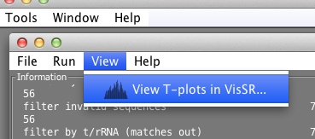
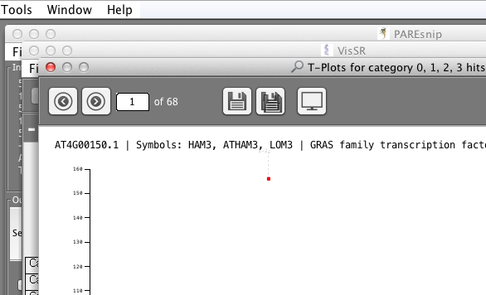
TUTORIAL
Save your analysis:
The first save dialog is for the analysis log. Save it with a .txt extension.
The second save dialog is for the results. Save it with a .csv extension.
View the target plots in VisSR.
Save ALL the target plots to pdf with a .pdf extension.
The Genome Analysis Centre

Slide 21
EXERCISE 3
Find the t-plot for AT1G77850.1
Find the PAREsnip record for this t-plot?
What is the name of the miRNA in this t-plot?
The Genome Analysis Centre

Slide 22
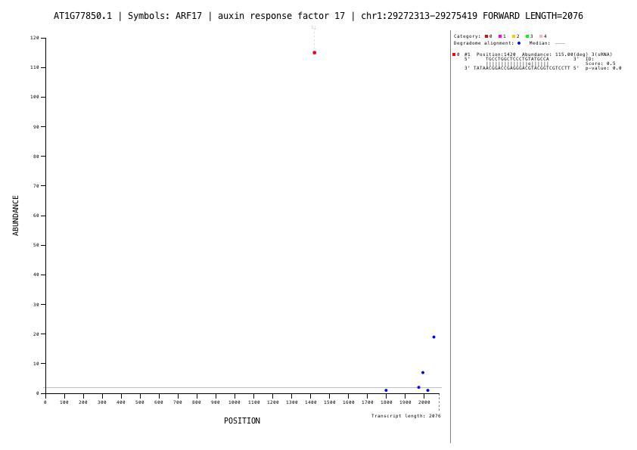
TUTORIAL
Can you find the t-plot for AT1G77850.1?
The Genome Analysis Centre

Slide 23
TUTORIAL
Can you find the PAREsnip record for this t-plot? (AT1G77850.1)
What is the name of the miRNA in this t-plot?
Ath-miR160b
The Genome Analysis Centre

Slide 24
SUMMARY
You should now be able to perform a complete analysis of small RNA data
Remember that most datasets are much larger than those used in this tutorial
This may mean that you need to run on a powerful computer or on a compute cluster
If you are performing your own analysis and would like help/advice then feel free to get in touch with me: simon.moxon@earlham.ac.uk
You can subscribe to the Small RNA Workbench email newsletter and twitter/rss feeds on the websites to keep updated with the latest developments
The Genome Analysis Centre

Slide 25
VISUALISATION OF PARE NETWORKS
PAREnet:
A tool for degradome assisted
discovery and visualization of small RNA/target interaction networks
The Genome Analysis Centre

Slide 26
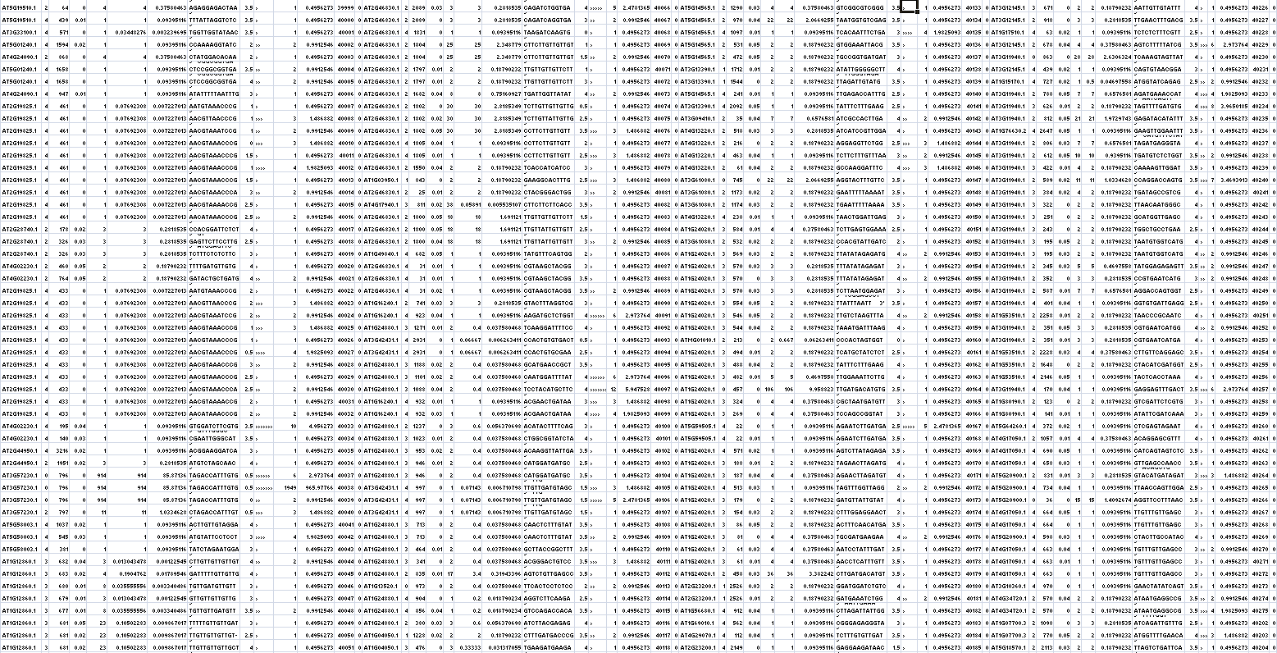
VISUALISATION OF PARE NETWORKS
Output from degradome analysis can be large and contain tens of thousands of interactions.
Results from degradome analyses can be difficult and time consuming to interpret.
Screenshot of CLI output from PAREsnip: shows the amount of data produced from genome-wide degradome analysis is difficult to interpret without further analysis.
The Genome Analysis Centre

Slide 27
PAREnet: Visualisation of sRNA/mRNA networks
In plants AGO usually cleaves target. We can sequence 3’ fragments
2.
1.
PAREsnip tool finds all potential cleaved targets by looking for degradome peaks cleaving sRNA
3.
Returns a list of binary sRNA/mRNA interactions and cleavage positions
The Genome Analysis Centre

Slide 28
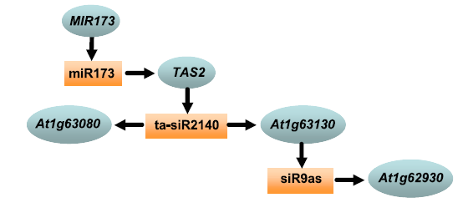
PAREnet: Visualisation of sRNA/mRNA networks
TAS2 cascade
Chen, H et al. Bioinformatic prediction and experimental validation of a microRNA-directed tandem trans-acting siRNA cascade in Arabidopsis. PNAS 104.9 (2007): 3318-3323.
Degradome reveals complex networks of small RNA/mRNA interactions
Hard to interpret large interaction lists!
Require tools to visualise - PAREnet
The Genome Analysis Centre

Slide 29
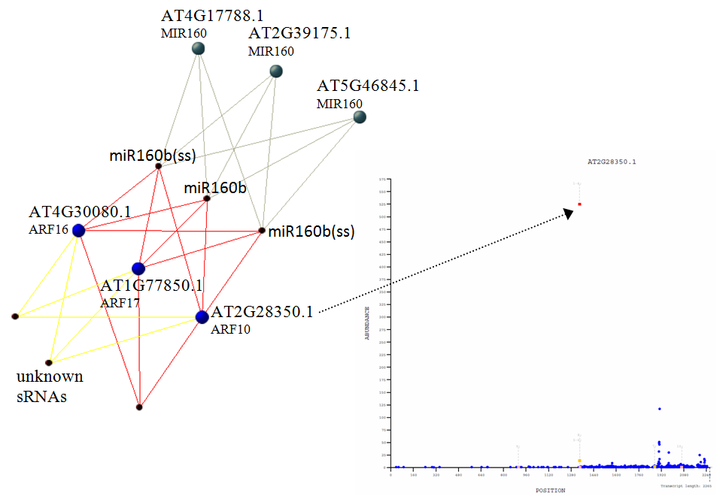
PAREnet: Visualisation of sRNA/mRNA networks
A network representation of degradome analyses can contain the equivalent information as many of t-plots.
A network representation of degradome analyses can contain many interactions in a single view.
A network representation of degradome analyses helps with the interpretation of the data by placing interactions in a larger context.
A network example for miR160b: shows miR160b and isomiRs cleaving ARF family targets with a category 0 cleavage signal.
The Genome Analysis Centre

Slide 30
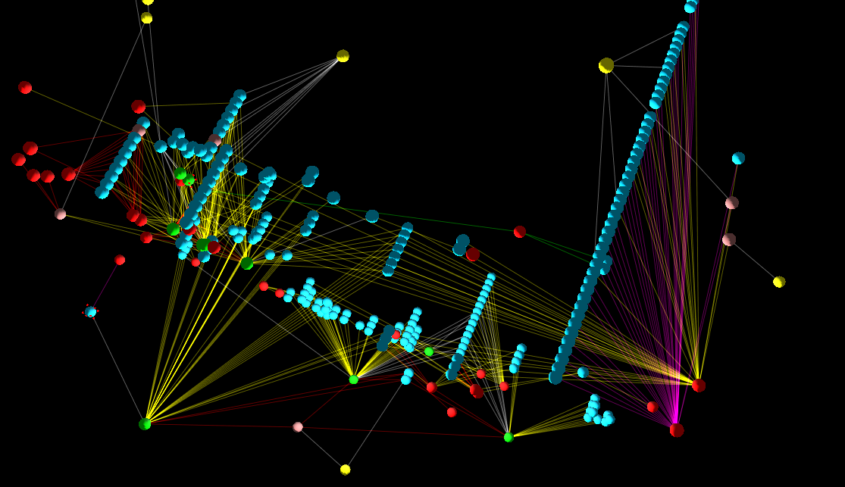
PAREnet: Visualisation of sRNA/mRNA networks
From degradome analyses, we can generate large scale regulatory interaction networks.
PAREnet allows users to rapidly generate, visualise and analyse complex networks of small RNA regulatory interactions in three dimensional space.
Example network from Arabidopsis thaliana: Shows trans-acting small interfering RNA (tasiRNA) interaction network. Coloured edges represent interaction confidence. Yellow nodes are small RNA origins, red mRNAs and blue small RNA nodes. Green nodes are origin and cleavage nodes. Light red nodes are known miRNAs.
The Genome Analysis Centre

Slide 31
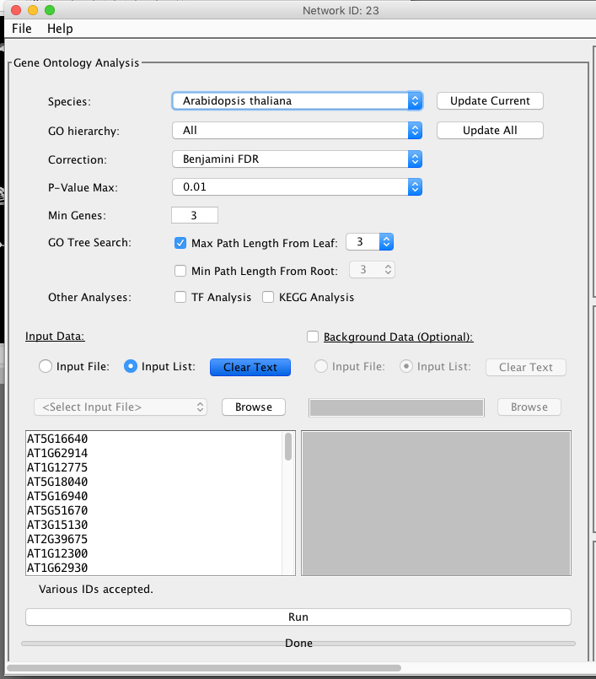
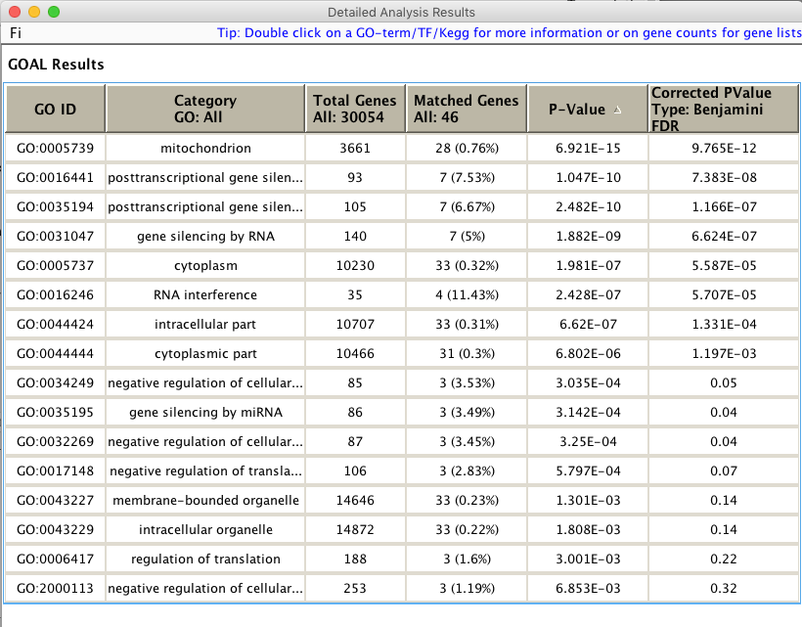
PAREnet: Visualisation of sRNA/mRNA networks
The function of a network can be investigated.
GO term enrichment analysis can be performed on groups of genes within a network.
GO term enrichment analysis is performed by a software module called GOAL.
Screen shot of GO Term analysis options: Shows user configurable settings.
Screen shot of GO Term analysis output: Shows GO Categories and p-values for genes within a network group.
The Genome Analysis Centre

Slide 32
Availability
The PAREsnip tool is available within the UEA sRNA Workbench.
PAREnet tool will be released within the UEA sRNA workbench (summer 2016).
http://srna-workbench.cmp.uea.ac.uk/
The Genome Analysis Centre

