Slide 1
Identifier mapping: where do I go?
Q5S007
?
ENSG00000188906

Slide 2
Using identifiers/accessions
The use of identifiers allows for “unambiguous” identifications of molecules and their representation in databases
In reality, they reflect a conceptual entity that might represent one or more molecules
Example: GeneID that reflects every variant/splicing alternative of a given gene – multiple sequences
That leaves space to ambiguity
There is a large number of identifiers that aim to represent the “same” entities
Example: alternative protein IDs (Ensembl protein vs UniProt)

Slide 3
Using identifiers: most commonly used accessions
Entrez GeneIDs
Gene-centered identifier: DNA consensus sequence, no isoform or variants.
UniProt
Represents proteins, taking into account isoforms. Additional identifiers for variants and post-processed chains.
RefSeq
Represents sequences of DNA, RNA and proteins.
Ensembl
Identifiers that represent genes and their different products: gene, gene tree, protein, regulatory feature, transcript, exon and protein family.
International Protein Index
Proteomics reference database (protein sequences). Now obsoleted, but still used in proteomics.
HUGO gene symbols
Unique symbols and names for human loci (protein-coding genes, RNA genes and pseudogenes).
Organism centered databases: TAIR, WormBase, SGD…

Slide 4
Mapping identifiers: common problems
gene ≠ transcript ≠ protein ≠ isoform ≠ clone
protein
transcript
protein
gene
transcript
protein
isoform
transcript
protein
isoform
gene
transcript
gene
transcript
protein
gene
transcript

Slide 5
Mapping identifiers: common problems
gene ≠ transcript ≠ protein ≠ isoform ≠ clone
It’s a model!
protein
transcript
protein
gene
Models change: identifiers (and sequences!) disappear and get updated
transcript
protein
isoform
transcript
protein
isoform
It’s “misused”!
gene
transcript
gene
transcript
protein
Example: Gene identifiers are used to represent proteins
gene
transcript

Slide 6
Mapping identifiers: common problems
gene ≠ transcript ≠ protein ≠ isoform
protein
transcript
Solution
protein
gene
transcript
protein
isoform
transcript
protein
isoform
Know your databases!
gene
transcript
gene
transcript
protein
gene
transcript

Slide 7
Mapping identifiers services
Non exhaustive list!
UniProt ID mapping | http://www.uniprot.org/mapping/
PICR | http://www.ebi.ac.uk/Tools/picr/
MatchMiner | http://discover.nci.nih.gov/matchminer/index.jsp
Ensembl BioMart | http://www.ensembl.org/biomart/
DAVID GeneID Conversion Tool | http://david.abcc.ncifcrf.gov/conversion.jsp
CRONOS | http://mips.helmholtz-muenchen.de/genre/proj/cronos/
Clone/GeneID Converter | http://idconverter.bioinfo.cnio.es/IDconverter.php

Slide 8
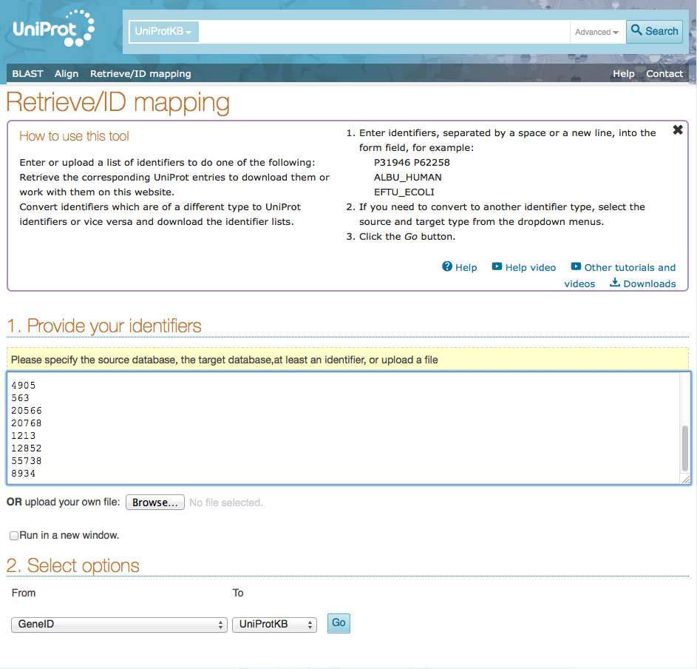
Examples of use: UniProt ID mapping service
Enter identifiers here
Select identifier input / output type

Slide 9
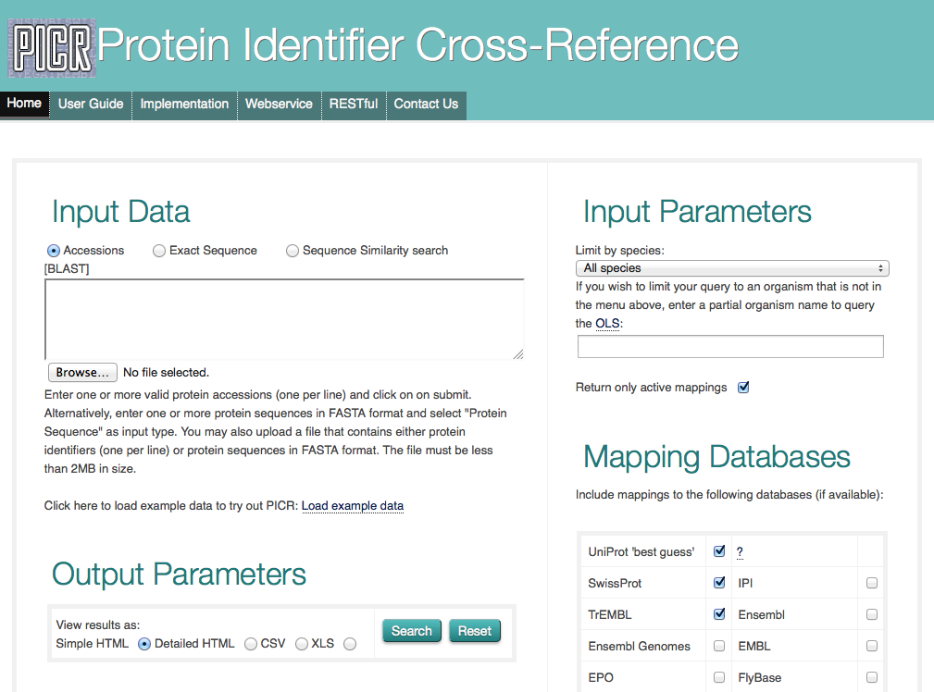
Examples of use: PICR

Slide 10
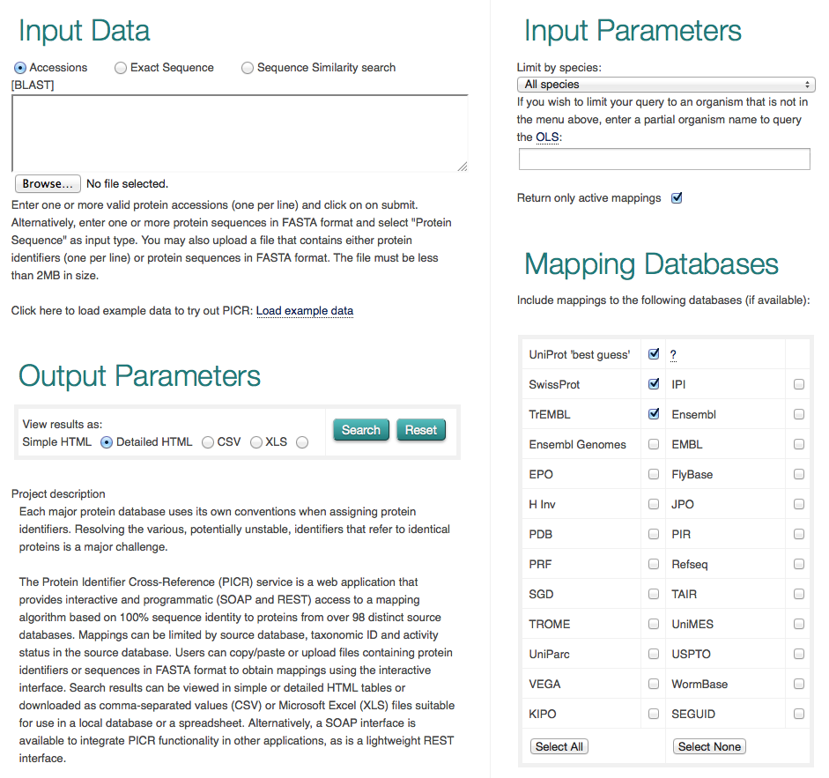
Examples of use: PICR
Enter identifiers / sequences here
Select organism
Select destination identifier
Select output format

Slide 11

Hands-on: Translate into UniProt accessions
Translate the identifiers from the files human_emsemblIDs.txt and human_entrezgeneIDs to UniProt accessions using different mapping tools
What differences can you observe in the different services?

Slide 12
Hands-on: Translate into UniProt accessions
Have a look at the file unknownidentifiers.txt
Can you recognize the different identifiers listed there?
Try translating the identifiers using different mapping tools. Can you get the whole list translated?
What differences can you observe in the different services?

Slide 13


