Slide 1
Rothamsted Research
Training Activities & Software resource development update
C.E. McInerney, A. Singh, A. Mead, K. Hassani-Pak, C.J. Rawlings
Rothamsted Research, Computational and Systems Biology, Harpenden, UK

Slide 2
Development of e-Learning
Platform to host statistics & bioinformatics training
Content Management System, Moodle on server (March)
www.e-learning.rothamsted.ac.uk/moodle/login
Added plugins
Content - Mathematical equations in LaTeX - MathJax, TeX
Course tracking – Course completion progress bar
Site functionality - Moodle for mobile devices
Future - develop more functionality useful for teaching
Dynamic panes / images, Interactive Environments for R (Jupyter)
Developing expertise - Moodle, LaTeX and HTML
Exchanging knowledge & experiences (Cloud Fileshare) - SYSMIC, IFR

Slide 3

Applied Statistics Training
Convert “Basic Statistics & Introduction to GenStat” to
online “Introduction to Statistics” using GenStat & R Studio:
Compilation & familiarisation with course & other materials
e.g. Babraham Institute R training materials
Filmed & annotated the course for materials development
e.g. Statistical software implementation videos
Course structure - re-ordered & new topics
Developing content & resources
e-Learning digital badges (Visual Communications Unit)

Slide 4
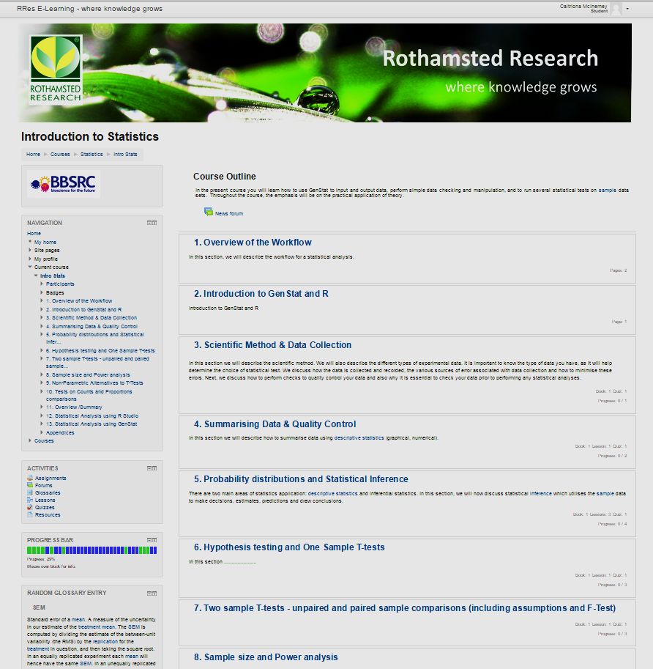
Introduction to Statistics - Content & Resources

Slide 5
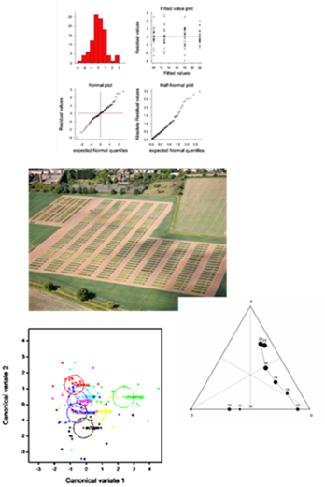
Introduction to Statistics - Content & Resources
Theory – Schematics, Figures, Images, Equations in LaTeX
Lessons – Exercises & Solutions implemented in GenStat & R Studio
New exercises, R Scripts, Compiled R Notebook
Hardcoded HTML & uploaded into Moodle
Quizzes – Various question types
Matching, Embedded Answers (Cloze Test / Gap Fill)
Multiple Choice, Short Answer, Numerical, True/False
Manuals - GenStat & R Studio (Video demos)
Appendices
Glossaries: Statistical Equations, Statistical terms, Symbols & formulae
R commands, Probability distribution tables, Tables

Slide 6
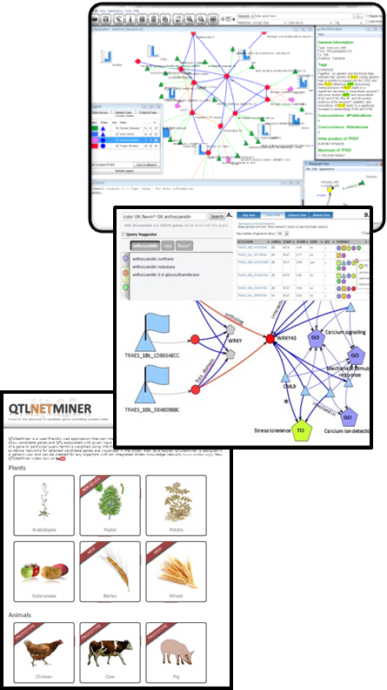
Applied Bioinformatics Training
Ondex and QTLNetMiner - Data Integration & Mining
Hypothesis generation & candidate gene discovery
Developed new training materials
Hands-on tutorial for Ondex
Updated hands-on tutorial for QTLNetMiner
Tutorial worksheet for QTLNetMiner
Data Integration & Mining - Integrative Omics at EBI
Guest invitations for Babraham Institute
Host training materials on e-Learning platform
Potential to create online course
Quizzes, Exercises etc.

Slide 7
Software Development (QTLNetMiner)
Web application that efficiently interrogates large genome-scale knowledge networks (built using Ondex) with user data such as search terms, QTL and gene list.
Main focus to facilitate gene-phenotype discovery.
Gene knowledge networks can be explored in the Network Viewer.
Can be created for any organism with an integrated knowledge network.
Open-source, code available on GitHub.
Web: https://ondex.rothamsted.ac.uk/QTLNetMiner
Code: https://github.com/KeywanHP/QTLNetMiner

Slide 8


QTLNetMiner software architecture
Web Browser
KNETViewer
User
Device
JavaScript
Flash
DHTML
HTML, JSON, XML and images over HTTP via Ajax
Apache Tomcat
QTLNetMiner Client
Servlets and JSP Page
Java Socket
Java Socket
Multithreaded Java Server
Views
KNET-Server
Knowledge Network Graph DB
Ondex API

Slide 9
Software development objectives
Network View:
Replacing the existing Java applet-based Network Viewer with a lightweight, Javascript-based, touch-enabled version (KNETviewer).
Map View:
Replacing the Flash-based GMOD Gviewer with a lightweight, Javascript-based version.
QTLNetMiner enhancements:
Making the existing QTLNetMiner source code more robust and enhancing its existing features.

Slide 10
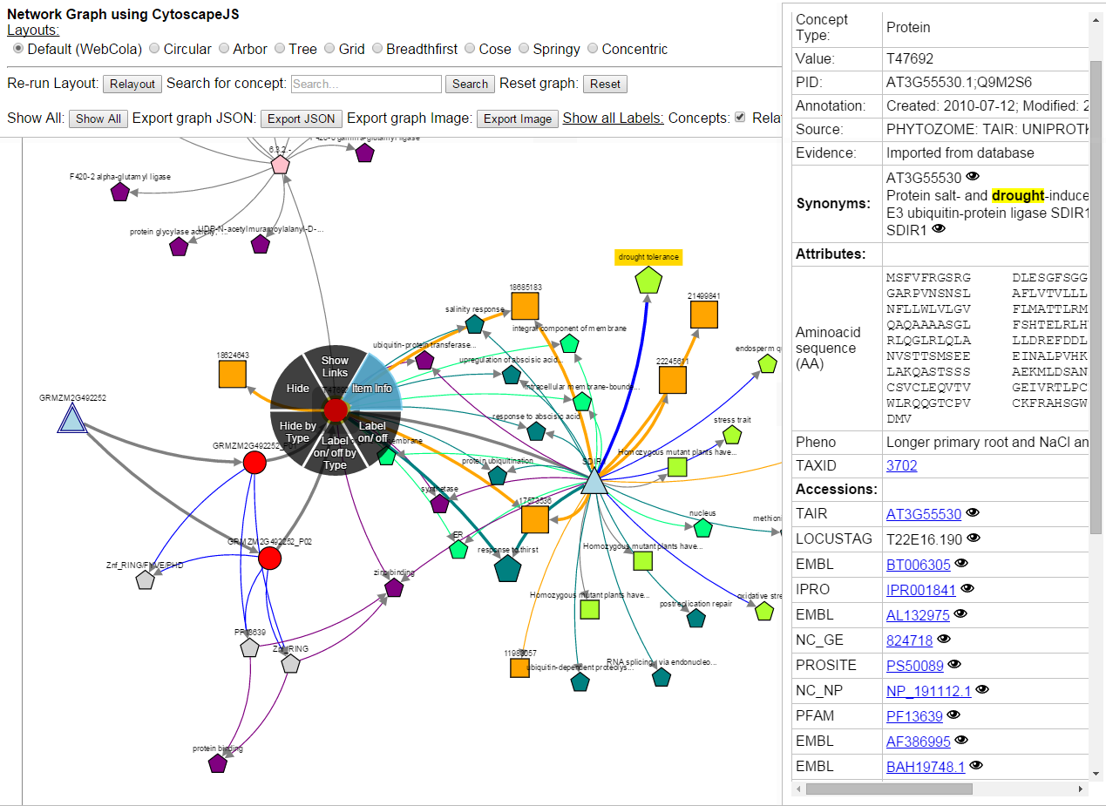
KNETViewer (in progress)

Slide 11
KNETViewer features
Visualize content-rich, semantic networks
Create animated network graphs
Interactive viewport manipulation
Compatible with touch devices
Works on Apple iOS, Android and Microsoft mobile devices.
Modular architecture
Sliding Item Information panel
Radial context menu
Export graph datasets (JSON) or graphs as images
Multiple graph layout algorithms implemented.

Slide 12
KNETViewer availability
Currently developed as part of the QTLNetMiner source code.
Work is underway to package and release it as a standalone component as well, with supporting documentation.
Open source: The source code will be made available on GitHub and users will be able to embed it in their projects and web applications.
Users will be able to launch it in their web applications by simply providing a JSON dataset containing concept and relation data.

Slide 13

Head of Applied Statistics: Andrew Mead
andrew.mead@rothamsted.ac.uk
http://www.rothamsted.ac.uk/applied-statistics
Head of Applied Bioinformatics: Keywan Hassani-Pak
keywan.hassani-pak@rothamsted.ac.uk
http://www.rothamsted.ac.uk/applied-bioinformatics

