Slide 1
Linux and C introduction
曾歆勋
鸣谢黄博

Slide 2

Getting Started
Pictures from google

Slide 3
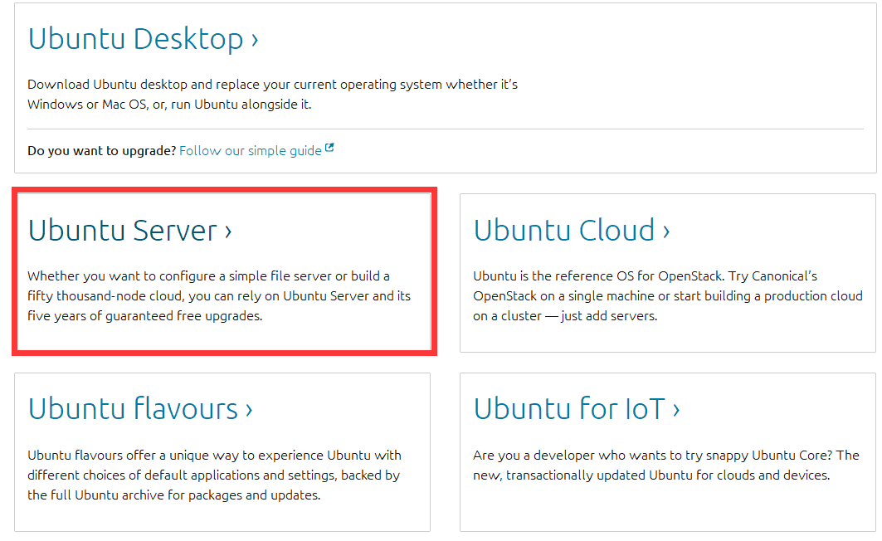
How to get a Linux OS?
Ubuntu Server 18.04 LTS recommend
https://www.ubuntu.com/download
Burn the iso into your USB. ( ultraiso )
Startup by USB
Install

Slide 4
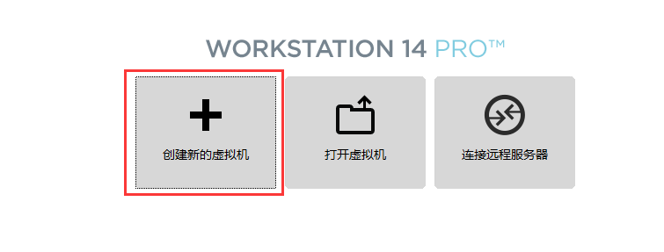
How to get a Linux OS?
Using virtual machine
Download Vmware

Slide 5
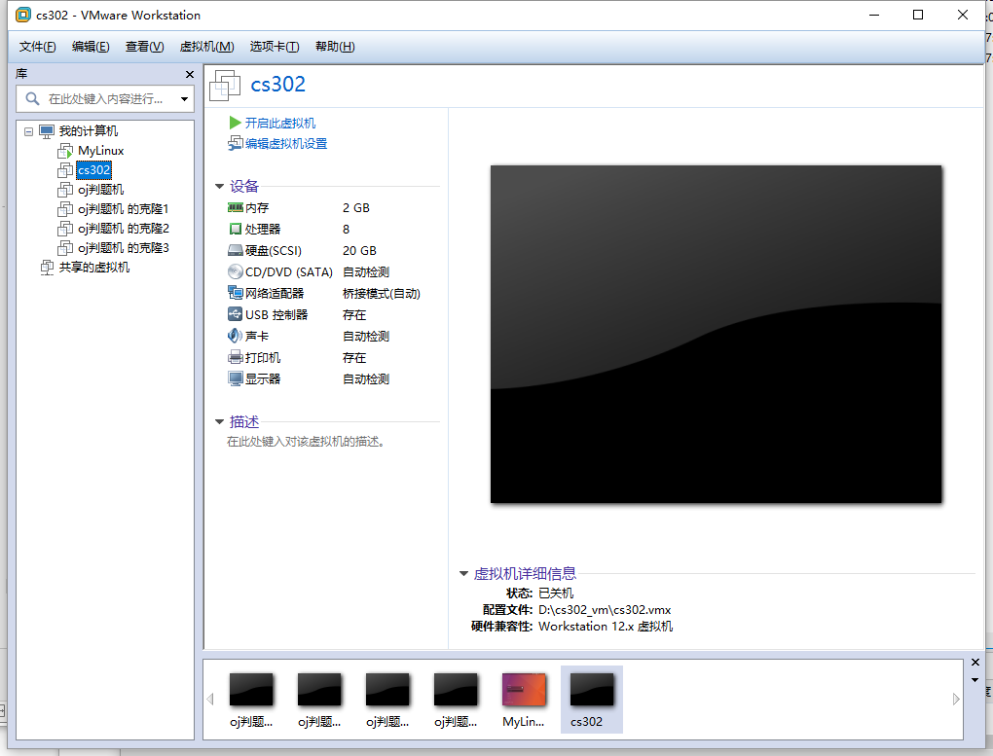
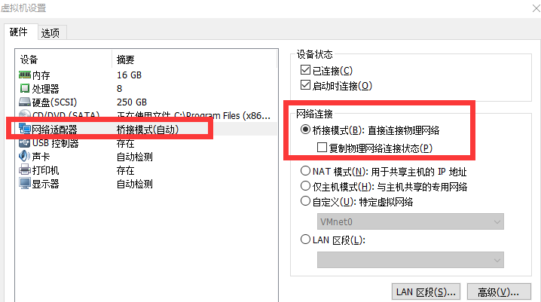
Virtual Machine

Slide 6

Basic command
Pictures from google

Slide 7
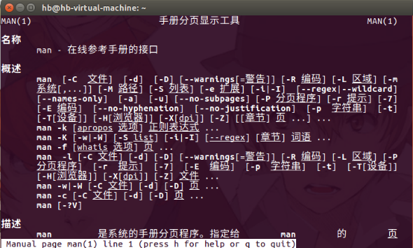
Basic command
man xxx
show the manual of command xxx
you can try “man man”

Slide 8
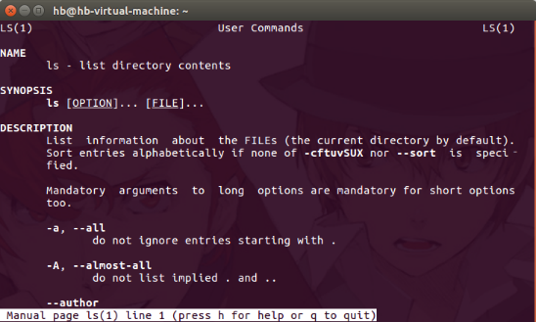
Basic command
ls
list directory contents
let’s try “man ls”

Slide 9
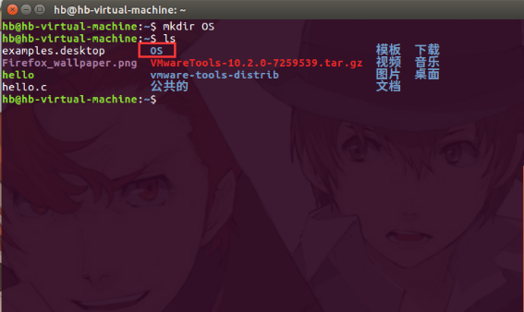
Basic Command
mkdir
make a new directory
try man mkdir by yourself
try to make a directory named OS in HOME(~)

Slide 10
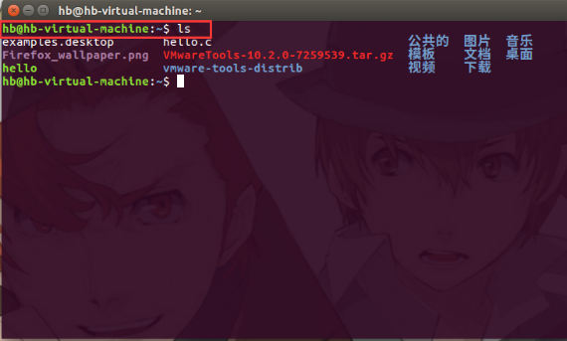

Basic command
ls
How to go into OS?

Slide 11
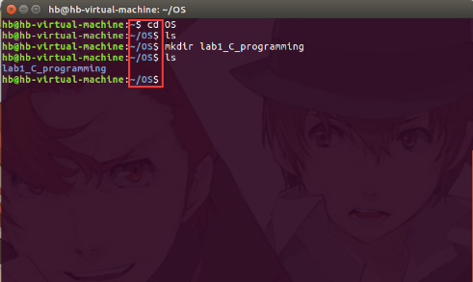
Basic command
cd
change directory
let’s go to OS directory
Try cd /home
Try cd ~, cd ..

Slide 12
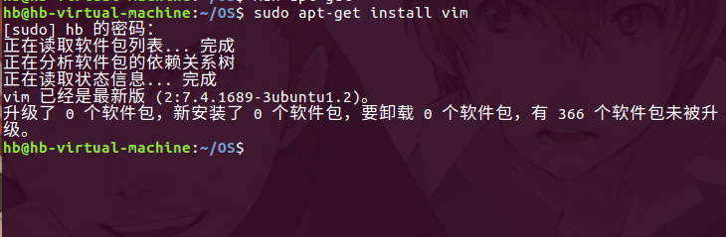
Basic command
apt-get install vim
This command need root authority. Use sudo to swtich get root authority for a while.
apt-get handling packages
install means we want to install this package
you can man apt-get to learn details

Slide 13

Editor
Pictures from google

Slide 14
Why we need editor
Server
When you connect to a linux server, sometimes it doesn’t have GUI.

Slide 15
VIM
vim
A powerful editor.
You can use vim/vi in terminal to edit files.
In order to get full functions about vim, we can install some packages first.

Slide 16
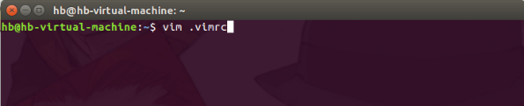
Configure vim
This is not necessary, just let you be more comfortable when using vim.
Go to HOME
Using vim command to edit file .vimrc

Slide 17
VIm
Vim has three modes, they are:
Command mode: you can not input text, everything you input will be command.
Insert mode: you can input text. Press Esc to return command mode.
Last line mode: you can input special command. Such as exit and find string.

Slide 18
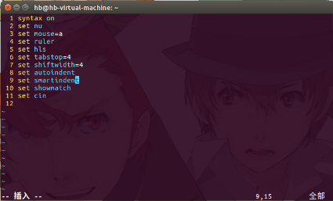
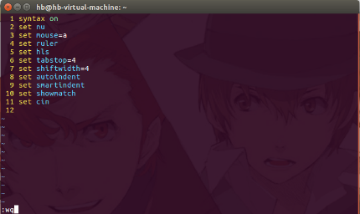
VIm
Configure
Press i to go to insert mode
Input text
Press Esc go back to command mode
Press shift + ; to go to last line mode
Press wq to write and quit

Slide 19
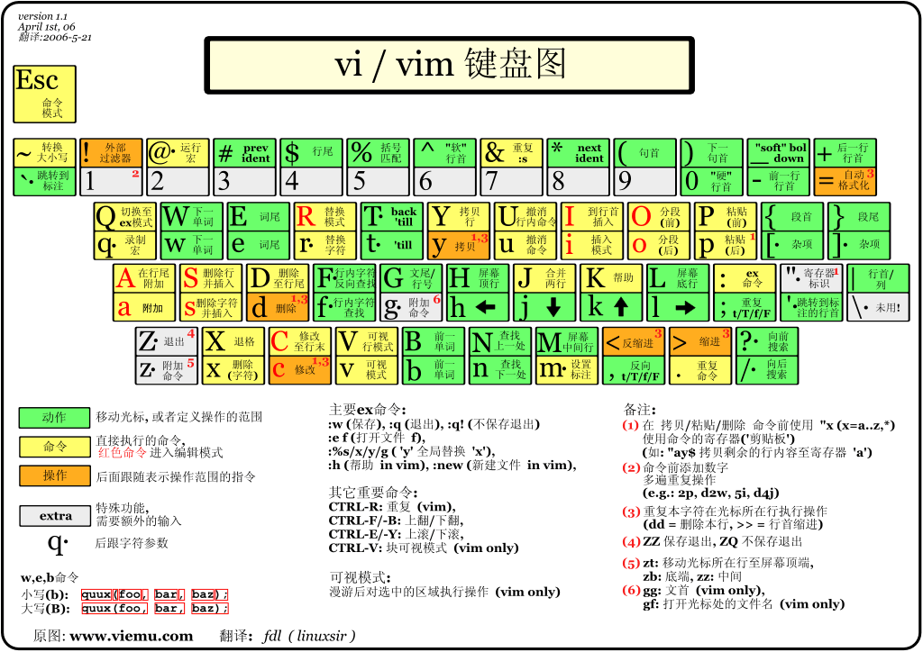
You may need this

Slide 20

Programming
Pictures from google

Slide 21
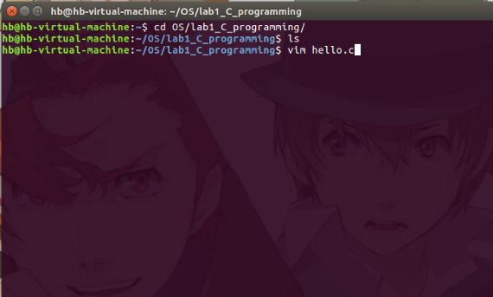
First C program
Now we are ready for our first C program.
Go to lab1_C_programming directory
And edit file: hello.c

Slide 22
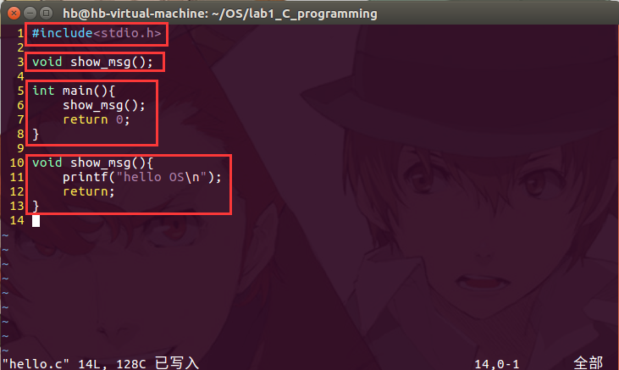
First C program
C header file
Function declaration
Main function
Function definition

Slide 23
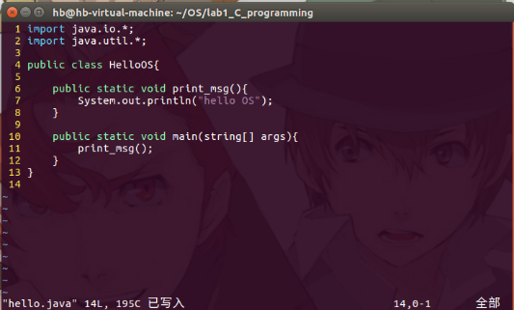
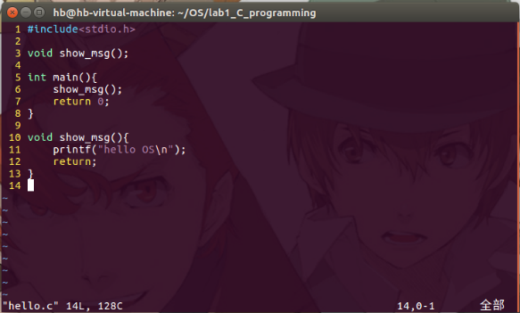
A java program

Slide 24
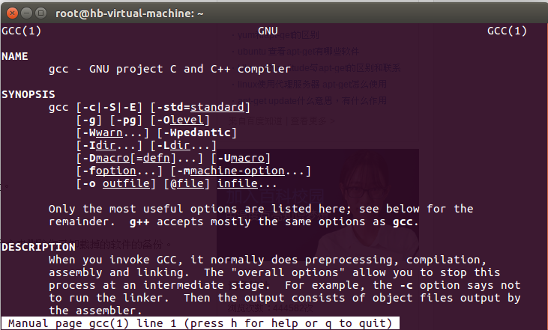
First c program
How to run our program?
We need compile it!
Ubuntu has GCC (GNU Compiler Collection)
Let’s compile our first c program

Slide 25
About GCC
gcc
-c Compile or assemble the source files, but do not link.
-S Stop after the stage of compilation proper; do not assemble.
-E Stop after the preprocessing stage; do not run the compiler proper.
-o filename Place output in file file.
If no parameters, gcc will do all things and output an execute file a.out

Slide 26
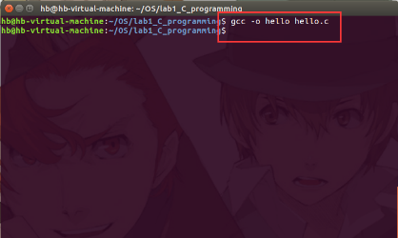
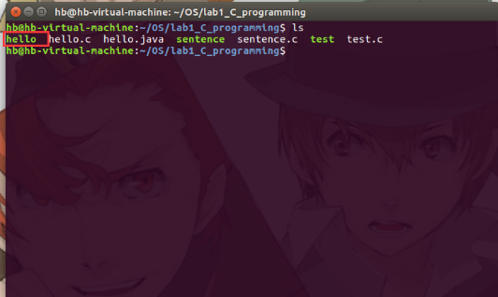
First c program
Input gcc –o hello hello.c on terminal
You can also input gcc hello.c –o hello

Slide 27
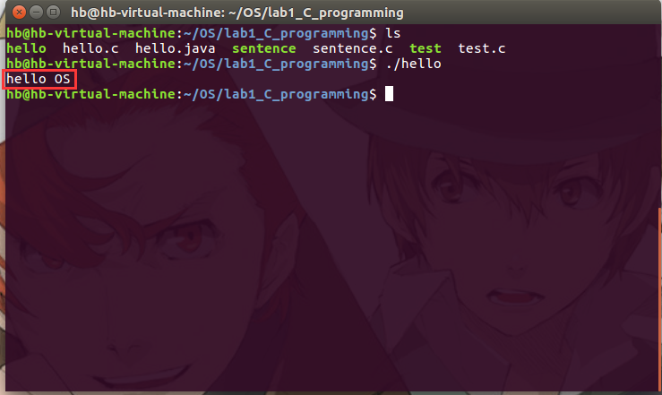
First c program
Let’s run it!
./hello

Slide 28
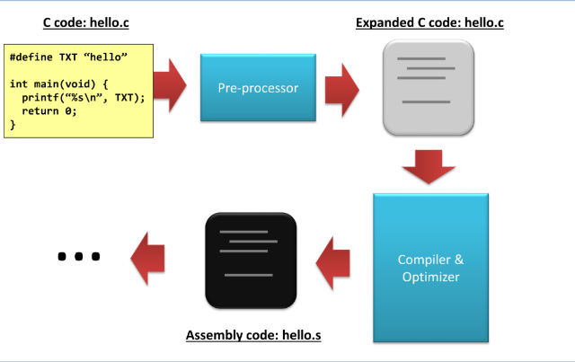
What happens?
Pictures from: https://calvinkam.github.io/csci3150-Fall17-lab3/building-a-program.html

Slide 29
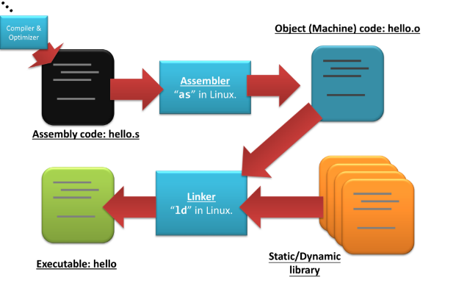
What happens?
Pictures from: https://calvinkam.github.io/csci3150-Fall17-lab3/building-a-program.html

Slide 30
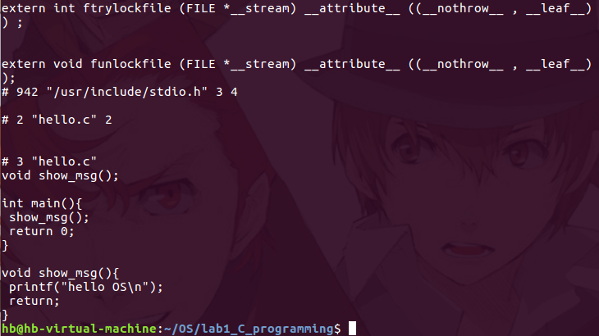
What happens?
Pre-processor
Input gcc –E hello.c
Replace #include

Slide 31
What happens?
compiler and optimizer
First check syntax and analyze it.
Then produce assembly code.
Optimizer will improve the code quality.

Slide 32
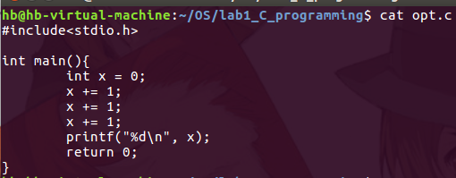
More about optimizer
Consider this example opt.c
We open the optimizer to get assembly code

Slide 33
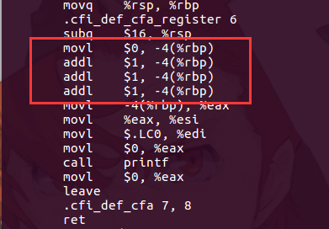
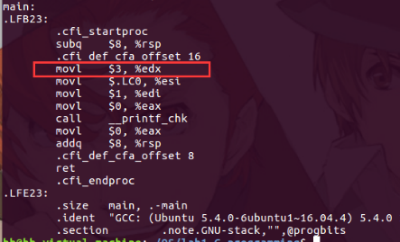
More about optimizer
opt0.s
opt1.s

Slide 34
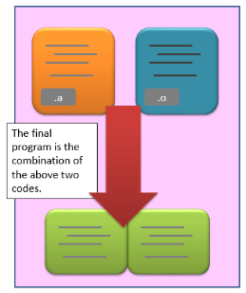
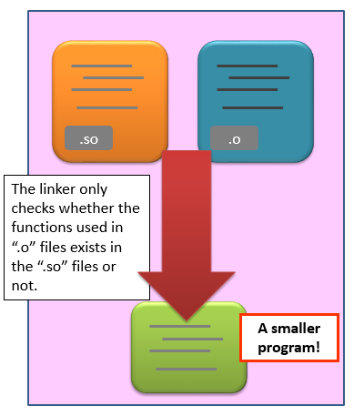
What happens?
Finally, Linker will link share library or static library with your code. And form executable file.
Pictures from: https://calvinkam.github.io/csci3150-Fall17-lab3/assembler-and-linker.html

Slide 35

C language
Pictures from google

Slide 36
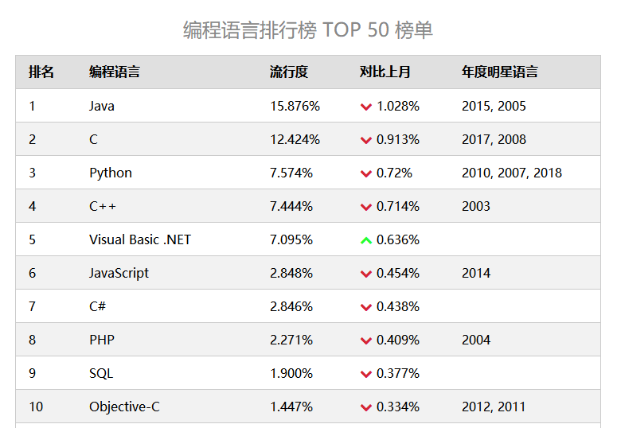
Why we need C

Slide 37
example
Please write a simple program.
Get 2 integer from user input
Print the square root of their square sum.

Slide 38
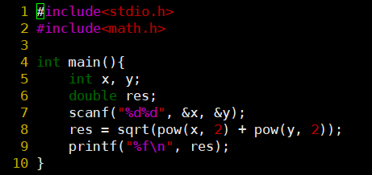
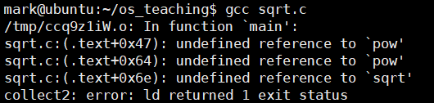
Example
We write the code and save it. Do you remember how to use vim?
Then compile it.

Slide 39


example
Do not be afraid of meeting problems, we have many ways to solve it.
Let’s search it on the internet.
https://stackoverflow.com/questions/13228111/c-undefined-reference-to-sqrt
Here is the solution!

Slide 40

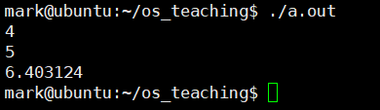
example
OOPs, it works. Thanks to stackoverflow!
Let’s try again.
And it works!

Slide 41
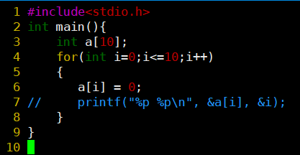
Strange code
Sometimes these code will cause infinite loop, sometimes will not.
Why?
Try yourself

Slide 42
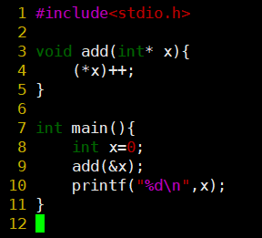

Pointer
指针——C语言的精髓
& 取址操作符
* 取值操作符
x
*ptr
&x
ptr
值
5
地址
0x2ac
You will meet pointer many times in this course.

Slide 43

Exercise
Pictures from google

Slide 44
Exercise
gcc exercise
Try gcc hello.c what do you find?
Try gcc –c hello.c what do you find?
Try gcc –E hello.c what do you find?
Try gcc –S hello.c what do you find?
How about add –o output to these commands?

Slide 45
Exercise
Be aware
How to use array
The average number
I will input 20 integers, please calculate the maximum, minimum and the average number of these 20 integers.

Slide 46
Exercise
Be aware
How to sort them?
Can you use library?
I will input n integers,(1 <= n <= 100), please sort them by ascending order.

Slide 47

Exercise
Be aware
spaces
Give you an integer n. Please print the following picture. (ex. n = 7)
n <= 11, n is odd.

Slide 48
Exercise
Be aware
directions
Give you an integer n. Please print the following picture. (ex. n = 9)
n <= 100, n is a square number
123
894
765

Slide 49
Thank you

