Slide 1
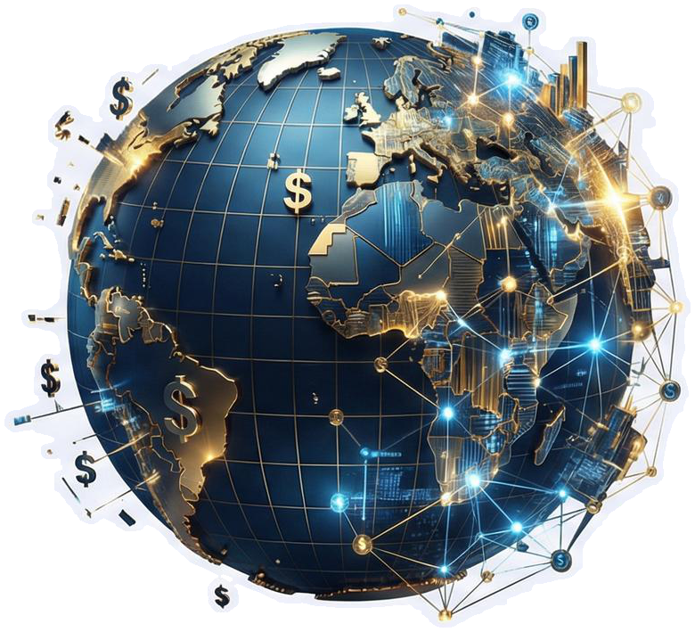
Beyond the Greenback - Architects of the Post-Dollar Era
Navigating the Future of Geopolitical Fintech

Slide 2
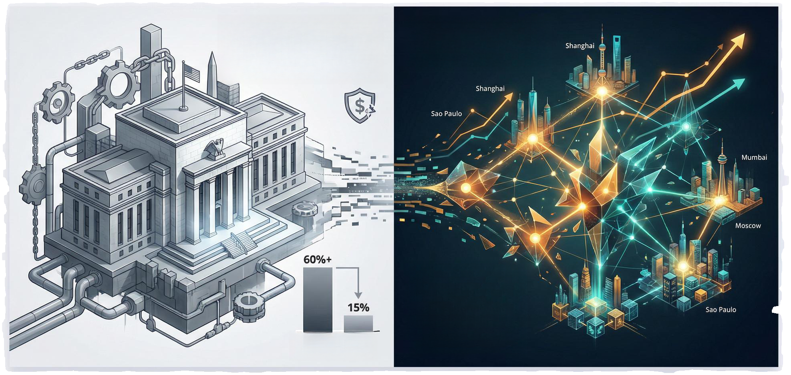
The Weaponization of Finance
THE CHALLENGE: The US Dollar's 'exorbitant privilege' has historically allowed for power projection through financial sanctions.
THE TURNING POINT: Recent freezing of sovereign reserves served as a wake-up call for the Global South.
BRICS Payment Systems Adoption Non-USD Trade Volume
Non-USD Trade Volume
Sovereign Digital Currencies (CBDCs)
THE RESPONSE: Financial sovereignty is now a national security imperative, driving BRICS nations to build parallel rails bypassing New York.
USD Global Sanctions Reserves Share Impact (Historical High)

Slide 3
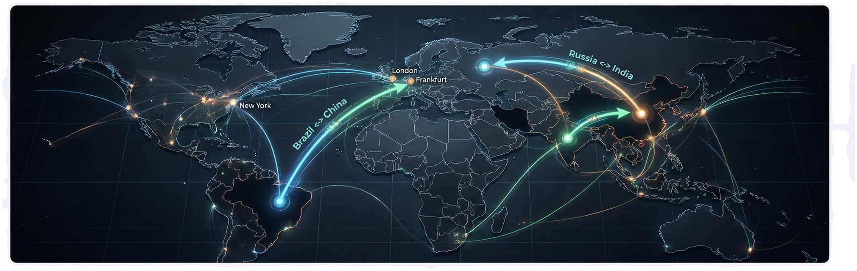
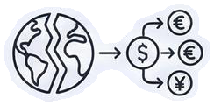
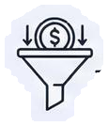
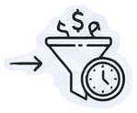
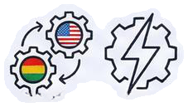
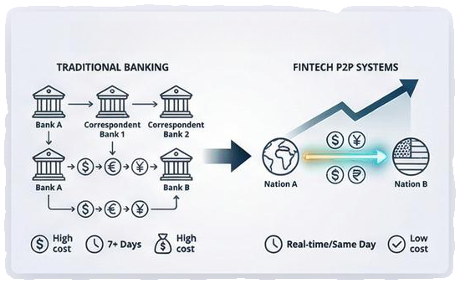
THE FRAGMENTATION OF GLOBAL TRADE
New Peer-to-Peer Trade Efficiency
Structural Shift: Moving from a unipolar financial system to a multipolar economy with direct non-G7 trade.
The Bottleneck: Traditional correspondent banking is inefficient, expensive, and reliant on dollar conversion.
The Solution: Fintech builders are designing “peer-to-peer” national trade systems that respect local liquidity and political neutrality.

Slide 4
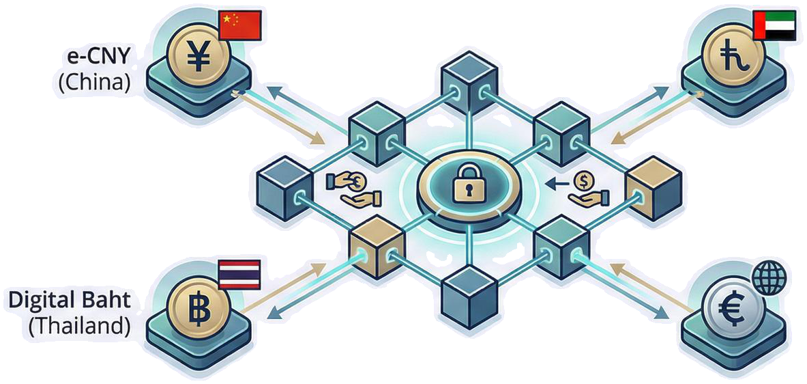


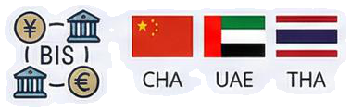
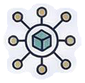


Project mBridge: The Public Sector's Answer
Other Central Bank CBDC (e.g., HKMA)
Corridor of Trust
State-Sponsored De-dollarization
Shared Ledger Innovation
• Payments settle instantly in local currency, completely removing US correspondent banks and compliance hurdles.
• A collaboration between the BIS and central banks of China, UAE, and Thailand. Shared Ledger Innovation
• Unlike SWIFT’s messaging, mBridge allows direct swapping of digital currency on a single blockchain.

Slide 5
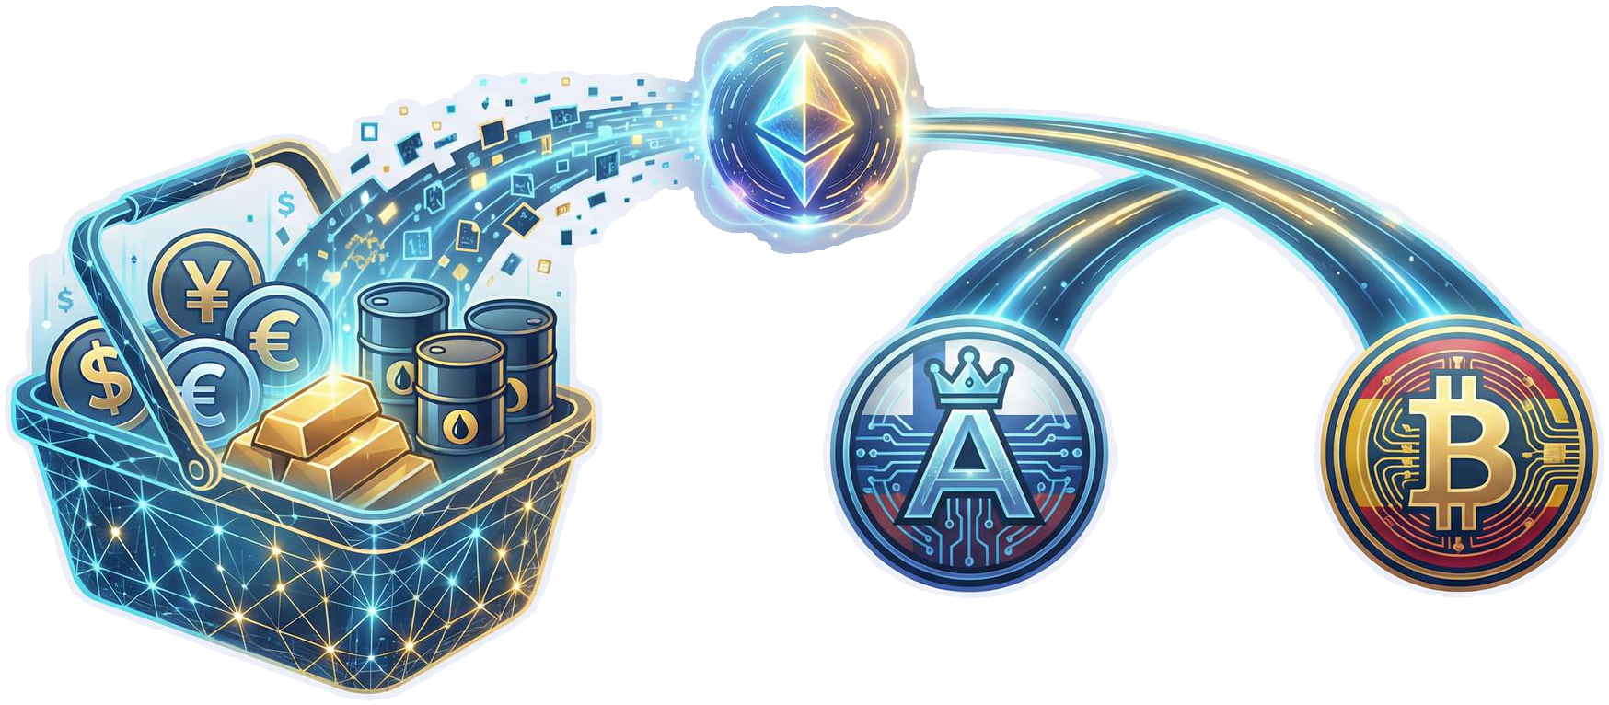



THE RISE OF NEUTRAL SETTLEMENT ASSETS
National Currency A
National Currency B
Private Sector Innovation: Fintechs are utilizing stablecoins and tokenized Real-World Assets (RWA) as neutral bridges.
Risk Mitigation: Eliminates the risk of holding volatile partner currencies or politically sensitive dollars.
The Mechanism: Using gold-backed tokens or algorithmic ‘BRICS baskets’ to settle trades instantly outside USD liquidity pools.

Slide 6

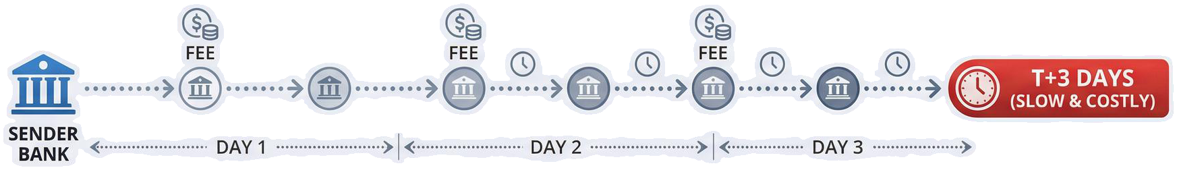

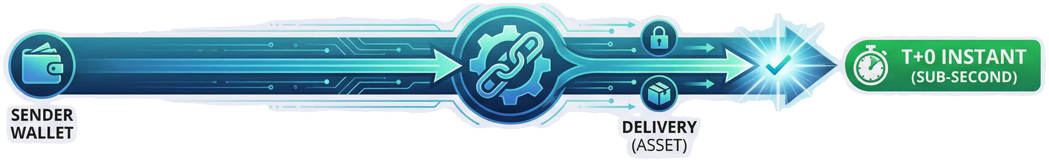


ATOMIC SETTLEMENT VS. LEGACY MESSAGING
Legacy Flaw: Old banking exchanges “promises to pay” (messaging), creating counterparty risk and trapping capital in “nostro” accounts.
Core Innovation: Shift to “Atomic Settlement” via smart contracts—payment and delivery happen simultaneously. Impact: Releases billions in trapped liquidity, allowing businesses to redeploy capital immediately.

Slide 7
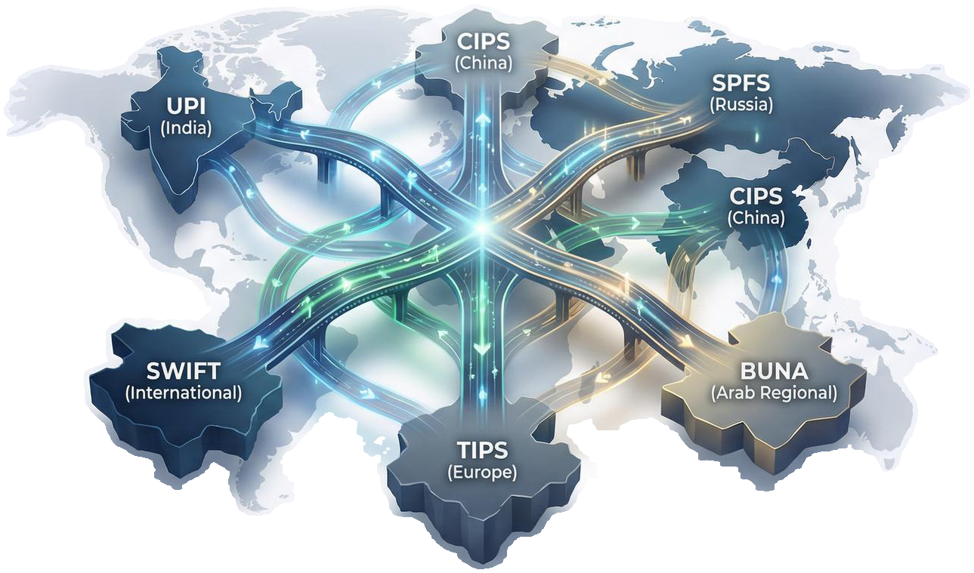



Interoperability in a Fragmented World
'Liquidity Bridges'
The New Challenge:
Connecting emerging ‘walled gardens’ like Russia’s SPFS, China’s CIPS, and Indian UPI.
The Middleware Layer:
Fintechs are building the ‘universal translators’ of money.
Seamless Connection:
Aggregators navigate local compliance and technical standards to trigger cross-border payments seamlessly.

Slide 8

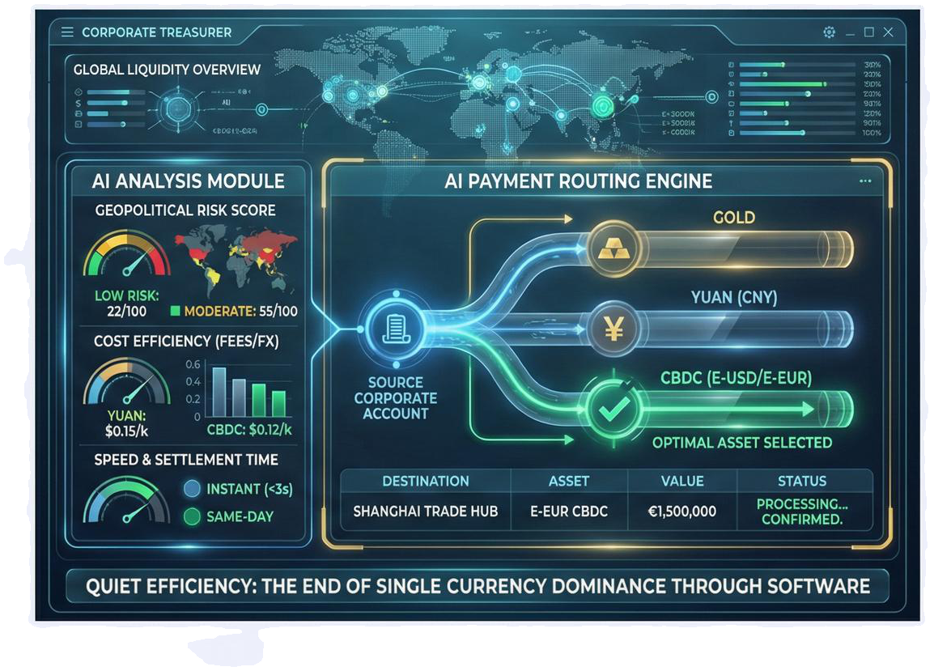


The Future: Currency Agnosticism
Beyond Replacement: The future isn’t replacing the Dollar with the Yuan, but abstracting the settlement asset entirely.
AI-Driven Efficiency: Platforms dynamically select the optimal route (Gold, Yuan, CBDC) based on real-time risk, speed, and cost.
Democratized Access: The dominance of a single currency ends through the quiet efficiency of software.

Slide 9
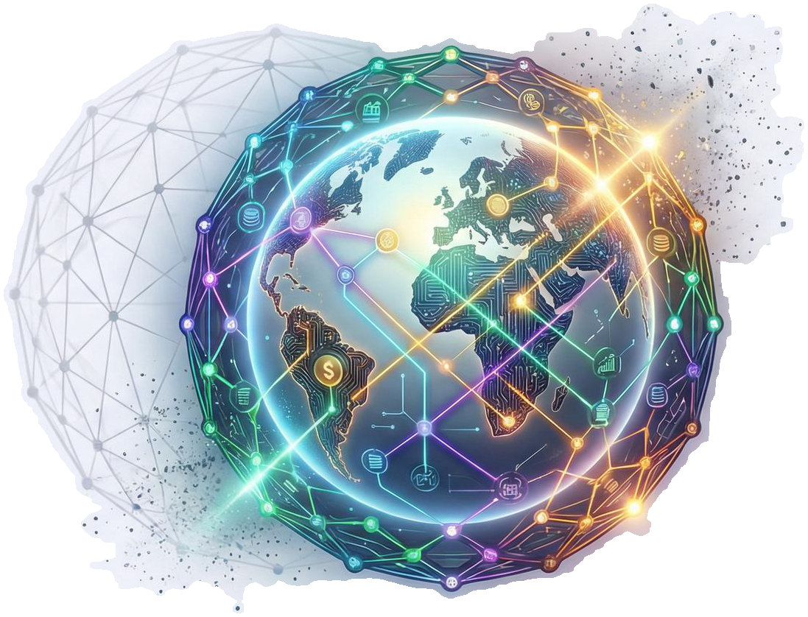
Building the Multi-Rail World - Navigating the New Financial Geography
The unipolar financial moment has passed.
✿ Opportunity lies in architecting the bridges that allow a diversified world to trade freely.
Welcome to the dawn of sovereign, programmable value transfer.

