Slide 1


Circle CCTP: The Architecture of Native Global Liquidity Unifying the Multi-Chain Ecosystem through Native Settlement

Slide 2

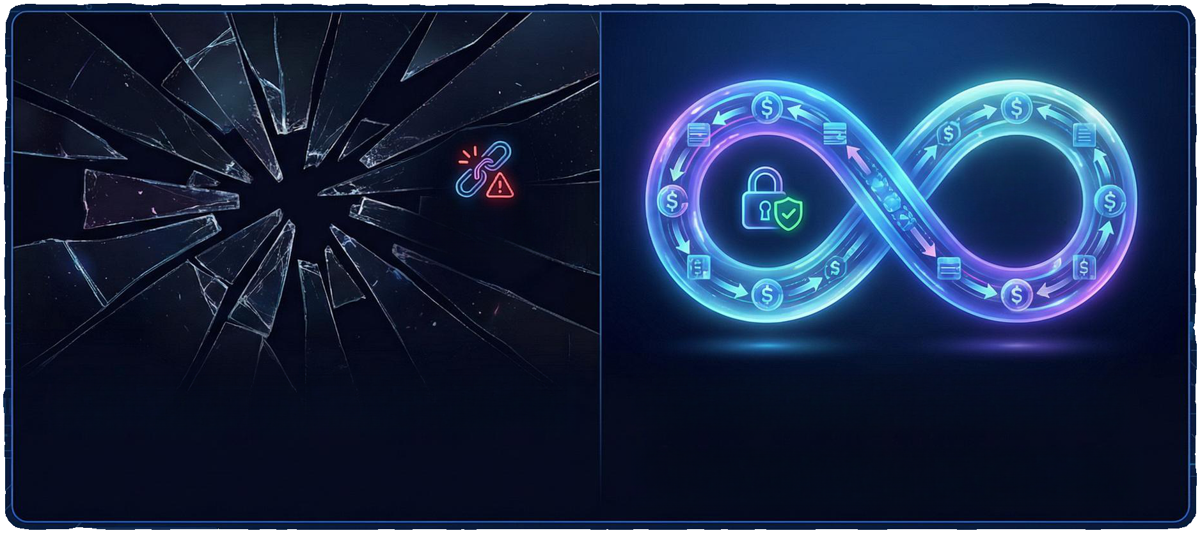
The End of Fragmentation: Why CCTP Matters
Native Asset Security
Wrapped Asset Risk
Problem: The 'lock-and-mint' model fractured liquidity and created vulnerable 'wrapped' assets. Solution: CCTP enables native teleportation of USDC, eliminating bridge honeypots.
eliminatingbridgehoneypots.
Benefit: Removes slippage and security risks by avoiding liquidity pools on bridge contracts.
Goal: By Dec 2025, CCTP becomes the unified circulatory system for digital dollars.

Slide 3


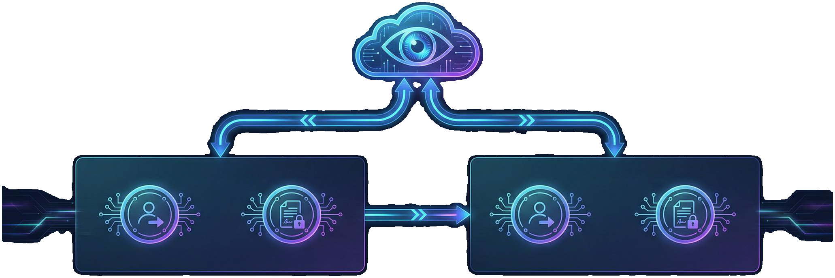





Architectural Overview: On-Chain & Off-Chain Harmony
Off-Chain Attestation Service
Off-Chain Layer: Circle's centralized Attestation Service acts as the vigilant notary.
Security: Eliminates complex consensus mechanisms between chains.
On-Chain Layer
On-Chain Layer
TokenMessenger
MessageTransmitter
TokenMessenger
MessageTransmitter
Permissionless smart contracts deployed on blockchains. TokenMessenger: Handles user intent and routing. MessageTransmitter: Manages low-level messaging and signature verification.
Permissionless smart contracts deployed on blockchains. TokenMessenger: Handles user intent and routing. MessageTransmitter: Manages low-level messaging and signature verification.

Slide 4



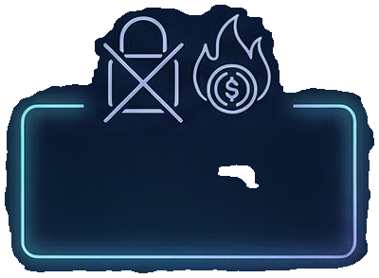


Step 1: The Source Chain Burn
Initiation
Signaling
User interacts with TokenMessenger specifying amount and destination.
MessageTransmitter emits a specific log event signaling valid asset destruction.
Key Concept: 'Burn' ≠ 'Lock'
The Burn
Impact
Tokens are immediately and permanently destroyed, not locked.
Mathematically final removal from the source chain's circulating supply.

Slide 5








Step 2: Verification by the Attestation Service
Inter Regular
Monitoring: Circle continuously scans for specific burn log events.
Safety: Waits for block confirmations to prevent reorganization attacks.
Attestation: Generates a cryptographic signature using Circle's private key.
Result: An irrefutable ‘permission slip’ proving the burn occurred.

Slide 6







Step 3: The Destination Chain Mint
Presentation: The signed Attestation is submitted to the MessageTransmitter.
Verification: Contract validates the signature against Circle's public key.
Minting: TokenMessenger mints equivalent native USDC to the recipient.
Macro Economics: Maintains global 1:1 backing without synthetic derivatives.
1 Burned = 1 Minted

Slide 7
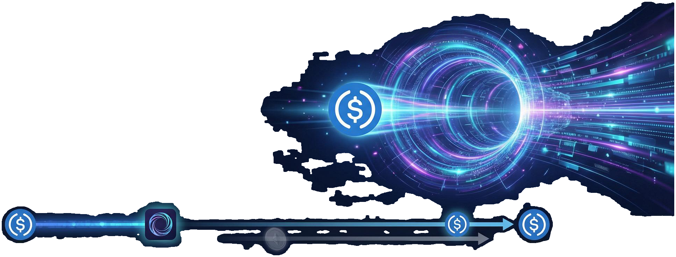

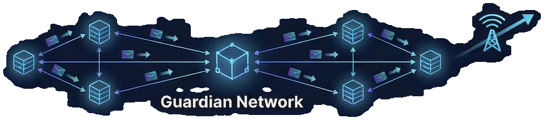
Integration Case Study: Wormhole
• Native transfer option embedded in generic messaging layer. • Bypasses 'Wormhole-wrapped' tokens for direct USDC movement. • Guardian network acts as the deliveryman, fetching attestations automatically. • A 'one-click' experience abstracting manual complexity.
WRAPPED
Direct USDC Movement & Simplified UX
Direct USDC Transfer (Native)
Source Chain
Wormhole Protocol
Wrapped Token (Bypassed)
Destination Chain
Automatic Attestation Delivery

Slide 8
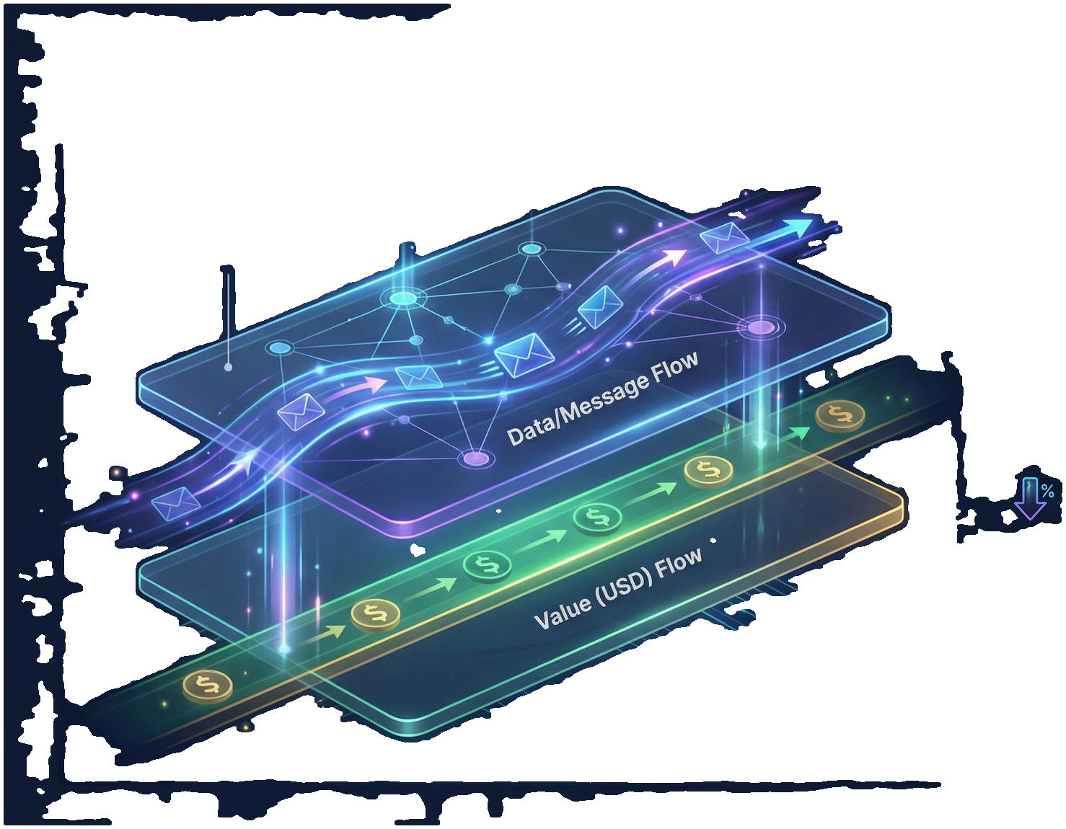






Integration Case Study: LayerZero
Standard: Enhanced Omnichain Fungible Token (OFT) for USD transfers.
LAYERZERO Arbitrary Messaging Layer
Hybrid Model: LayerZero handles arbitrary messaging; CCTP handles asset settlement.
Data/Message Flow
Benefit: Deferring value transfer to Circle's rails eliminates slippage.
Value(USD) Flow
Efficiency: Zero reliance on external liquidity pools.
CCTP (Circle Cross-Chain Transfer Protocol) Asset Settlement Layer

Slide 9
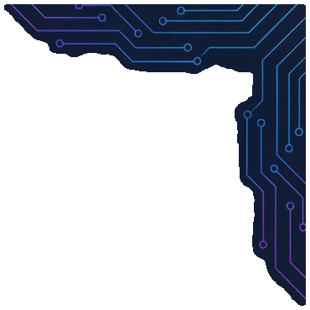

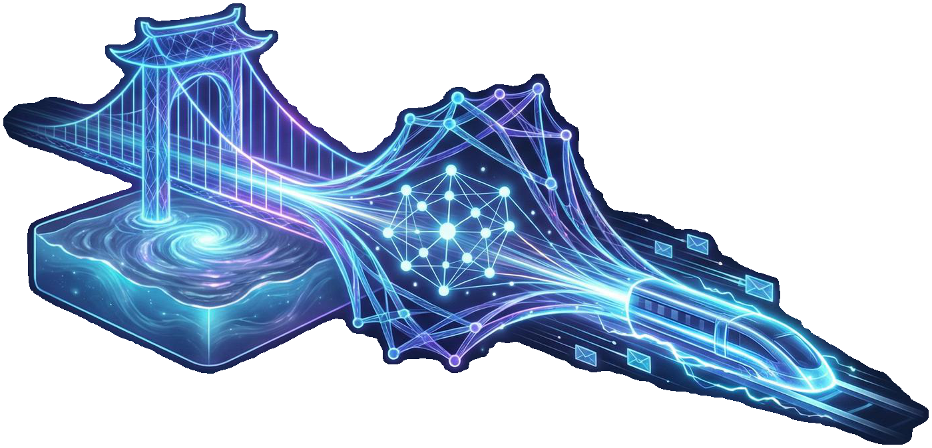


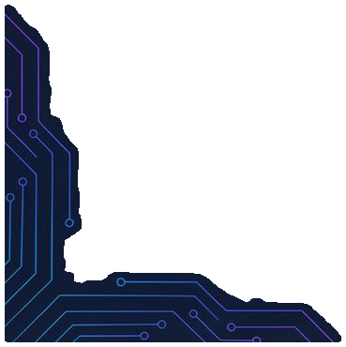
Integration Case Study: Celer cBridge
Mechanism: Celer State Guardian Network (SGN) acts as the relayer.
Advantage: Eliminates liquidity shortages in destination pools.
Outcome: Combines Celer's fast frontend with Circle's capital efficiency.
Shift: Moving from liquidity-pool model
to settlement-based model.

Slide 10
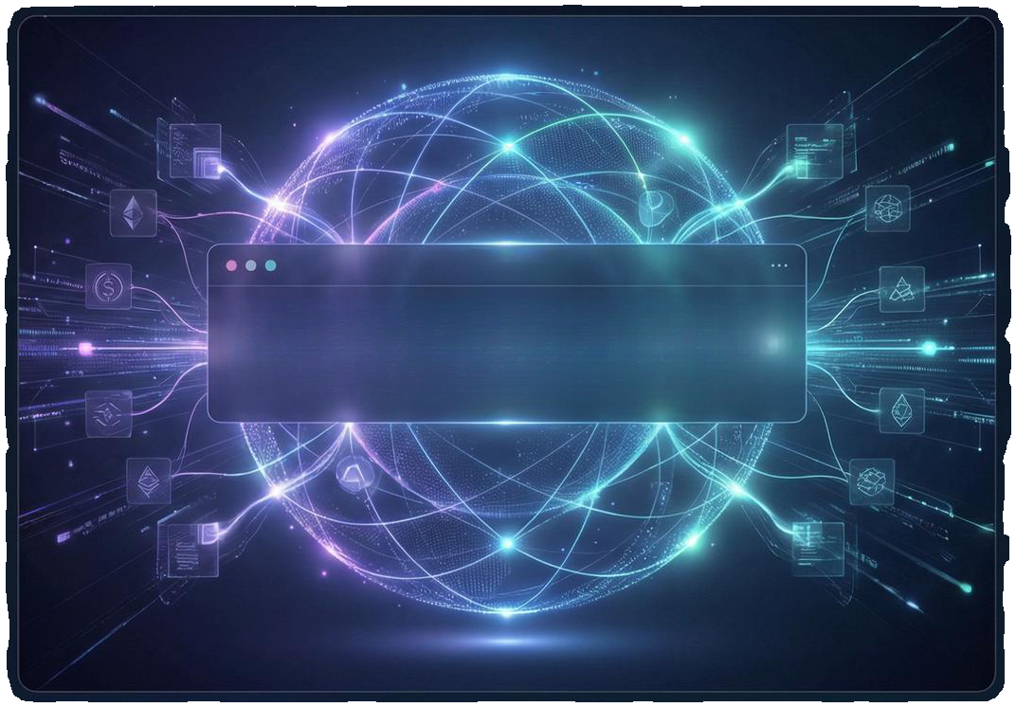
Future Outlook: The Universal Ledger
• Evolution: CCTP as the foundational settlement layer for the internet of value.
• Chain Abstraction: Users interact without needing to know the underlying blockchain.
Global Balance
TOTAL LIQUIDITY: $500,000,000,000,000 UNIVERSAL ASSET POOL
• Standardization: A unified liquidity layer for USDC and future Real-World Assets (RWAs).
• Vision: Issuer-mediated native settlement replaces wrapped-asset schemes.

Slide 11
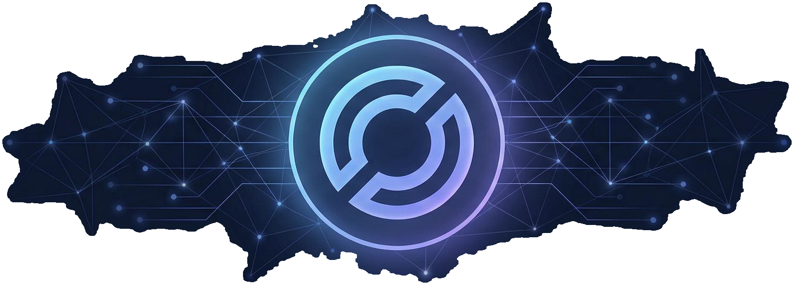
The Future of Liquidity is Native
• One Protocol. • Multi-Chain Access. • Zero Fragmentation.

