Slide 1


The Anti-Deflation Protocol
Preserving Muscle Mass While Navigating Weight Loss Treatments

Slide 2
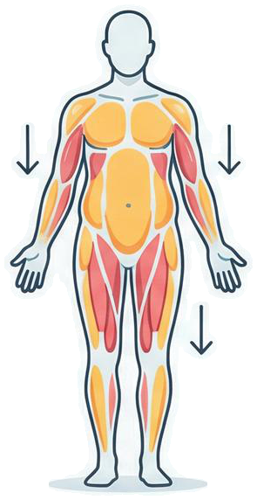
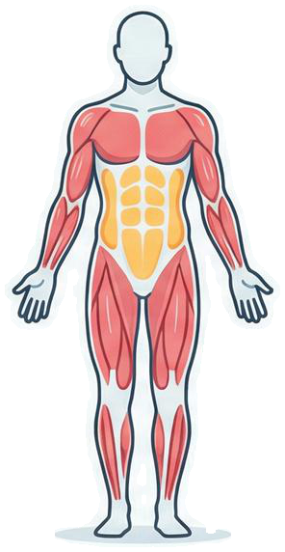





The ‘Deflated’ Phenomenon Explained
STANDARD WEIGHT LOSS
MUSCLE-SPARING LOSS
FAT & MUSCLE REDUCTION
FAT REDUCTION, MUSCLE RETENTION
The Cause: Rapid weight loss from GLP-1 medications often reduces lean muscle mass alongside fat.
The Biology: Without countermeasures, the body adapts to the caloric deficit by catabolizing muscle tissue for energy.
The Effect: This creates the 'Ozempic face' or a generic 'deflated' physique.
The Key: This is a manageable biological adaptation, not a necessary side effect.

Slide 3
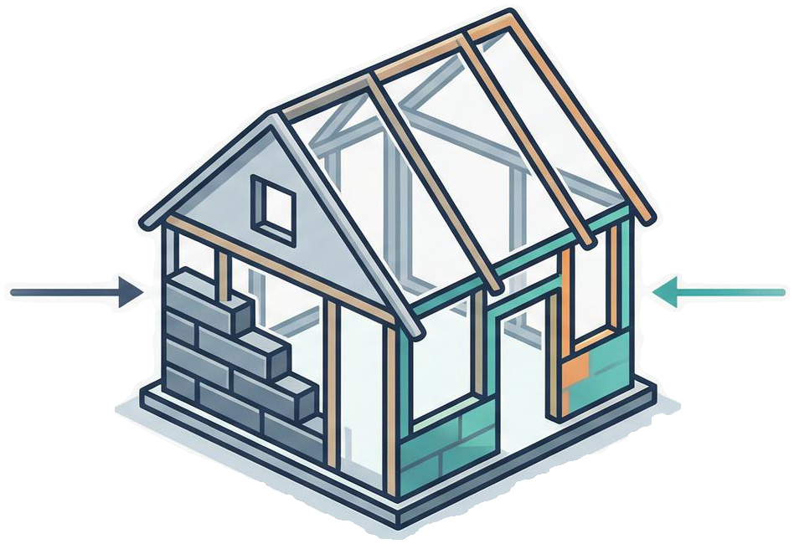
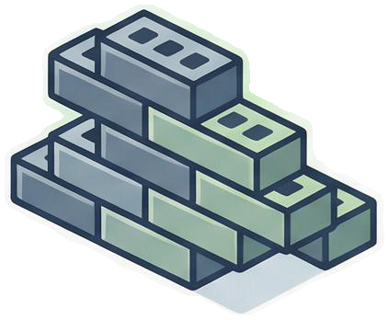

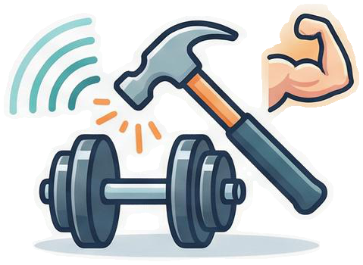
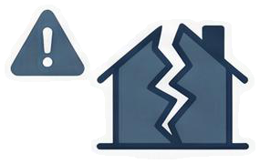
The Two-Pillar Defense Strategy
Pillar 1: High Protein Intake
Pillar 2: Mechanical Tension
Think of protein as the raw bricks needed to maintain your body’s structure.
Resistance training acts as the signal to the construction crew to keep the walls standing.
The Consequence:
Without both bricks (protein) and the signal (exercise), the body strips its own infrastructure to survive the perceived famine.

Slide 4

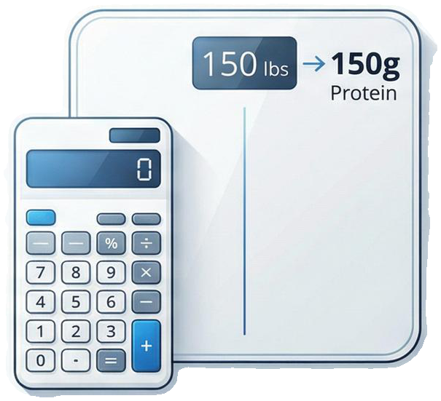
Pillar One: The Protein Prescription
Standard dietary guidelines are insufficient for rapid weight loss scenarios.
The Formula: 0.7 to 1 gram of protein per pound of your GOAL body weight daily.
• Example Calculation:
– Goal Weight: 150 lbs
– Daily Target: 105 – 150 grams of protein

Slide 5
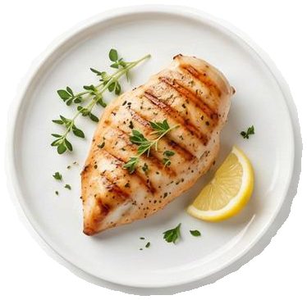
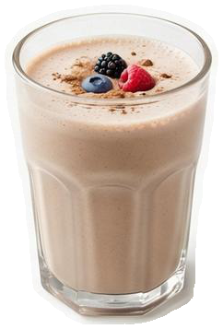
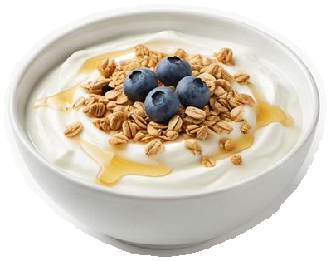
Visualizing the Intake: The "30-Gram Rule"
30g
30g
30g
The Challenge: High targets are difficult when appetite is suppressed.
The Solution: Ensure every main meal contains at least 30g of high-quality protein.
A palm-sized portion of chicken breast
A full scoop of whey isolate
A cup of Greek yogurt
Schedule:
Spread across 3-4 distinct windows to maximize synthesis without fullness.

Slide 6
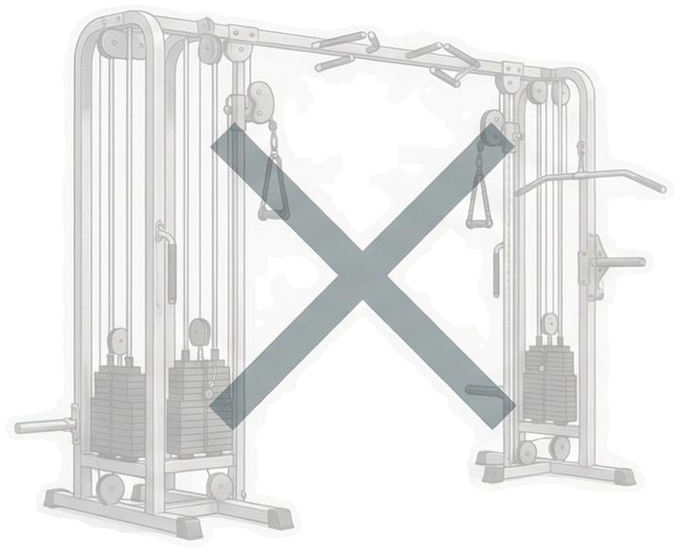
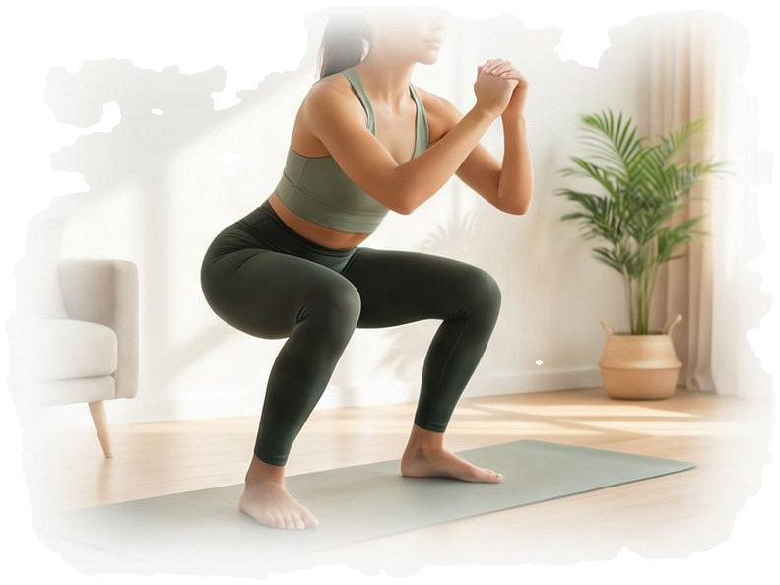





Pillar Two: Defining “Resistance Training”
• Redefining the Gym: No membership or complex machinery required.
• The Mechanism: Move the body against a force difficult enough to cause fatigue.
• The Signal: Sends a clear anabolic message: "This muscle is necessary for survival; do not eat it."
• The Goal: Tissue preservation, not calorie burning.

Slide 7
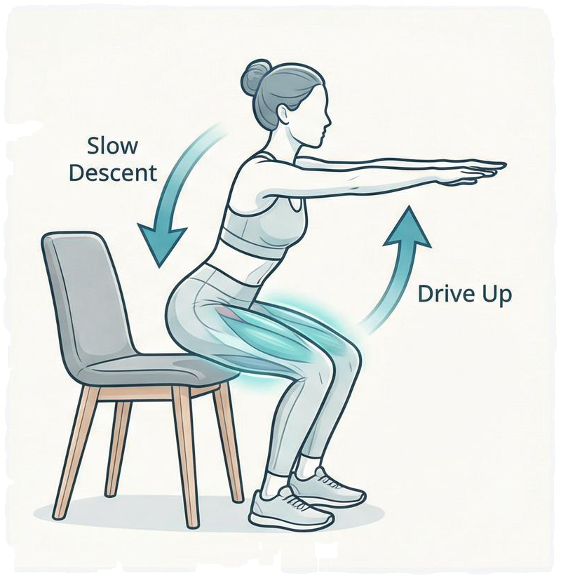

Move 1: The Chair Squat (Lower Body)
Why: Targets the large muscles of the quads and glutes safely.
Execution:
1. Stand in front of a sturdy chair.
2. Sit back slowly until glutes barely touch the seat.
3. Immediately stand back up without resting full weight.
Target: Repeat until legs feel a distinct burn.

Slide 8

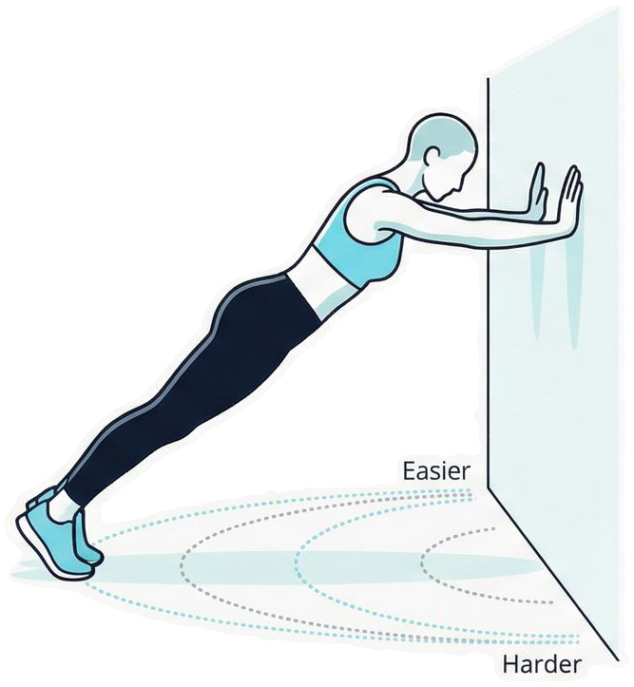




Move 2: The Wall Push-Up (Upper Body)
Why:
Preserves chest, shoulders, and arms without floor strain.
Execution:
1. Stand an arm's length from a wall, palms flat.
2. Lower nose toward the wall.
3. Push back to starting position.
Progression:
Move feet further back to increase difficulty.

Slide 9
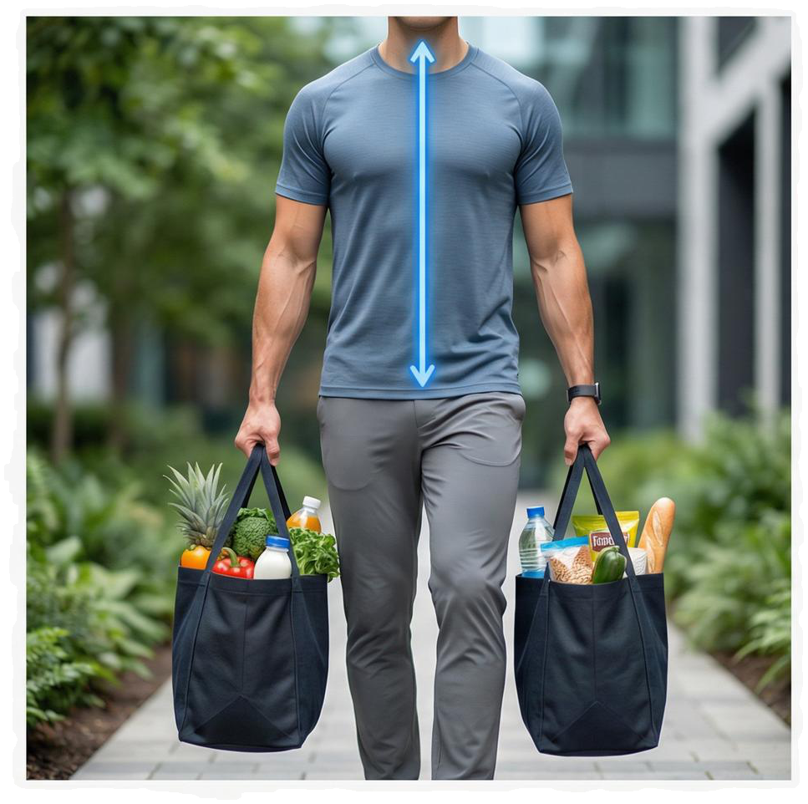

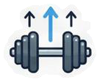
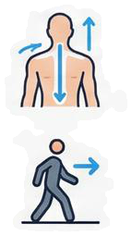
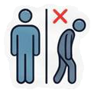
Move 3: The 'Grocery Carry' (Core & Grip)
Why:
• Functional full-body engagement (grip, core, posture).
Execution:
1. Pick up two heavy objects (dumbbells, water jugs, loaded bags).
2. Keep shoulders back and posture perfectly upright.
3. Walk for distance.
Benefit:
• Prevents the ‘slumped’ posture associated with weight loss.

Slide 10





The Composition Conclusion
The Shift: Move from "weight loss" to "fat reduction".
The Routine: Daily protein (0.7-1g/lb goal weight) + 3 movements (3-4x/week).
• The Result: A leaner, stronger version of yourself—not just a smaller, softer one.
Avoid the deflation. Feed the muscle.

