Slide 1

Basic Details of the Team and Problem Statement
Ministry of Defence:
PS Code: SIH1422
Problem Statement Title: Identification of victim buried under avalanches
Team Name: Life Defender
Team Leader Name: Vikram Kumar
Institute Code (AISHE):6133
Institute Name: Techno Main Salt Lake
Theme Name: Identification and Avalanche Victim Detector

Slide 2
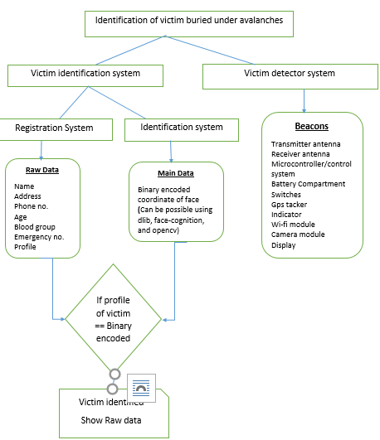
Idea/Approach Details
Idea/Solution/Prototype :
The proposed solution is a registration system that stores victim data in two parts: raw data (including name, age, blood group, phone number, emergency contact, and profile) is stored in a database. Simultaneously, a victim detection system processes a victim's face, generates binary-encoded coordinates, and matches them with the profile image. If there's a match, all victim details are displayed for identification.
On the other side we have a beacon, that will transmit and receive signal and helps to detect the victim buried under, It will also have for alert message and detection. GPS tracker and sensor
This all will we be in implanted in a single device.
Technology stack:
React
Database
Python (with different module)
Cmake, dlib, face-recognition, cvzone, opencv-python
Micro-controllers, sensors, transmitters , Camera module, wi-fi module.

Slide 3
Idea/Approach Details
Use Cases
Dependencies and Challenges
Avalanche Search and Rescue: In the event of an avalanche, the victim detection system can use facial recognition to identify buried individuals and transmit their locations to rescue teams.
Disaster Response and Recovery: During natural disasters like earthquakes or building collapses, the system can assist first responders in quickly locating and identifying victims under rubble, improving the efficiency of rescue operations.
Industrial Accidents
Search and Rescue in Wilderness
Natural Disaster Evacuations
Border Control and Security
Smart City Infrastructure
Dependencies:
Hardware Components
Software Libraries and Frameworks
Data Storage and Database
Networking and Communication
Facial Recognition Accuracy
Battery Life and Power Supply
Regulatory and Privacy Compliance
Integration with Emergency Services
Challenges:
Data Security Breaches
False Positives and Negatives
Hardware Failures
Reliability and Availability
User Adoption and Training
Scalability

Slide 4
Team Member Details
Team Leader Name: Vikram Kumar
Branch : Btech Stream: CSE Year : IV
Team Member 1 Name: Mandira Chakraborty
Branch: Btech Stream: CSE Year : IV
Team Member 2 Name: Julee Singh
Branch : Btech Stream : CSE Year : IV
Team Member 3 Name: Soumyadeep Banerjee
Branch : Btech Stream : ECE Year : IV
Team Member 4 Name: Payel Chaudhuri
Branch : Btech Stream : AIML Year : III
Team Member 5 Name: Somay Das
Branch : Btech Stream : CSE Year : IV
Team Mentor 1 Name: Dr. Atrayee Gupta
Category (Academic/Industry): Expertise (AI/ML/Blockchain etc): Domain Experience (in years):

