Slide 1

2018 NSF Expeditions in Computing PI Meeting
Customizable Domain-Specific Computing, NSF-0926127
Jason Cong, PI
http://www.cdsc.ucla.edu
Co-PIs
University of California, Los Angeles Collaborators: Jens Palsberg, Glenn Reinman, Alex Bui, Eleazar Eskin, Mau-Chung Chang
Rice University Lead: Vivek Sarkar (Now at Georgia Institute of Technology)
Ohio State University Lead: P. Sadayappan
University of California, Santa Barbara Lead: Tim Cheng
Key Collaborator: Intel, partner of the NSF InTrans (Innovation Transition) Program, NSF-1436827, Accelerator-Rich Architectures with Applications to Healthcare,
Notes:
BRIEFLY INTRODUCE YOURSELF AND YOUR INVESTIGATORS (10 sec slide)
https://www.nsf.gov/awardsearch/showAward?AWD_ID=0926127&HistoricalAwards=false
https://www.nsf.gov/awardsearch/showAward?AWD_ID=1436827&HistoricalAwards=false

Slide 2
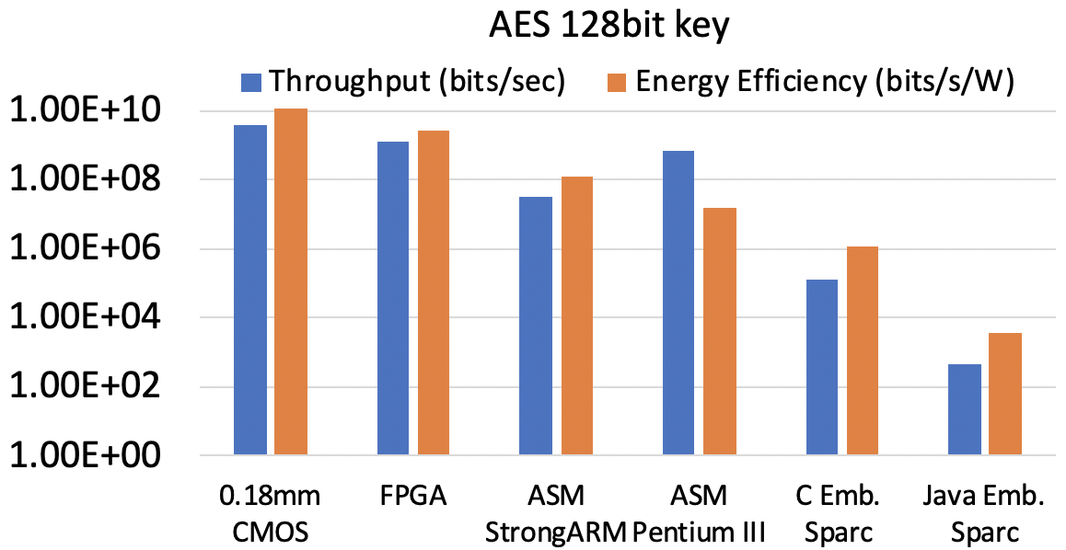
Project Background and Aims
Motivation: Large energy efficiency gap between general-purpose vs. customized computing
Goal: Significant improvement in performance/watt with customizable architecture + automated compilation & runtime
Three levels of customization
Chip-level
Server node-level
Datacenter-level
Log Scale
80x
800x
Source: P Schaumont and I Verbauwhede, IEEE Computer 36(4), 2003
Notes:
A brief background: Please describe the problem you are addressing and why it is important (20sec slide)
Background and motivation for your project.
Goals you set out to accomplish.
Fundamental research questions/challenges.
Disciplines (or subdisciplines) that are/were involved, and how this allowed for transformative research.
Key collaborators or informal partnerships outside of academia (if any) and their role.
Automated compilation tools and runtime systems to support accelerator-rich architectures (ARAs) at all levels to support efficient accelerator design, deployment, and management, with great improvement on design productivity; End of Dennard scaling in mid- 2000’s, the power and energy constraint became one the most significant bottlenecks in computing.
Large efficiency gap exists between general-purpose computing and customized computing solutions. How to drastically improve the energy efficiency of computer systems with proper trade-off of flexibility and customization?
Demonstration of significant performance/energy efficiency improvement with extensive use of programmable and composable accelerators at multiple levels of computing hierarchy, including chip-level, server node-level, and datacenter level;

Slide 3
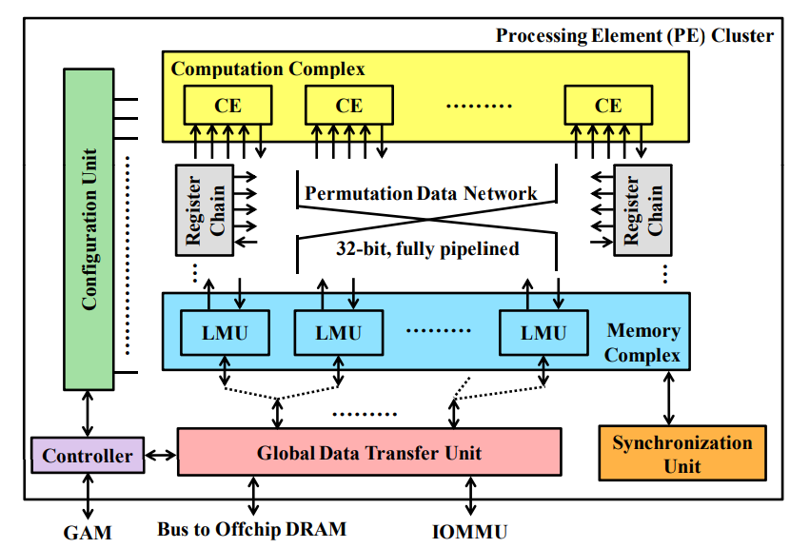

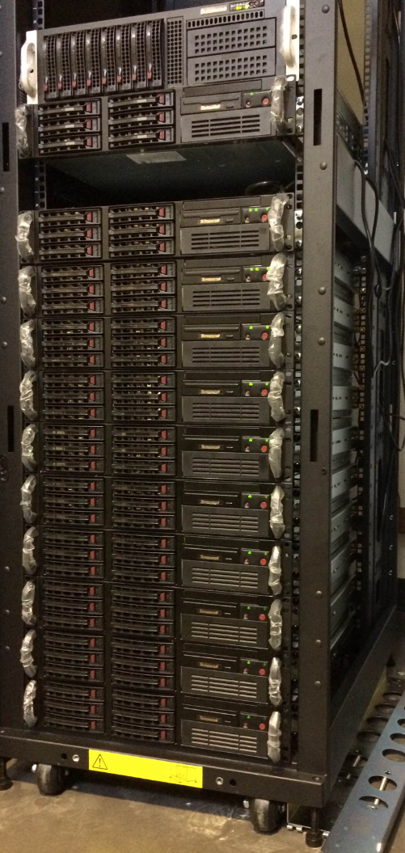
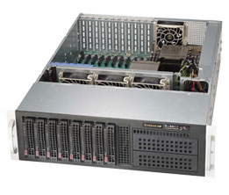
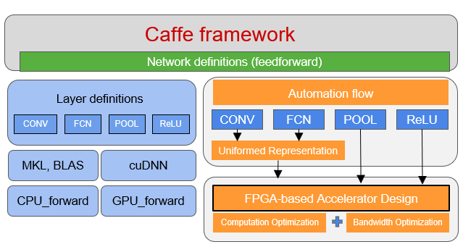

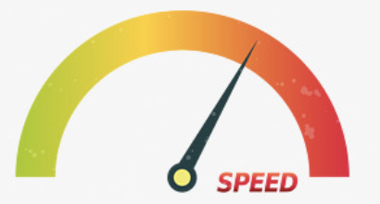

Customized Accelerators at All Levels
Chip-level
Datacenter-level
FPCA [FCCM 14]
if projected on 45nm ASIC, 40x energy gains over Dual-Core ARM @800MHz
CDSC cluster - each node
CPU Processors
Virtex-7 FPGA
10Gb NIC
AWS EC2 F1.2xlarge: UltraScale+ VU9P FPGA
Server Node-level
Heterogeneous Cluster Scheduling
Whole-genome genome pipeline
7 days -> 4.6hrs via parallelization + customization
43.5x and 1.5x energy gains over a 12-core CPU and K40 GPU using a medium-sized FPGA [ICCAD 16]
Variant analysis: 2x performance & 1.23x cost gains
Notes:
1.6x performance gain and 1.17x cost gain compared to pure-CPU version
F1 instance
time cost
Pure CPU 1 1
Pure AWS-F1 0.6 2.475
Ours 0.6 0.85

Slide 4
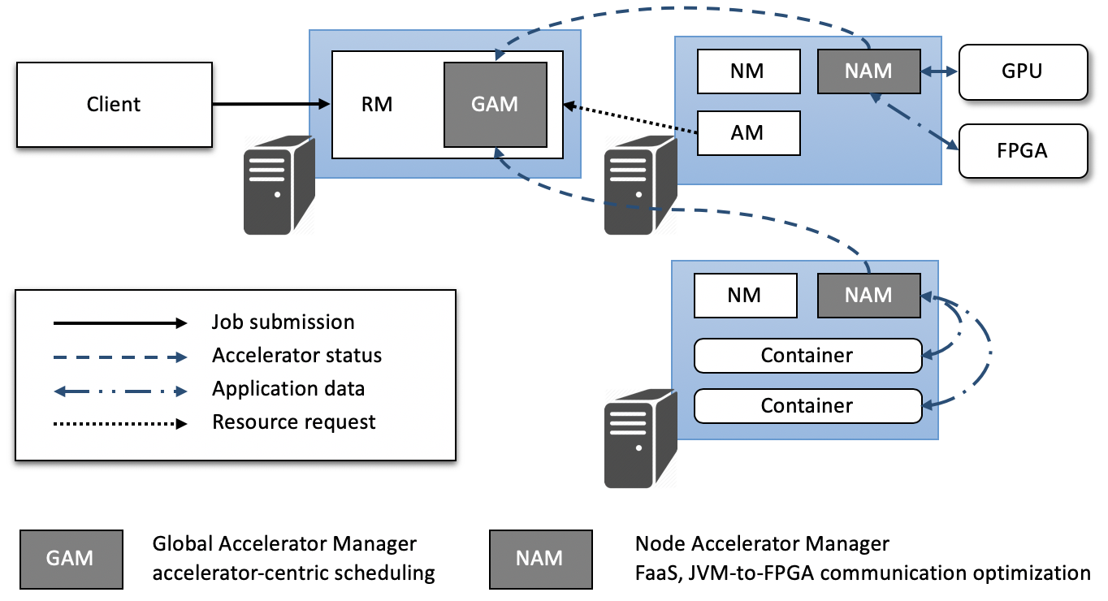
Automated Compilation & Runtime
Automated compilation and synthesis flows -> high-level programmability;
Runtime systems -> efficient accelerator deployment &management
Blaze, abstracts FPGA accelerators as a service (FaaS)
Programming & Mapping for Customizable Heterogeneous Architecture
Runtime Resource Management for Customizable Heterogeneous Datacenters [SOCC 16]

Slide 5
Impact
Publications
>350 publications, with multiple best-paper awards
Book on “customizable Computing”
Open-source Tools
CDSC mapper, PolyOpt, CMOST compilation tools, Blaze runtime, …
Start-up
Falcon Computing Solutions, Inc.
Outreach:
28 high-school students for summer research,
50% female, 28% African American, and 25% Latinos
New Courses
E.g. “Customizable computing for big-data applications” CS259 at UCLA
Notes:
A brief background: Please describe the problem you are addressing and why it is important (20sec slide)

