Slide 1
Latte: Locality Aware Transformation for High Level Synthesis
Speaker: Jie Wang
Student: Peipei Zhou, Cody Hao Yu, Peng Wei
Faculty: Jason Cong
Notes:
Hi Good morning everyone, My name is XXX, a PhD student from Prof. Jason Cong’s lab of UCLA. I am very happy today to give an introduction on our work “Latte: Locality Aware Transformation of High Level” Synthesis”.

Slide 2
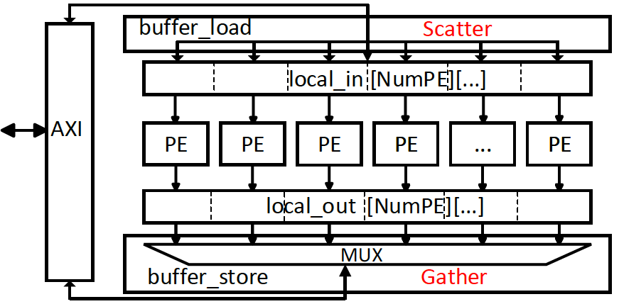
Common Practice Accelerator Template
batch 0
batch 1
batch 2
batch 3
Jason Cong, Peng Wei, Cody Hao Yu, and Peipei Zhou. Bandwidth Optimization Through On-Chip Buffer Restructuring for HLS. DAC 2017.
Jason Cong, Zhenman Fang, Michael Lo, Hanrui Wang, Jingxian Xu and Shaochong Zhang. Understanding Performance Differences of FPGAs and GPUs. FCCM 2018,
Jason Cong, Peng Wei, Cody Hao Yu, Peng Zhang. Automated Accelerator Generation and Optimization with Composable, Parallel and Pipeline Architecture. DAC 2018.
Notes:
When using HLS based FPGA designs, a common practice accelerator design template is shown here.
Here we just show some latest publications that achieve success in accelerating a wide range of applications in using this template. And the list should continue to grow in the future.
The accelerator has on-chip input buffer local_in and output buffer local_out. The accelerator works in batches or iterations. Let’s first focus on the first batch, shown in yellow blocks.
In each batch, it reads in data from off-chip to on-chip buffers through AXI interface, processes in NumPE kernels in parallel, and then writes to off-chip from on-chip buffers.
As you may already notice, since double buffer optimization is applied, off-chip communication in buffer_load and buffer_store can be overlapped with computation part among different batches, which are shown in different colors.
Here, the number of Processing Elements (PE) controls the parallelism and determines the total resource area and also throughput of the accelerator.

Slide 3
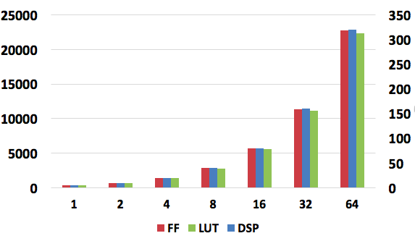
Area Increases as Design Scales Out
Matrix Multiplier
#PE increases, what about F?
Resource
#PE
Peipei Zhou, Hyunseok Park, Zhenman Fang, Jason Cong, Andre DeHon. Energy Efficiency of Full Pipelining: A Case Study for Matrix Multiplication. The 24th IEEE International Symposium on Field-Programmable Custom Computing Machines (FCCM 2016) , Washington DC, May 1-3, 2016.
Notes:
For example, as demonstrated by this paper in FCCM 2016, in Matrix Multiplication accelerator, when #PE increases from 1 to 2 to all the way to 64, the number of FF, LUT and DSPs increase. This means more chip resources are utilized and more parallelism is achieved.
However, the throughput of an accelerator is also determined on the frequency of the accelerator after place & route.
So, one key question is, when #PE increases, what about the frequency?

Slide 4

Frequency Degradation when Design Scales Out in HLS-based Accelerator
30% -> 200MHz
90% -> 130MHz
NW
KMP
Viterbi
Frequency (MHz)
AES
SPMV
Stencil
MM
FFT: 88%->
57MHz
FFT
Area (Xilinx Virtex-7 XC7VX690T)
Notes:
Actually we observe a severe frequency degradation problem when design scales out in HLS based accelerator.
For example, we plot the chip area percentage and the frequency after implementation here in the graph. We tested for eight applications, and for every one of them, when area increases, frequency drops significantly.
We also plot a trendline here and it shows that on average, HLS generated accelerators sustain a 200 MHz on 30% resource usage, however, it drops to only 130 MHz when usage is up to 90%.
One extreme case is FFT design, that operates on only 57MHz when usage is 88%.
[Favorite Gavin!!] Why does this happen? Where is the critical path? Are there any common reasons to explain these different applications? The answer is Yes!

Slide 5
Why Frequency Degradation?
Scatter
Gather
batch 0
Notes:
We investigate on the critical path carefully and let me explain now.
If we look again on the buffer_load in the accelerator template again, we can see that, data is scheduled from the AXI read port to each BRAM bank, This means, one AXI port needs to be routed to all BRAM banks. We call it one-to-all scatter pattern.
Similar situation happens in buffer_store, where all output BRAM banks need to be routed to the AXI port through a big MUX, we call it all-to-one gather pattern.
And the critical paths lie in the long wires in scatter and gather patterns.
You may wonder how do they look like in the real chip layout? Let me show you!

Slide 6
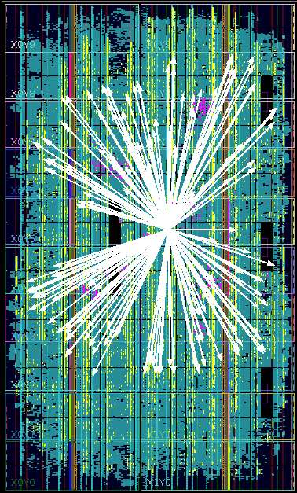
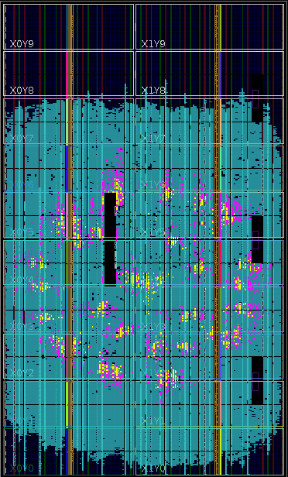
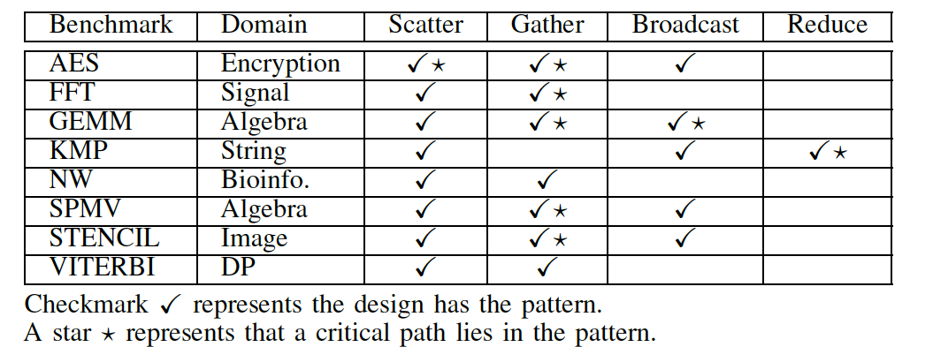
Achilles’ Heel: Scatter, Gather, Broadcast, Reduce
Scatter
Gather
*broadcast and reduce are similar to scatter, gather patterns
Notes:
Here you are. The yellow highlight area are the scattered on-chip BRAM blocks. In the center of this picture is the data port in AXI logic. It’s not hard to imagine the wirelength of these wires scale up as design scales out.
Actually, there are other two patterns, broadcast and reduce, that are similar to scatter and gather patterns.
These pattern, we called them Achilles’ Heel in HLS, because they happen in most, if not all, accelerators.
In accelerators that we studied, out of 8 of them, in 6 designs, a critical path lie in the four patterns.

Slide 7

Latte: Locality Aware Transformation for high-level synThEsis
Latte microarchitecture: pipelined transfer controllers (PTC) to reduce critical path
PTCs are chained through FIFOs
Each PTC connects to a local set of buffers
Improves a lot in frequency:
1.50x with 3.2% LUT, 5.1% FF on average
2.66x with 2.7% LUT, 5.1% FF for FFT
10 LOC: Latte Pragma
Notes:
To alleviate the pain HLS design suffer, we propose Latte, Latte comes from Locality Aware Transformation for high-level synthesis.
The core part of Latte microarchitecture is PTC, pipelined transfer controllers, inserted into long wires in the four patterns.
PTCs are chained through FIFOs to cap the growth of wire delay. And Each PTC connects to only local set of buffers. Thus wire delays in the critical paths in the four patterns can be reduced.
In short, Latte boosts a lot in frequency, for example, 1.5x with only 3.2% LUT area overhead on average.
If you want to know how we can use only 10 lines of latte pragma to achieve this and more details of Latte,
Please come to the poster session.

Slide 8
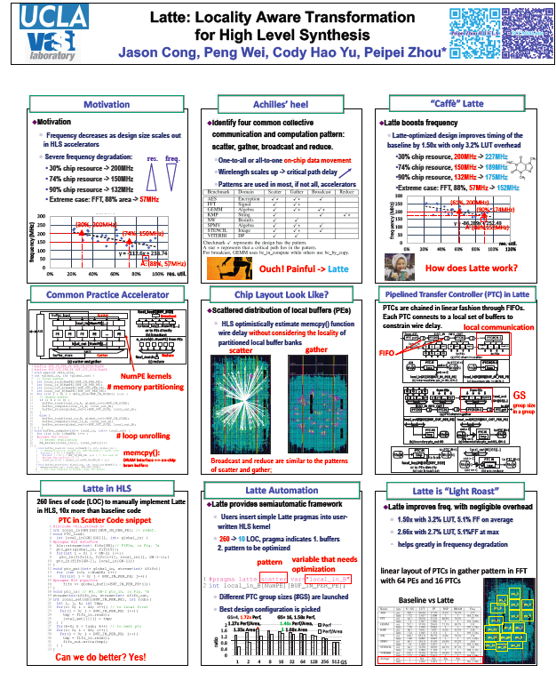

Welcome to Poster Session P3, 10:10-11:15
Notes:
This is an overview of the Latte poster, I hope you will enjoy! Thank you!

