Slide 1
Energy Efficiency of Full Pipelining: A Case Study for Matrix Multiplication
Speaker: Peipei Zhou
Student: Peipei Zhou, Hyunseok Park, Zhenman Fang,
Faculty: Jason Cong, Andre DeHon

Slide 2
II = 1 or not?

Slide 3
A new Question, II vs Energy and II > 1

Slide 4
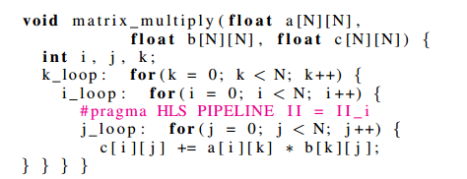
A case study of MM
II change, what happens?

Slide 5
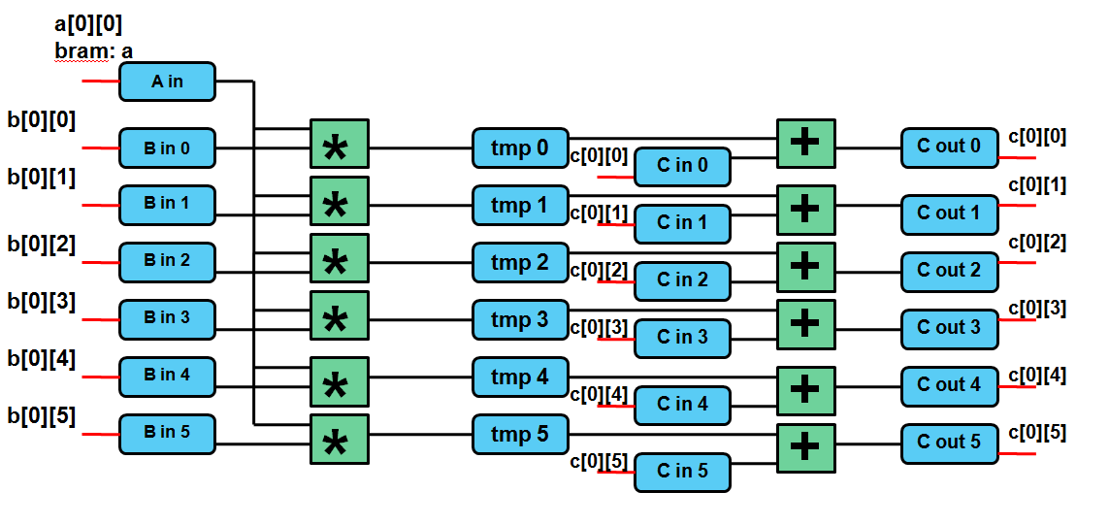
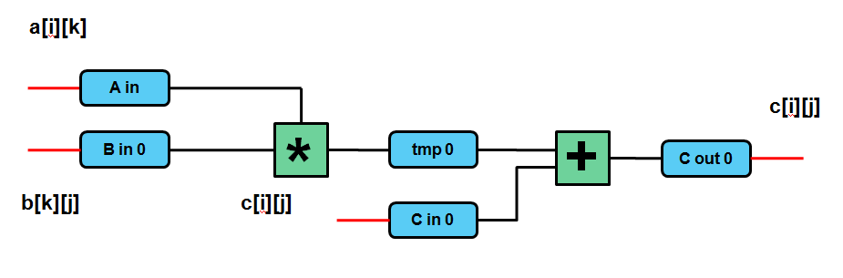
Architecture for II = 1, II = N
a[0][0]
II = 1
a[0][0]
a[0][0]
a[0][0]
a[0][0]
a[0][0]
b[1][0]
b[0][0]
b[1][1]
b[0][1]
b[1][2]
b[0][2]
b[1][3]
b[0][3]
b[1][4]
b[0][4]
b[1][5]
b[0][5]
II = N

Slide 8
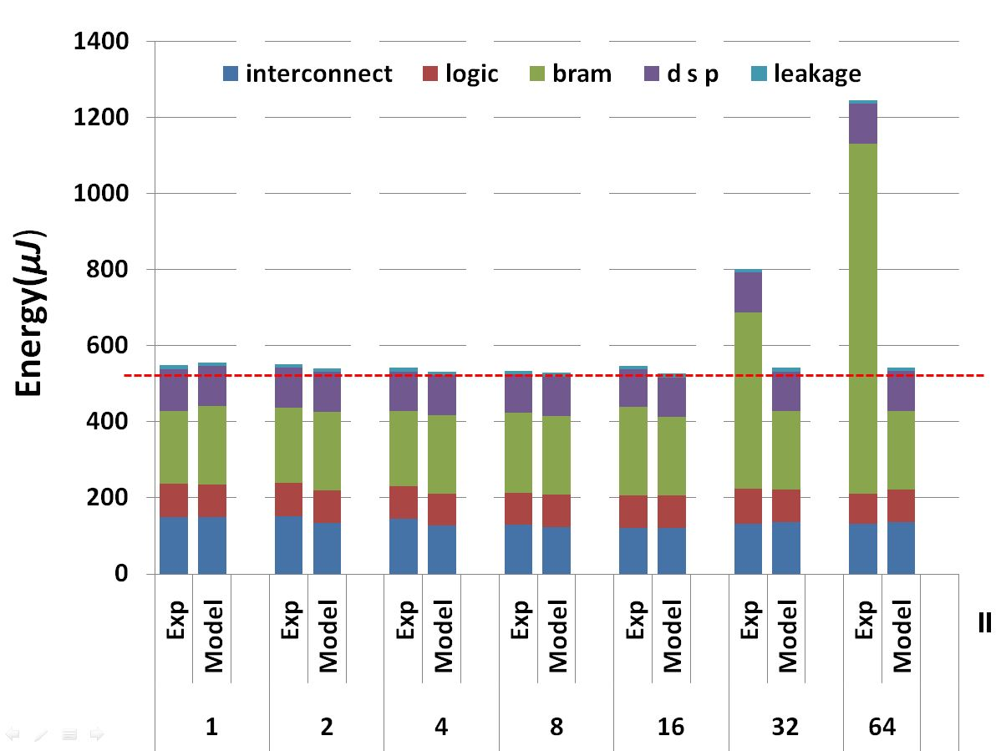
Experimental results
Xilinx virtex-7 xc485, Vivado 2015.1.5
Energy(uJ)
II

Slide 9
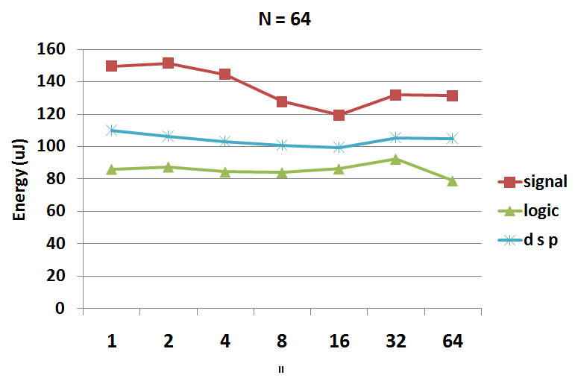
Highlight in the poster
Logic, DSP, Interconnect, BRAM, leakage
Flat compute(logic /dsp), bram
Interconnect
interconnect

Slide 10
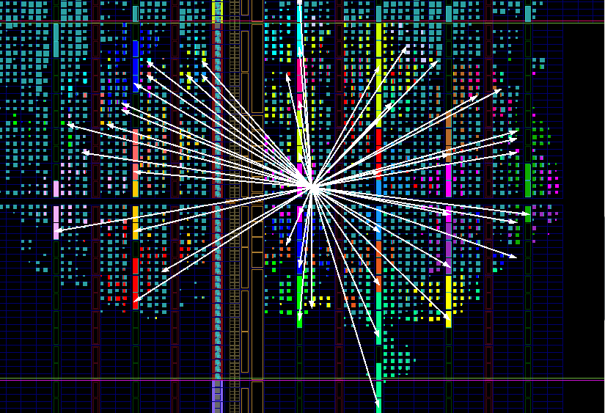
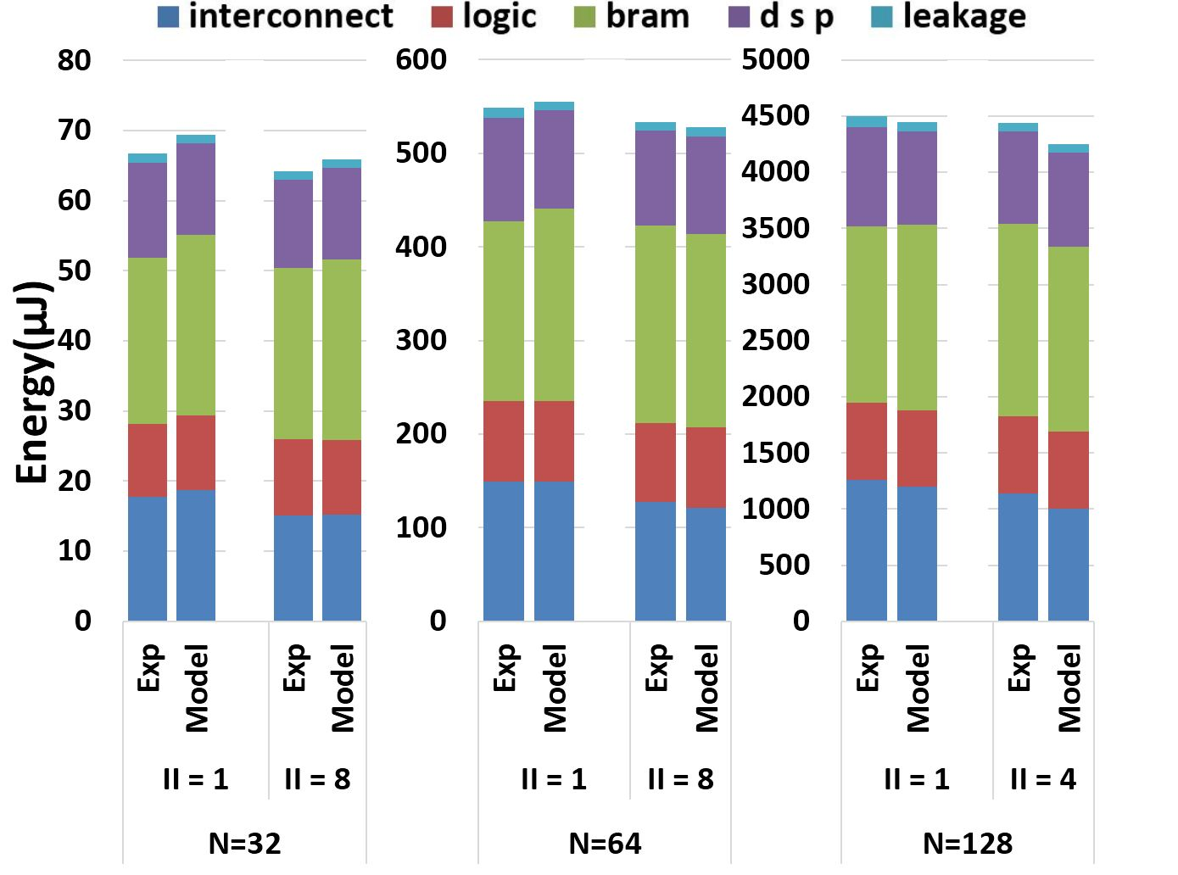
Highlight in the poster

Slide 11
Thank you
Welcome to My Poster
@2:20PM

