Slide 1

A Fully Pipelined and Dynamically Composable Architecture of CGRA
Faculty: Jason Cong
Project members: Hui Huang, Chiyuan Ma, Bingjun Xiao, Peipei Zhou*
VAST Lab
Computer Science Department
University of California, Los Angeles

Slide 2
Computing Beyond Processors
CPU
  General purpose computing solution
  Sharing hardware among all instructions
  Low energy efficiency
ASIC
  Customized for dedicated applications
  High efficiency but no flexibility
FPGA
  Configurable at bit level to keep both efficiency and flexibility
CGRA
  Programming granularity to word level ← most applications use full precision
  Reduce configuration information and enable on-the-fly customization

Slide 3
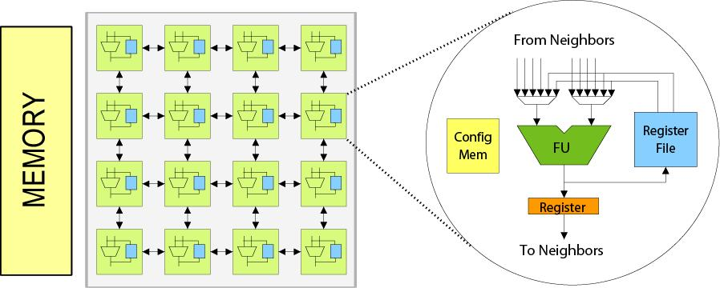
Conventional CGRA
CGRA
  Transistor resources are scarce in the past
  Each PE contains configuration RAM to store the multiple instructions
  Now transistor resources are rich -> Primary target changes: Energy efficiency
Source: Hyunchul Park etl, Polymorphic Pipeline Array: A Flexible Multicore Accelerator with Virtualized Execution for Mobile Multimedia Applications, 2009 Micro

Slide 4
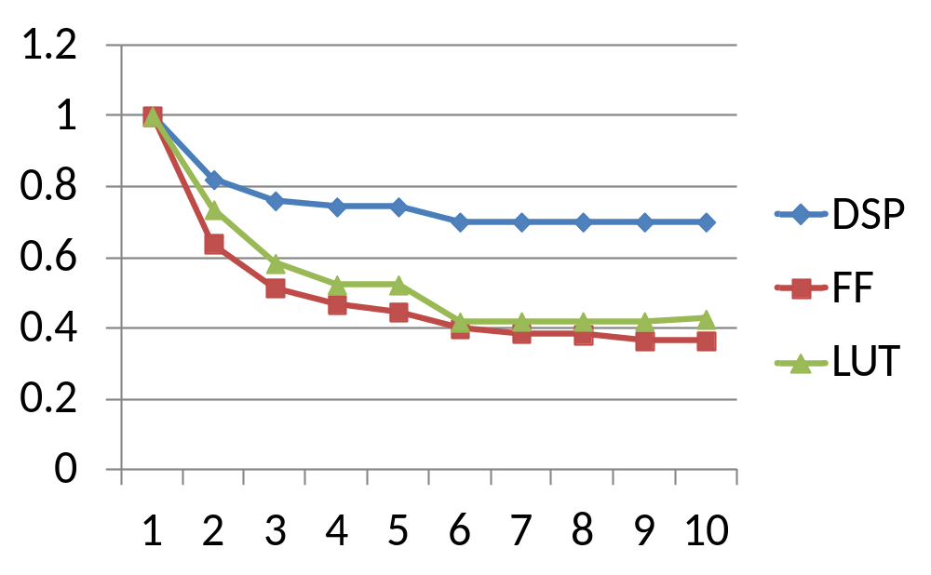
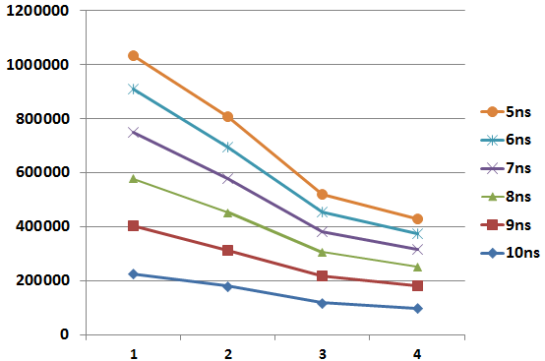
Full Pipelining with Rich Transistor Resources
When pipeline initial interval increases 1 → 2, resource does not reduce by 50%
When an accelerator achieves II=1, i.e., each input/output consumes/produces a new data/cycle → the highest performance/area → our design principle
Insights
  Time multiplexing costs resource to store more pipeline states and switch data paths
  When there are rich transistor resources, no need to suffer these overheads
Performance/Area:
Words/Second
/Slice
Resource (normalized)
Pipeline Initial Interval (II)

Slide 5
Dynamic Composition with Rich Transistors
Dynamically Composition
  (a) Compose accelerators for two applications from the reconfigurable array
  (b) Duplicate multiple copies of accelerators for a single application
APP1
APP1
APP2
APP1
APP1

Slide 6
Outline
Programming Model
Architecture Overview
Computation Complex
Case Study
Experiment Result
Conclusion and Future Work

Slide 7
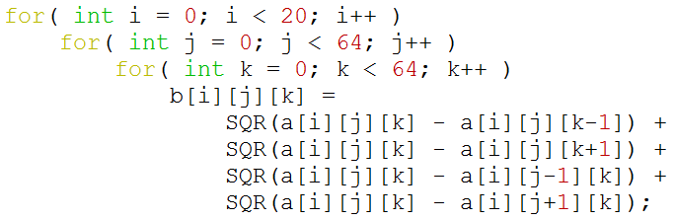
What Programming Model Can Be Mapped?
prefetch data block from offchip
load
load
load
load
load
+
+
+
+
Iterate over elements in a data block processed by inner loops
x
x
x
x
+
+
Iterate over different data blocks
+
store
Loop is the key!
Focus on loop acceleration, without inter-loop dependencies
write back data block to offchip

Slide 8
Outline
Programming Model
Architecture Overview
Computation Complex
Case Study
Experiment Result
Conclusion and Future Work

Slide 9
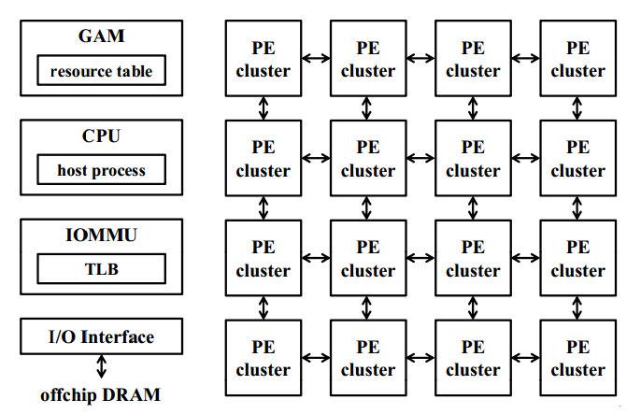
Complete System Design
FPCA(Fully Pipelined and Dynamically Composable Architecture of CGRA) architecture overview
  The host process will execute the general-purpose operations
  Also send the computation tasks to the global accelerator manager(GAM) *.
  Array of processing element (PE) clusters
*:Source: J. Cong et al. CHARM: A Composable Heterogeneous Accelerator-Rich Microprocessor, ISLPED 12

Slide 10


Overview of Our Composable Accelerator
Composable Accelerator
Computation Complex
CE
CE
………
CE
Register Chain
[31:0]Pipelined Data Network
Register Chain
Configuration Unit
………………………
Data flow though @ II=1
…
…
Memory
Complex
LMU
LMU
………
LMU
………
Controller
Global Data Transfer Unit
Synchronization Unit
GAM
AXI data bus
IOMMU

Slide 11
Outline
Programming Model
Architecture Overview
Computation Complex
Case Study
Experiment Result
Conclusion and Future Work

Slide 12

Computation Complex
Computation Complex
P_{n-1}
P_{n}
………
CE
CE
CE
A_{n}
B_{n}
C_{n}
D_{n}
P_{out}
operators can be skipped by configuration
[31:0] Pipelined Data Network
+
+
+
+
CE
CE
x
x
x
x
+
+
CE
CE
+

Slide 13
Outline
Programming Model
Architecture Overview
Computation Complex
Case Study
Experiment Result
Conclusion and Future Work

Slide 14
Case Study of Data Flow
t=0
1
2
3
4
5
6
7
8
9
10
11
Computation Complex
tmp0
tmp1
tmp2
CE
CE
CE
CE
CE
CE
(c-d)²
+(c-u)²
(c-r)²
+…+(c-l)²
b[1][1]
a[1][1]
Register Chain
Permutation Data Network
a[1][1]
a[1][1]
Register Chain
a[1][1]
32-bit, fully pipelined, configured upon accelerator composition
…
a[1][0]
a[1][2]
a[0][1]
a[2][1]
a[1][1]
On-Chip Memory Complex
l: a[j][k-1]
r: a[j][k+1]
u: a[j-1][k]
d: a[j+1][k]
c: a[j][k]
b[j][k]
LMU
LMU
LMU
LMU
LMU
LMU

Slide 15
Case Study of Data Flow
Computation Complex
CE
CE
CE
CE
CE
CE
(c-d)²
+(c-u)²
(c-r)²
+…+(c-l)²
b[1][1]
b[1][2]
No Flow Control Here
b[1][3]
b[1][4]
Register Chain
Permutation Data Network
Register Chain
32-bit, fully pipelined, configured upon accelerator composition
…
a[1][0]
a[1][2]
a[0][1]
a[2][1]
a[1][1]
b[1][1]
a[1][1]
a[1][3]
a[0][2]
a[2][2]
a[1][2]
b[1][2]
countdown: 3
countdown: 2
countdown: 1
a[1][4]
a[0][3]
a[2][3]
a[1][3]
countdown: 0
a[1][2]
b[1][3]
a[1][5]
On-Chip Memory Complex
a[1][3]
a[0][4]
a[2][4]
a[1][4]
a[1][4]
a[1][6]
a[0][5]
a[2][5]
a[1][5]
left
right
up
down
center
output
LMU
a[1][5]
LMU
a[1][7]
LMU
a[0][6]
LMU
a[2][6]
LMU
a[1][6]
LMU

Slide 16
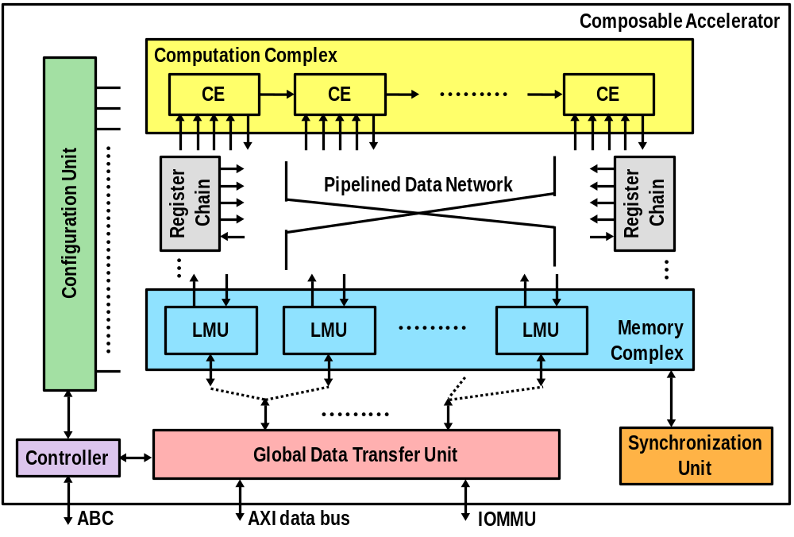
Putting Them Together
Takes 4 CEs, 6 LMUs and a register chain
Associated with 16872 LUTs
(c-d)²
+(c-r)²
(c-u)²
+…+(c-l)²
left
right
up
down
center
output

Slide 17
Outline
Programming Model
Architecture Overview
Computation Complex
Case Study
Experiment Result
Conclusion and Future Work

Slide 18
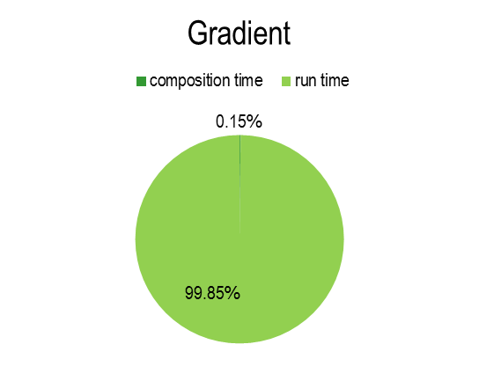
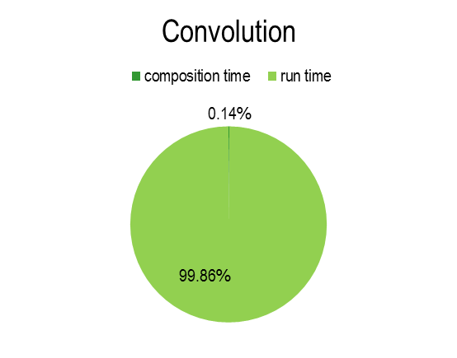
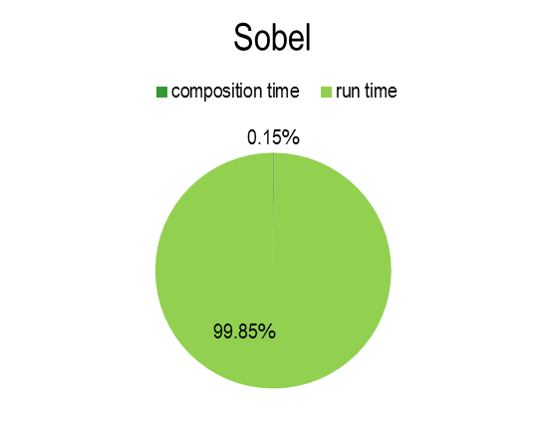
Experiment Results
Composition time VS Run time:
  Xilinx ML605 FPGA Board
  256*256*256 3D image, 100MHz frequency
bitstream download time: 20s
application | Gradient | Convolution | Sobel
Composition time(ms) | 0.357ms | 0.355ms | 0.356ms
Run time(ms) | 235ms | 253ms | 234ms

Slide 19
Experiment Results
Run time:
  Xilinx ML605 FPGA Board
  256*256*256 3D image, 100MHz frequency
 |  | Gradient | Convolution | Sobel
Dual-Core ARM Cortex-A9 MPCore @ 800MHz | Runtime(s) | 0.346 (1x) | 0.576 (1x) | 0.787 (1x)
 | Energy(J) | 0.381 (1x) | 0.634 (1x) | 0.866 (1x)
FPCA prototype in FPGA @ 100MHz | Runtime(s) | 0.235 (1.5x) | 0.253 (2.3x) | 0.234 (3.4x)
 | Energy(J) | 0.729 (0.52x) | 0.784(0.81x) | 0.725 (1.19x)
FPCA projected on 45nm ASIC with power gating | Runtime(s) | 0.059 (5.8x) | 0.063 (9.1x) | 0.059 (13.3x)
 | Energy(J) | 0.015 (25x) | 0.016 (39x) | 0.015 (57x)
Projection based on: I.Kuon etl “Measuring the Gap Between FPGAs and ASICs”, IEEE Transaction on Computer-Aided Design of Integrated Circuits and Systems, vol. 26, no. 2, pp. 203—215 Feb, 2007

Slide 20
Area Breakdown
Slice Register and Slice LUTs for each module
 | Slice register | Slice LUTs | # in current design | # used in mapping | Percentage register, LUTs
Computation element | 192 | 511 | 6 | 4 | 9.7%, 12%
Local memory unit | 136 | 432 | 6 | 6 | 10.3%, 15%
Register chain | 768 | 512 | 2 | 1 | 9.7%, 3%
Global data transfer unit | 3018 | 3897 | -- | -- | 38%, 23%
Data network | 2048 | 7136 | -- | -- | 25.8%, 42.3%
Synchronization unit | 2 | 32 | -- | -- | 0.02%, 0.2%
controller | 523 | 659 | -- | -- | 6.6%, 4%
total | 7943 | 16872 (~5x) | -- | --

Slide 21
Outline
Programming Model
Architecture Overview
Computation Complex
Case Study
Experiment Result
Conclusion and Future Work

Slide 22
Conclusion & Future Work
A Novel CGRA Architecture Enables
  Full pipelining
  Dynamic composition
Future Work
  CE: The selection of computation patterns for different domains
  Heterogeneous or Homogeneous CE design
  Reduce overhead of composition

Slide 23
Thank you
Q&A?

Slide 24
Back Up Slides
Compared to VLIW
Difference
  There is no routing problems for VLIW since all FUs can read from register file

Slide 25
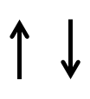
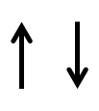


Case Study of Execution Flow
task 0~20
task list
Initiator
to_IOMMU (page translation)
Controller
data transfer request of A0
data transfer request of A1
from_IOMMU (DMA packet)
data transfer request of A2
Monitor
data transfer request of B0
DMA: tile B0
data transfer request of B1
DMA: tile B1
data transfer request of B2
tile A0
DMA: tile A0
DMA: tile A1
DMA: tile A2
DMAC
Bus to external memory
tile A2
tile A1
!full
write commit
!empty
read commit
cmp…
cmp…
tileB0
tile B1
LMU (a)
………
LMU (b)
cmp…
cmp…
ready (!empty)
read start
ready (!full)
write start
Synchronization Unit

Slide 26
Computation Element (CE)
Execute computation with pattern:
  3 cycles latency always assumed from any input
Configuration bit protocol
  Constant configuration bits provided during operation, 8 bits
  Config[6:5], stage1 = A+D when 1, A-D when 2, A otherwise
  Config[4:3], stage2 = B * stage1 when 1, stage1 * stage1 when 2, stage1 otherwise
  Config[2:0], output P_{n} = stage2 + C when 1, P_{n-1} + stage2 when 2, P_{n-1} + stage2 + C when 3, P_{n-1} – stage2 when 4, P_{n-1} – stage2 + C when 5, stage2 otherwise
  Config[7], output P_{n} is further buffered for {0,1} * delay(CE) cycles
Configuration bits
stage1
stage2
P_{n}
P_{n-1}
P_{n}
A_{n}
CE
FF
+/-
FF
*
FF
+/-
FF
xFF
FF
2 FFs
3 FFs
3 FFs
A_{n}
B_{n}
C_{n}
D_{n}
D_{n}
B_{n}
C_{n}
P_{n-1}

Slide 27
Composition of Computation Complex
Pattern supported by computation element
Found lots of computation patterns follow:
  add, then multiply, then add
Adjacent CEs are chained to save interconnects
Also matches Xilinx DSP block
+
+
+
+
x
x
x
x
+
+
+
stage1
stage2
P_{n}
Configuration bits
A_{n}
FF
+/-
FF
*
FF
+/-
FF
xFF
P_{n-1}
P_{n}
CE
FF
2 FFs
3 FFs
3 FFs
D_{n}
B_{n}
C_{n}
P_{n-1}
A_{n}
B_{n}
C_{n}
D_{n}

Slide 28
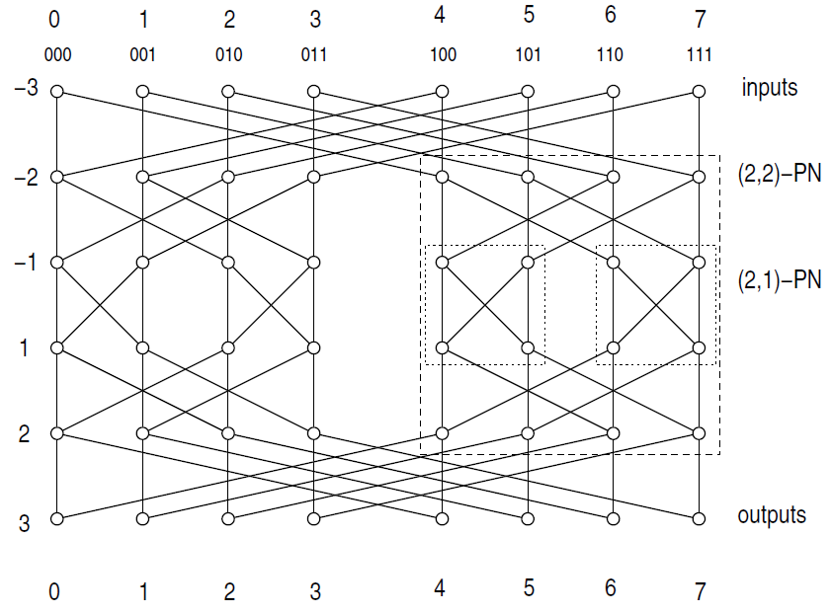
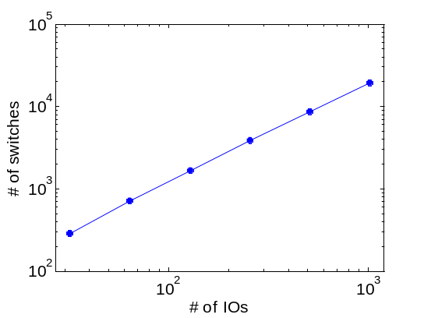
Composition of Data Network
Connections among computation elements (also on-chip memories) can be arbitrary
However most edges are single fan-out
Use one-to-one permutation network to connects them together
Reconfigure the network only when composing accelerators
Pseudo scalable with # of inputs and outputs
  # of switches = (2log(x)-1)x
CE
CE
CE
CE

Slide 29
Composition of Registers
Enable
  data duplication to match CE fanout in data flow graph
  configurable delays to synchronize CE inputs
Motivation example: r*(r*(r+0.2)+0.1)
Adjacent register chains can be further chained to
  provide even larger fanout
  provide even longer delay
Configuration bits
Register Chain
In_{prev}
In
Out0
Out1
Out2
Out3

Slide 30
Composition of On-Chip Memories
To avoid memory contention, load operations of different addresses → different local memory units
Each local memory unit contains a dedicated address generator to
  generate a new address every clock cycle, and read (or write) data from on-chip memory, and send to computation element through the permutation network
The iteration domain of address generator is configured upon composing accelerators
u[j-1][k]
u[j][k-1]
u[j][k]
u[j+1][k]
u[j][k+1]
load
load
load
load
load
LMU
LMU
LMU
LMU
LMU

Slide 31
Composition of Global Memory Controllers
Data transfer initiator
  iterate over a task list of image tiles, generate and send data transfer request to IOMMU
  keep generating requests until > 10 requests sent but yet to finish
IOMMU monitor
  receive DMAC requests (physical addresses, page wise), distribute to channel queues
DMAC
  if empty/full signal from LMUs is ‘0’ and exists a request in queue for each channel, execute DRAM/LMU memcpy
Select MUX
  Multicast a var to multiple LMUs
Initiator
to_IOMMU
Controller
to LMUs
from_IOMMU
Monitor
queue per channel
DMAC
each variable array occupies a channel
AXI data bus to DRAM

Slide 32
Mapping Example
Takes 4 CEs, 6 LMUs and a register chain
Associated with 16872 LUTs
(c-d)²
(c-r)²
+(c-u)²
+…+(c-l)²
to fetch left, start_addr = 6
length = 3, copy = 3, stride = 5
left
right
up
down
center
output

Slide 33
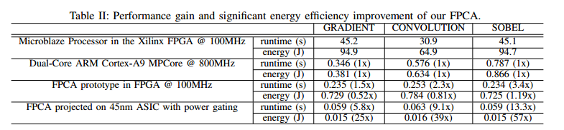
On-Board Experimental Results
Accelerator kernel: gradient in denoise
Image size 128x128x128
Note that composable accelerators can compose all resources for as many instances as possible due to flexibility
  residual resources can be composed to 5 more gradient kernels
  results are projected due to contention on limited FPGA pins to DRAM

