Slide 1


Caffeine: Towards Uniformed Representation and Acceleration for Deep Convolutional Neural Networks
Chen Zhang^{1，2，3}, Zhenman Fang ², Peipei Zhou ², Peichen Pan ³, Jason Cong ^{1，2，3}
1 Center for Energy-Efficient Computing and Applications, Peking University, Beijing, China
2 Computer Science Department, University of California, Los Angeles, USA
3 Falcon-computing Solutions Inc.

Slide 2
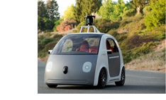
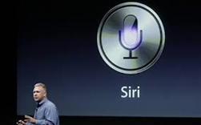

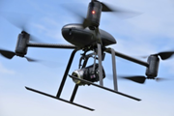

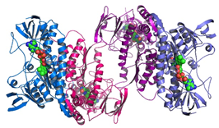



Deep Learning：Heart of Future Applications
Unmanned Vehicle
Speech & Audio
Text & Language
Genomics
Image & Video
Multi-media

Slide 3
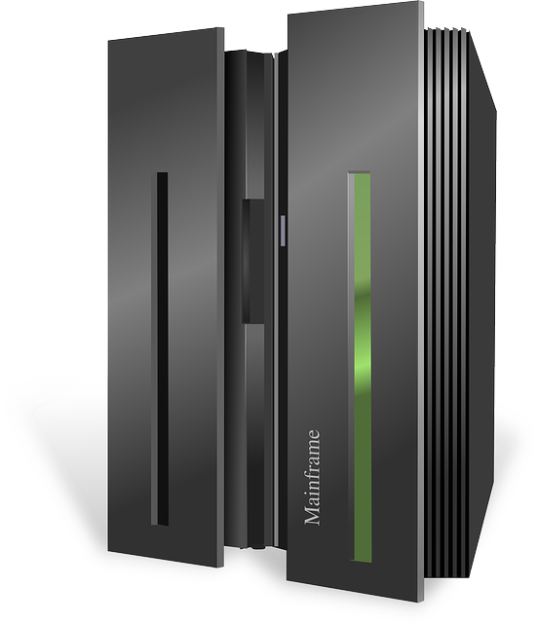

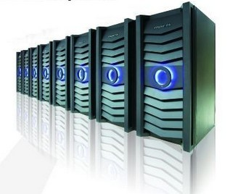
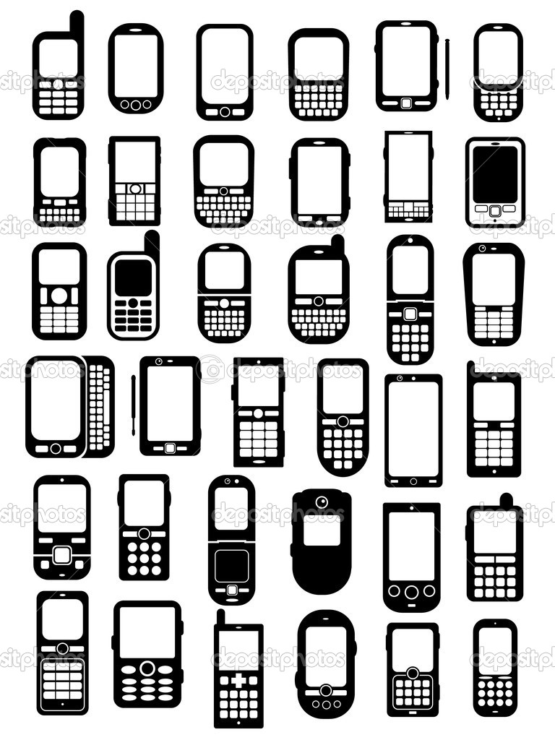
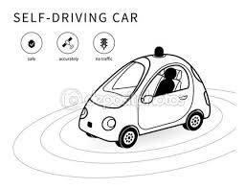

Deep Learning Application Scenarios
Back-end training
Online Processing
— big training data
— big models
— fast iteration
— ~100 high-end GPUs
Intelligent Device
— billions requests/day
— critical cost & power demands
— on forward stage
— ~10,000 CPUs+Accelerators
— real-time response
— critical cost & power demands
— on forward stage
Notes:
Deep learning algorithms are used everywhere. But, we think, they are deployed in 3 stages.
The first stage is called back-end training, where a large amount of data is fed to deep learning algorithms to let it learn data patterns automatically.
It usually contains a huge amount of computation workload. So those servers are usually equipped with tens to hundreds of high end GPUs.
The second stage is called online processing. A cloud cluster usually contains tens of thousands servers to process online data, like image search engines.
Because of data center’s limit on power budget and low-latency computing, a large amount of accelerators are needed in this level.
The last level is called embedded or intelligence device.
Our work is mainly focused on accelerating deep learning’s online processing.

Slide 4
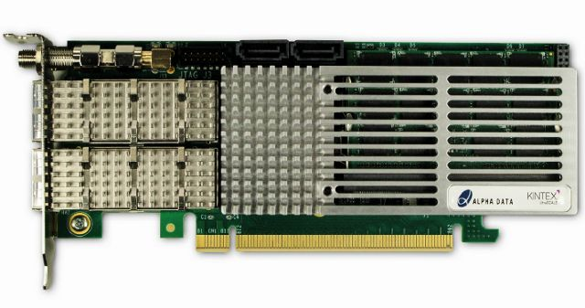
FPGA-based Accelerator in Data Center
CPU
Interconnect
FPGA
CPU
FPGA
Applications (with CNNs)
Our Work
Customized Accelerator
High-level Network Description
Computation Model Optimization for Customized Platforms
Our Work
PCIe
DRAM
Notes:
FPGAs are one of the most promising devices in data center level acceleration. Microsoft recently has deployed 10k FPGA devices on its bing search ,and Azure cloud server.
In our work, we assume each cloud server is equipped with one FPGA acceleration board. Each FPGA has one local DRAM and communication with CPU host with PCIe interconnect.
After CPU received requests from user applications, It offloads deep learning computation workload to FPGA device.
The green part is our work, which contains a customized accelerator and corresponding accelerator-specific driver/compiler.

Slide 5
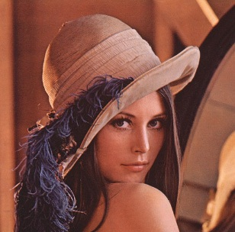

Convolutional Neural Networks (CNNs)
Input Image
Fully connect
Fully connect
Pool
Conv
Conv
Fully connect
ReLU
Conv
ReLU
Conv
ReLU
Conv
ReLU
64
128
$$w_{ij}^{1l}$$
$$w_{ij}^{1l}$$
56
K=3
224
K=5
56
128
3
224
Convolution Layer
Convolution Layer
Notes:
A CNN network has different convolution layers, for example as shown here, two convolution layers are different in number and size of input/output feature maps and shape and stride of weight kernels.

Slide 6
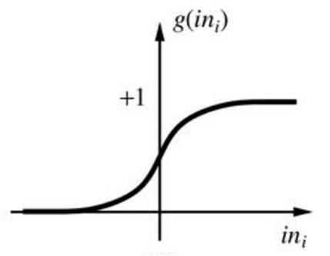
Convolutional Neural Networks (CNNs)
Input Image
Fully connect
Fully connect
Pool
Fully connect
Pool
Conv
Conv
Conv
ReLU
Conv
ReLU
ReLU
Conv
ReLU
Pooling Layer
Non-linear layer
Notes:
A CNN network also have different layers, other than convolution layer, there are pooling layer and non-linear activation layer for feature extraction and fully connected layer for classification.

Slide 7
Challenge 1: Various Convolution Kernel & Layer Configurations
Network definitions (& layer parameters) change according to applications
CNNs are getting deeper, more precision achieved with deeper network
Network parameters vary across layers, many user definable parameters
Hardware has limited programmability
Re-synthesize bitstream for each network? – Not preferred
Re-program FPGA for each layer? – No!
152 layers
Error Rate
28.2
25.8
16.4
11.7
19 layers
22 layers
7.3
6.7
shallow
8 layers
8 layers
3.57
Notes:
There are many challenges in designing deep learning accelerators. First of all, there are various convolution kernels with different layer configurations.
As shown here, from 2010 to 2016, lower error rate and higher precision are achieved as CNN networks are getting deeper, that is, having more layers. Not say, network parameters vary across different CNN networks and different layers within one CNN network.
As algorithm changes, the hardware, however, has limited programmability. Shall we re-synthesize bitstream for each network? This is not preferred because synthesizing FPGA bitstream takes hours of effort.
And shall we re-program FPGA for each layer? This is also not a good choice because the latency requirement for online processing jobs and we could not afford latency in the reprogramming for each layer.

Slide 8
Challenge 2: Various Computation Patterns
Convolution layer & Fully connected layer
Convolution layer -- Compute Intensive
Fully Connected layer -- Communication Intensive
Hardware has limited bandwidth resource
Convolution layer -- extensive previous study
Fully connected layer -- How to maximize bandwidth utilization?
CONV + FCN -- How to re-use hardware for both kernels?
 | CONV | POOL | ReLU | FCN
Mega float Op. | 3x10⁴ (99.5%) | 6 (0%) | 14 (0%) | 1.2x10² (0.4%)
Feature map +weights size (MB) | 113 (19.3%) | 0 (0%) | 0 (0%) | 471.6 (80.6%)
Time% in pure software | 96.3% | 0% | 0% | 3.7%
after CONV acceleration | 48.7% | 0% | 0% | 51.2%
Mega float Operations | 3x10⁴ (99.5%) | 6 (0%) | 14 (0%) | 1.2x10² (0.4%)
Feature map +weights size (MB) | 113 (19.3%) | 0 (0%) | 0 (0%) | 471.6 (80.6%)
Notes:
The second biggest challenge is that CNN layers have different computation and communication patterns.
Convolution layer and Fully connected layer are two major layers in CNN. CONV layer and FCN present two extreme features. As shown in the table here, CONV layer are very computation intensive, it takes 19% total data but need 99% computation. In contrast, FCN layer in the last column, are communication intensive. They need 0.4% of arithmetic operations but use 80% of the total data. These two layers occupy more than 99.9% of the total execution time.
As hardware has limited bandwidth resource, how we can maximize bandwidth utilization for FCN layer and how to accelerate both the CONV and FCN layer on one accelerator need to be solved.

Slide 9
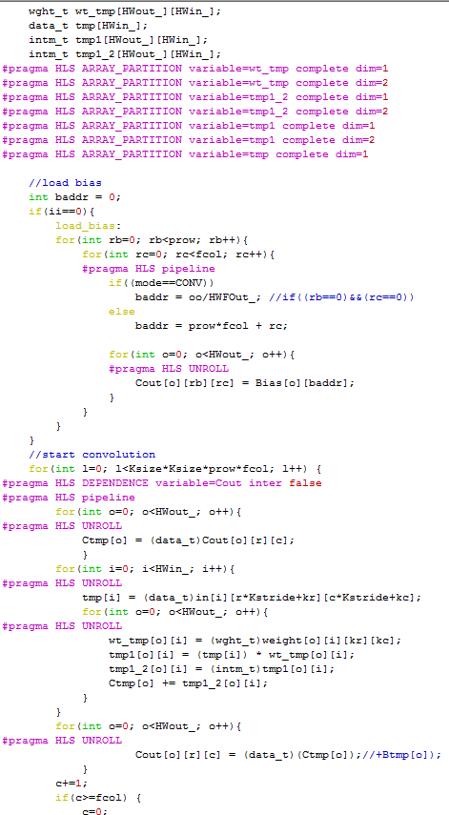
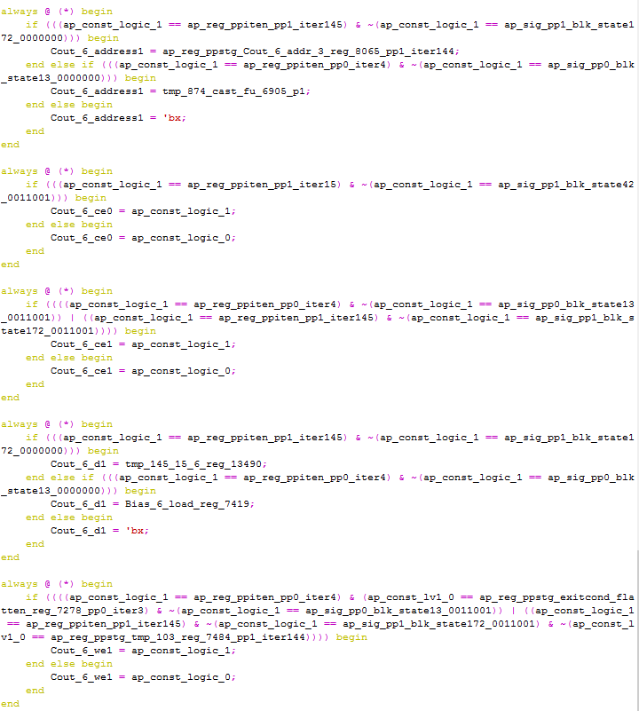

Challenge 3: Hardware is very hard for software programmer
10 lines of Caffe Code
600 lines of HLS Code
10,000 lines of Verilog
layers {
bottom: "conv1_1"
top: "conv1_2"
name: "conv1_2"
type: CONVOLUTION
convolution_param {
num_output: 64
pad: 1
kernel_size: 3 }
}
layers {
bottom: "conv1_2"
top: "pool1"
name: "pool1"
type: POOLING
pooling_param {
pool: MAX
kernel_size: 2
stride: 2 }
}
Harder
Harder
Notes:
The third challenge is that hardware accelerator design is hard for software programmer to deploy.
A software programmer only need around 10 lines of Caffe code to define a CNN network, however, this corresponds to 600 lines of HLS C code to design FPGA accelerator. And furthermore, this corresponds to 10,000 lines of RTL Verilog code. How to let software programmer to use hardware accelerator easily also needs to be addressed.

Slide 10
Challenges & Our Solutions
High-level Network Definitions
Challenge 3: Hardware is very hard for software programmer
Automation flow
CONV
FCN
POOL
ReLU
Challenge 1:
Various Convolution Kernel & Layer Configurations
Uniformed Representation
Challenge 2: Performance Optimization
Software Definable
FPGA-based Accelerator Design
1. Re-use same hardware for both CONV&FCN
2. Deal with both computation & bandwidth bound kernels
Computation Optimization
Bandwidth Optimization
Notes:
In this way, we propose Caffeine, that is, Caffe FPGA engine, to address these issues.
For challenge 1, that is, CNN have various convolution kernels and layer configurations. We propose a uniformed representation for both convolution and fully connected layers.
We further made our FPGA-based accelerator design according to this uniformed representation.
For challenges 2, that is, CONV&FCN kernel’s have different computation and communication pattern, we design hardware for both CONV and FCN, and we do optimizations to maximize both computation operations and bandwidth.
For challenge 3, that is, efforts in deployment of FPGA-based CNN accelerator, we made an automation flow for application –level users to use our accelerator. A standard caffe programming language is all users need to know to program our FPGA accelerator.

Slide 11
Caffeine
Software/Hardware Co-designed FPGA-based deep learning library
Caffe framework
Network definitions (feedforward)
Layer definitions
Automation flow
CONV
FCN
POOL
ReLU
CONV
FCN
POOL
ReLU
Uniformed Representation
Our work
MKL, BLAS
cuDNN
CPU_forward
GPU_forward
FPGA-based Accelerator Design
Computation Optimization
Bandwidth Optimization
Notes:
And Caffeine is the software/hardware co-designed FPGA-based deep learning library, We integrate Caffeine with industry standard Caffe deep learning framework. As shown in this figure, our work caffeine is in the same level as other GPU or CPU based deep learning library, including cuDNN on GPU or Intel MKL.

Slide 12
Energy-Efficient CNN Implementation on a DeeplyPipelined FPGA Cluster
Chen Zhang1 , Di Wu2 , Jiayu Sun1 , Guangyu Sun1,3, Guojie Luo1,3, and Jason Cong1,2,3
1Center for Energy-Efficient Computing and Applications, Peking University, Beijing, China
2Computer Science Department, University of California, Los Angeles, USA
3PKU/UCLA Joint Research Institute in Science and Engineering

Slide 13
