Slide 1

Basic Command-Line Navigation and Access Control
Week 3
SA1 – Systems Administration and Maintenance

Slide 2
Learning Objectives:
Identify basic Linux commands for navigation and admin access
Match commands to appropriate user roles and scenarios
Navigate the file system via terminal commands
Verify user access

Slide 3
Introduction
Understanding the terms terminal, console, shell, and kernel is crucial for anyone working with computers or learning about operating systems. These concepts are key components of how we interact with our devices and software. The terminal is a text-based interface used to interact with the computer, while the console is often referred to as the physical or virtual interface that provides input/output access. The shell acts as an interpreter between the user and the operating system, and the kernel is the core part of the operating system that manages hardware resources.

Slide 4
What is Linux terminal?
The terminal in Linux is a text-based interface that allows users to interact with the system by entering commands. It's a powerful tool for executing commands, managing files, and controlling system processes. Unlike a graphical interface, the terminal provides direct access to the command line where users can perform tasks such as installing software, navigating directories, and editing files. It’s widely used by developers and system administrators for automation, scripting, and system management. The terminal enhances productivity through efficient command-line operations and offers deep control over the Linux operating system.
- Takes input from the user in the form of commands
- Displays output on the screen
- We can say the terminal is a dumb thing so it does not know what to do with the input, so it needs another program to process it, and in most cases, it's the Shell.

Slide 5
What is Console?
In the case of Windows OS, the “Console” performs the same operations performed by the terminal, so we can say for Windows OS, the Console is the alias name for the Terminal. But the Console is not opened directly rather we need to open it through the Command Prompt which then opens the console or the rectangular frame on the screen.

Slide 6
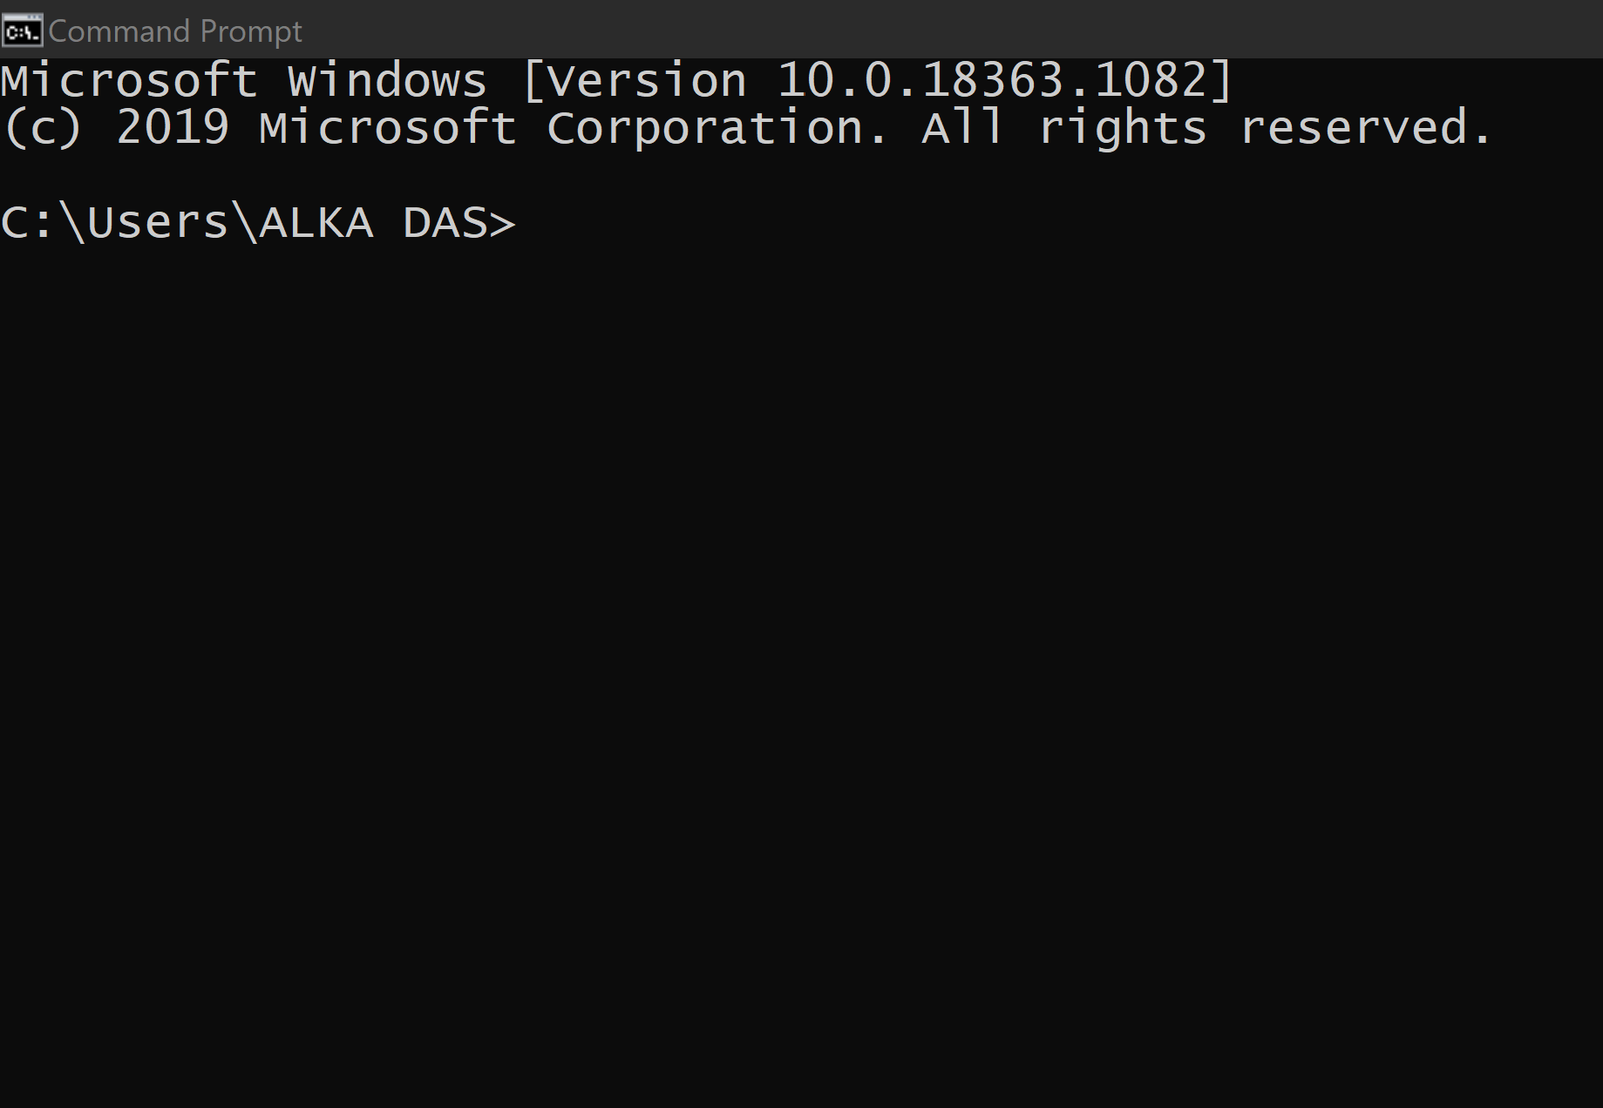
What is Console?

Slide 7
What is Shell?
After writing our commands on the terminal, when we press the Enter key, the terminal passes those commands to another program to figure out what the user wants to do, and in most cases, that program is the Shell, which forms the outer layer of Linux OS, which performs the following functions:
1. Interprets the command given by the end-user
2. Check the syntax of the command and then Check whether the command is correctly used or not.
3. If everything is correct, the shell converts the command Into a kernel- understandable form and passes it to the kernel. Else, It returns an error message.
4. The $ prompt appears on the terminal waiting for the next command, Irrespective of whether the previous commands were correct or not.

Slide 8
What is Shell?
The shell is the mediator or the interface between the end user and the kernel. There are various shell programs we can choose from namely TCSH, KSH, Seashell, Bash, and many more, but the default one on most Linux systems and the Mac is the GNU Bash

Slide 9
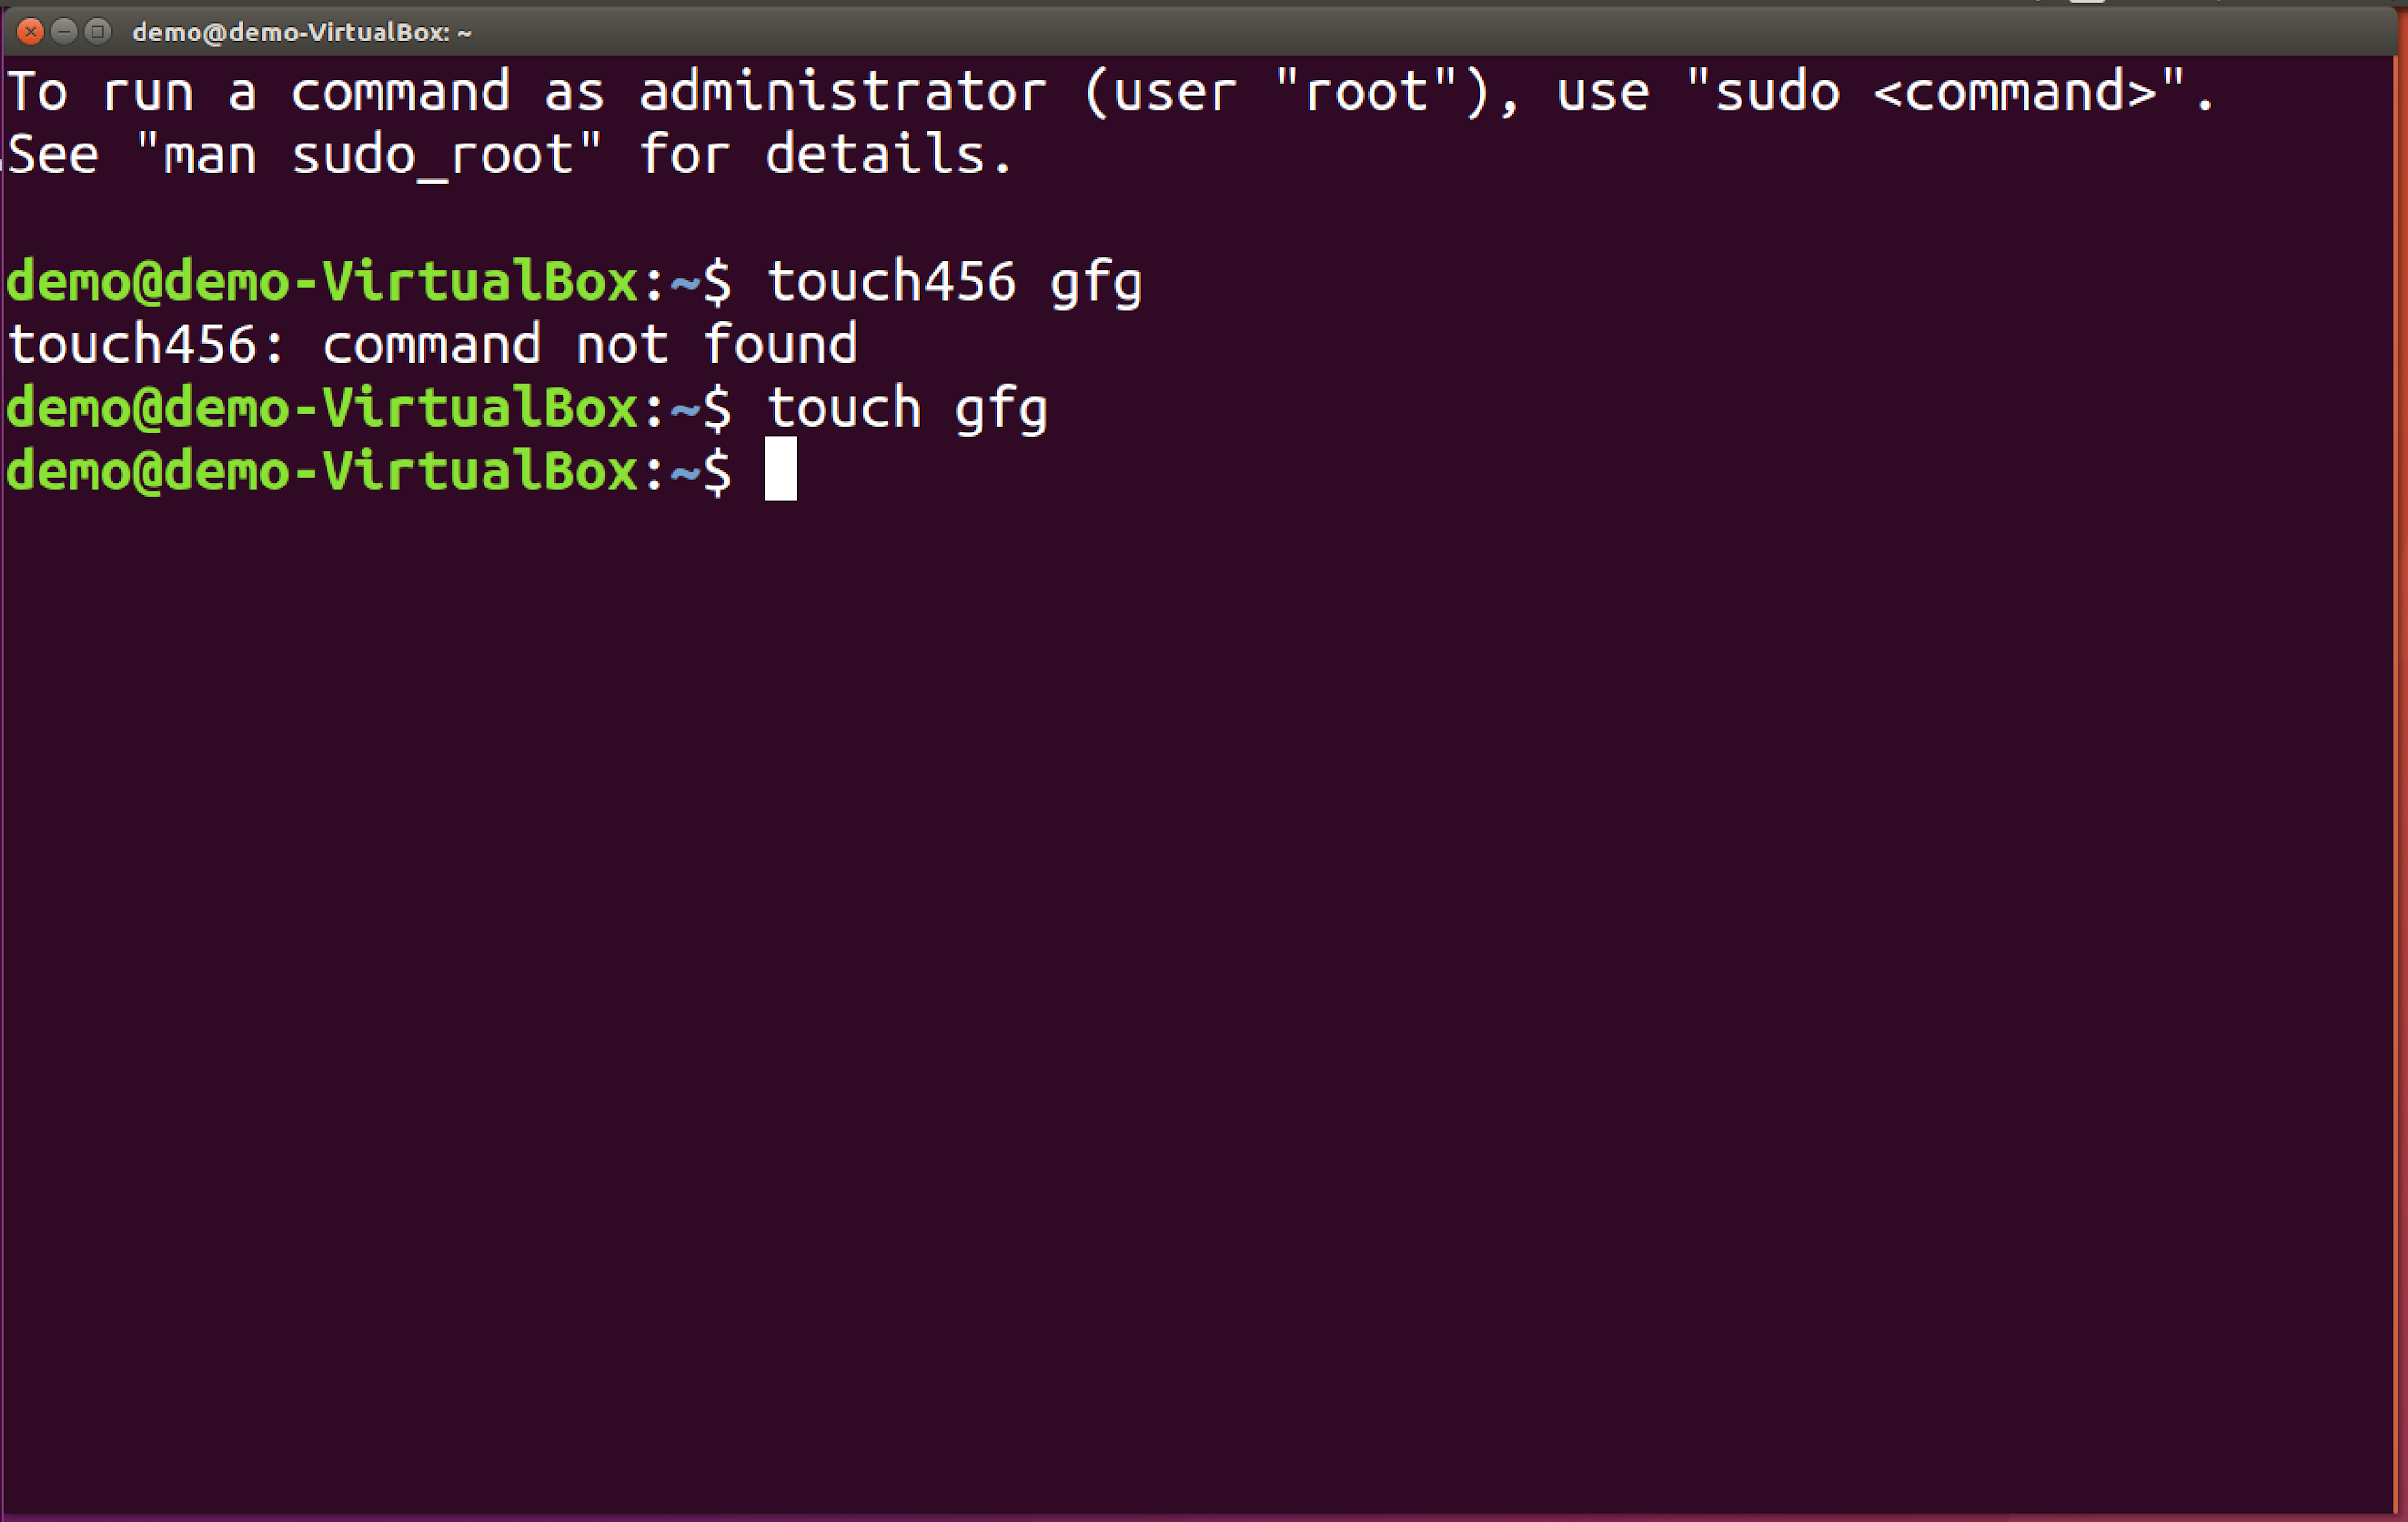
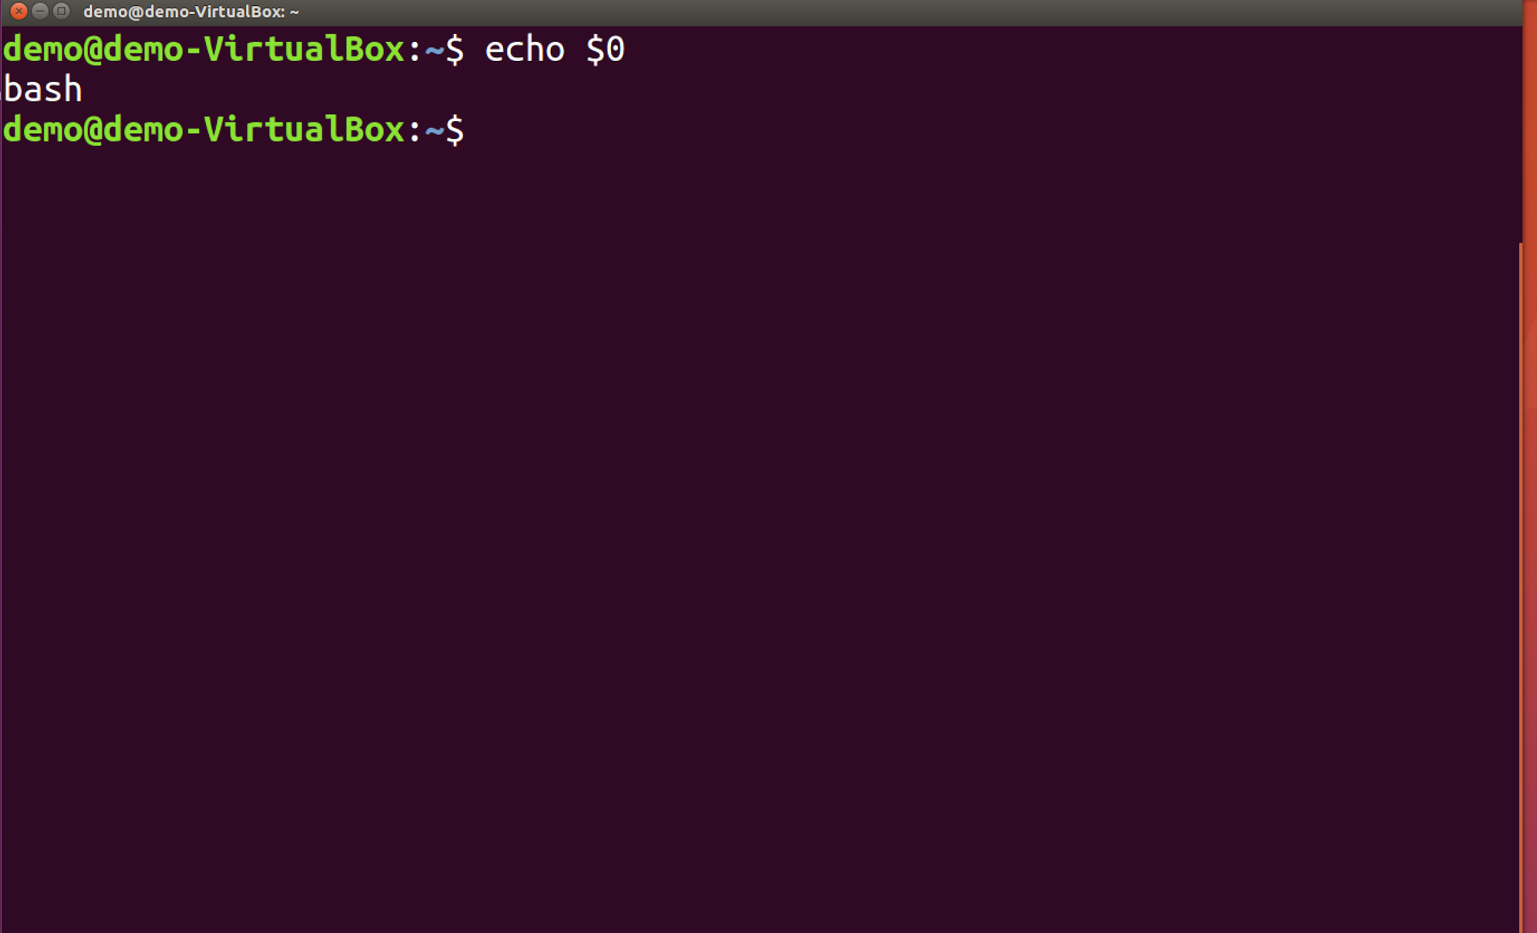
What is Shell?

Slide 10
What is Kernel?
It's a computer program that forms the innermost component of an OS after the Shell. As soon as the shell converts the user's command into kernel understandable form, the kernel is responsible for executing the commands with the help of its 2 components which are OS libraries and Device Drivers interacting with Application software and device hardware respectively. Following is an example of a C-program execution flow through the OS till the hardware:

Slide 11
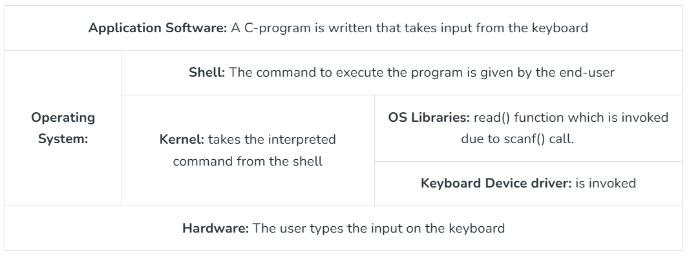
From the table below, it is clear that the Kernel acts as the interface between the Application Software and the Hardware. Memory Allocation and the Processor Allocation will also be taken care of by the Kernel.

Slide 12
Conclusion
In summary, the terminal, console, shell, and kernel each plays distinct roles in computing. The terminal and console provide user interfaces for input and output, with the shell acting as a command interpreter between the user and the system, while the kernel manages hardware resources and system processes. Understanding the difference between terminal and console, as well as shell vs kernel, is fundamental for grasping how an operating system functions and how we interact with it through various tools.

Slide 13



Linux Command Structure
Navigating the File System
pwd - The pwd (Print Working Directory) the command shows your current directory path in the terminal. This command is useful for knowing where you are in the file system.
ls - The ls command lists all files and directories in your current directory. You can use various options to customize the output, such as -l for a detailed view and -a to include hidden files.
cd - The cd (Change Directory) command allows you to navigate through directories. Use it to move to a specific folder.

Slide 14





Managing Files and Directories
mkdir - The mkdir command creates a new directory. This is helpful for organizing your files.
touch - The touch command is used to create a new empty file or update the timestamp of an existing file.
cp - The cp command copies files or directories. You can specify the source and destination paths.
mv - The mv command moves or renames files and directories. It’s useful for organizing files or changing their names.
rm - The rm command removes files or directories. Use with caution, as deleted files cannot be easily recovered.

Slide 15

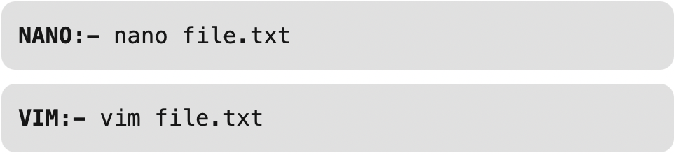
Viewing and Editing Files
cat - The cat command displays the content of a file in the terminal. It’s a quick way to view text files.
nano or vim - These are text editors used to create or edit files directly from the terminal. nano is more user friendly for beginners, while vim is powerful for advanced users.

Slide 16



System Information and Management
top - The top command displays real-time system resource usage, including CPU and memory. It’s useful for monitoring system performance.
df - The df (Disk Free) command shows disk space usage for all mounted filesystems. It helps you keep track of available storage.
free - The free command displays information about memory usage, including total, used, and free memory.

Slide 17

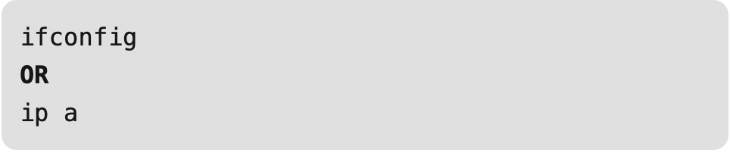

Networking Commands
ping - The ping command tests network connectivity to a specific host. It’s useful for troubleshooting network issues.
ifconfig or ip - These commands display network interface configuration. ifconfig is older and may be replaced by ip.
wget - The wget command downloads files from the internet. It’s helpful for retrieving files via HTTP, HTTPS, or FTP.

Slide 18


Package Management
apt-get (Debian/Ubuntu) - This command manages packages in Debian-based distributions, allowing you to install, update, and remove software.
yum (CentOS/Fedora) - Similar to apt-get, yum manages packages in RPM-based distributions.

Slide 19
Conclusion
Learning the basics of Linux commands can really boost your productivity when working with the system. With just a few commands, you’ll be able to move around directories, manage files, and perform essential tasks more efficiently. Once you get comfortable with these everyday commands, using the Linux command line will feel much less intimidating—and you’ll be able to handle your work or personal projects with confidence, almost like a pro.

Slide 20
Navigation commands
pwd (print working directory): This command displays the full path of your current location in the file system. The command outputs the current working directory absolute path. In this case, the home directory path.

Slide 21
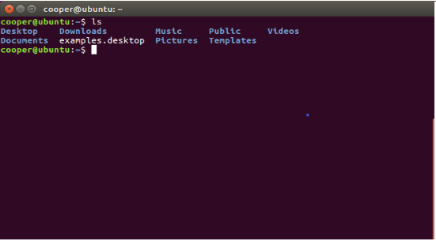
Navigation commands
ls (list): This command lists the contents (files and directories) of the current directory by default. You can also specify a directory to list its contents.

Slide 22
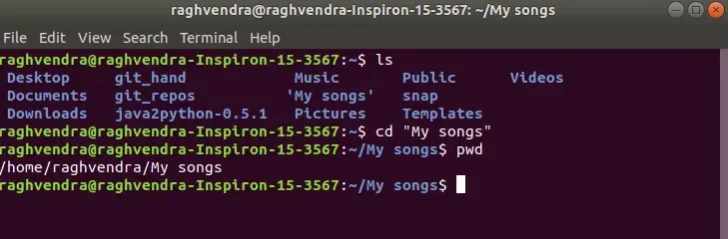
Navigation commands
cd (change directory): This command is used to move between directories.
cd directory_name: Changes to a subdirectory within the current directory.

Slide 23
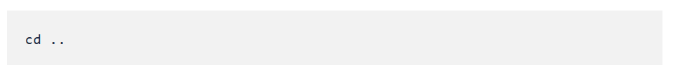
Navigation commands
Moving up one directory:
You use the cd command followed by ... The .. symbol represents the parent directory of the current directory.

Slide 24
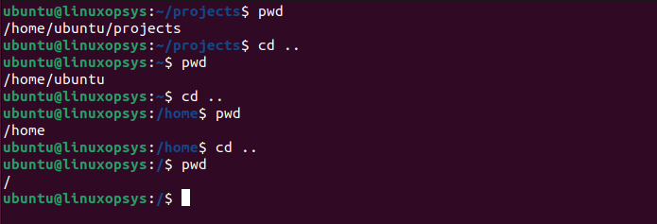
Navigation commands
After executing this command, you'll be in the parent directory of your previous location. If you keep using cd .. repeatedly, you will eventually reach the root directory /, which is the topmost level in the filesystem hierarchy.

Slide 25
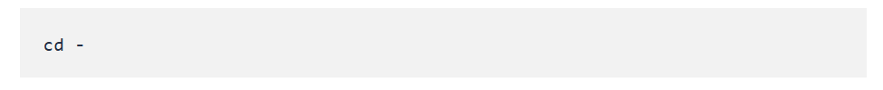
Navigation commands
Returning to the previous directory:
To return to the previous directory in a Linux or Unix-like system, you can use the cd command with the - (dash) option.

Slide 26
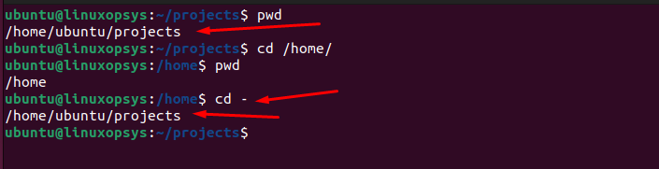
Navigation commands
When you execute this command, the shell will take you back to the directory you were in before the last cd command. The system will also display the path of that directory as output, letting you know where you've navigated to.

Slide 27
Navigation commands
Heading to the root directory:
Use the cd command followed by a forward slash /.

Slide 28
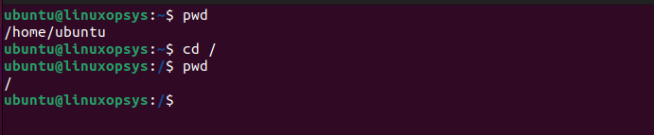
Navigation commands
After executing this command, you'll be located in the root directory, and any commands you execute will operate from this directory context unless otherwise specified. If you've ever lost within the directory structure, you can quickly get back to the root directory by typing cd /. From there, you can navigate to any other location in the filesystem with relative ease.

Slide 29
References:
https://www.geeksforgeeks.org/techtips/basic-linux-commands-day-day-life/
GeeksforGeeks, “What is Terminal, Console, Shell and Kernel?,” GeeksforGeeks, Sep. 30, 2024. https://www.geeksforgeeks.org/operating-systems/what-is-terminal-console-shell-and-kernel/
Linuxopsys, “cd Command in Linux Explained [With Examples],” LinuxOPsys, Aug. 24, 2023. https://linuxopsys.com/cd-command-in-linux
Chatgpt

Slide 30
Group Members:
Jhon Laurence Pacite
John Omar Peňas
Mark Dale Pasiona
Mark Jun Belaro
Aries Iraula
Shaila Rebuya

Slide 31
Thank You

