Slide 1
Asynchronous Deterministic Networking (ADN) Framework for Large scale networks
draft-joung-detnet-asynch-detnet-framework-02
Jinoo Joung, Jeong-dong Ryoo, Tae-sik Cheung, Yizhou Li, Peng Liu
Design Team meeting, April 12

Slide 2
Overview of the Draft
Framework for Latency Guarantee
Regulation based
Asynchronous Traffic Shaping (ATS)
Flow Aggregate Interleaved Regulators (FAIR)
Port-based Flow Aggregate Regulators (PFAR)
Packet meta-data based
Work-conserving stateless core fair queuing (C-SCORE)
Framework for Jitter Guarantee
Buffered network
Today’s focus is on the operational procedures

Slide 3
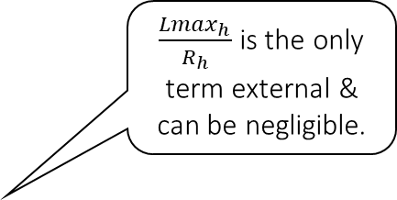
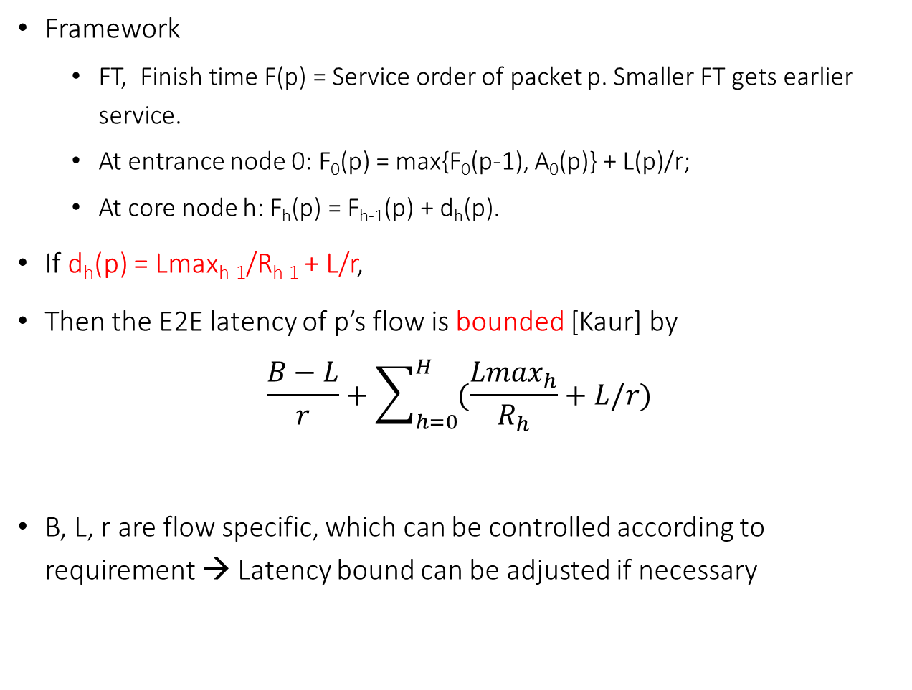
Work Conserving Stateless Core Fair queuing (C-SCORE)
Framework
FT, Finish time F(p) = Service order of packet p. Smaller FT gets earlier service.
At entrance node 0: F₀(p) = max{F₀(p-1), A₀(p)} + L(p)/r;
At core node h: F_{h}(p) = F_{h-1}(p) + d_{h}(p).
If d_{h}(p) = Lmax_{h-1}/R_{h-1} + L/r,
Then the E2E latency of p’s flow is bounded [Kaur] by
$$\frac{B−L}{r}+\sum_{h=0}^{H}{(\frac{{Lmax}_{h}}{R_{h}}+L/r)}$$
B, L, r are flow specific, which can be controlled according to requirement → Latency bound can be adjusted if necessary
Symbol | Definition
F_{h}(p) | ‘Finish time’ of packet p at node h
A_{h}(p) | Arrival time of p at h
L(p) | Length of p
L | Max Packet Length of p’s flow
r | Service rate of p’s flow
B | Max Burst size of p’s flow
Lmax_{h} | Max Packet Length at node h
R_{h} | Link capacity of h
H | Last node of p’s path
PGPS | Packetized Generalized Processor Sharing
$\frac{{Lmax}_{h}}{R_{h}}$ is the only term external & can be negligible.
This bound is same with a stateful fair queuing network (PGPS, etc.)

Slide 4
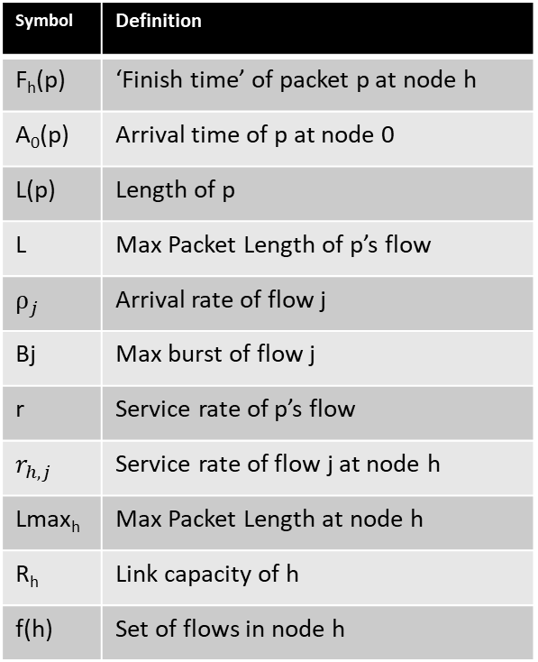
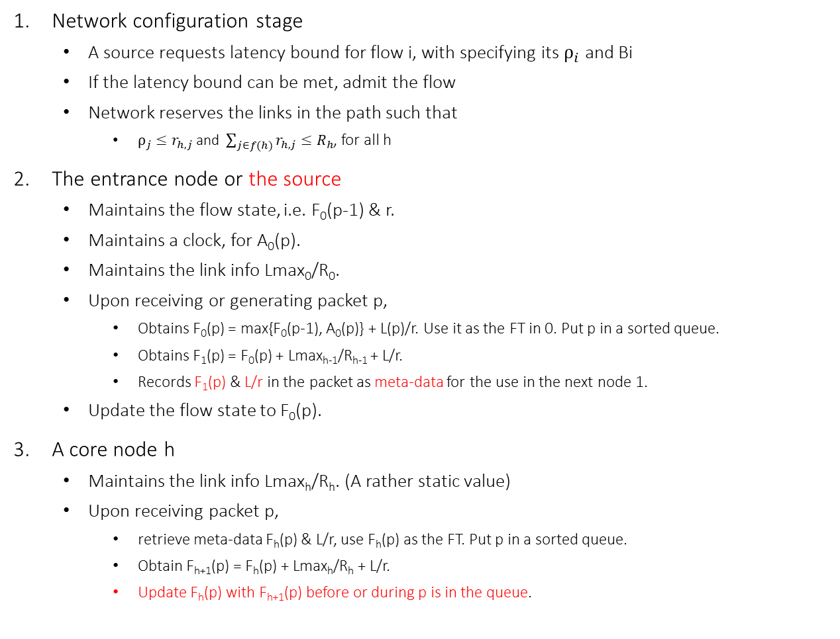
C-SCORE: Operational procedures
Network configuration stage
A source requests latency bound for flow i, with specifying its $ρ_{i}$ and Bi
If the latency bound can be met, admit the flow
Network reserves the links in the path such that
${ρ_{j}≤r}_{h,j}$ and $\sum_{j∈f(h)}{r_{h,j}≤R_{h}}$, for all h
The entrance node or the source
Maintains the flow state, i.e. F₀(p-1) & r.
Maintains a clock, for A₀(p).
Maintains the link info Lmax₀/R₀.
Upon receiving or generating packet p,
Obtains F₀(p) = max{F₀(p-1), A₀(p)} + L(p)/r. Use it as the FT in 0. Put p in a sorted queue.
Obtains F₁(p) = F₀(p) + Lmax_{h-1}/R_{h-1} + L/r.
Records F₁(p) & L/r in the packet as meta-data for the use in the next node 1.
Update the flow state to F₀(p).
A core node h
Maintains the link info Lmax_{h}/R_{h}. (A rather static value)
Upon receiving packet p,
retrieve meta-data F_{h}(p) & L/r, use F_{h}(p) as the FT. Put p in a sorted queue.
Obtain F_{h+1}(p) = F_{h}(p) + Lmax_{h}/R_{h} + L/r.
Update F_{h}(p) with F_{h+1}(p) before or during p is in the queue.
Symbol | Definition
F_{h}(p) | ‘Finish time’ of packet p at node h
A₀(p) | Arrival time of p at node 0
L(p) | Length of p
L | Max Packet Length of p’s flow
$$ρ_{j}$$ | Arrival rate of flow j
Bj | Max burst of flow j
r | Service rate of p’s flow
$$r_{h,j}$$ | Service rate of flow j at node h
Lmax_{h} | Max Packet Length at node h
R_{h} | Link capacity of h
f(h) | Set of flows in node h

Slide 5
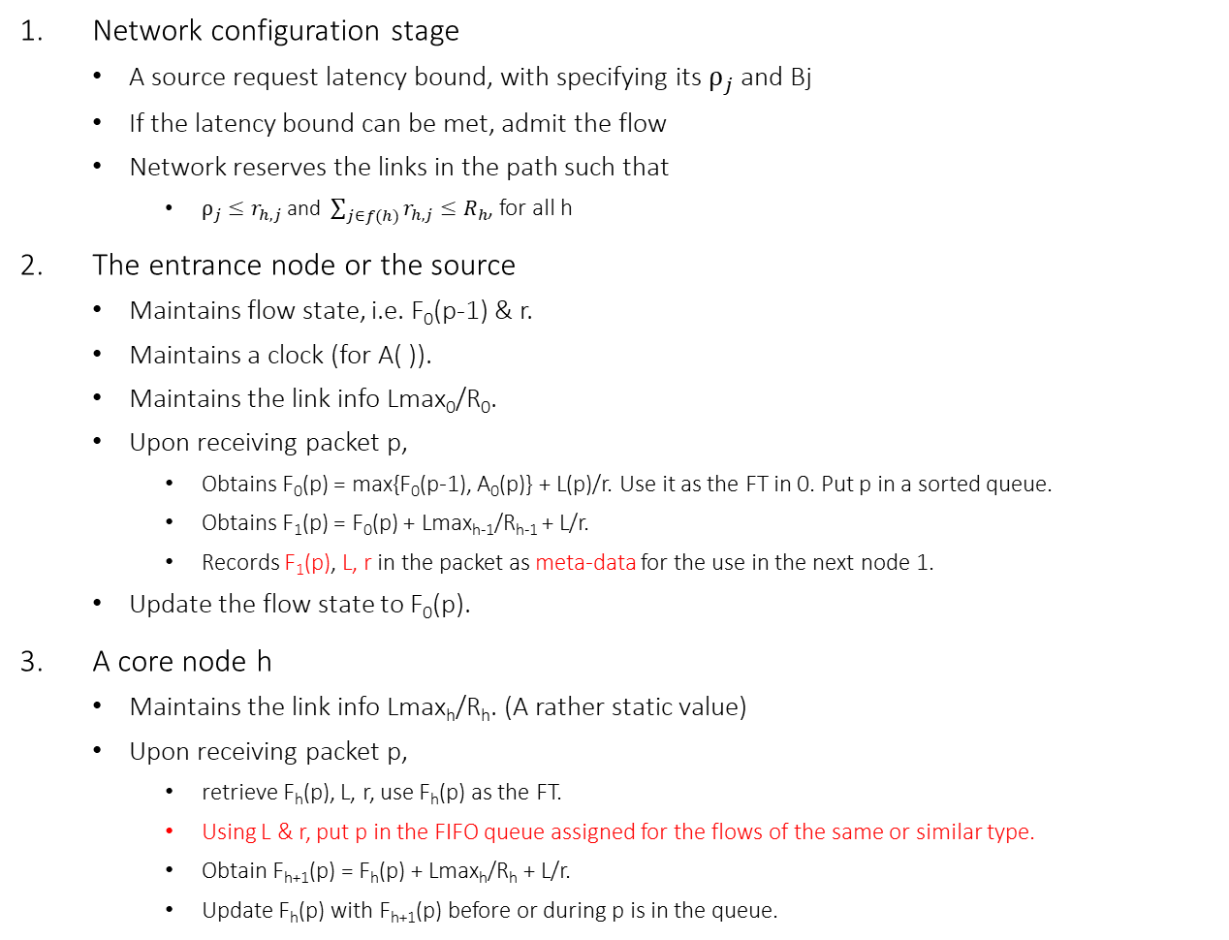
C-SCORE with FIFO: Operational procedures
Network configuration stage
A source request latency bound, with specifying its $ρ_{j}$ and Bj
If the latency bound can be met, admit the flow
Network reserves the links in the path such that
${ρ_{j}≤r}_{h,j}$ and $\sum_{j∈f(h)}{r_{h,j}≤R_{h}}$, for all h
The entrance node or the source
Maintains flow state, i.e. F₀(p-1) & r.
Maintains a clock (for A( )).
Maintains the link info Lmax₀/R₀.
Upon receiving packet p,
Obtains F₀(p) = max{F₀(p-1), A₀(p)} + L(p)/r. Use it as the FT in 0. Put p in a sorted queue.
Obtains F₁(p) = F₀(p) + Lmax_{h-1}/R_{h-1} + L/r.
Records F₁(p), L, r in the packet as meta-data for the use in the next node 1.
Update the flow state to F₀(p).
A core node h
Maintains the link info Lmax_{h}/R_{h}. (A rather static value)
Upon receiving packet p,
retrieve F_{h}(p), L, r, use F_{h}(p) as the FT.
Using L & r, put p in the FIFO queue assigned for the flows of the same or similar type.
Obtain F_{h+1}(p) = F_{h}(p) + Lmax_{h}/R_{h} + L/r.
Update F_{h}(p) with F_{h+1}(p) before or during p is in the queue.
Core node with FIFO
Input
port
High
priority
FIFO queue for similar flows
M
S
Strict priority
Scheduler with pre-emption
FIFO queue for similar flows
Low priority queue
Low
priority
Node =
output port module
Input
port
output port module
Switching device
M: Meta-data retrieve & update; FIFO enqueue
S: HoQ examine, Select the packet with min FT
Red letters: the only differences from the previous page

Slide 6
C-SCORE Summary
C-SCORE with d_{h}(p) = Lmax_{h-1}/R_{h-1} + L/r
Has a theoretical E2E latency bound,
Needs a clock at the source or entrance node,
Needs a sorted queue,
Needs a meta-data of F_{h}(p), L/r
Needs to update meta-data, but not upon the packet’s transmission.
C-SCORE with d_{h}(p) = Lmax_{h-1}/R_{h-1} + L/r with FIFO per flow type (of the same L and r)
Shows similar performance
Needs similar things, but needs the meta-data F_{h}(p), L, r
Does not need a sorted queue
They both perform as if the stateful fair queuing schedulers are placed in all the nodes, which are known as the best statistical-multiplexing schedulers.

Slide 7
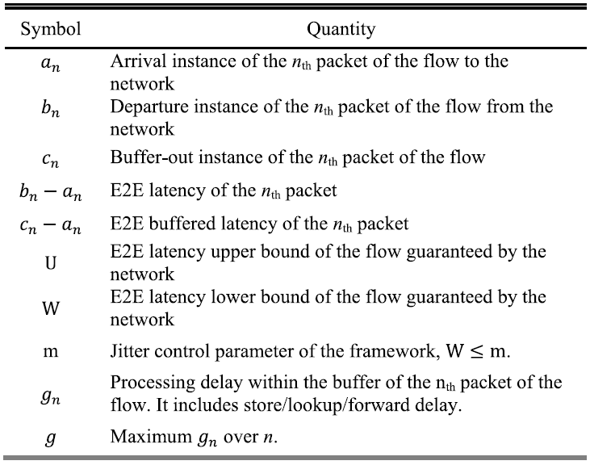
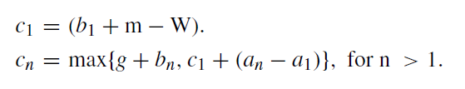
Jitter guarantee framework: BN [BN, ADN]
Basic idea: Jitter guarantee ≈ Reproducing the inter-arrival process with the inter-departure process of a network.
With a latency guaranteed network, time-stamping, and buffering at the network boundary; Hold packets as follows:
Properties
E2E jitter is upper bounded, by (U+g-m)⁺.
‘E2E buffered latency’ (c_{i} – a_{i}) is also upper bounded by (U-W+m).
We can control the jitter bound by selecting m.
We can have zero jitter by setting m=U+g, with E2E buffered latency bound (2U+g-W) ≈ 2U.
Source
a_{n}
Time-stamper
Network with E2E latency upper bound guarantee
b_{n}
Buffer
Destination
c_{n}

Slide 8
Buffered Network Operations
The time-stamper, TS (at the source or entrance node),
maintains a clock (that does not need to be synched with other nodes)
time-stamps a packet upon
its generation (if TS is in the source) or
its arrival (if TS is in the entrance node)
Network does nothing (just guarantees latency)
The buffer (at the destination or the last node)
holds the packet according to the rule & releases
Note: Time-stamping:
is similar to the 1-step PTP
but not upon a packet’s transmission
Stamped Time can be placed in the RTP timestamp field or the packet header as meta-data. It is A₀(p) in the C-SCORE, which was anyway maintained by the source or entrance node.
Source
a_{n}
Time-stamper
Network with E2E latency upper bound guarantee
b_{n}
Buffer
Destination
c_{n}

Slide 9
Thank you
Please take a look at
https://datatracker.ietf.org/doc/draft-joung-detnet-asynch-detnet-framework/
Comments and Questions are welcome!
[Kaur] Jasleen Kaur, and Harrick M. Vin. "Core-stateless guaranteed rate scheduling algorithms." In Proceedings IEEE INFOCOM 2001. Conference on Computer Communications. Twentieth Annual Joint Conference of the IEEE Computer and Communications Society (Cat. No. 01CH37213), vol. 3, pp. 1484-1492. IEEE, 2001.
[FAIR] Jinoo Joung. "Framework for delay guarantee in multi-domain networks based on interleaved regulators." Electronics 9, no. 3 (2020).
[ADN] Jinoo Joung, Juhyeok Kwon, Jeong-Dong Ryoo, and Taesik Cheung. "Asynchronous Deterministic Network Based on the DiffServ Architecture." IEEE Access 10 (2022).
[Zhang] Lixia Zhang. "Virtual clock: A new traffic control algorithm for packet switching networks." In Proceedings of the ACM symposium on Communications architectures & protocols, pp. 19-29. 1990.
[Stoica] Ion Stoica and Hui Zhang. "Providing guaranteed services without per flow management." ACM SIGCOMM Computer Communication Review 29, no. 4 (1999): 81-94.
[Stiliadis] Dimitrios Stiliadis and Varma Anujan. "Rate-proportional servers: A design methodology for fair queueing algorithms." IEEE/ACM Transactions on networking 6, no. 2 (1998): 164-174.
[BN] Jinoo Joung and Juhyeok Kwon. "Zero jitter for deterministic networks without time-synchronization." IEEE Access 9 (2021).

