Slide 1
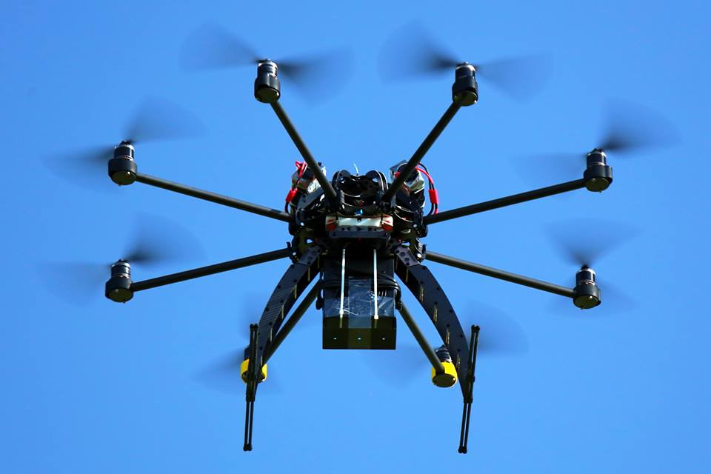
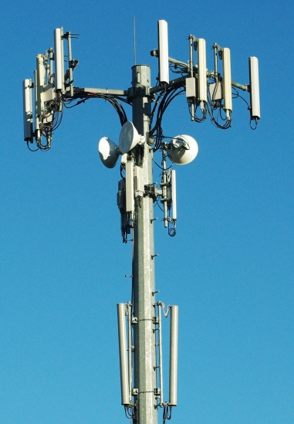

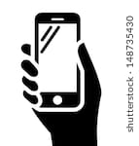

IETF 105 Side Meeting: Trustworthy Multipurpose Remote ID
Bob Moskowitz, Stu Card, Adam Wiethuechter
Extending Locator/Identifier split & strong authentication techniques to identify physically nearby objects
This file, TM-RID-2019JUL21-Adam-Stu-to-Bobv2.pptx, is a placeholder. It exists only to inform readers that TM-RID-2019JUL21-Adam-Stu-to-Bobv1.pptx was an inadvertently released draft with extraneous content and incorrect release markings. The corrected presented version is IETF105-side-meeting-2019JUL22-tm-rid.pptx.

