Slide 1
IETF work for TM-RID
Work items in IETF
Related to TM-RID
Mostly with HIP
Robert Moskowitz
July 22, 2019

Slide 2
Hierarchical HITs
Old draft exists for HHITs
draft-moskowitz-hierarchical-hip-06.txt
Provides for distributed registries HITs
The devil is in the details (sec 4.1)
Two levels of hierarchy? How many bits?
Crypto agility
Only ECDSA/hier/SHA-256 defined in draft
How to manage more and future algorithms

Slide 3
HHITs Registries
Registry services
Separate into own draft?
Who registers registries?
Proof of registration
Lookup at Registry
Certificates for client HHITs
Add Concise Identities
Draft-birkholz-core-coid
‘Raw’ signatures

Slide 4
HHITs Registries
Additional services
Extract from
draft-moskowitz-hip-based-5gpp-ip-mobility
RVS services
Federation of RVS
Forwarding I1 from ‘own’ RVS to ‘foreign’ RVS?

Slide 5
Other HIP work
Crypto, crypto and more crypto
How to manage and bound growth of YAA
Yet stay current with NIST and other
New, lightweight crypto
Still ‘under development’ per NIST
More?

Slide 6
Concise Binary Object Representation CBOR
Use CWT (CBOR tokens) throughout
Including new HIP payload formats? Is there value here?
Register HIP parameters with CBOR?
Concise Identities alternative to X.509
draft-birkholz-core-coid
Death to ASN.1! :)
More?

Slide 7
OAUTH
OAUTH has been included in ASTM work
Add HIP as OAUTH method
What does this entail?
Who will do it?

Slide 8
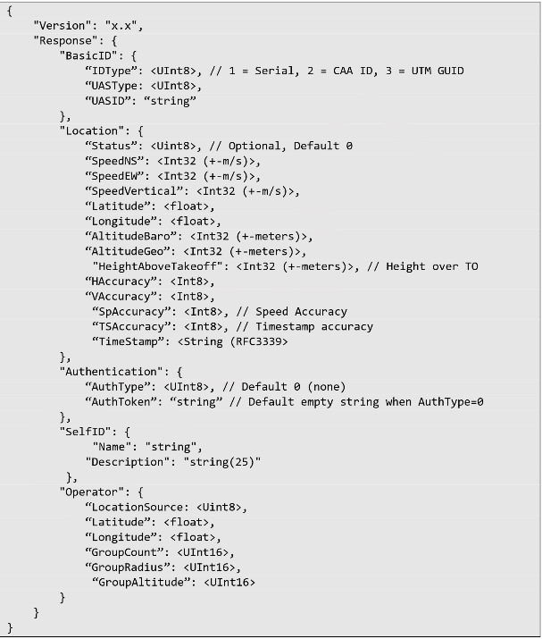
RemoteID Message Format
Only up to 24 bytes of data space to work with
Fit in Bluetooth advertisement data field for single beacon message
5 primary types
Basic ID, Authentication, Self ID, Location, & Operator
Basic ID & Location required
Spec document can be found: https://github.com/opendroneid/specs

Slide 9
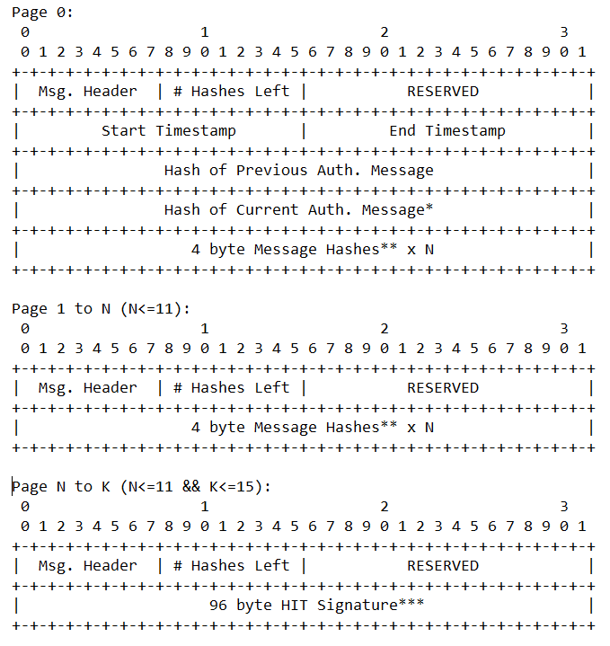
Proposed Auth Message Format
For OpenID type HIT
Format to carry hashes of previous messages sent and a signature on hash list
Provide provenance of sent messages in given time period
16 pages of data available to use

Slide 10
Loose ends
There is always something left out
What is it?

