Slide 1
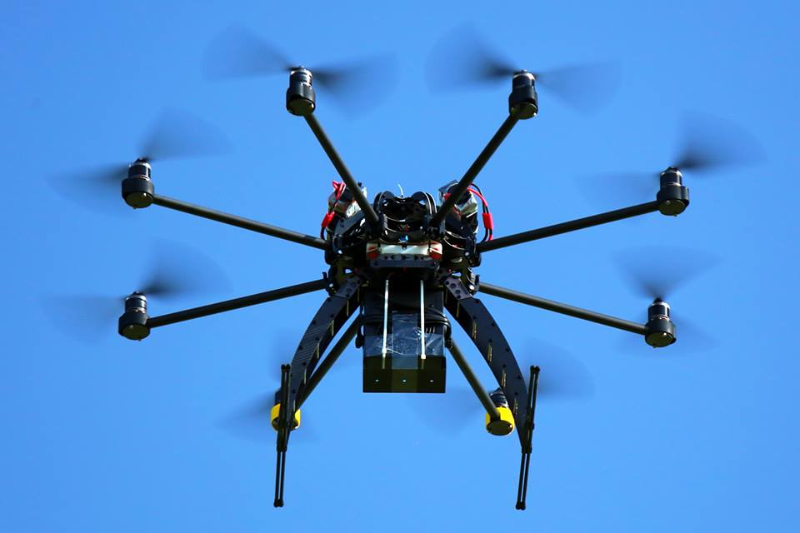
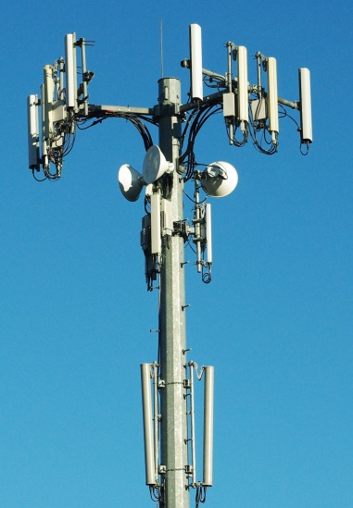



IETF 105 Side Meeting: Trustworthy Multipurpose Remote ID (tm-rid)
Bob Moskowitz, Stu Card, Adam Wiethuechter
Extending Locator/Identifier split & strong authentication techniques to identify physically nearby objects

Slide 2
Remote ID / V2X Applications
Remote ID itself as an app (vs enabling technology)
Platform
Command & Control
Detect And Avoid (DAA) “self separation”
Collision Avoidance
Payload
Mission apps, e.g. remote sensing

Slide 3
Aerial Internet Weaknesses
Today’s Internet has significant weaknesses in
Mobility
Multicast
Multihoming
Management
Quality of Service
Security
Aero wireless networking compounds these…

Slide 4
Some network issues compounded by aeronautical communications
Each non-trivial aircraft has multiple radios of different types
Many types of radios hand off between base stations frequently
Most open standard protocols are challenged by
Low data rates
High error (or loss) rates
Long latencies
Link asymmetry
Rapid wide variation in channel characteristics
Security protocols requiring cryptographic handshakes are further challenged by
Limited on-board processing power
Brief contact time w/fast moving platforms
Enormous safety implications (e.g. remotely crash my drone).
Aggregation of enough public information enables inference of sensitive information about the physical world (e.g. air operations routes & schedules).

Slide 5
1st Mitigation: Multiple Wireless Links
Aviation authorities will require at least 2 largely independent radio systems for reliability
Multiple links also greatly benefit security
jammer must jam all your links to deny you service
info can be spread over N links so an eavesdropper must listen on at least M of them to learn anything
3 links are obvious in many cases today
WiFi or other RF LOS coverage built to suit
LTE, w/extensive coverage already built out
Iridium or other global coverage systems
End systems & users
Should know what network Quality of Service they currently can expect
But should not need to know which link[s] reach a given UA at a given time

Slide 6
2nd Mitigation: Strong ID Based Security
Aircraft identity is distinct from its physical (spatial) & logical (network) locations
Aircraft identifiers should be distinct from locators (e.g. current IP addresses)
Security associations should belong to identity, not location, thus remain unaffected by handoff between radio base stations
IETF Host Identity Protocol (HIP) offers
identifier / locator de-conflation as justified above
identifiers corresponding to crypto public keys
IPSEC interoperability w/automatic dynamic setup
multi-homing (multiple concurrent network connections)
smooth make-before-break handoff between base stations

Slide 7
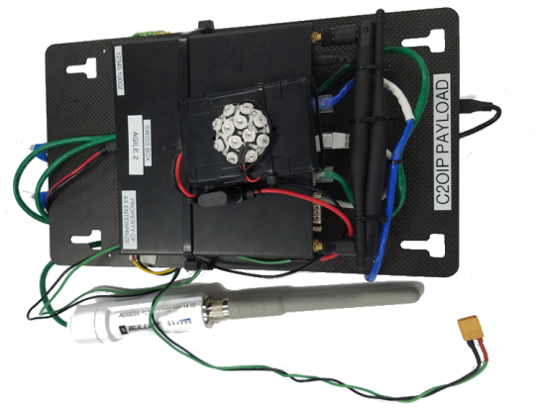
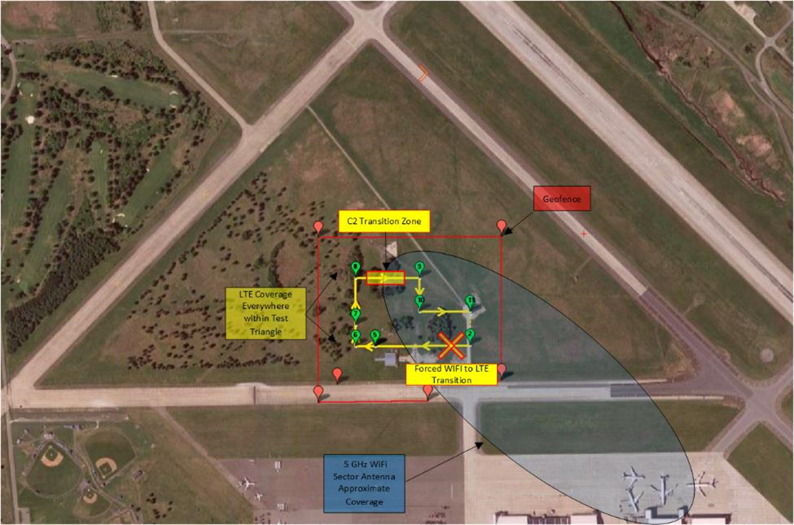
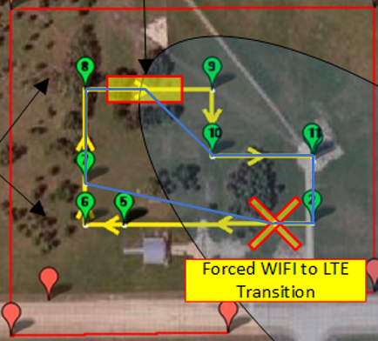
Cyber Resilient Communications
Demonstrated maintaining control of UAS w/HIP-based robust/secure C2.
Assured C2 over multiple links (WiFi & LTE) w/automatic failover/fallback.
Strongly encrypted communications between authenticated endpoints w/persistent IDs.

Slide 8
HIP benefits for Remote ID
General
Give each device a persistent identifier that remains the same across IP address changes
enable persistent TCP connections, security associations, etc.
Give all packets a provenance
“Secure Mobile Architecture” (Boeing, Lockheed-Martin, et al)
see R. Paine’s Beyond HIP: The End to Hacking As We Know It
Auto-configure IPsec VPNs (frustrating to do manually)
Aero networking
Associate persistent identifier with aircraft tail #
Multihoming for make-before-break smooth handoff

Slide 9
Broadcast Remote ID
One-way transmissions
UAS to observer devices w/RID app
Short range media
Bluetooth 4.X beacon & 5 extended advertisement
Wifi w/Neighbor Awareness Networking (NAN)

Slide 10
Network Remote ID (Net-RID)
Uses various Internet media
Typically LTE
Net-RID Service Provider (SP)
Gather data from connected UASes & other sources
Net-RID Display Provider (DP)
Connection point for RID APP
Aggregate data that user requests for a given area
SP & DP can be co-located or remote to each other
UAS Service Supplier is expected to be SP only or both

Slide 11
Using HIP for RID
Broadcast RID
Trustworthy (verifiable) persistent ID using HIT
Network RID
Can leverage all of HIP advantages
Persistent ID of all interconnected devices (UAS, USS)
Automagic IPSec ESP tunnels

Slide 12
Strawman ODID Auth Message
Interval start timestamp
Interval end timestamp
Hash of previous Auth Message
Hash of current Auth Message (0 when computing)?
Hashes of all other messages sent during interval
Signature using HIT private key

Slide 13
Proposed Next Steps
Propose ASTM add HIP HIT as an ID Type
already talking w/ASTM & FAA
Define any necessary HIP extensions
already drafting ODID Auth Message
Extend Open Drone ID implementation
Integrate HIP into USS (Net-ID DP/SP)

