Slide 1


Notes:
What the application will do: Students can create posts as buyers or sellers of a textbook. The final goal is to connect OSU students and promote academic discourse on campus.
Why this application: There are no mediums for buying and selling textbooks at a low price. Services such as Facebook do not offer convenient search features and posts may be outdated. This app allows students to work directly with other students in a timely manner.

Slide 2
Agenda
Introduction
Data Storage
Workflow
Functionality
Authentication(Devise)
Authorization(Petergate)
Fetch Google Book API(jQuery & RESTful API)
Search(Sunspot)
Message(Ajax & jQuery)
Rails Active Job
Further development plan

Slide 3
DEMO

Slide 4
Data Storage
https://www.processon.com/view/link/5ab235dae4b0d165d5ab9da6

Slide 5
Workflow
https://www.processon.com/view/link/5b58fd1ae4b0edb750eaea85

Slide 6
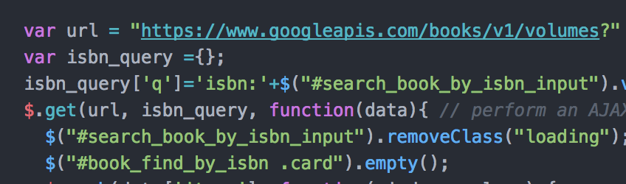
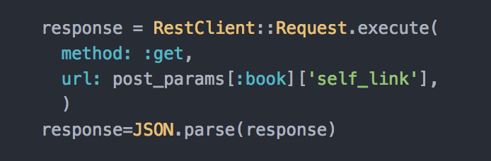
Google Books API
Fetch Data From Google Books API

Slide 7
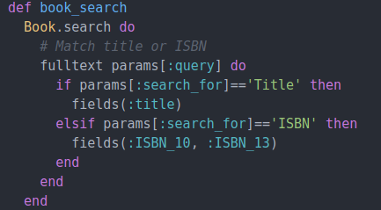
Searching
Sunspot handles database indexing and partial matches

Slide 8
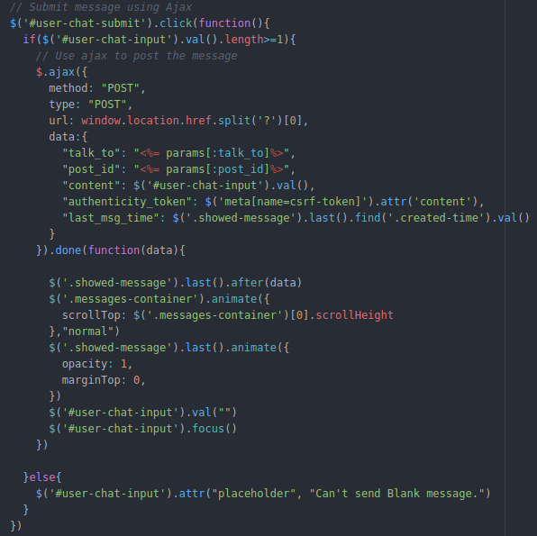
Messaging
Periodic check for new content
Animation when msg received

Slide 9
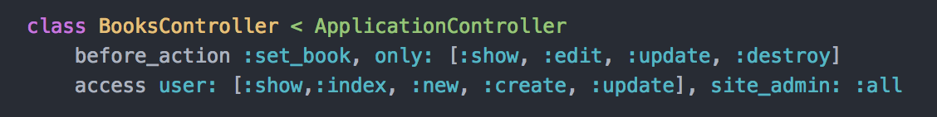

Authentication and Authorization
Devise for authentication
Petergate allows for role authorization
Guest: Use Devise to check login status
Users: Default role added by Petergate
Admin: Permission to all actions and access to admin management center
Controller:
User Model:
Notes:
############################################################################################
## PeterGate Roles ##
## The :user role is added by default and shouldn't be included in this list. ##
## The :site_admin can access any page regardless of access settings. Use with caution! ##
## The multiple option can be set to true if you need users to have multiple roles. ##
petergate(roles: [:site_admin], multiple: false) ##
############################################################################################

Slide 10
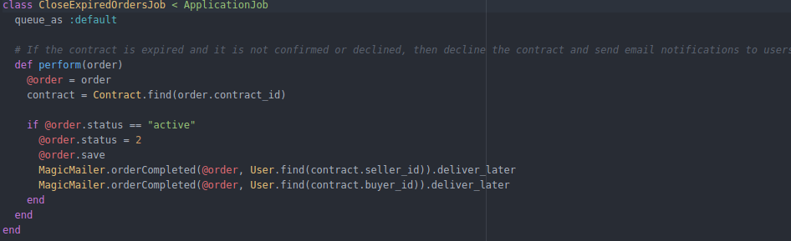
Rails Active Job
Periodically update the database and notify users by email

Slide 11
Further Development
Implementing online payment system

Slide 12
Questions?

