Slide 1

Leading Club Case Study
Group MEMBERs:
Mohammad Tasleem Arif
MEENAKSHI GUPTA

Slide 2
Problem Statement
This project aims to develop a comprehensive understanding of factors influencing loan default rates within a consumer finance company. By employing exploratory data analysis (EDA) techniques, we will analyse historical loan data to identify key attributes that correlate with loan repayment behaviour. The insights derived from this analysis will enable the company to construct a robust credit risk model, aiding in the assessment of loan applicants and mitigating financial losses due to defaults. Ultimately, this project seeks to optimize lending decisions and enhance overall portfolio performance.

Slide 3
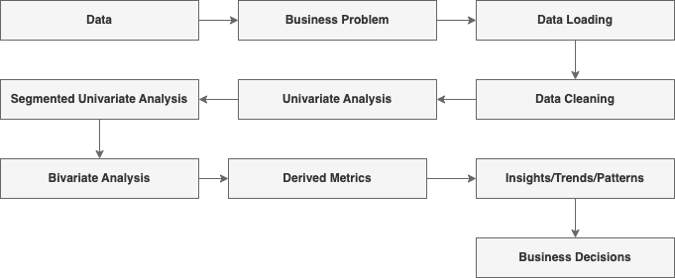
Steps for Analysis

