Slide 1
Lending Club Case Study
Submitted BY :
MOHAMMAD TASLEEM ARIF
MEENAKSHI GUPTA

Slide 2
Background
Background:
Lending company is the largest online loan marketplace, facilitating personal loans, business loans, and financing of medical procedures. Borrowers can easily access lower interest rate loans through a fast online interface. The Customer applies loans to the company on basis of different Customer attribute & loan attribute the company decides whether to give loan or not.
When a person applies for a loan, there are two types of decisions that could be taken by the company:
Loan accepted: If the company approves the loan, there are 3 possible scenarios Fully Paid, Current & Charged Off
Loan rejected: The company had rejected the loan (because the candidate does not meet their requirements etc.).
Business Objective:
This project aims to develop a comprehensive understanding of factors influencing loan default rates within a consumer finance company by employing exploratory data analysis (EDA) techniques, we will analyze historical loan data to identify key attributes that correlate with loan repayment behaviors. The insights derived from this analysis will enable the company to construct a robust credit risk model, aiding in the assessment of loan applicants and mitigating financial losses due to defaults. Ultimately, this project seeks to optimize lending decisions and enhance overall portfolio performance.

Slide 3
Step for Analysis
Data Loading
Data Understanding
Data Cleaning & Pre-processing
Univariate Analysis
Segmented Analysis
Bivariate Analysis
Derived Metrics
Insights & Trends
Business Decision
The primary goal is to uncover underlying patterns & find the insights & trends on basis of data provided.

Slide 4
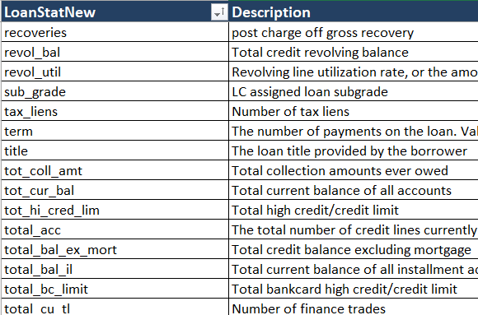
Data Loading
We will be loading data for analyzing, Lending Club provided us with historical data on their customers. This dataset includes details about the borrower’s past credit history & information about their loans from Lending Club. The dataset is extensive, containing over 39717 records & 111 columns, giving large volume & variety of information to analyze. This data allowed us to identify key factors & relationships that could influence a borrower’s for fully paying or defaulting the payment of loan in their agreed tenure.
To effectively predict a borrower’s potential default, we focused on columns which will directly or indirectly impact the outcome of analysis.

Slide 5
Data Understanding
Key Variables :
We focused on a subset of critical variables directly related to loan performance & borrower reliability. These include:
Customer Demographic: Variables such as Home Ownership (home_ownership),state of residence (addr_state), employment length (emp_length), job title (emp_title) help in understanding borrower profiles.
Financial Metrics: Variables like annual income (annual_inc), debt-to-income ratio (dti), and credit utilization (revol_util)offer insights into the financial health of the borrowers.
Credit History: Metrics such as the delinq_2yrs) ,earliest_cr_line , fico_range_high & fico_range_low provide a snapshot of the borrower's creditworthiness.
Loan Characteristics: Information on loan amounts (funded_amnt, funded_amnt_inv), loan grade (grade), Sub Grade(sub_grade), Term(term), Loan Date (issue_d), Purpose of Loan (purpose), Verification Status (verification_status), Interest Rate (int_rate), Installment (installment), Public Records Bankruptcy (public_rec_bankruptcy) and loan descriptions (desc) helps to assess the loan's risk profile.

Slide 6
Data Cleaning & Pre-processing
Data Quality: To ensure robust analysis, the data was subjected to thorough cleaning. This included handling missing values, correcting inconsistencies, and ensuring uniformity across all variables. The step by step process for it as follows:
Checking for null values in the dataset: There’re many columns with null values. So they had to be dropped as they won’t play a role in the analysis of the dataset. Roughly 48% of the columns were dropped.
54 columns contain NA values only, and these columns will be removed namely acc_open_past_24mths, all_util, annual_inc_joint, avg_cur_bal, bc_open_to_buy, bc_util, dti_joint, il_util, inq_fi, inq_last_12m, max_bal_bc, mo_sin_old_il_acct, mo_sin_old_rev_tl_op, mo_sin_rcnt_rev_tl_op, mo_sin_rcnt_tl, mort_acc, mths_since_last_major_derog, mths_since_rcnt_il, mths_since_recent_bc, mths_since_recent_bc_dlq, mths_since_recent_inq, mths_since_recent_revol_delinq, num_accts_ever_120_pd, num_actv_bc_tl, num_actv_rev_tl, num_bc_sats, num_bc_tl, num_il_tl, num_op_rev_tl, num_rev_accts, num_rev_tl_bal_gt_0, num_sats, num_tl_120dpd_2m, num_tl_30dpd, num_tl_90g_dpd_24m, num_tl_op_past_12m, open_acc_6m, open_il_12m, open_il_24m, open_il_6m, open_rv_12m, open_rv_24m, pct_tl_nvr_dlq, percent_bc_gt_75, tot_coll_amt, tot_cur_bal, tot_hi_cred_lim, total_bal_ex_mort, total_bal_il, total_bc_limit, total_cu_tl, total_il_high_credit_limit, total_rev_hi_lim, verification_status_joint
Checking for columns where missing data is >=50% & removing them. 3 columns were dropped.
Checking for unique values: If the column has only a single unique value, it does not make any sense to include it as part of our data analysis. We need to find out those columns and drop them from the dataset. 9 columns had such unique values and they were removed
Checking for duplicated rows in data: No duplicate rows were found.
Checking for columns with text value & unique ID
Columns (member_id,id,url) to be dropped as it unique LC assigned Id for the borrower member, will not help in analysis
Column zip_code is a masked data and cannot be used as input for the analysis.
Columns (emp_title , title, desc) will be dropped as they contain descriptive text & do not help in analysis.

Slide 7
Data Cleaning & Pre-processing
Column pub_rec_bankruptcies has mostly null values, so we are dropping it due to missing value.
After Column dropping we are left with 33 columns.
Filling null values :
Column emp_length has null values, replacing it with mode value i.e 10+ years.
Column revol_util has null values, replacing it with median i.e 49.3
Data Conversion:
Column term removing months & converting to int.
Columns int_rate & revol_util removing % & converting it to float.
Column emp_length if <1 year is assumed as 0 & 10+ years assumed as 10 & converting it to int.
Derived Columns
Column issue_d , getting issue_month & issue_year columns.
Column earliest_cr_line , getting issue_month & issue_year columns.
Outlier Removal : Calculated the Inter-Quartile Range (IQR) and filtering out the outliers outside of lower and upper bound
Funded_amt_inv , upper fence turns around 28k whereas max is 35k, so no need to remove outliers.
Annual_inc , we need to remove outliers as there is vast difference using 99 percentile we will remove it.

Slide 8
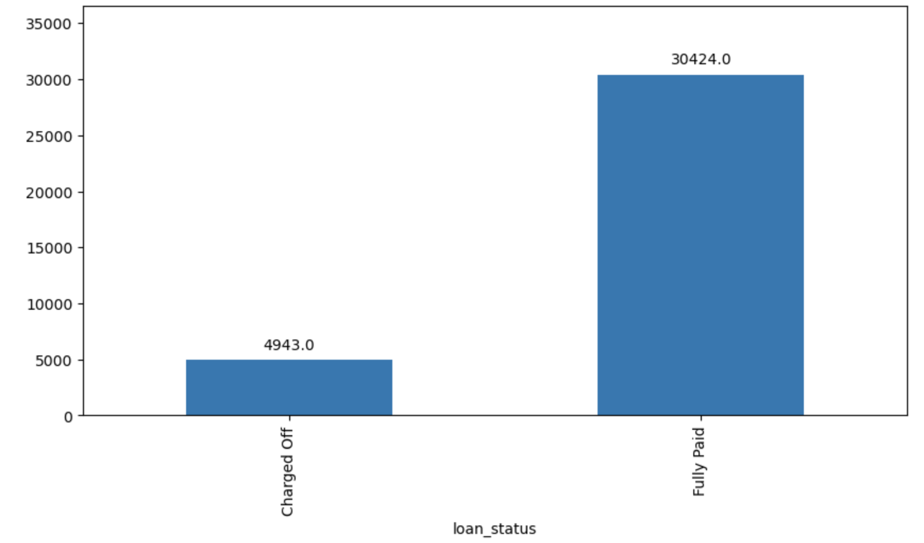
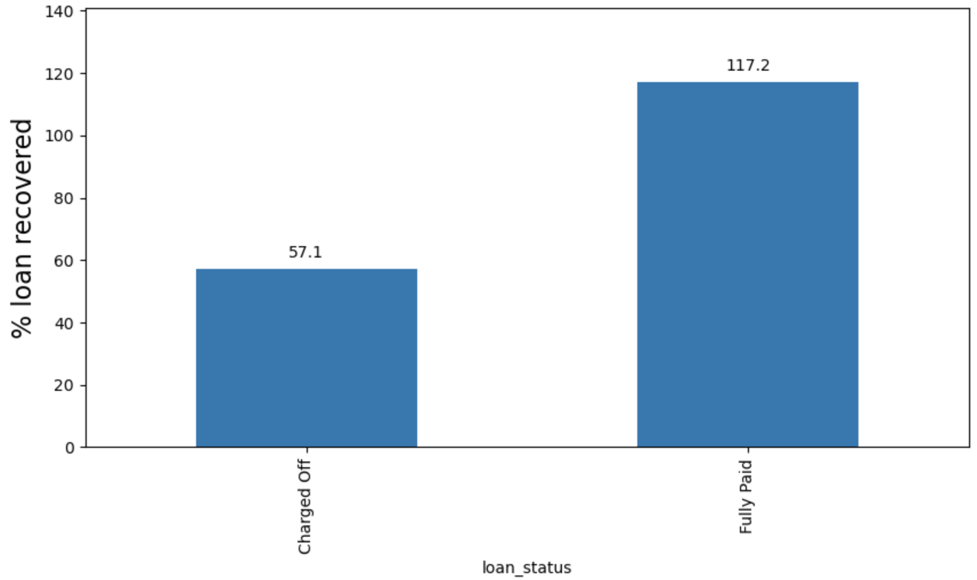
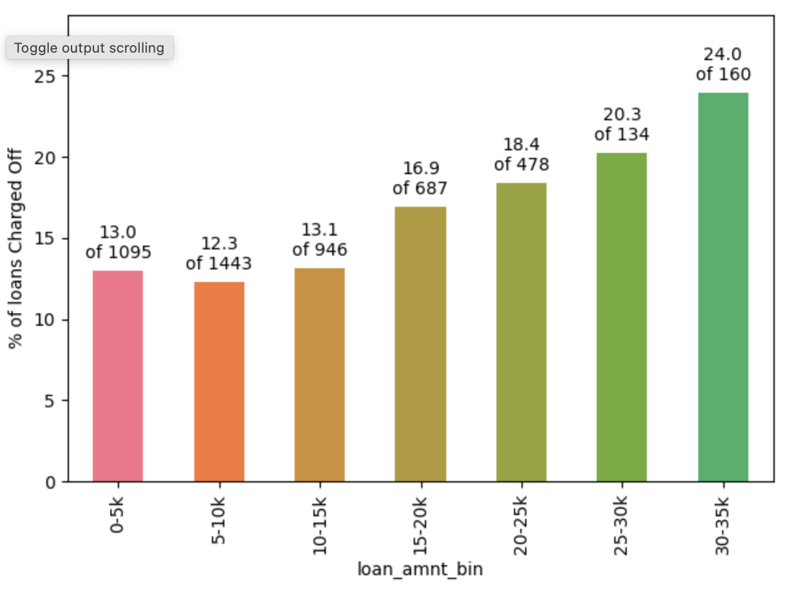
Overall status of loans allotted
57% of the amount is recovered from charged off loan, while 17% profit is made on Fully Paid loans.
As the loan amount increases , the % of charged off loan also increases. Hence, higher the loans, the risk of defaulters increases.
Approx 14% of loans in the datasets are defaulted.

Slide 9
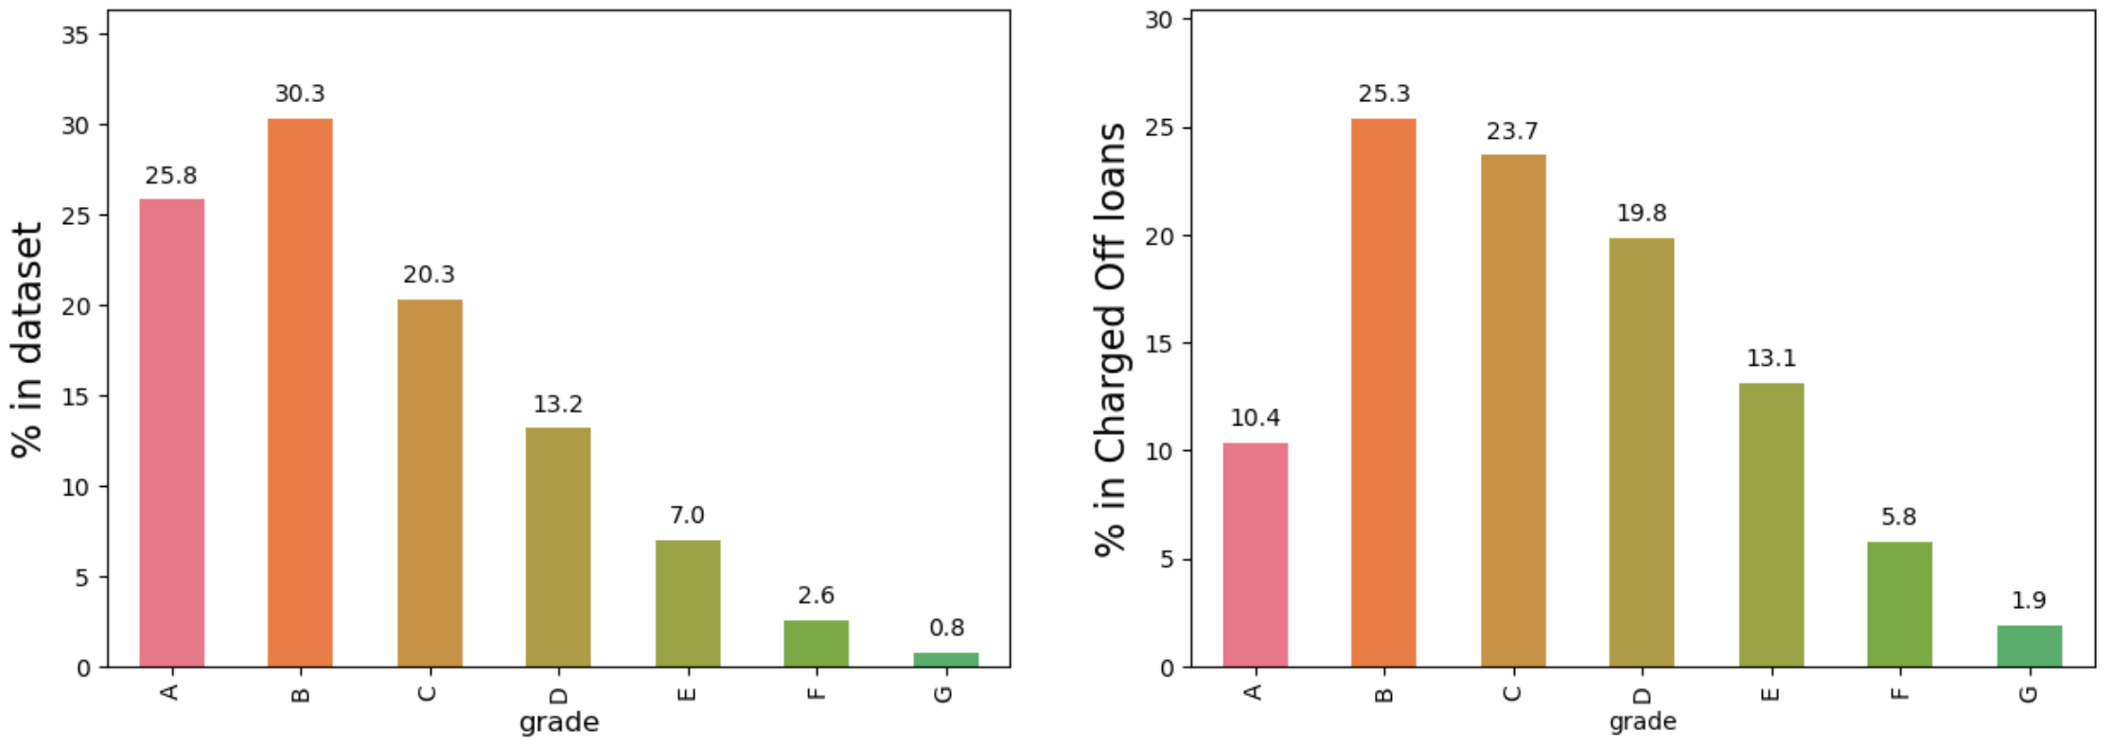
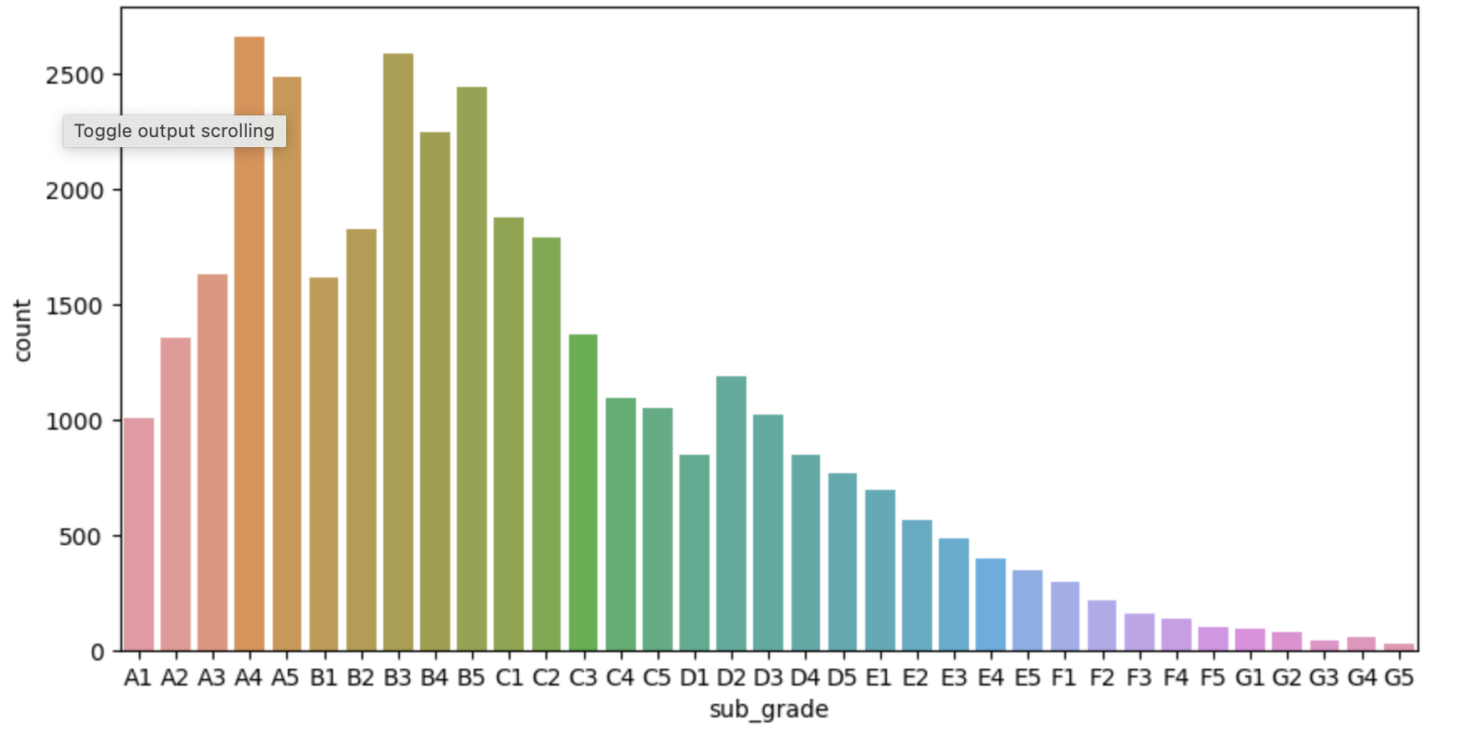
Univariate Analysis – Loan Grade Analysis
Grade A and B loans are safe. The percentages in full dataset are much higher than percentages in Charged Off loans.
Grade D, E, F, G loans are less safe. We should plot grade by percentage Charged Off by category
Grading system of LC works properly.

Slide 10
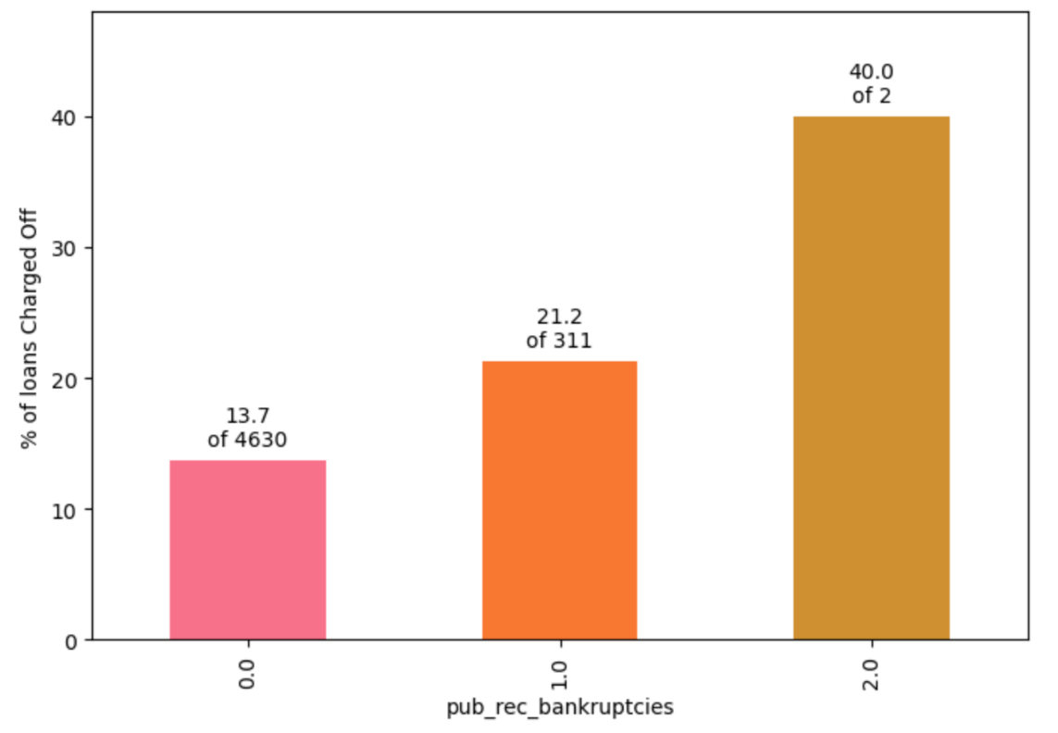
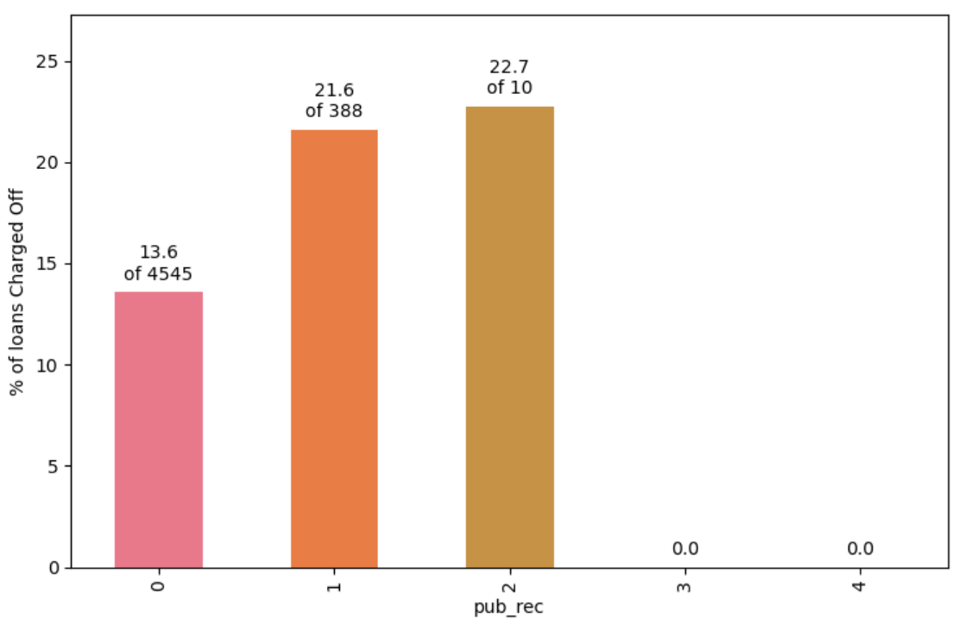
Univariate Analysis on prior Bad Records
The percentage of Charged Off loans is markedly higher when the borrower has a prior record of bankruptcy.
94% have no Public derogatory records. 5% have 1 derogatory record.
Having even 1 derogatory record increases the chances of Charge Off significantly.

Slide 11
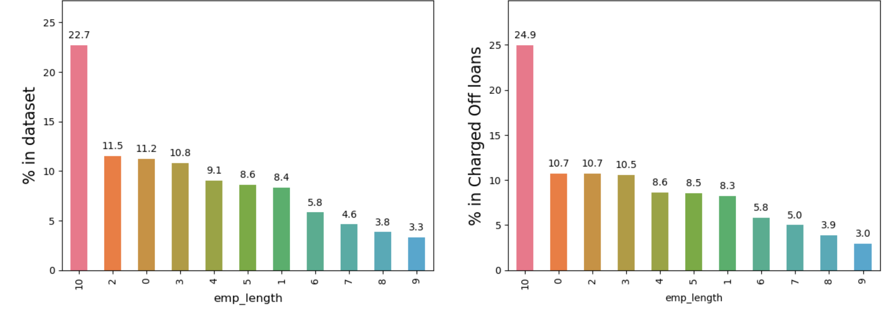
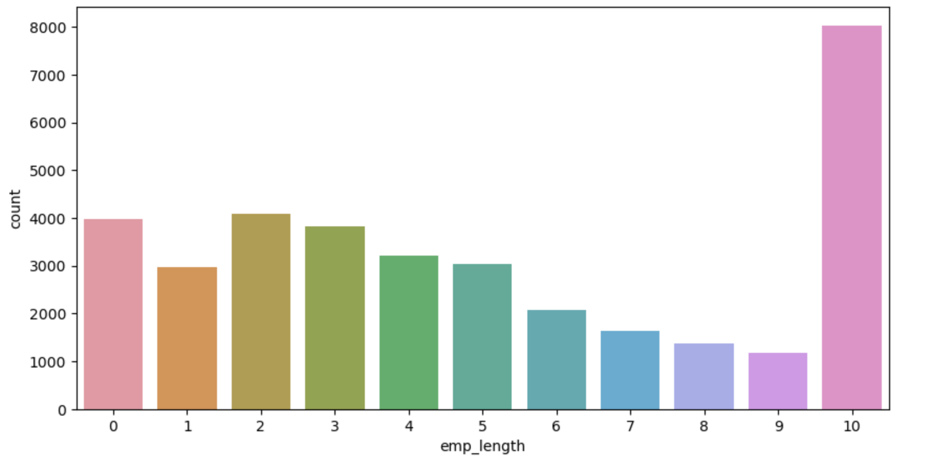
Univariate analysis of emp-length
Majority of people applying loan have more than 10 years of experience.
Tendency of person to default loan is high for people more than 10 years of experience, so company need to be careful while giving loan to those people.

Slide 12
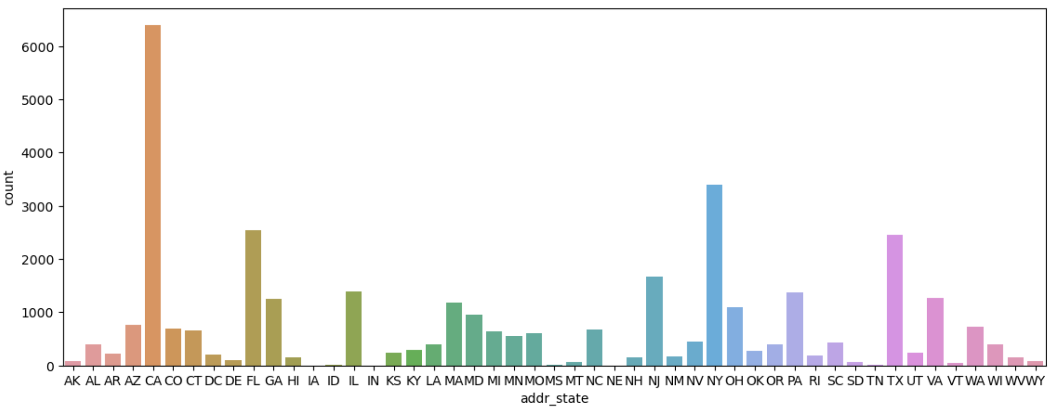
Loan Defaulters Sate Analysis
Short term loans should be avoided in states California, Florida, New York, New Jersey & Texas.

Slide 13
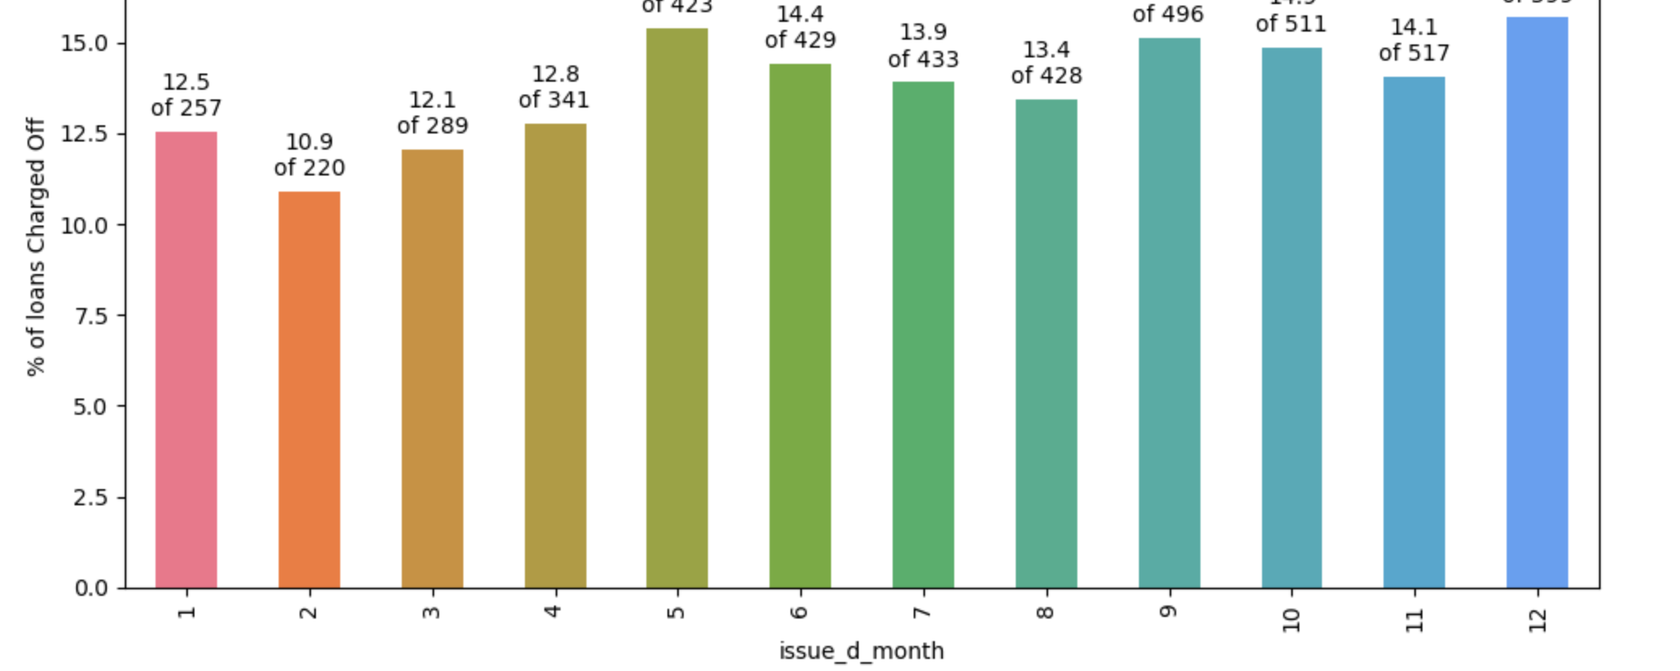
Univariate Analysis of month
The loan applications are increased during peak periods such as December and Q4.

Slide 14
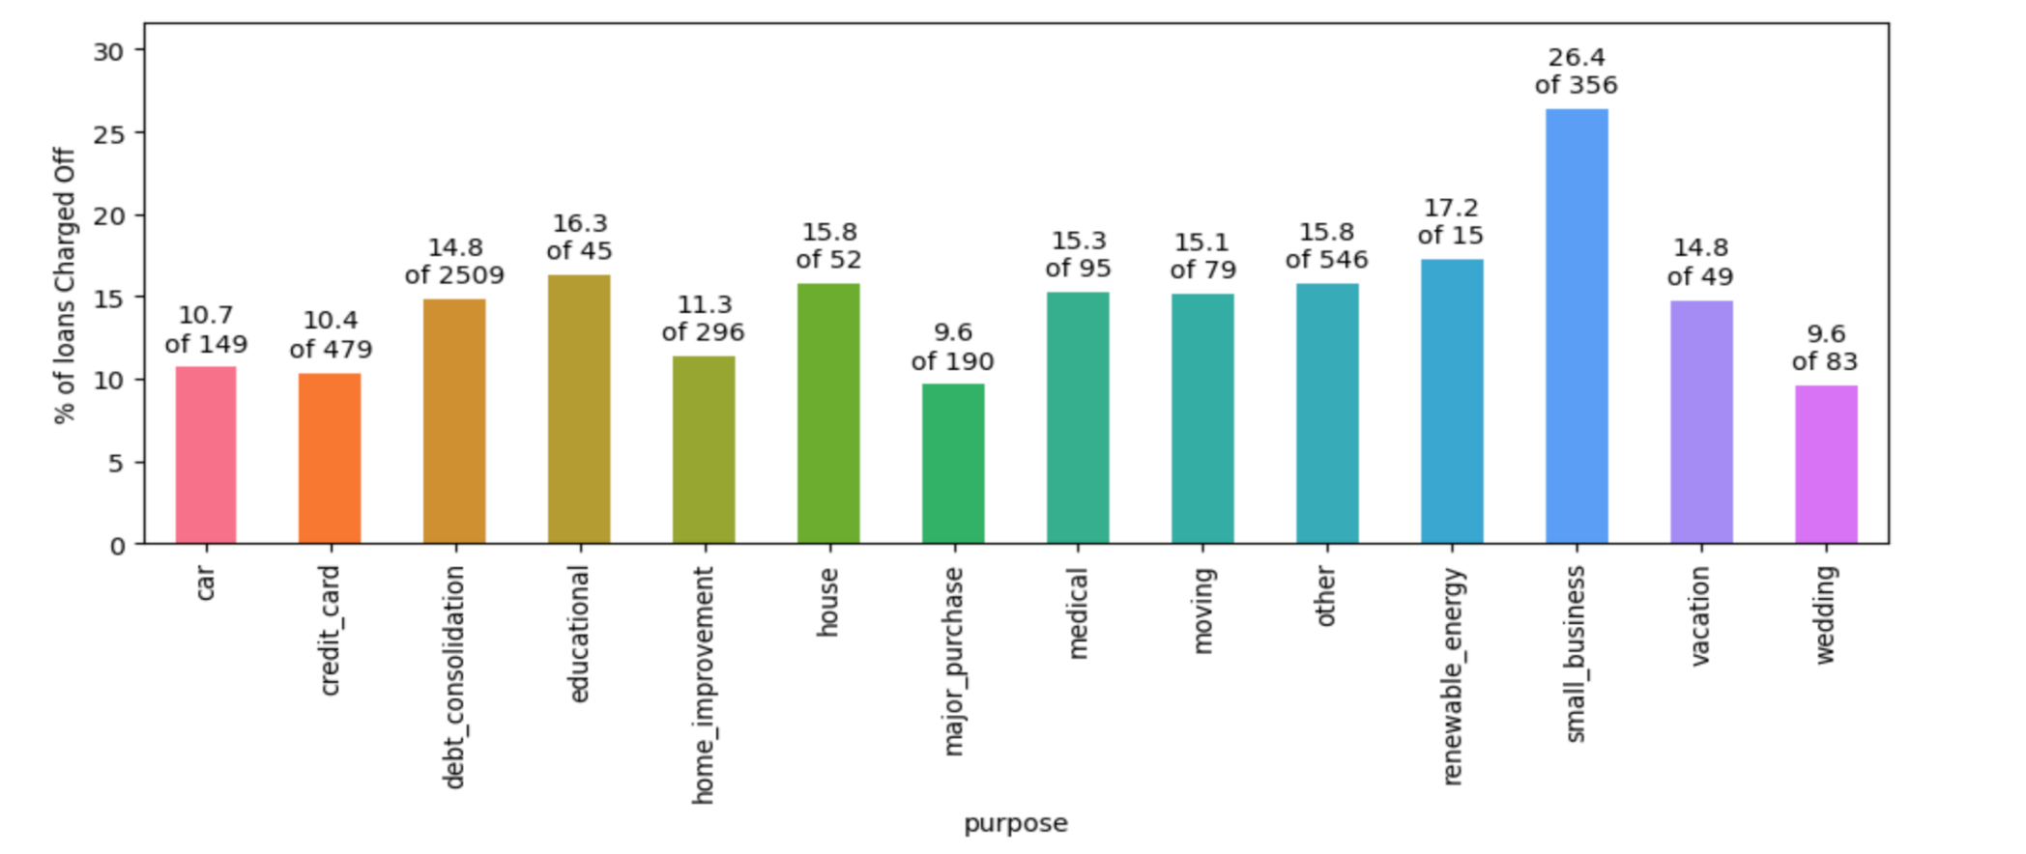
Segmented Analysis
26% of loans for small business are Charged Off. Making them the riskiest purpose.

Slide 15
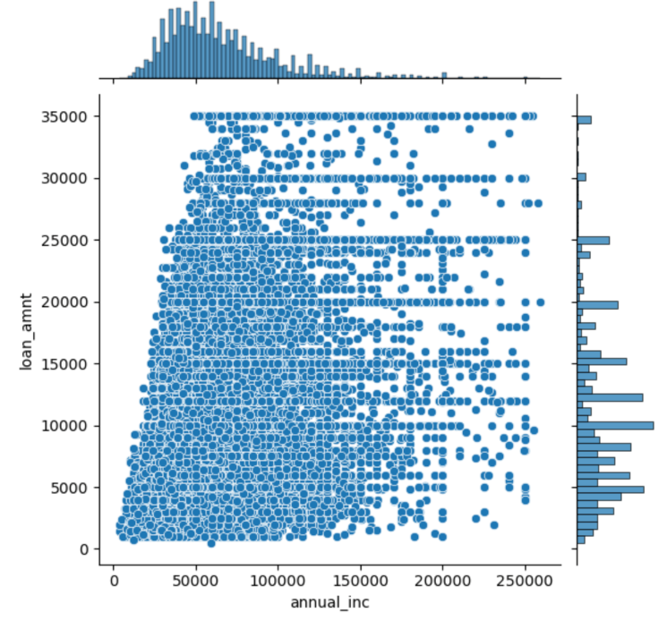
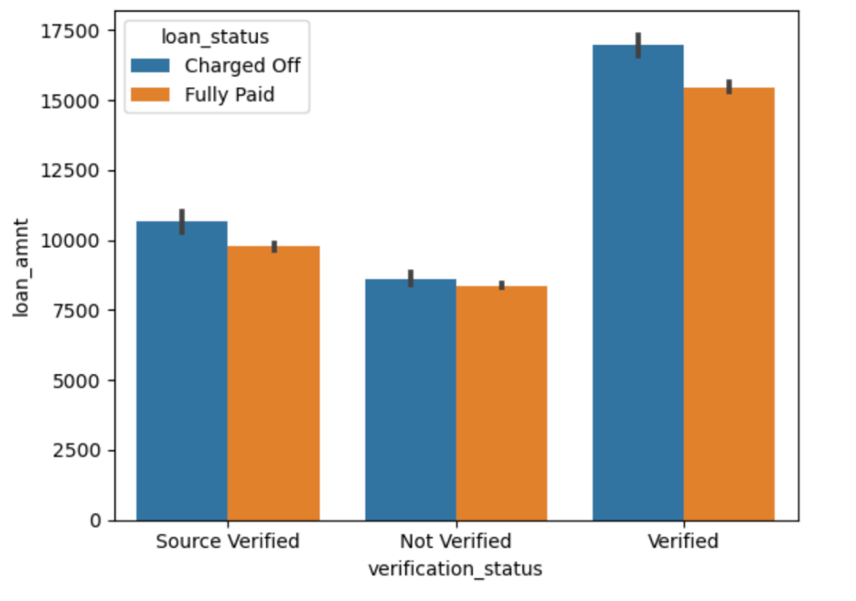
Bivariate Analysis
Higher loan amounts are Verified more often.
We already know that larger loans are less in number but see a higher charge off rate.
This, combined with previous observation, explains why verified loans see a higher rate of default. It's not the verified status per se, it's the fact that higher loan amounts are riskier and are also verified more often by Lending Club.
There are people with average income lower than 50000 taking loans of 25000 or higher. These would be risky loans.

Slide 16
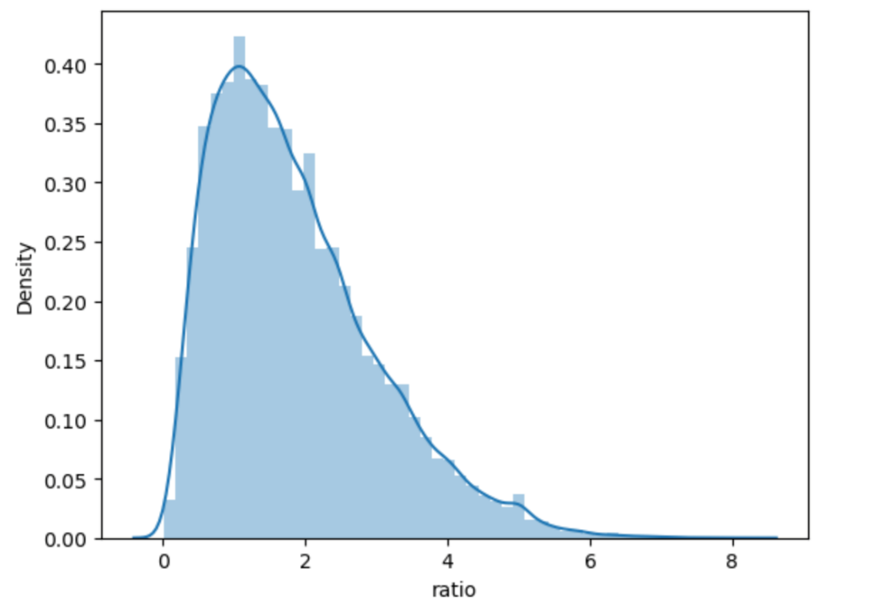
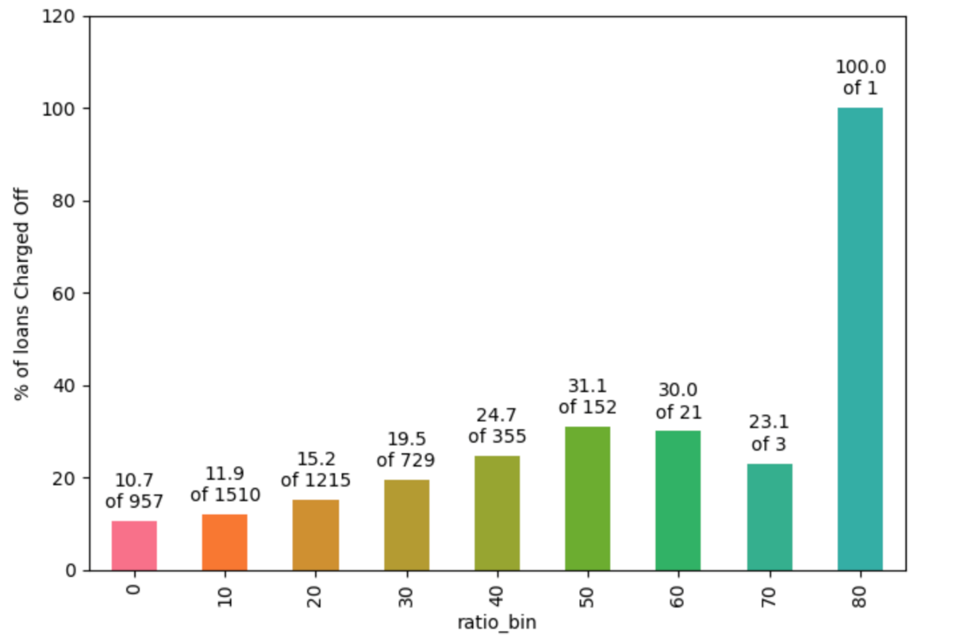
Derived Metrics
Observation:
As long as loan amount is less than 20% of annual income, defaults are low.
Loan amounts of 30% of annual income or higher see a high rate of default.

Slide 17
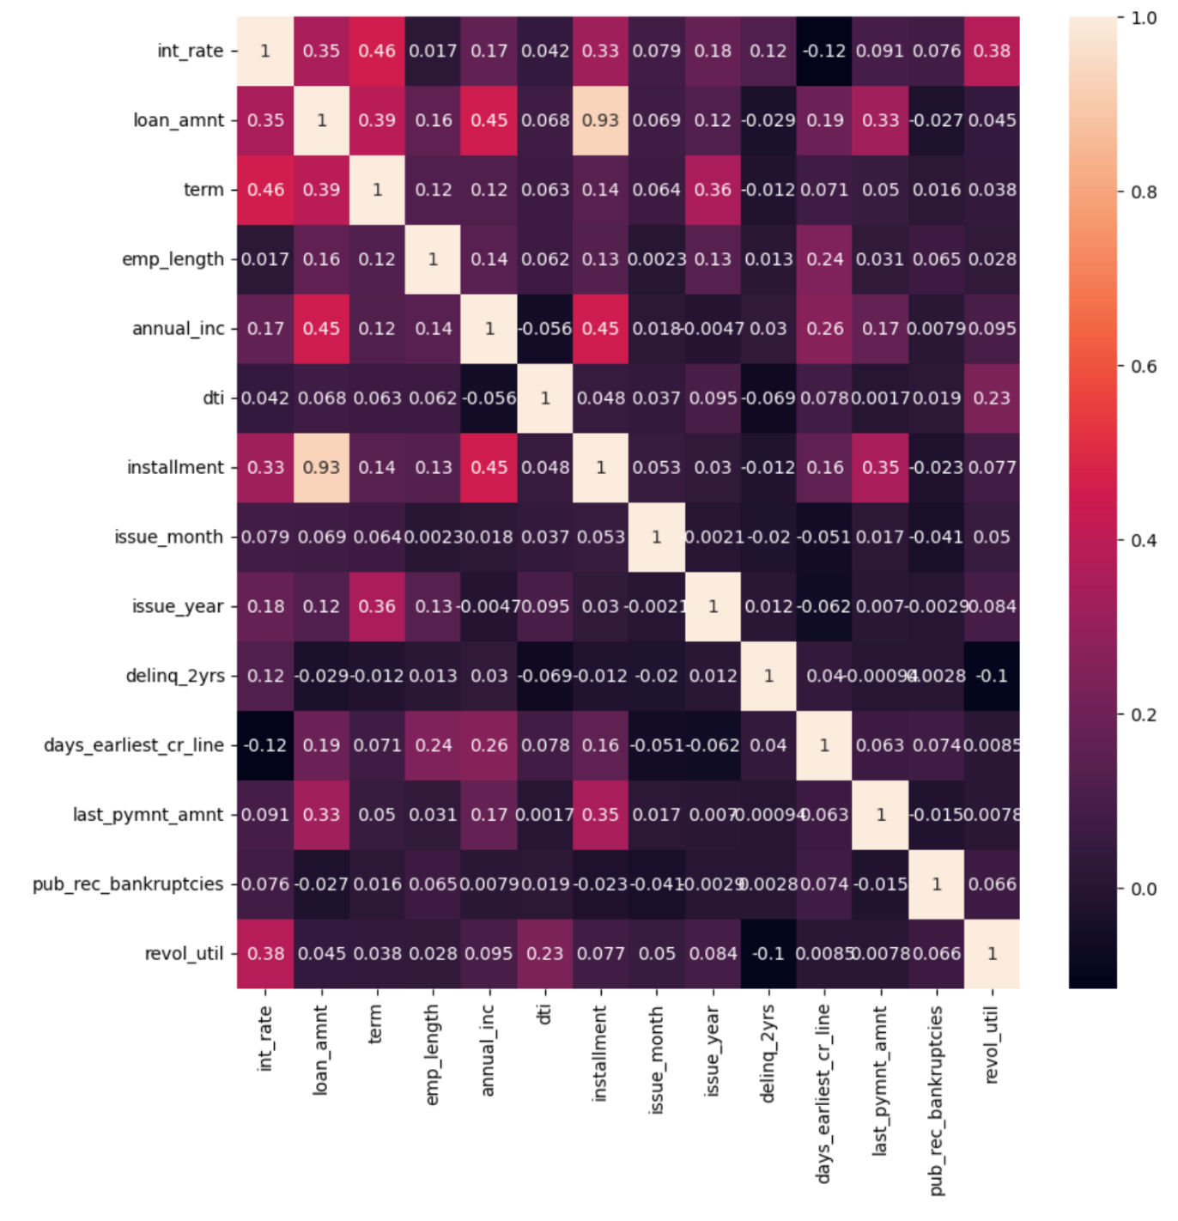
Correlation Analysis
installment has strong correlation with funded_amnt, loan_amount
term has strong correlation with int_rate.
annual_inc has strong correlation with loan_amnt.
dti and emp_length has weak correlation with most of the fields.
dti has strong negative correlation with annual_inc

Slide 18
Insights & Trends
Loans allotted to Grade A and Grade B are safer.
Loans allotted to people with prior bad records are riskier.
Loans allotted to small business are of riskiest purpose.
Loans background verification should be stricter, as percentage of charged off loan increases for non verified customer.
As long as the loan amount is less than 20% of annual income, default rate is low.
When providing loans to borrowers with lower annual income, verification of income should be made mandatory.
The Loans should be provided to borrowers with more than 2 years & less than 10 years of employment length.
Short term loans should be avoided in states California, Florida, New York, New Jersey & Texas.
The loan applications are increased during peak periods such as December and Q4.
Evaluate loan applicants seeking debt consolidation loans.
Evaluate home ownership status of the borrowers, they should be owning their own home, so they have a stability in paying the debt.

