Slide 1

Solvent Dependent Charge Transfer and Acidity in p-Nitroaniline
Arif Ahmed Begg
24CY40005
M.Sc. Chemistry, Sem-IV
Dept. of Chemistry, IIT Kharagpur, India
Course Instructor: Prof. Sabyashachi Mishra
Modelling of Quantum Systems & Processes

Slide 2
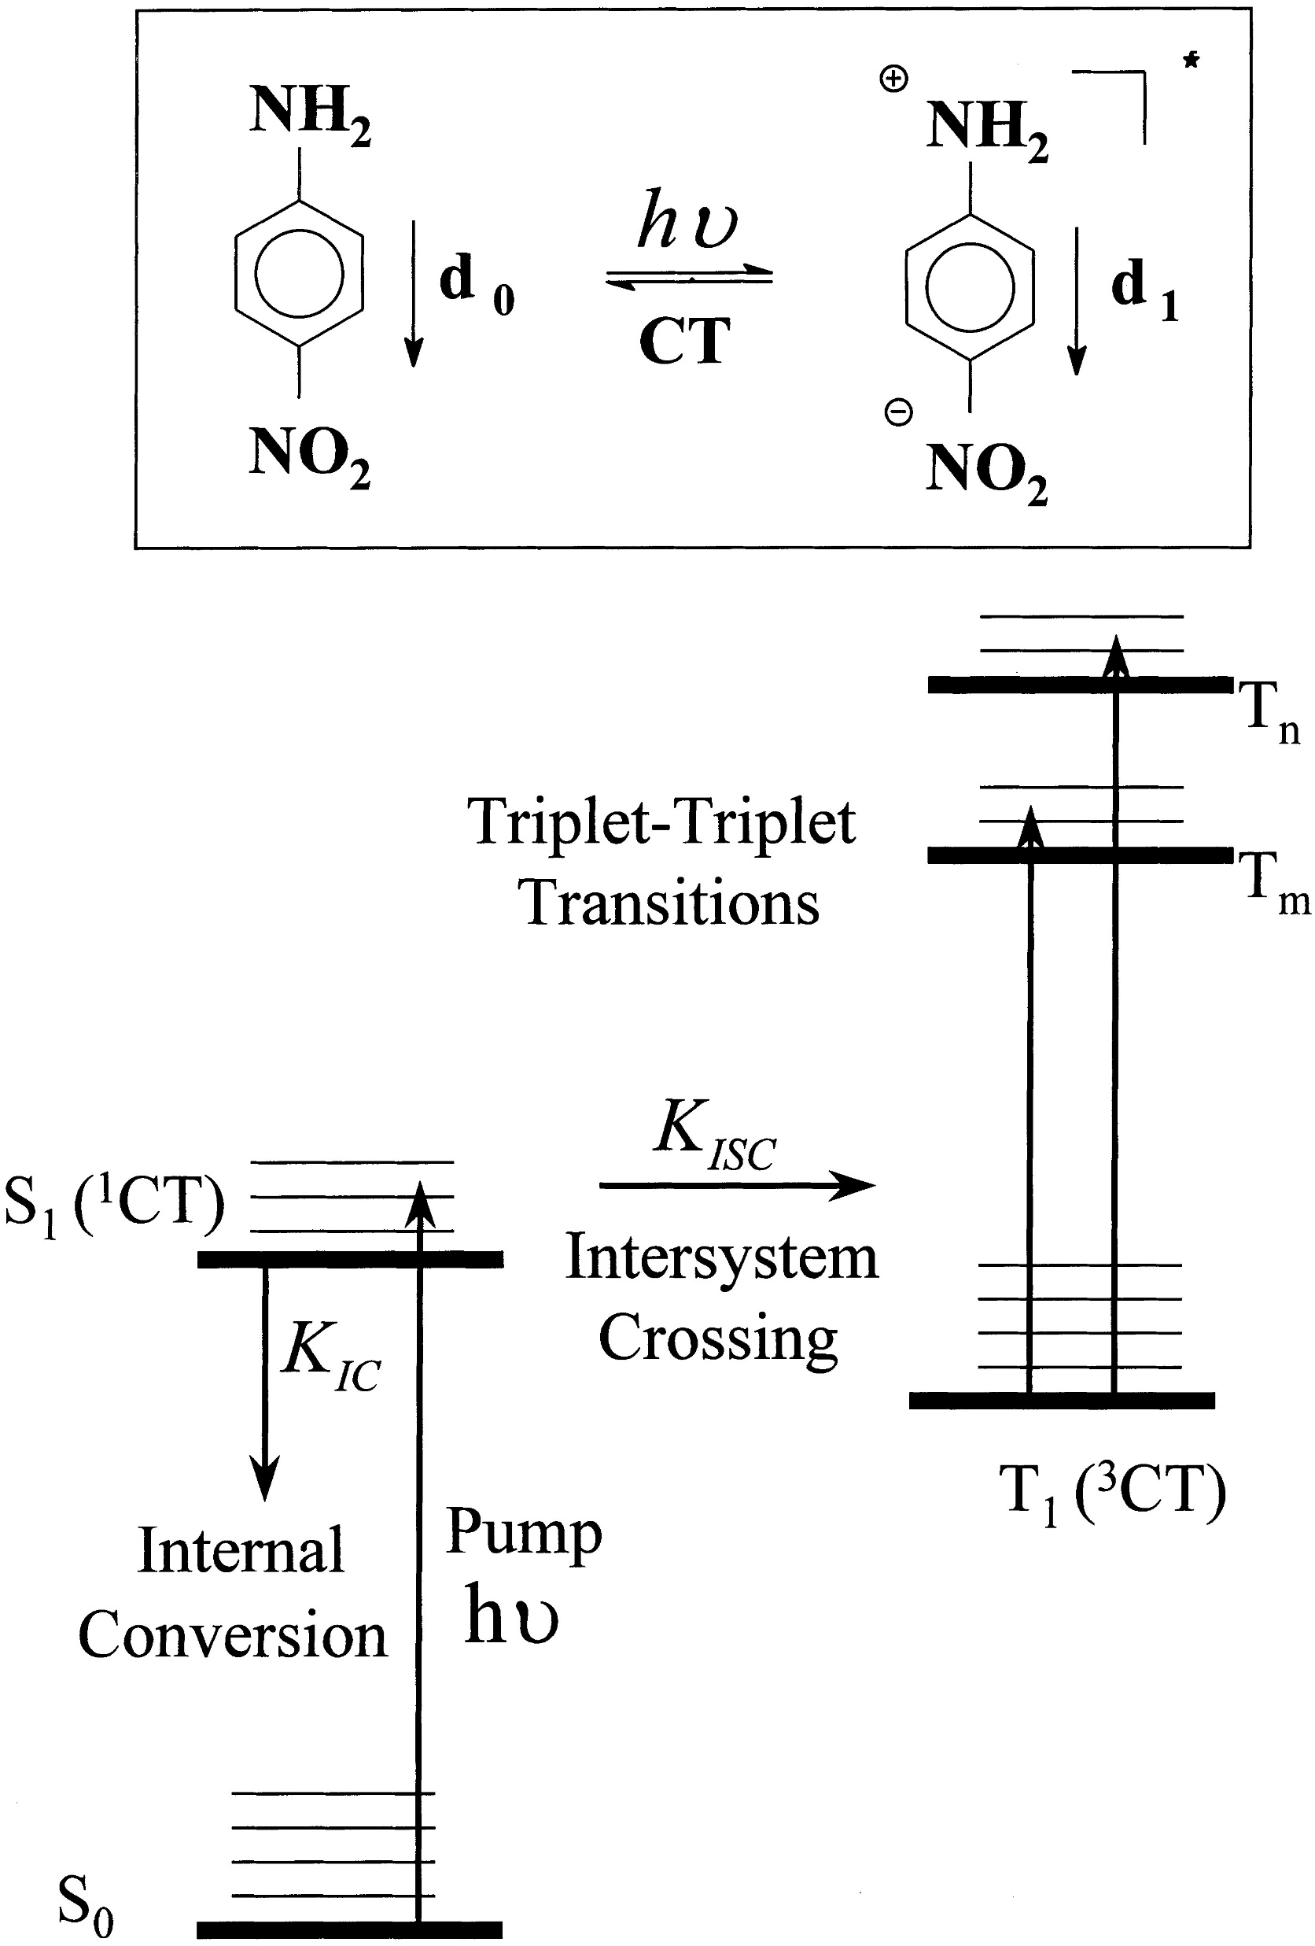
Introduction
Involves electron movement from donor → acceptor within the molecule
Results in large charge separation in excited state
Shows strong dependence on solvent polarity (red shift in polar solvents)
Charge Transfer Spectra:
CT transitions involve electron relocation across the molecule,
unlike local excitations, which remain confined
System: p-Nitroaniline (pNA)
Donor: Aniline group
Acceptor: Nitro group
Wasielewski et al., J. Phys. Chem. (1985) — Ultrafast CT in pNA

Slide 3
Computational Methodology
Geometry optimization:
ES Acidity calculations:
B3LYP / 6-31G(d)
Prepared protonated pNA
5 singlets
Functionals: CAM-B3LYP / 6-31G(d)
Solvent-dependent studies:
Benzene
Acetonitrile
Water
TD-DFT calculations:
5 singlets
Functionals: B3LYP & CAM-B3LYP
Functional comparison
Basis: 6-31G(d)
Solvent-dependent studies:
Benzene
Acetonitrile
Water
PCM (Polarizable Continuum Model)

Slide 4
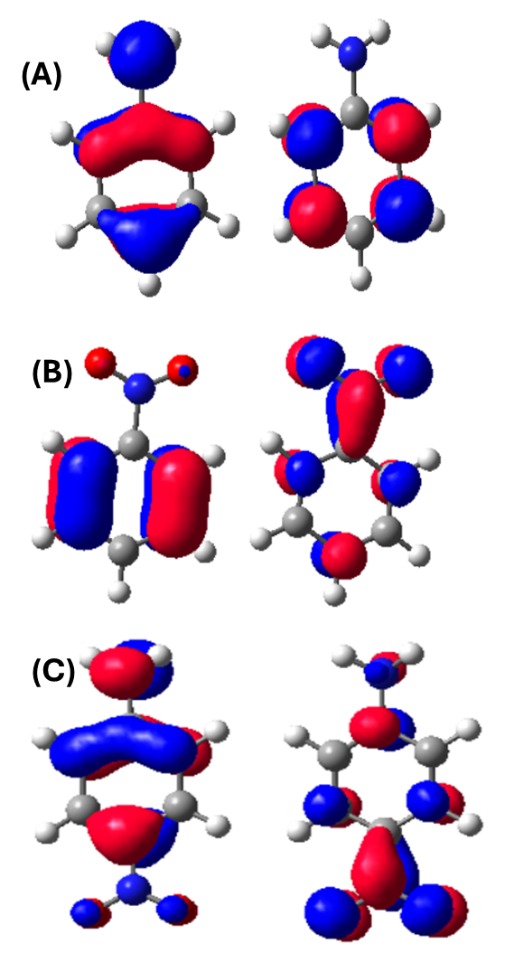
Results: CT Band in pNA
Donor → acceptor transition (36 → 37)
HOMO on NH₂, LUMO on NO₂
Strong solvent dependence
Spatial separation and pronounced solvent sensitivity
Medium | Functional | Wavelength (nm)
Gas phase | B3LYP | 302.72
 | CAM-B3LYP | 272.97
Benzene | B3LYP | 322.66
 | CAM-B3LYP | 289.92
Acetonitrile | B3LYP | 233.69
 | CAM-B3LYP | 299.47
Water | B3LYP | 334.10
 | CAM-B3LYP | 299.84

Slide 5
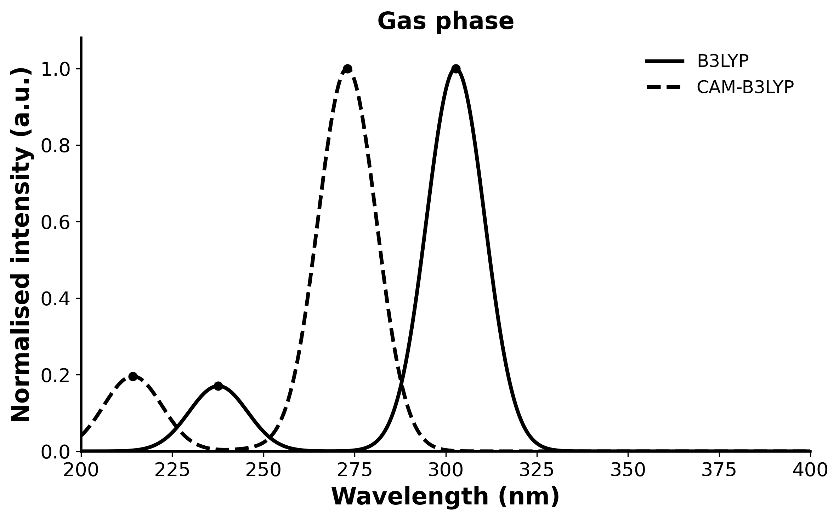
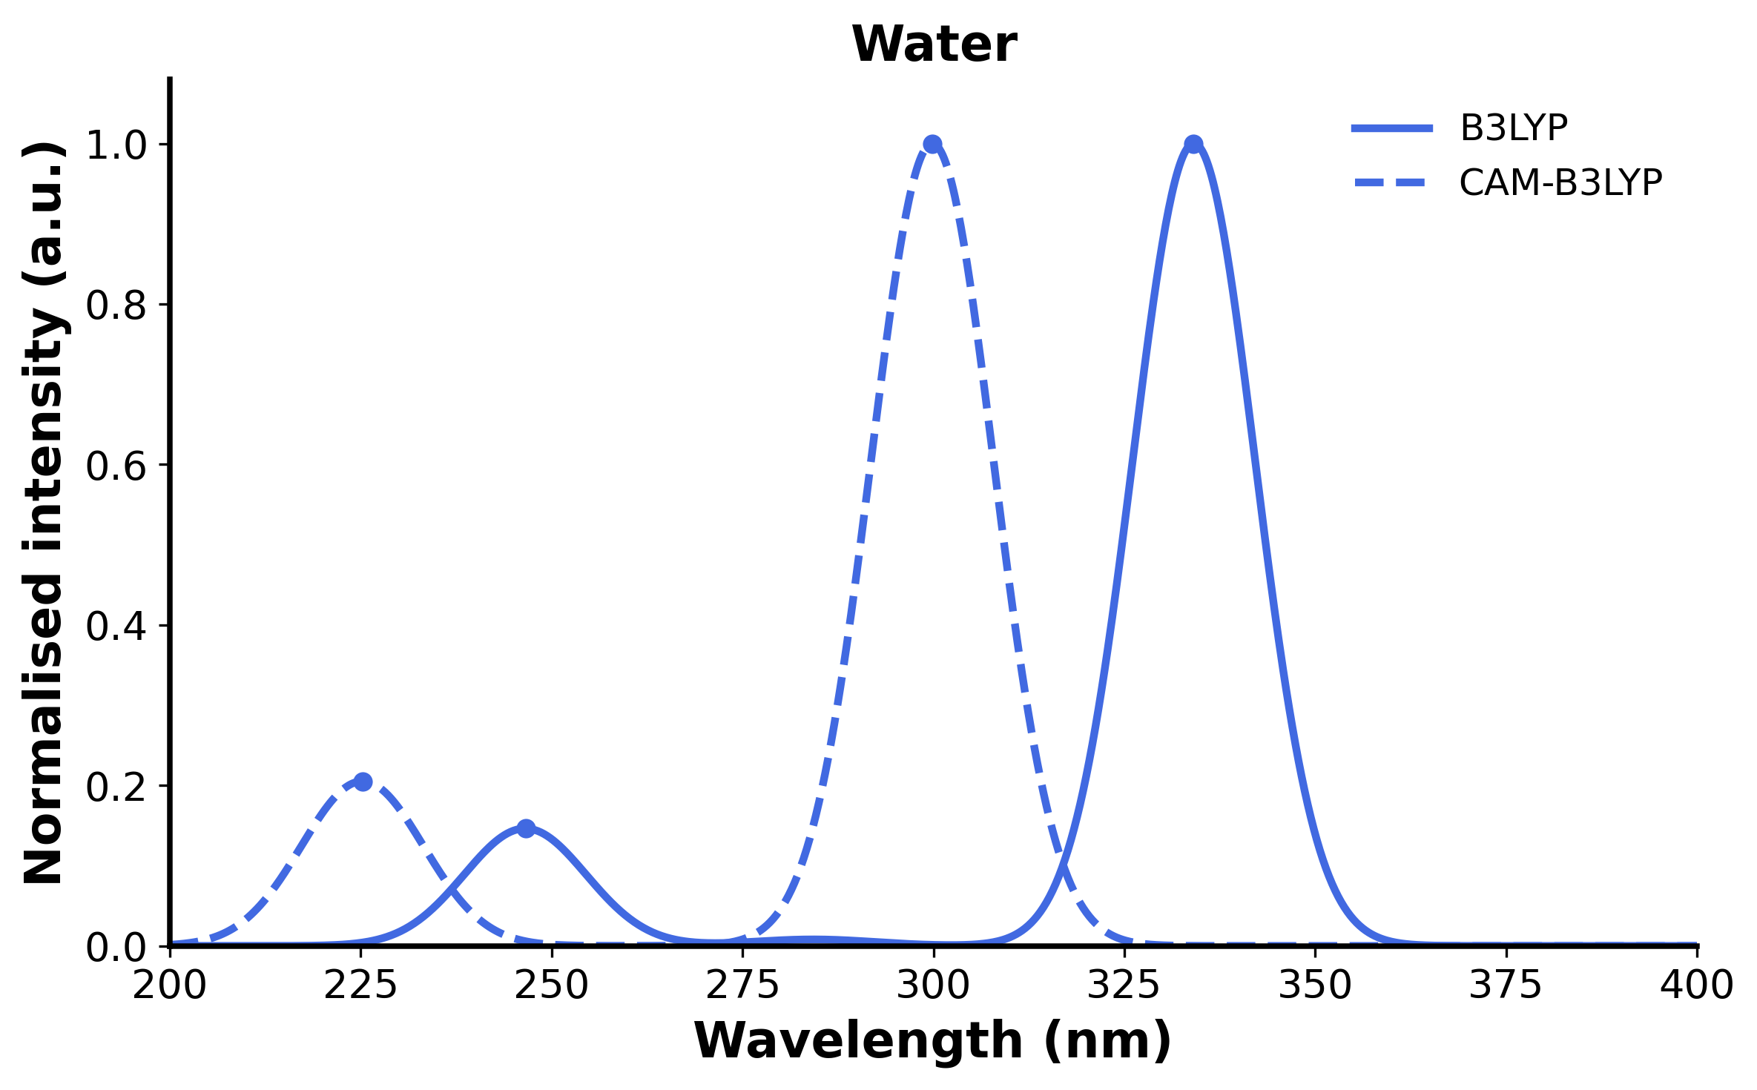
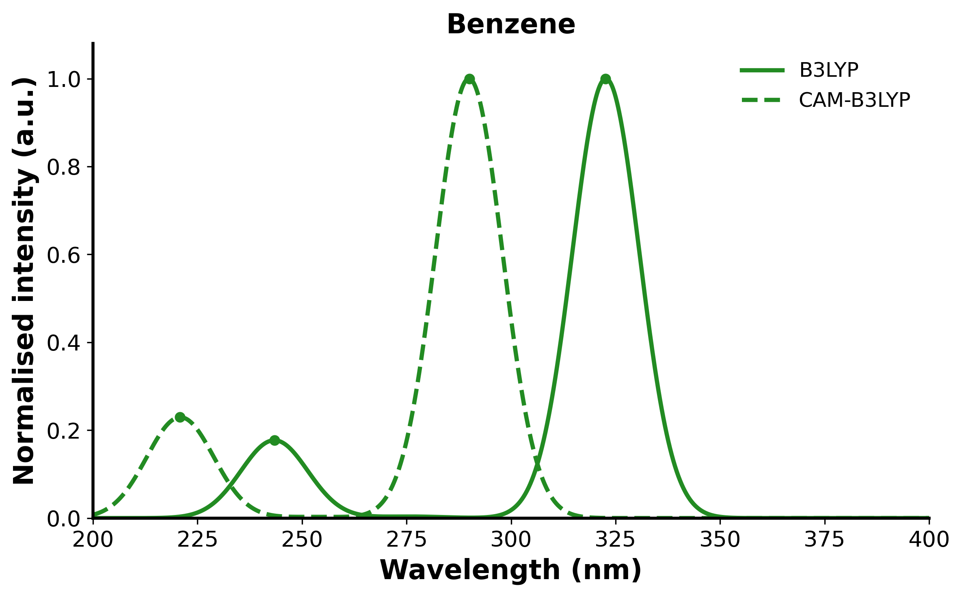
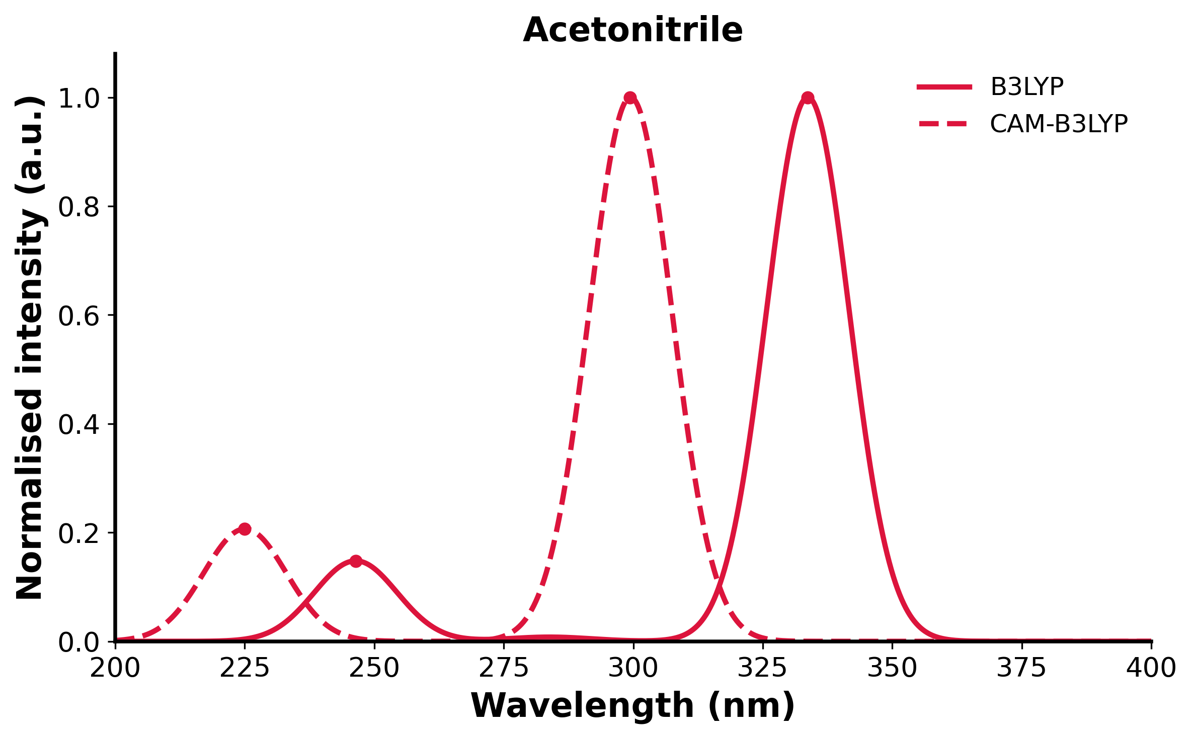
Results: Solvent and Functional Dependence
Medium | Functional | Wavelength (nm)
Gas phase | B3LYP | 302.72
 | CAM-B3LYP | 272.97
Benzene | B3LYP | 322.66
 | CAM-B3LYP | 289.92
Acetonitrile | B3LYP | 233.69
 | CAM-B3LYP | 299.47
Water | B3LYP | 334.10
 | CAM-B3LYP | 299.84
Stabilization of the charge-separated excited state in polar solvents

Slide 6
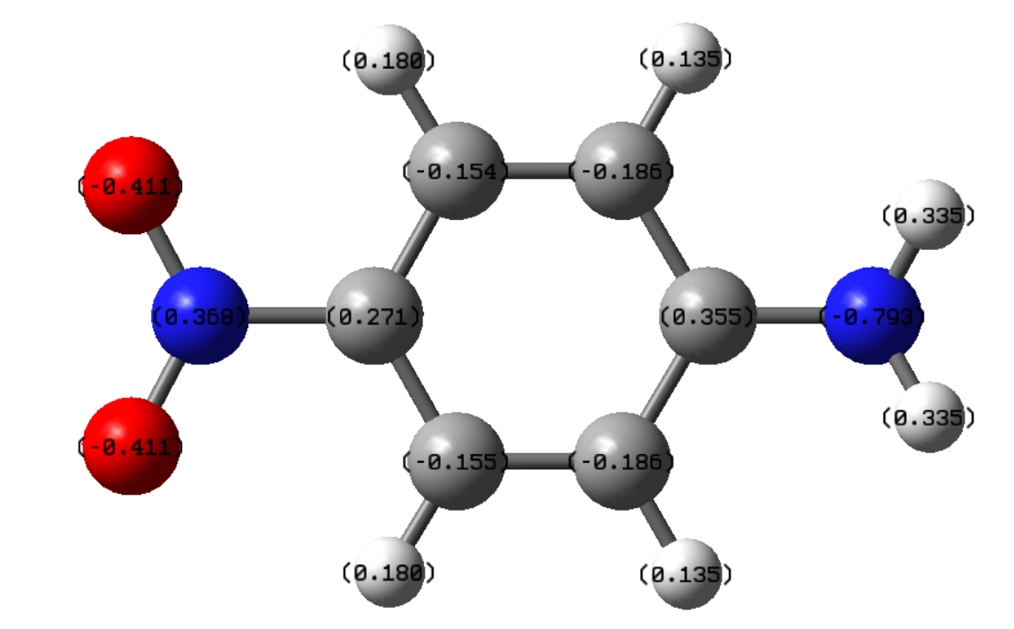
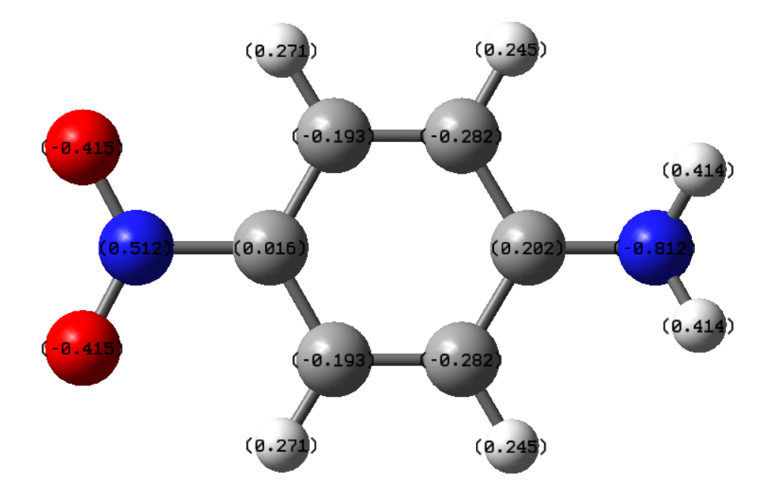
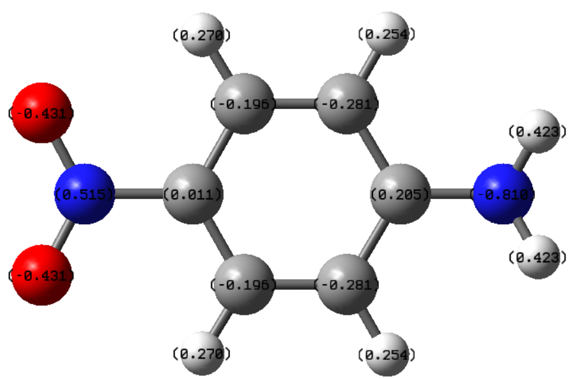
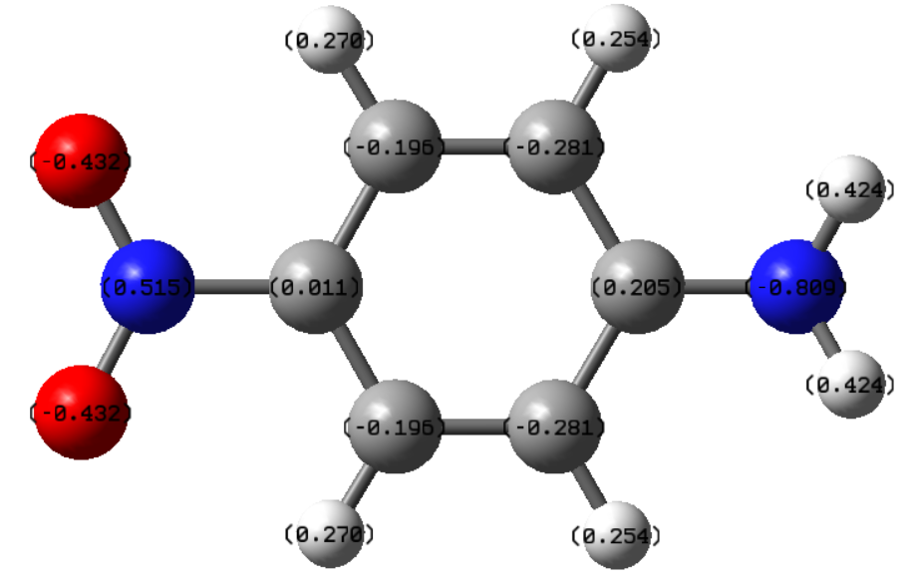
Results: NBO Charge Distribution
A B
Medium | Amino N charge | Nitro N charge
Gas phase | -0.793 | 0.368
Benzene | -0.812 | 0.512
ACN | -0.810 | 0.515
Water | -0.809 | 0.515
C D
A=gas phase B=Benzene C=ACN D=Water

Slide 7
Results: Solvent and Functional Dependence
Effect of functionals
B3LYP → lower excitation energy
CAM-B3LYP → blue shift (higher energy)
CAM-B3LYP is better for CT states
long-range correction
Effect of solvent
Polar solvent → stabilises CT state
Red shift in absorption
Trend: benzene → acetonitrile → water
Confirms charge-transfer nature

Slide 8
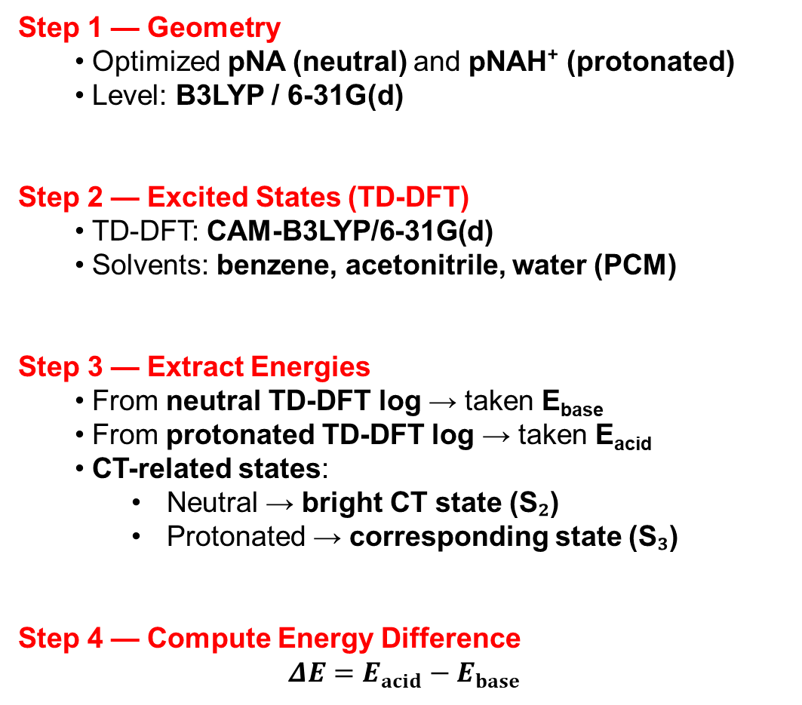
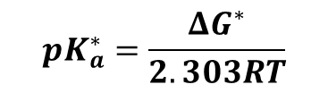
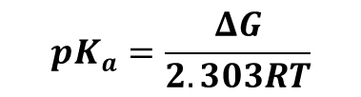

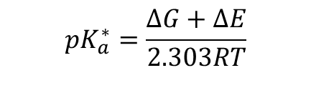

Results: Excited State Acidity
Step 1 — Geometry
Optimized pNA (neutral) and pNAH⁺ (protonated)
Level: B3LYP / 6-31G(d)
Step 2 — Excited States (TD-DFT)
TD-DFT: CAM-B3LYP/6-31G(d)
Solvents: benzene, acetonitrile, water (PCM)
Step 3 — Extract Energies
From neutral TD-DFT log → taken E_{base}
From protonated TD-DFT log → taken E_{acid}
CT-related states:
Neutral → bright CT state (S₂)
Protonated → corresponding state (S₃)
Step 4 — Compute Energy Difference
$$ΔE=E_{acid}−E_{base}$$
$$pK_{a}=\frac{ΔG}{2.303RT}$$
$$pK_{a}^{∗}=\frac{ΔG^{∗}}{2.303RT}$$
$$ΔG^{∗}=ΔG+ΔE$$
$$pK_{a}^{∗}=\frac{ΔG+ΔE}{2.303RT}$$
$$ΔpK_{a}^{∗}=pK_{a}^{∗}−pK_{a}=\frac{ΔE}{2.303RT}$$
$$ΔpK_{a}^{∗}≈−16.91 ΔE \left(\text{in} \text{eV} \text{at}\text{ 298 }\text{K}\right)$$
Electronic transitions are well described at 0 K (QM calc); thermal effects are secondary

Slide 9
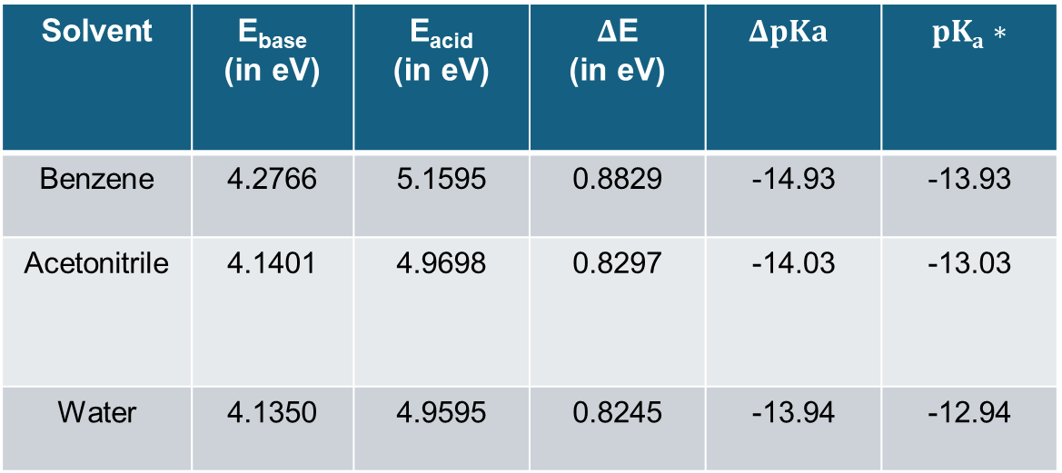

Results: Excited State Acidity
CT: NH₂ → NO₂*
Protonation suppresses donor
(NH₂ → NH₃⁺)
Excited state destabilised
ΔE ↑ → pKa* ↓
Solvent | E_{base} (in eV) | E_{acid} (in eV) | $Δ$E (in eV) | $$ΔpKa$$ | $$pKa∗$$
Benzene | 4.2766 | 5.1595 | 0.8829 | -14.93 | -13.93
Acetonitrile | 4.1401 | 4.9698 | 0.8297 | -14.03 | -13.03
Water | 4.1350 | 4.9595 | 0.8245 | -13.94 | -12.94
$$ΔpK_{a}^{∗}≈−16.91 ΔE$$
Polar solvents stabilize the CT state of the neutral molecule more than the protonated form, increasing ΔE and enhancing excited-state acidity.

Slide 10
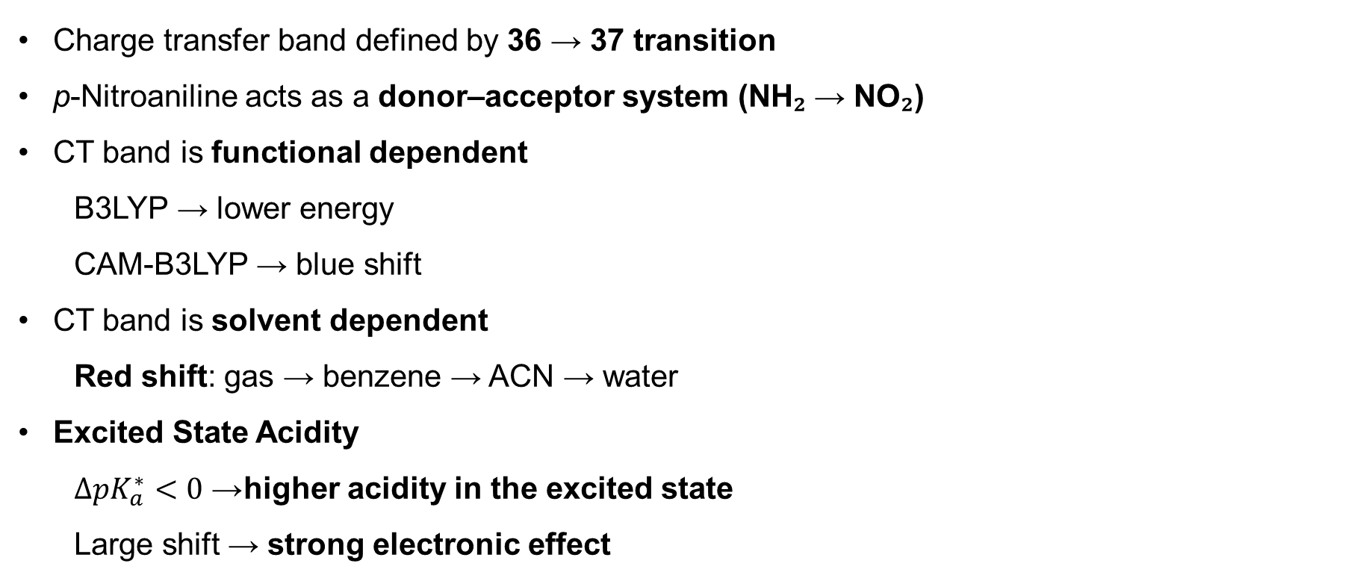
Conclusion
Charge transfer band defined by 36 → 37 transition
p-Nitroaniline acts as a donor–acceptor system (NH₂ → NO₂)
CT band is functional dependent
B3LYP → lower energy
CAM-B3LYP → blue shift
CT band is solvent dependent
Red shift: gas → benzene → ACN → water
Excited State Acidity
$ΔpK_{a}^{∗}<0$→ higher acidity in the excited state
Large shift → strong electronic effect

Slide 11
Limitations & Pending Work
Solvent Model
PCM used → continuum approximation
No explicit solvent interactions (H-bonding, dynamics)
Excited-State Acidity
pK*_{a} from Förster relation (approximate)
Based on the vertical excitation energies approximation
Perform Multiwfn analysis (hole-electron, NTO) to quantify CT character
Calculate charge-transfer metrics (CT distance, IFCT charge)
Generate difference density plots for visual confirmation of CT

Slide 12
Acknowledgements
Course Instructor: Prof. Sabyashachi Mishra
TA: Ms. Rituparna Sinha
Friends and family
Takshashila CIC lab technicians
Paramshakti supercomputing facility, IIT Kharagpur

