Slide 1
DeepFake Detection
Using FFNN, CNN & Transformers
Team DeepScan
https://github.com/ArifAli-0/CS725-Project

Slide 2
“DeepFake” What is it?
Deepfakes are realistic media that have been manipulated to make it appear as if someone is saying or doing something they never did.
Deepfakes are created using artificial intelligence (AI) and machine learning (ML) techniques.
Deepfakes can be used to spread misinformation, slander people, and damage reputations.

Slide 3

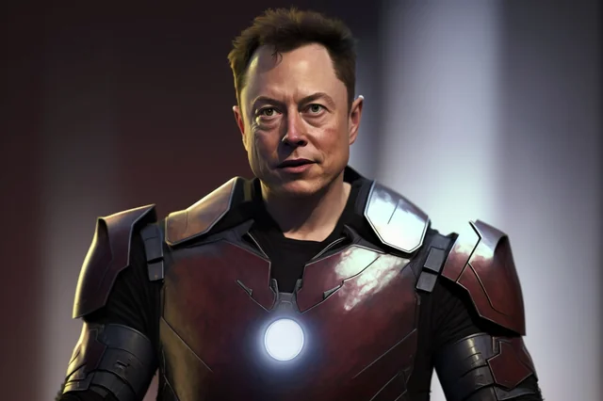
Example

Slide 4
Challenges Addressed
There is a growing need for methods to detect deepfake images.
As the deepfake is getting more and more real and hence can be used for malicious purpose.
Methods we used for DeepFake detection, are
FFNN
CNNs,
Transformers.
Comparative study of above method
Dataset used from Kaggle

Slide 5
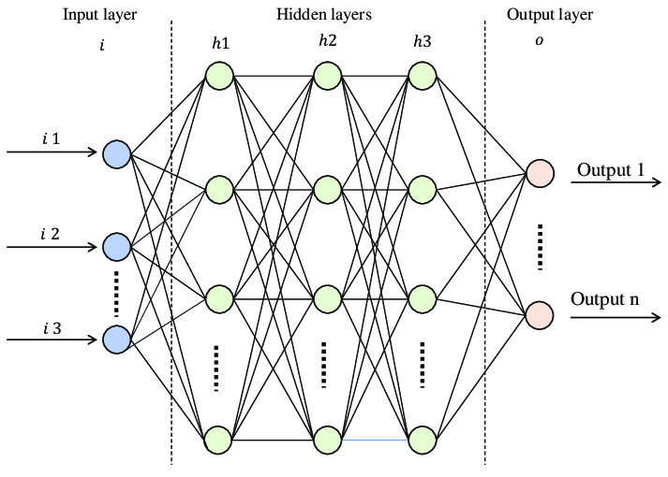
Feed Forward Neural Network
FFNNs are a type of neural network that are more general than CNNs
FFNNs can be used to solve a wider range of tasks, including deepfake detection.
FFNNs work by learning a mapping from input data to output data.

Slide 6
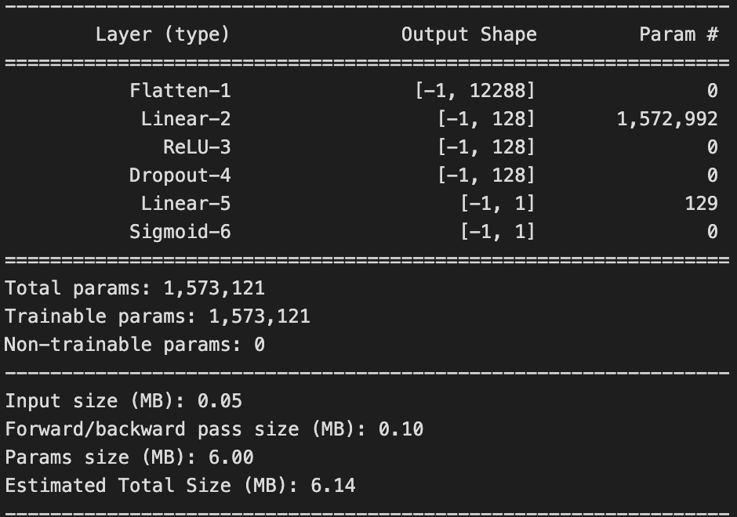
DeepFake and FFNNs
The provided information outlines the architecture and characteristics of a Feedforward Neural Network (FNN)

Slide 7
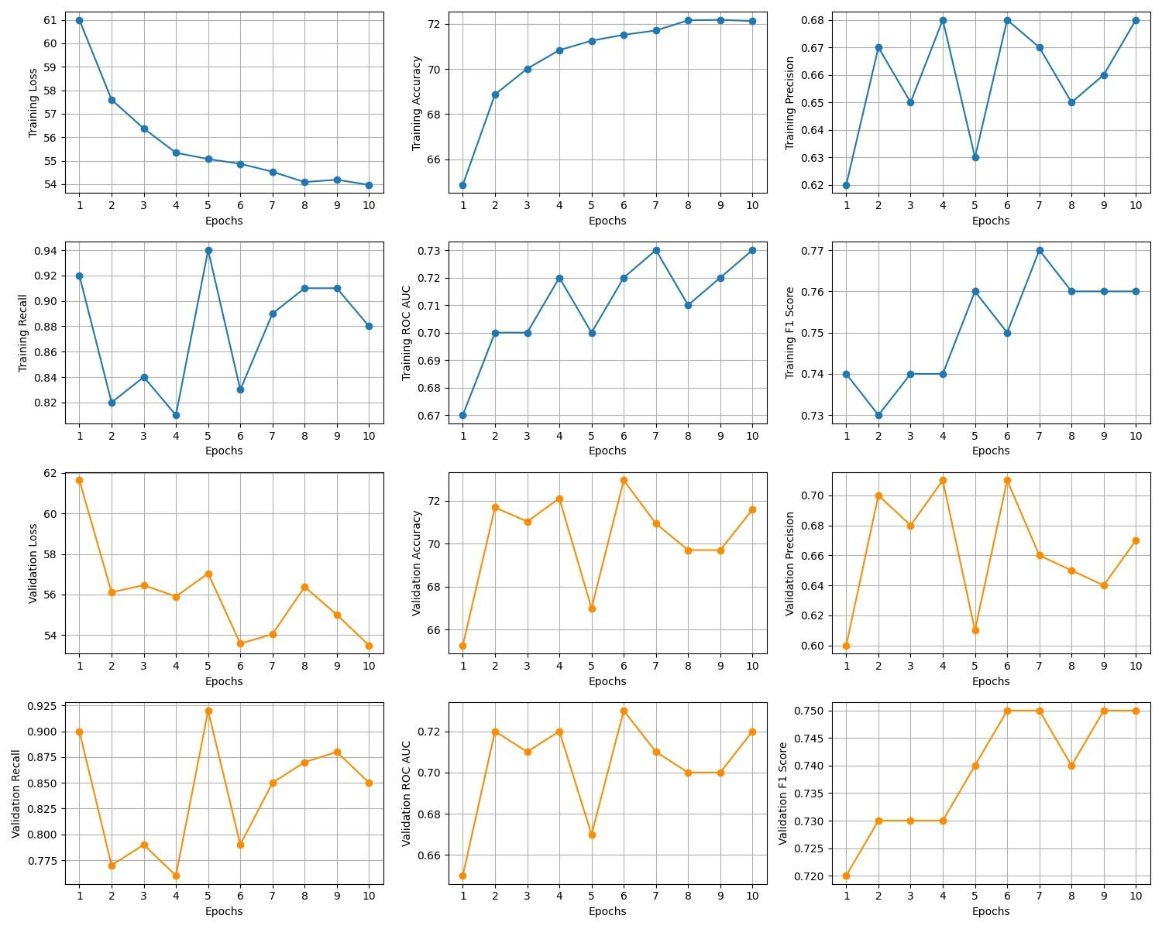
Results :

Slide 8
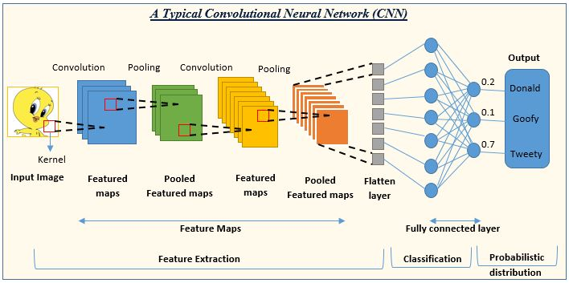
Convolutional Neural Network
CNNs are a type of neural network that are well-suited for image classification tasks.
CNNs work by extracting features from images and then using these features to classify the images as real or fake.

Slide 9
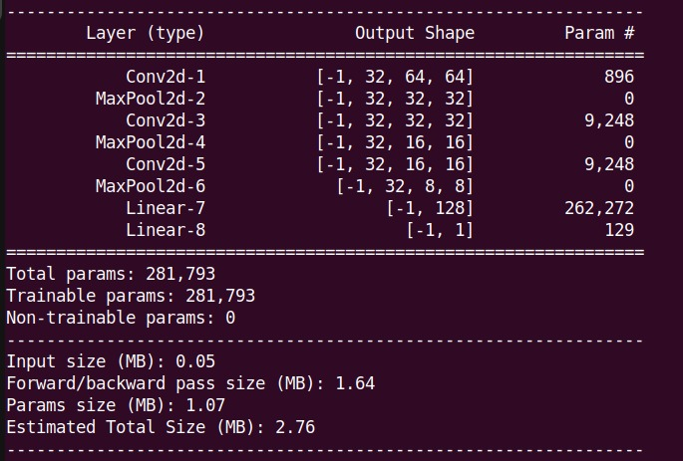
DeepFake CNN Model
TRAINING CNN MODEL
Iteratively present batches of images to the CNN during epochs (complete passes through the entire training dataset).
The model processes each batch, computes the loss, and updates its weights through backpropagation and optimization.
Repeat this process for multiple epochs to allow the model to learn and adjust its parameters.
Main Entities of Model:
Loss Function - Binary Cross Entropy Loss,
Optimizer - Adam
Architecture Layer Output

Slide 10
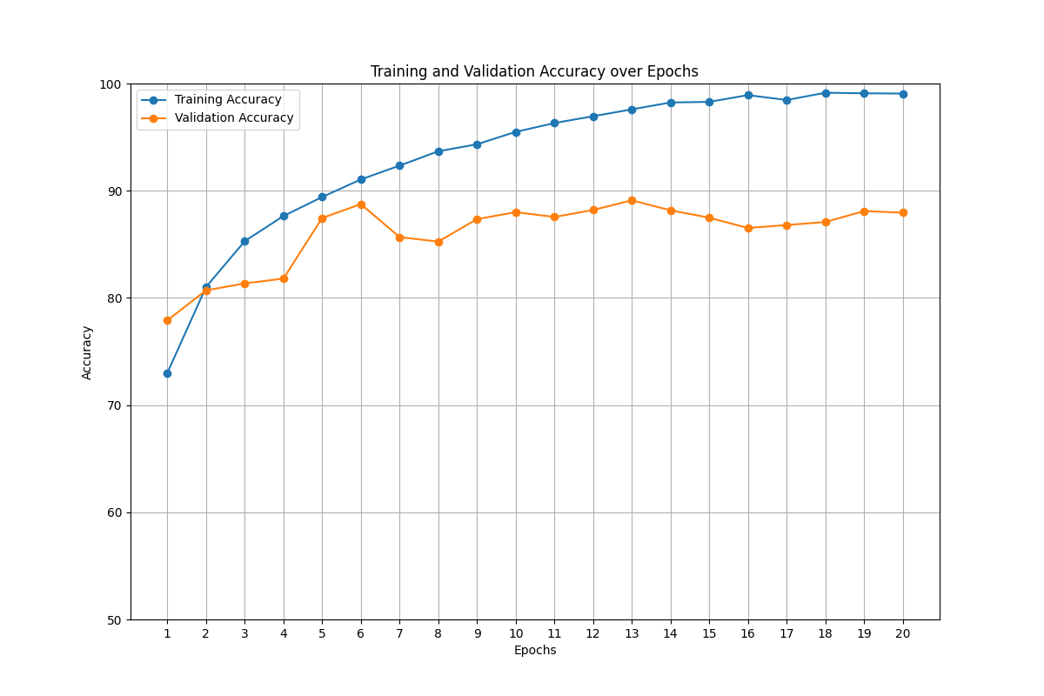
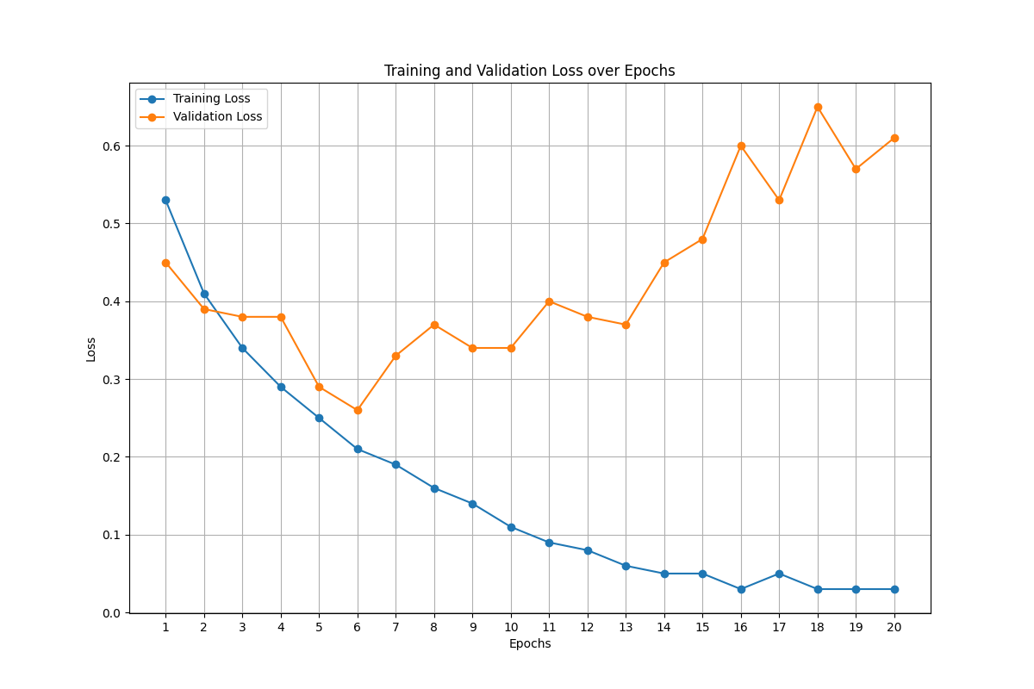
Results :Analysis of Model Performance
Training and Validation Accuracy:
Best Training Accuracy:98%
Best Validation Accuracy:86%
Best Epoch:6
Models Does not seem to improve after epoch number 6.
Training and Validation Loss:
Best Training Loss:0.29%
Best Validation Loss:0.25
Best Epoch:6
Since The Validation loss is increasing after epoch 6 ,the model seems to overfit.

Slide 11
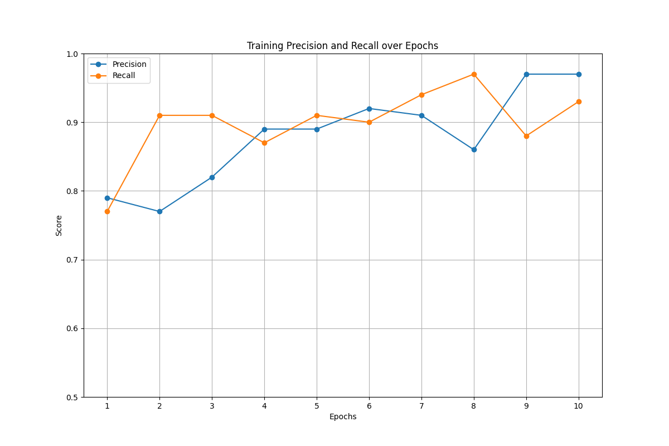
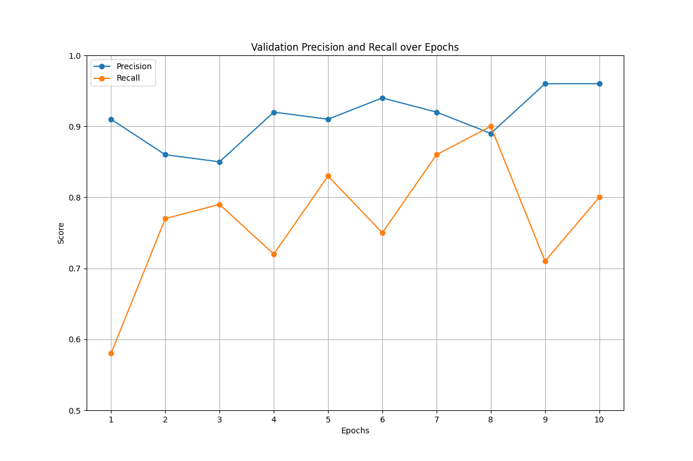
Training Precision and recall Validation precision and Recall
Precision focuses on the accuracy of positive predictions. It measures the ability of the model to avoid making false positive predictions.
Recall measures the model's ability to capture all the actual positive instances. It is crucial when the goal is to minimize false negatives.

Slide 12
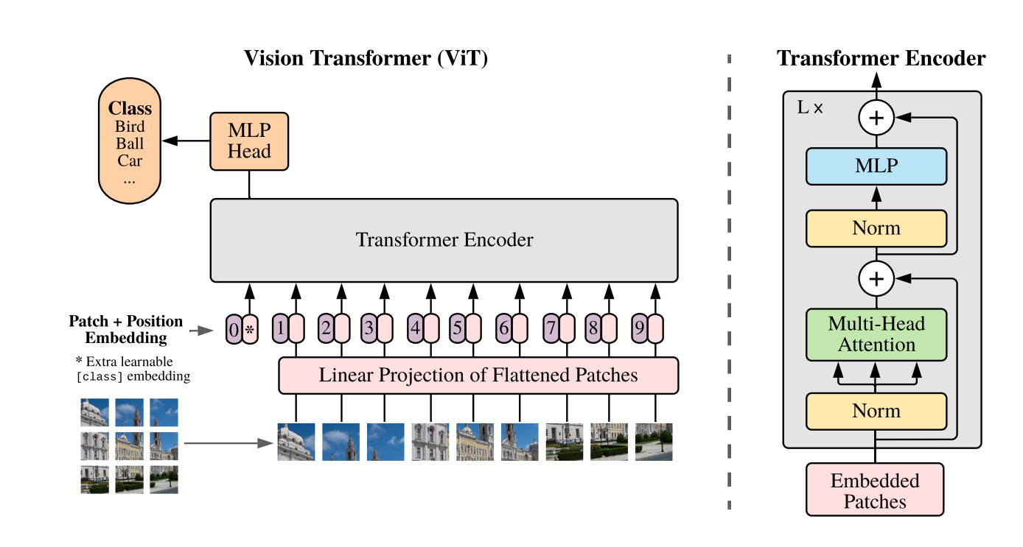
Transformers
Transformers are a type of neural network that are based on attention mechanisms.
Attention mechanisms allow transformers to learn long-range dependencies in data.
Transformers have been used to achieve state-of-the-art results on natural language processing (NLP) tasks.
Transformers have also been shown to be effective for deepfake detection.

Slide 13
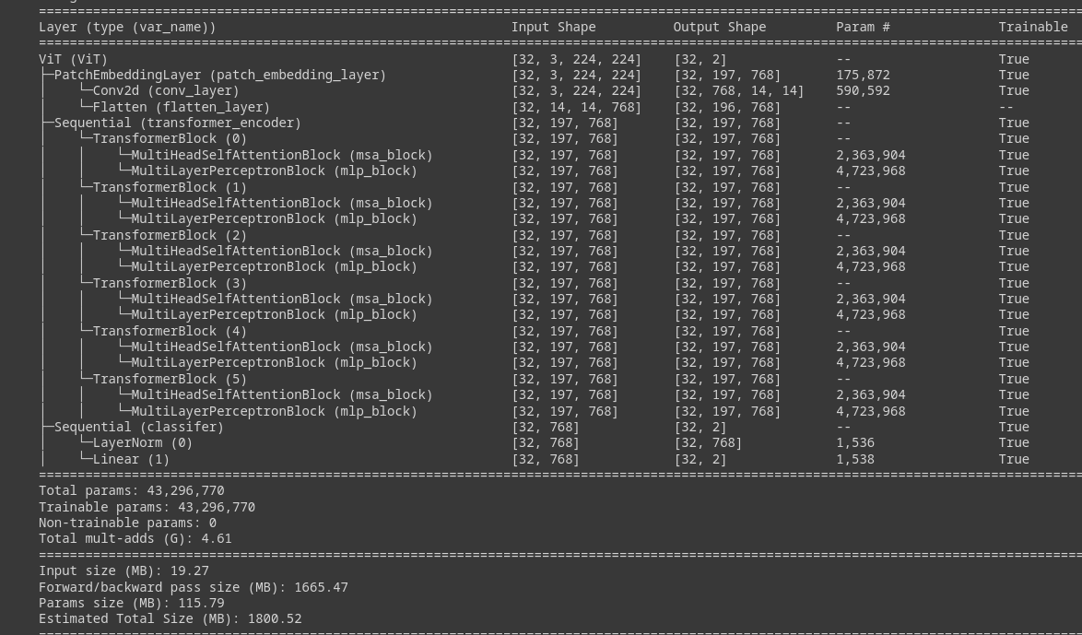
DeepFake and Transformers
TRAINING ViT MODEL
Creates patch embeddings of input image.
The patch embeddings, along with the classification token, are passed through multiple Transformer blocks.
Each Transformer block consists of a MultiHead Self-Attention Block (MSA Block) and a Multi-Layer Perceptron Block (MLP Block).
The final output from the Transformer blocks is passed through an MLP block.
The classification token, which contains information about the input images’ class, is used to make predictions.
Main Entities of Model:
Loss Function - Binary Cross Entropy Loss,
Optimizer - SGD, momentum = 0.9, lr =1e-2

Slide 14
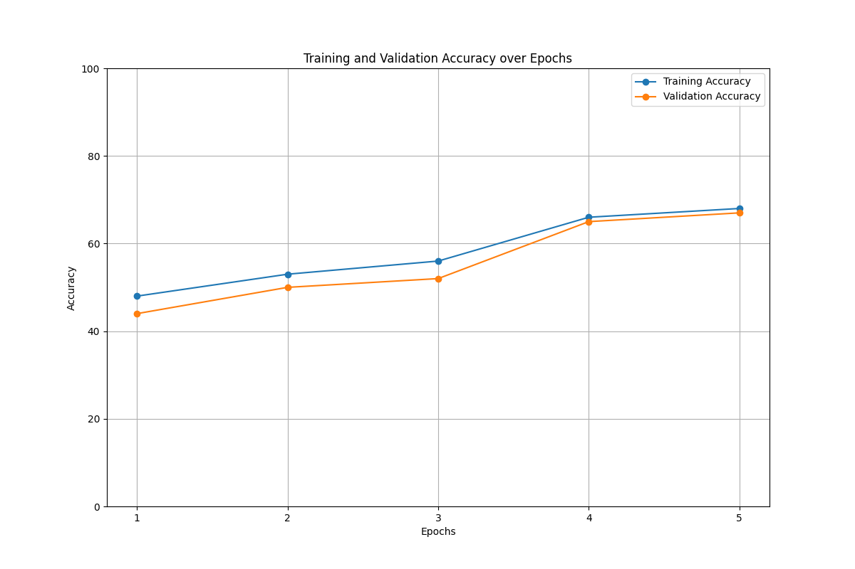
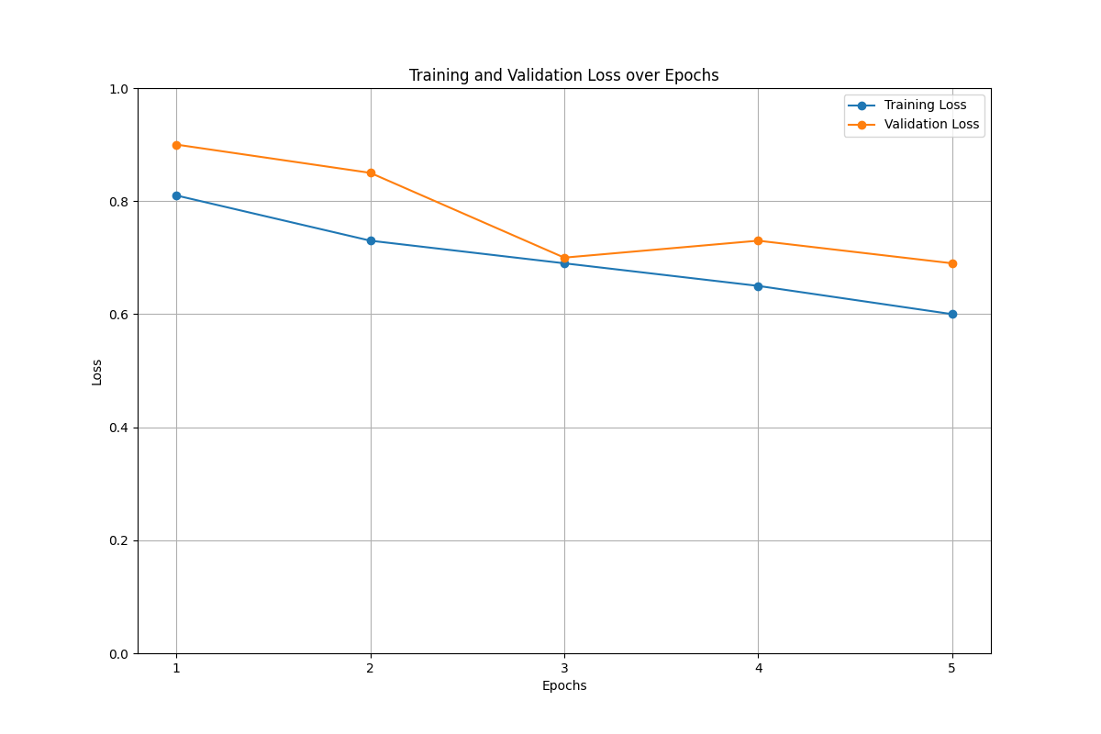
Results :Analysis of Model Performance
Training and Validation Accuracy:
Best Training Accuracy:68%
Best Validation Accuracy:67%
Best Epoch:5.
Training and Validation Loss:
Best Training Loss:0.60
Best Validation Loss:0.69
Best Epoch:5

Slide 15
Comparison Between the models
Model | Validation Loss | Accuracy | Number of parameter | Remark
FNN | 0.56 | 71.12% | 1,573,121 | Does Not support translation Invariance.
CNN | 0.29 | 86% | 2,81,793 | -No Augmentation -256x256 image reduced to 64x64 (feature loss)
Transformer | 0.69 | 67% | 43,296,770 | - We couldn’t train the ViT model to converge

Slide 16

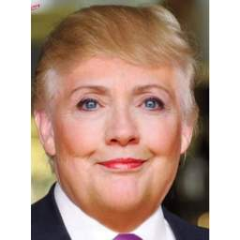

Results on Custom photoshopped images
modi-obama.jpg: fake donal-lady2.jpg: real superman.jpg: fake
CNN Model Accuracy : 13/17 ⇒ 76% (Tested on Total 17 images)
ViT Model Accuracy: 10/17 = 58%
Why accuracy on custom dataset is less than dataset from Kaggle?
=>Deep learning models are sensitive to domain differences. If your custom-generated dataset significantly differs from the Kaggle-trained dataset in terms of content, lighting conditions, camera angles, or other factors, the model may struggle to generalize well.
Deepfake detection models often focus on identifying inconsistencies in facial features, or artifacts introduced during the deepfake generation process. Custom photoshopped images might not exhibit the same artifacts or inconsistencies, making them harder to detect.

Slide 17
Conclusion
Deepfakes are a serious threat to the integrity of information.
There is a need for methods to detect deepfake images.
CNNs, FFNNs, and transformers are all promising methods for deepfake detection.
Due to resource limitation, we couldn’t train the ViT model to converge but it definitely has potential to improve

Slide 18






“THE DEEPSCAN”
Our team and Sweat of their eyebrows
Suchit M
CNN
Irshad Khan
Mohiboddin
Transformer
Deep fake Image detection
Arif Ali
Soumik Dutta
FFNN
Skand Raturi

Slide 19
Related Work
https://arxiv.org/abs/2010.11929
https://ieeexplore.ieee.org/stamp/stamp.jsp?tp=&arnumber=9776410
DATASET and Code references
https://www.kaggle.com/datasets/manjilkarki/deepfake-and-real-images

